Slide 1
Clinical Pathology
Quality Dashboard
August 2014

Slide 2
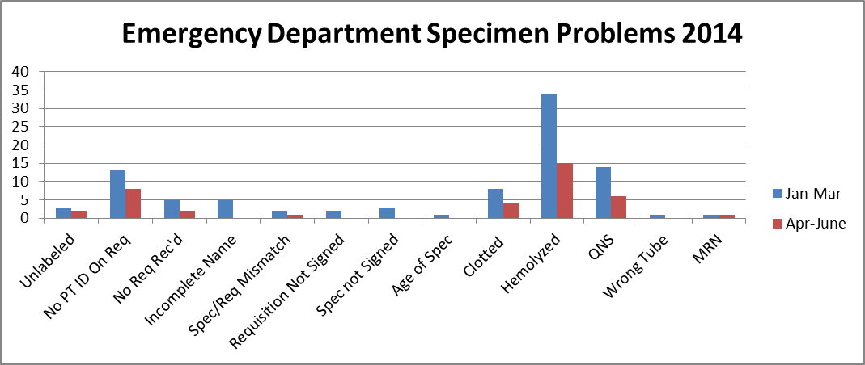
Clinical Pathology Patient Care Quality
Blood Bank
Pathology is pursuing a two pronged approach to “specimen quality” in the ED.
There is and has been ongoing discussions via Nursing Liaisons (Barb Wetula, RN, and Sheryl Woloskie) to addressing training for non-Pathology collected specimens. This focus has been on all of UMHS, with an emphasis on the ED.
Pathology and the Emergency Department are investigating possible deployment of additional Pathology personal in the ED POCT lab or utilization of the Soft ID system which has been shown to assist with patient identification/signature errors at other institutions. A visit to another peer institution is scheduled for September 2014.
There has been a decrease in the 2nd quarter of this year. There has been extra effort into refining training as well as processes. We will continue to monitor this metric for sustainability.

Slide 3
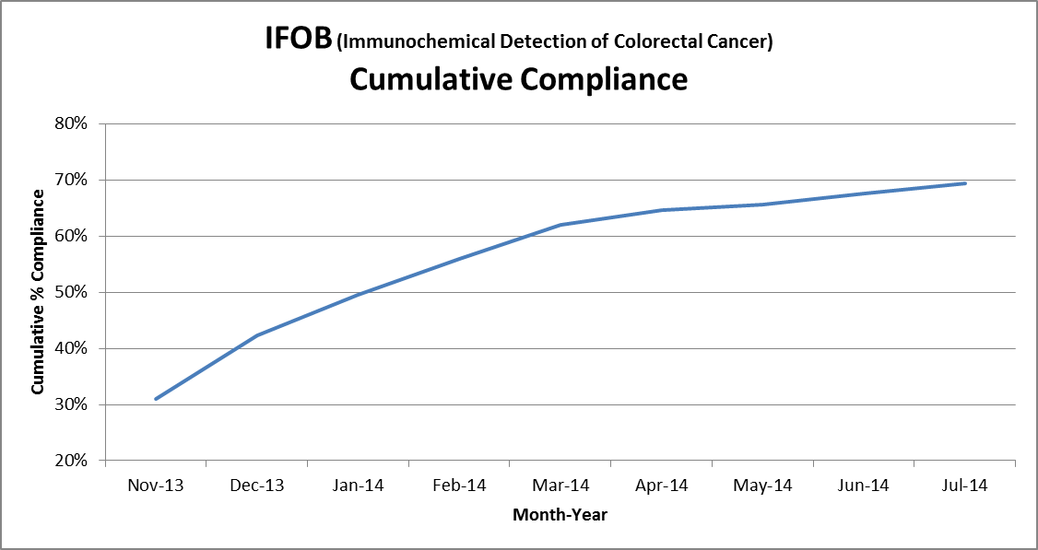
Clinical Pathology Patient Care Quality
Chemistry
Description of Problem: The guaiac method for detecting blood in the stool as a detection of colorectal cancer requires the patient to adhere to several diet restrictions as well as to collect three separate stool samples. Due to this complexity, we had low compliance (<20%). Newer methodologies such as IFOB are available that only require a single sample, no diet restrictions, and have a higher sensitivity.
Impact of Problem:
Historically, the amount of guaiac cards distributed had a low rate of return as indicated above. Use of the newer immunochemical method has increased the rate of return more than two-fold due to ease of collection by the patient.
Reporter of Problem:
Laboratories, physician offices
Description of Solution:
Implement the immunochemical method for detection of colorectal cancer. Physicians would order the test when the kit was handed to the patient. Pre-stamped envelopes provided to the patient will be returned to the laboratory where the test will be run.
How we know it worked:
We continue to see a positive outcome relative to patient compliance with returning the kit for testing.
Date Solution Implemented: October 29, 2013

Slide 4
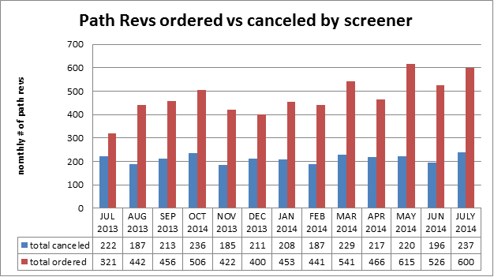
Clinical Pathology Patient Care Quality
Hematology
Description of Problem:
The Hematology lab created specific parameters related to the complete blood count that reflex to the pathologist for a review starting in 2005.
Impact of Problem:
If requests are not appropriate this can increase cost due to the additional Pathologist review. It can also increase the turnaround time for patients that should have a Pathologist review since there is no way to prioritize these if all of the slides are reviewed.
Reporter of Problem:
Hematology Pathologists/Staff
Description of Solution: Alter the current policy and allow technologists to prescreen MD request slides. If screens are determined to be inappropriate the MD Path Review would be canceled by the technologist.
How we know it worked?
Approximately 40% of all orders requests received each month are canceled before reaching the pathologist thus saving time and decreasing the cost to the institution and patient. Technologists are assessed monthly. Approximately, 10 cases per month are reviewed rotated between 5 screener technologists. This equates to each technologist being assessed twice per year.
Areas for continued improvement:
The procedure is reviewed annually to evaluate whether the parameters set are appropriate.

Slide 5
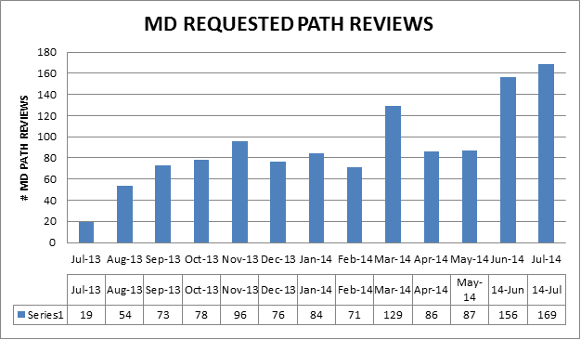
Clinical Pathology Patient Care Quality
Hematology
Description of Problem:
Historically, any MD requests are processed as ordered. There has been an upward trend in the number of Pathology Review requests from providers. Investigation into why this is occurring and whether the requests are appropriate and could be triaged in other ways is being investigated.
Impact of Problem:
If requests are not appropriate this results in the unneeded cost of Pathologist review. It can also delay the turnaround time for patients that should have a Pathologist review since there is no way to prioritize these if all of the slides are reviewed.
Reporter of Problem:
Hematology Pathologists/Staff
Description of Solution: Alter the current policy and allow technologists to prescreen MD request slides. If screens are determined to be inappropriate the MD Path Review would be canceled by the technologist.
How we know it worked?
TBD-Starting in late June or early July 2014 evaluation of use of a pre-screener in this process will begin.
Areas for continued improvement:
Is there a specific specialty or physician that is ordering pathologists reviews inappropriately?
Is there an educational opportunity?

Slide 6
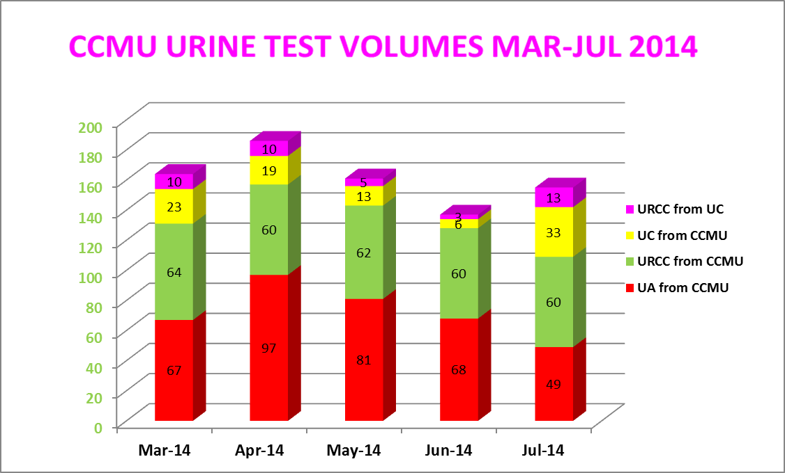
Clinical Pathology Patient Care Quality
Microbiology
URCC=urine culture
UA=urinalysis
UC=UA with reflex URCC if UA=positive
Areas for continued improvement:
Data pertaining to the use of the UC and UA/URCC orders indicates that re-education regarding use of the test codes is warranted.
Continue to revise Microbiology protocol for culture work-up
The CCMU CAUTI rate has dropped to 4.3 since countermeasures have been implemented, however rates need to meet benchmark.
Root Cause | Follow-up
Ordering cultures on asymptomatic patients | Training for care providers on proper test utilization
Collecting specimens from urine catheter bag not the catheter line | Training implemented for nursing
Delays in transport cause bacterial growth=false positives | Use BD urine vacutainers for collections to increase storage time at room temp
Triage screening test UC (UA with reflex URCC) not available for inpatients | Made UC available for inpatients
Urine cultures being “over worked” | Modify protocols for urine specimens to be consistent with guidelines
Description of Problem: Rates of catheter associated urinary tract infections (CAUTI) are a metric benchmarked for quality of care for patients. The inpatient population is particularly prone to high rates of infection. The CCMU (6D) is a focus of attention due to their patient population and propensity for positive urine cultures. The NHSN benchmark is 2.9 infections per 1000 catheter days. In 2013 the CCMU rate was 5.5.
Impact of Problem: False positive results might occur that infer patients acquired a hospital infection. Patients could receive treatment for a positive result. Inefficient use of resources to process these specimens.
Reporter of Problem: CCMU, Microbiology leadership & Infection Control
Description of Solution:
Several countermeasures are being implemented or addressed.

Slide 7
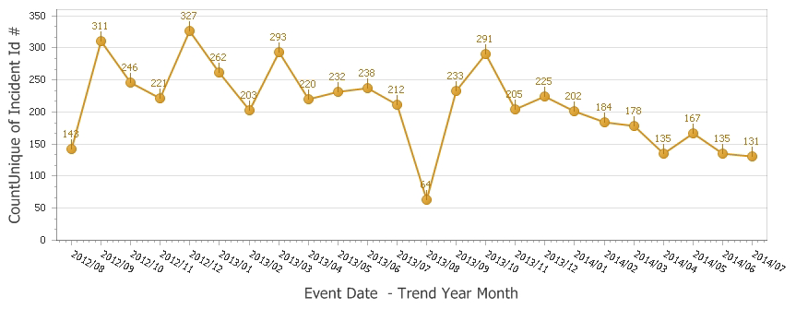
Clinical Pathology Patient Care Quality
Point of Care
*Note Aug 2013 data decreased due to POC coordinator absence and RMPRO reports not entered during this time frame.
*
Description of Problem:
Once MiChart was implemented, a change occurred in how the patient was identified. In order to correlate billing information relative to the specific patient stay, the CSN number on the patient’s wristband is used rather than the MRN. The patient’s wristband was changed so that the glucometer CSN number is now a 1D barcode versus the MRN which is a 2D barcode. Since making this change, numerous errors have occurred where the MRN was manually entered by mistake into the RAALS laboratory middleware. The RAALS middleware requires the current CSN to function properly.
Impact of Problem: The errors cause a delay in results being reported to the patient record. Additionally, the corrective action is for the POC Coordinator to match the misidentified patient results and then manually report them to the correct CSN. This opens the opportunity for human transcription errors along with inefficient use of the coordinator’s time to work on other tasks.
Reporter of Problem: POC Coordinator & Nursing Leadership
Description of Root Causes Identified:
Nursing is not able to access the barcode and has to manually enter CSN.
This can be entered incorrectly or the MRN is used which is traditionally used for other methods of identifying patients. This is especially true of pediatric wristbands which are smaller. Nurse educators have refocused training on this aspect. Investigation into modifying the patient wristband to allow more barcodes to be visible is ongoing by MiChart.
CSN mismatch-Examples of patients presenting at the ER or IPLV and then admitted on a different day (thus different CSN) still have their “old” wristband on which is no longer valid. Wristband printing-future visit day used to print wristband. Practice change by nursing to replace patient wrist band every time patient comes or returns to the floor (e.g. go to OR or procedure area and come back).
Identified reasons why nurses are manually entering MRNs and implementing countermeasures to address delays in downloading patient names & results to the patient’s record.
How we know it worked:
We continue to see a decrease in the number of incidents that are largely composed of glucometer errors. Investigation into reasons why nurses manually input the CSN are ongoing. This is partly due to delays in upload of results to MiChart. Countermeasures are being put into place to address these issues.

Slide 8
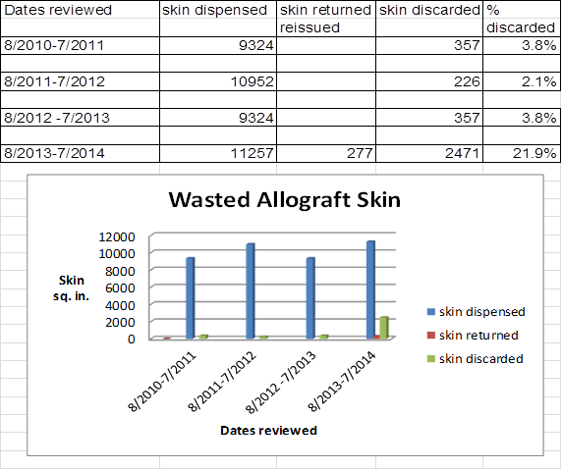
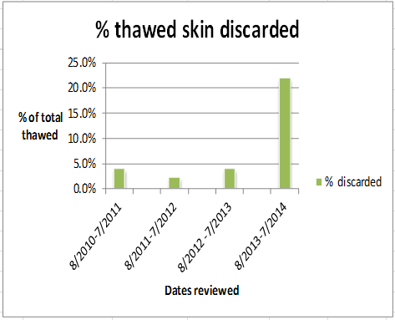
CP QA Meeting Highlight
Burn Lab
Description of Problem: The Burn Lab can experience issues with not have sufficient stock available for emergent needs without risking wasting product due to expiration. Surgeon needs can changed. Procedures can happen anytime outside of regular lab hours (7:30AM-4:00PM).
Impact of Problem:
Waste of tissue bank products is very expensive. Example for one product below.
Description of Solution:
Focus on the allowgraft/thawed skin. Develop spreadsheet and correlate the area to be grafted. Record the ratio of skin to graft.
The idea is that the amount of skin will be correlated to the need more appropriately thus resulting in less waste without compromising the need for skin. Additional skin can be thawed within 10 minutes during working hours.
How we know it worked:
To be determined. Waste of homograft skin will be evaluated quarterly. Worksheet will be revised as needed.
Date Solution Implemented:
Summer 2014
Integra prices: 2”x 2” is $1582.40
4” x 5” is $2539.36
4” x 10” is $3647.04
8” x 10” is $5243.04

Slide 9
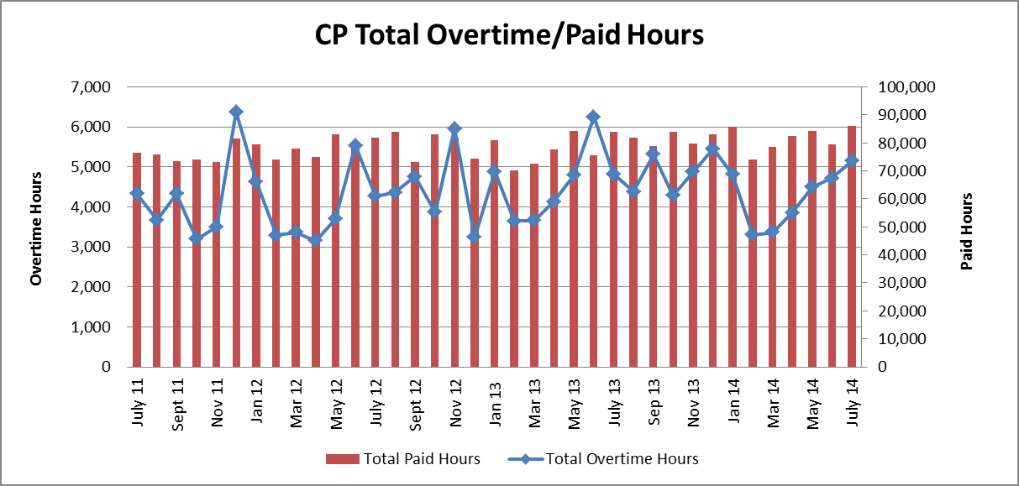
Clinical Pathology Financials

Slide 10
Clinical Pathology-Current Projects
**This is a highlight of projects ongoing in the CP labs. This list is not meant to be all inclusive of every activity occurring in the department.
Project | Brief Description | Owner
Customer Service/Call Center | Address multiple issues related to providing an appropriate level of customer service for UMHS care providers. | Dr. Newton
ER Specimen Issues | In coordination with the Emergency Department reduce the number of RMPRO specimen errors (e.g. hemolysis, mislabels etc.) | S. Butch/K. Martin/T. Morrow
Pathology Handbook | Maintain and update the Pathology handbook to be a robust resource for our customers. | K. Davis/K. Martin
NCRC Planning | Begin work to plan for the future state of the non-STAT Clinical Labs move to NCRC | PRR Committee

Slide 11
Clinical Laboratory News, Notes, and Kudos
------------------------------------------------------------------------------------
Labs that are working on process improvement projects that would like to display data can contact Kristina Martin (martkris@umich.edu) for future dashboards.
Kudos
Dr. Bachman, Dr. Giacherio, Dr. Vergilio-Assisting with development of protocols for potential Ebola specimen handling and testing.
Susan Clark in Hematology for her willingness to step up and assist with a potentially difficult patient situation. She was the epitome of a professional and her dedication is very much appreciated.
Cytogenetics led by Leslie Ernst- This group has worked diligently to develop processes on reducing waste related to the collection of chorionic villus specimens. They will be piloting the process in September in coordination with the Fetal Diagnostic Center.

