Slide 1
Clinical Pathology
Quality Dashboard
April 2014

Slide 2
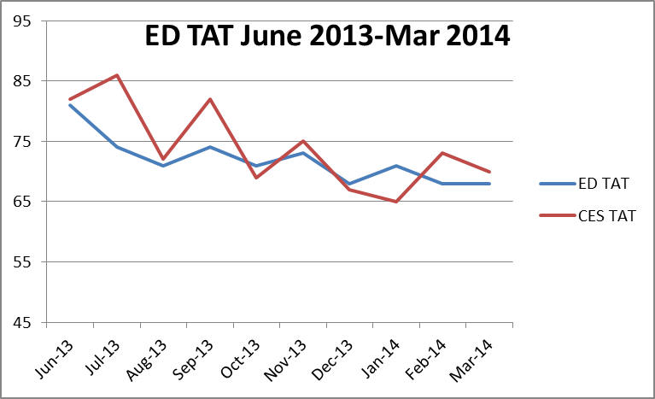
Clinical Pathology Patient Care Quality
Blood Bank
*ED=Adult Emergency Department, CES=Children’s Emergency Department
The Blood Bank experienced an increase in TAT for Emergency Department type and screen testing during the Soft go-live implementation. As staff have gained more confidence using the new software, there has been a steady decrease in the TAT approaching pre-Soft conditions. Blood Bank is working with the Infusion areas on a new process to prioritize the infusion patients using a new test code (PTS3D). This test code will distinguish itself from the current PTS test and we will be prioritizing these samples. Collection of the infusion patient TAT is ongoing and will be featured in future CP Dashboards.

Slide 3
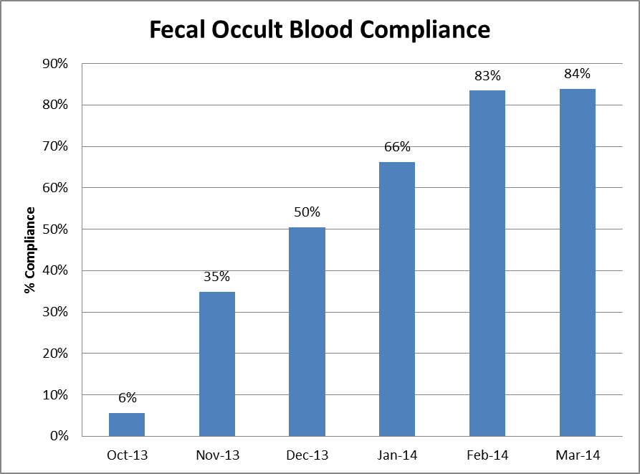
Clinical Pathology Patient Care Quality
Chemistry
Description of Problem: The guaiac method for detecting blood in the stool as a detection of colorectal cancer requires the patient to adhere to several diet restrictions as well as to collect three separate collections. Newer methodologies are available that only require a single sample, no diet restrictions, and have a higher sensitivity.
Impact of Problem:
Historically, the amount of guaiac cards distributed had a low rate of return. Use of the newer immunochemical method has increased the rate of return due to ease of collection by the patient alone.
Reporter of Problem:
Laboratories, physician offices
Description of Solution:
Implement the immunochemical method (FIT) for detection of colorectal cancer. Physicians would order the test when the kit was handed to the patient. Pre-stamped envelopes provided to the patient will be returned to the laboratory where the test will be run.
How we know it worked:
Using reports that pull data for the number of tests performed versus the number of tests pending we can calculate the rate of compliance. Over the first six months of testing there has been a consistent increase in the compliance
Date Solution Implemented: October 29, 2013

Slide 4
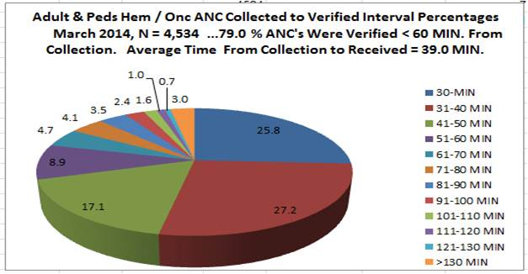
Clinical Pathology Patient Care Quality
Hematology & Phlebotomy
Description of Problem: Patients seen by the Hematology-Oncology service have lab testing followed by a clinic appointment where decisions as to whether the patient will receive an infusion treatment that day are made. A vast majority of specimens have results within the desired turn-around-time (TAT), however there continues to be outliers that impact delivery of care to the patients. These samples, due to the nature of the disease, often require more time to evaluate due to abnormal results and challenging blood smear differentials.
Impact of Problem: Patient treatment may be delayed because physicians wait for laboratory results to be available.
Reporter of Problem: Heme-Onc physicians and nurses
Description of Solution:
Although the in lab TAT is something that can be controlled more readily, the major portion of the delay in testing relates to the initial visit of the patient to the phlebotomy site: time waiting in line before draw, time for the draw, and transport to the laboratory. This month is the first month that data for the entire TAT was able to be computed.
To improve the TAT related to processes outside of the in lab TAT, a pilot at the C & W blood draw station started on November 11, 2013 to query patients whether they had an infusion appointment so they could be triaged ahead of other patients having blood work drawn that did not impact treatment for that day. Preliminary surveys of the patient experience have been positive with the Heme-Onc clinic noting a reduction in the number of complaints. Survey data will be available in the coming months to illustrate this fact.
Areas for continued improvement:
Real time monitor profiles are being built and tested to monitor the TAT in with color coordination when specimens become “overdue”.

Slide 5
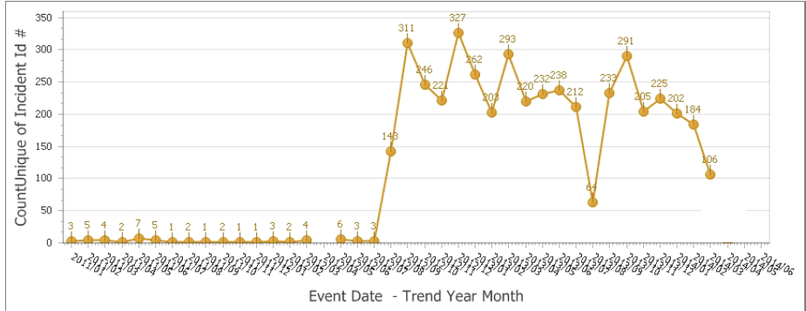
Clinical Pathology Patient Care Quality
Point of Care
*Note Aug 2013 data decreased due to POC coordinator absence and RMPRO reports not entered during this time frame.
*
19 additional incidents to complete the month for a total of 125
Description of Problem:
Once Michart was implemented, a change occurred in how the patient was identified. In order to correlate billing information relative to the specific patient stay, the CSN number on the patient’s wristband is used rather than the MRN. The patient’s wristband was changed so that the glucometer CSN number is now a 1D barcode versus the MRN which is a 2D barcode. Since making this change, numerous errors have occurred where the MRN was manually entered by mistake into the RAALS laboratory middleware. The RAALS middleware requires the current CSN to function properly.
Impact of Problem: The errors cause a delay in results being reported to the patient record. Additionally, the corrective action is for the POC Coordinator to match the misidentified patient results and then manually report them to the correct CSN. This opens the opportunity for human transcription errors along with inefficient use of the coordinator’s time to work on other tasks.
Reporter of Problem: POC Coordinator & Nursing Leadership
Description of Root Causes Identified:
Nursing is not able to access the barcode and has to manually enter CSN. This can be entered incorrectly or the MRN is used which is traditionally used for other methods of identifying patients. This is especially true of pediatric wristbands which are smaller. Nurse educators have refocused training on this aspect. Investigation into modifying the patient wristband to allow more barcodes to be visible is ongoing by Michart.
CSN mismatch-Examples of patients presenting at the ER or IPLV and then admitted on a different day (thus different CSN) still have their “old” wristband on which is no longer valid. Wristband printing-future visit day used to print wristband. Practice change by nursing to replace patient wrist band every time patient comes or returns to the floor (e.g. go to OR or procedure area and come back).
How we know it worked:
We continue to see a decrease in the number of incidents that are largely composed of glucometer errors. In the coming months it’s anticipated this will continue to decrease now that glucometers with screens that display the patient’s name when entered correctly are in use.

Slide 6
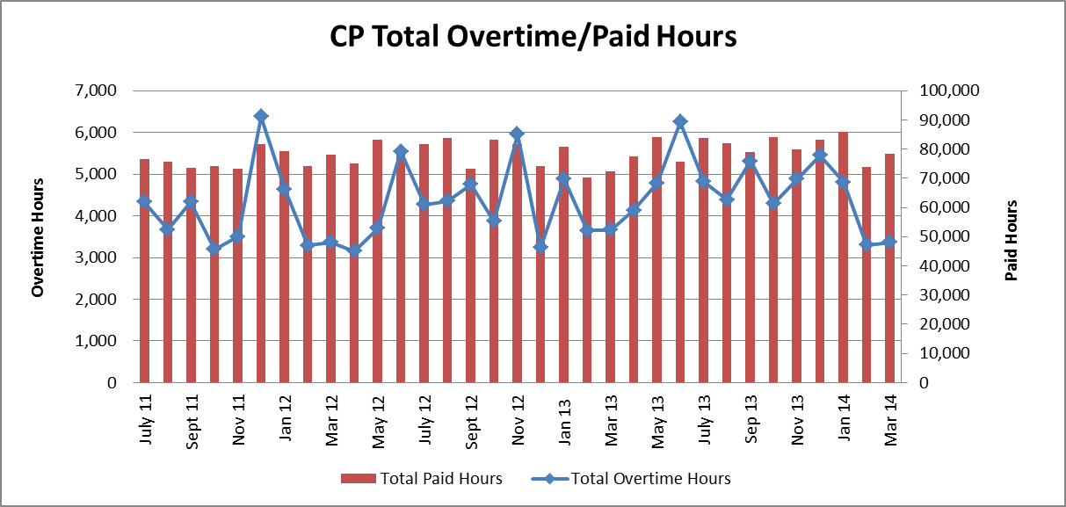
Clinical Pathology Financials

Slide 7
Clinical Pathology Safety
Proficiency Testing Performance

Slide 8
Clinical Pathology-Current Projects
**This is a highlight of projects ongoing in the CP labs. This list is not meant to be all inclusive of every activity occurring in the department.
Project | Brief Description | Owner
Customer Service/Call Center | Address multiple issues related to providing an appropriate level of customer service for UMHS care providers. | Dr. Newton
Leaky Specimens | Reduce the number of leaky specimens by exploring different transport containers and/or educational opportunities | Dr. Newton
CP Brochure | Compile information and photos from the Clinical Laboratories to create a generic CP overview for visitors/prospective clients. | K. Martin
Heme-Onc TAT for ANC results | In coordination with the heme-onc clinics explore opportunities to optimize TAT for patients receiving infusions. | J. Davis/U.Kota/K. Martin/H. Neusius
ER Specimen Issues | In coordination with the Emergency Department reduce the number of RMPRO specimen errors (e.g. hemolysis, mislabels etc.) | S. Butch/K. Martin/T. Morrow
Pathology Handbook | Maintain and update the Pathology handbook to be a robust resource for our customers. | K. Davis

Slide 9
Clinical Laboratory News, Notes, and Kudos
------------------------------------------------------------------------------------
Labs that are working on process improvement projects that would like to display data can contact Kristina Martin (martkris@umich.edu) for future dashboards.
Kudos
Congratulations to the UMHS staff presenting at the 2014 ASCLS-Michigan meeting held April 23-25th in Kalamazoo, Michigan
Dr. Michael Bachman
Suzanne Butch
Terry Downs
Kristina Martin
Lily Massengill
Dr. Jeff Warren
Thank you to all staff who participated in the April 2014 internal CAP inspection. Your thoroughness and diligence during this inspection will aid in ensuring our constant preparedness for future unannounced inspections.

