Slide 1
Clinical Pathology
Quality Dashboard
April 2015

Slide 2
Clinical Pathology Patient Care Quality
Chemical Pathology
Monitor: TAT for BASIC biochemical panel for Emergency Department adult patients (ESA) from time of collections to result reporting.
Goal: TAT <= 60 minutes. TAT for 95% of the specimens should meet the goal, with all specimens to 60 minutes as possible.
Impact: Delay in diagnosis and providing appropriate care.
Status: The last two months have shown an increase in the in all parameters. Continue to monitor for a trend in increased TAT. If increase continues, investigate potential causes of outliers.

Slide 3
Clinical Pathology Patient Care Quality
CFF Burkholderia cepacia Research Laboratory and Repository
Referring Laboratory Report Card
Monitor: Percent of isolates that do not meet our acceptability criteria.
Quality Assurance Goal: 97% or more of isolates received from referral laboratories
meet our acceptability criteria.
Impact: Delay in reporting results to referring physician and laboratory.
Status: 1.4 percent of isolates (1303 total isolates) sent from 146 different referring
labs fell into the categories listed in the above graph. The majority of isolates sent from
referring laboratory met our acceptability criteria. No trends needing corrective action
are apparent.

Slide 4
Clinical Pathology Patient Care Quality
Pathology
Purpose: Proficiency Testing is required for laboratory accreditation. Specimens are sent from an outside agency, tested and results reported to the agency. Our results are then graded and compared to the results other laboratories obtained.
Goal: If the percent satisfactory falls below 98.5 %, a root case analysis is performed.
Status: We continue to show excellent performance. It is unrealistic to expect a score of 100% on all challenges as some tests are not scored due to lack of consensus or specimen quality issues.
Each failure is investigated to determine the cause. Common causes for failing a challege are clerical errors in entering results and failure to submit results be the deadline.

Slide 5
Clinical Pathology Patient Care Quality
Blood Bank
Description of the Problem:
Unusable specimens being submitted by the Emergency Department.
Impact: Delay in providing blood components; waste as the specimen had to be redrawn.
Description of Solution:
Providing information to the ED staff collecting specimens.
How we know it worked:
The number of ED specimen problems per quarter has dropped from over 90 per quarter to less than 40 due to enhanced training of ED staff.
Area for Improvement:
Low volume (QNS), hemolyzed and clotted specimens. Occurrences of “no patient identification on requisition” increased this quarter. Monitoring to continue to ensure change is sustained.

Slide 6
Clinical Pathology Patient Care Quality
Blood Bank Emergency Department
Type and Screen Turn Around Time
ED = Adult Emergency CES = Peds Emergency
.
New Goals
Description of Monitor:
Turn-around time from receipt in-lab to report for Type and Screen.
Impact:
Delay in transfusion or use of uncrossmatched components.
Goal: Initial goal of <= 75 minutes TAT is being met consistently.
Status: Change monitor to 95 % of specimens tested <75 minutes. Investigate specimens tested >120 minutes.

Slide 7
Clinical Pathology Patient Care Quality
Blood Bank Biological Product Deviation Reports (BPDR)
Description of Problem:
Certain defined errors involving blood components must be reported to the Food and Drug Administration with 45 days of identifying that the error occurred.
Impact of Problem:
The impact on the patient is most often inconsequential, but represents a deviation from standard operations.
Goal: reduce total errors with a focus on the most common errors.
Areas for continued improvement and monitoring:
Focus on process improvements on error prevention as inspection of the product at the time of issue is prone to overlook labeling errors.

Slide 8
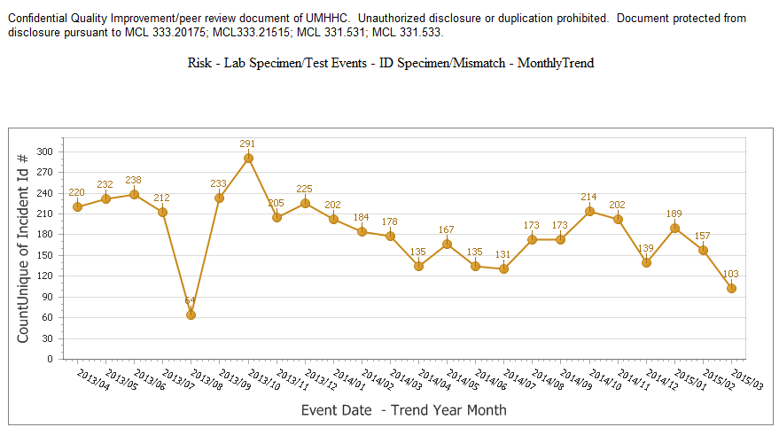
Clinical Pathology Patient Care Quality
ID/Specimen Mismatch
Description of Problem:
The wrong patient barcode is scanned or MRN is manually entered by patient care staff when using the glucose meter.
Impact of Problem:
Patient results are delayed in getting to the patient’s chart. Repeat testing performed wasting reagents.
Reported by: POC testing staff/nursing
Goal: Reduce the number of wristband barcode reading errors.
Description of Solution:
Competency assessment and training occurred during nursing blitz.
How Do We Know It Worked:
Decrease in reported errors.
Areas for continued improvement and monitoring:
While the number of errors has been reduced, there are still a significant number of errors that require manual intervention to get the results charted. Continue monitoring for continuing/sustained improvement.

Slide 9
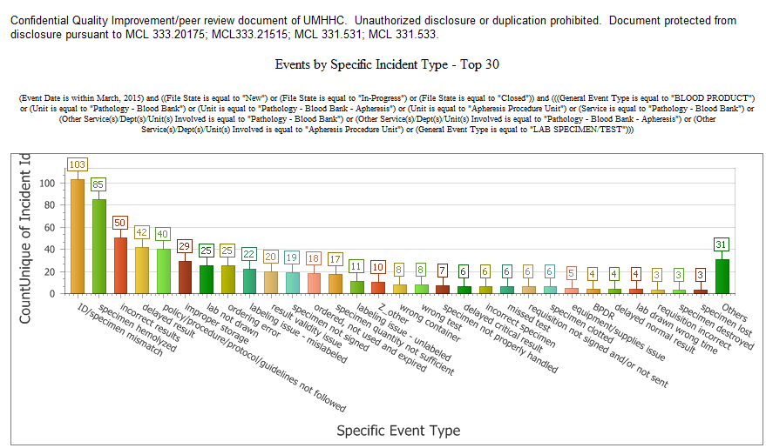
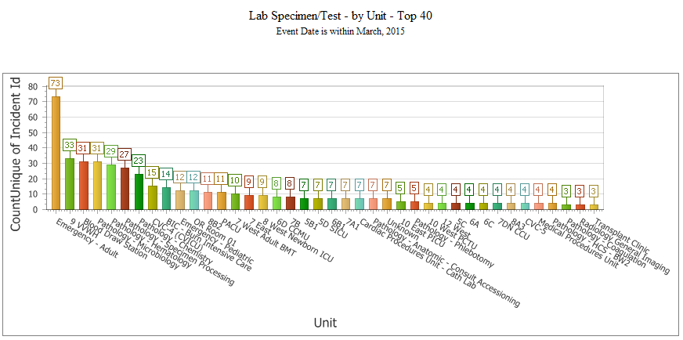
Clinical Pathology Patient Care Quality
Monitoring of Specimen/Testing/Reporting of Laboratory Results
Description of Problem:
Monitoring of Specimen/Testing/Reporting of Laboratory Results
Impact of Problem:
Patient results are delayed in getting to the patient’s chart.
Reported by: Pathology and clinical staff reports
Goal: Reduce the specimens not able to be tested
Status: ID/Specimen mismatches continue to be the source of the greatest number of errors. Hemolyzed specimens are the second most common errors. The Emergency Department has the largest number of errors.

Slide 10
Monthly CP QA Highlight
Hematology
Total potential cost to fill vacant hours with OT on midnight shift | Total cost of bonus program | Total cost of back-filling minimum on days | Total $$ saved
$54K | $14K | $10K | $30K
Description of the Problem: Loss of 2 (now up to 4) Midnight staff, need to cover all vacant hours with Overtime (OT).
Impact:
Would burn out remaining staff with OT.
Potential patient safety risk with staff working double shifts (16-18 hrs/day).
Lack of consistency for remaining midnight staff with a new person every night who are not familiar with their workflow, and very tired at the same time. Would cause overwork on their part.
Extreme effect on budget to pay out all vacant hours with OT.
Reporter of the Problem: Hematology FTE/staffing/OT monitor
Description of the Solution:
Worked with department to offer bonuses to 2 dayshift volunteers who changed their shift to midnights for one month at a time. Dayshift then put out for OT only when needed, and put items not directly related to patient care on hold for this time period (until midnight staff hired and trained). Dayshift OT is much easier to cover with staff who are not scheduled on those days.
Area for Improvement:
Exempt staff ended up putting in a lot of overtime (uncompensated) to keep up with their duties while working at the bench for missing day staff. There needs to be a way to compensate exempt staff when they consistently go above and beyond to accomplish their work. We could have been less conservative in putting out for OT for missing day staff so exempt staff don’t put in excess of uncompensated overtime, but we are short 8 staff members, and could not burn out remaining staff on OT (already serving a lot for vacant positions(s) on other shifts).
How we know it worked:
Successful in avoiding OT on midnights until we lost the 4th person in April.
No increase in patient safety reports due to burnout from working midnights/ double shifts.
Midnights has had consistency with one person for 4 months, and other staff for a month at a time.
Added bonus of saving the department a minimum of $30K in 4 months from Dec through Mar.

Slide 11
Clinical Pathology-Current Projects
**This is a highlight of projects ongoing in the CP labs. This list is not meant to be all inclusive of every activity occurring in the department.
New
Project | Brief Description | Owner
Lost Specimen Swat Team | Standardize process for investigation of “lost specimens”. | Brian Tolle, Kristina Martin, Chris Rigney, John Perrin, Suzanne Butch
Customer Service/Call Center | Address multiple issues related to providing an appropriate level of customer service for UMHS care providers. | Dr. Newton
ER Specimen Issues | In coordination with the Emergency Department reduce the number of RMPRO specimen errors (e.g. hemolysis, mislabels etc.) | S. Butch/K. Martin/T. Morrow
Pathology Handbook | Maintain and update the Pathology handbook to be a robust resource for our customers. | K. Davis/K. Martin/J. Sica
NCRC Planning | Begin work to plan for the future state of the non-STAT Clinical Labs move to NCRC | PRR Committee
Lab Ready Labels | Installation of lab label printers in the ED & Ambulatory Care clinics. | K. Davis/K. Martin

Slide 12
Clinical Laboratory News, Notes, and Kudos
------------------------------------------------------------------------------------
Eric Vasbinder, MT(ASCP) was awarded an AACC's Outstanding Speaker Award for 2014. This award recognizes the achievement of earning a speaker evaluation rating of 4.5 or higher during a 2014 continuing education activity accredited by AACC.
ASCLS Michigan Annual Meeting Planning Committee
Carl Byington – Annual Meeting Committee
John Ko – Annual Meeting Committee & Gleaners Food Bank Donation Chair
Kristina Martin – Awards Chair & Annual Meeting Committee
ASCLS Michigan Annual Meeting Speakers
Kelly Anderson, MLS(ASCP)^{CM} , Michelle Herrst, MT(ASCP), Sheri Higan, MLS(ASCP) ^{CM}, SBB^{CM}
  Blood Bank Case Studies
Noah Brown, MD
  Molecular Evaluation of Myeloproliferative Neoplasms
Suzanne Butch, MLS(ASCP)^{CM}, DLM^{CM}
  Safety in the Laboratory Quiz Show
  Transfusion Reactions
Theresa Downs, MT(ASCP)SBB, CQA(ASQ)
  The ABC’s of Blood Components
Donald Giacherio, PhD
  Interfaces in Chemistry and Immunoassay Tests
David Keren, MD
  Genetic Testing Resource & Quality Consortium (CTRQC)
  The Nitty Gritty of Capillary Electrophoresis
William LeBar, MS(ASCP
  Parasitology Case Studies
Shih-Hon (Sean) Li, MD
  Clinical Perspectives on Irradiated Blood Products
Kristina Martin, MLS(ASCP)^{CM}
  Document Control for Control Freaks
Duane Newton, PhD, D(ABMM)
  Clinical Impact of Rapid Microbiologic Diagnostic Tests
  Clinical, Infection Control & Laboratory Aspects of Ebola Virus Disease
Stephen Pipe, MD
  Demystifying Lupus Anticoagulant
Eric Vasbinder, MT(ASCP)
Don’t Get Stuck in the Middle with Your Middleware
Jeffrey Warren, MD
Complement: History, Cases & Perspectives

