Slide 1
Clinical Pathology
Quality Dashboard
December 2014

Slide 2
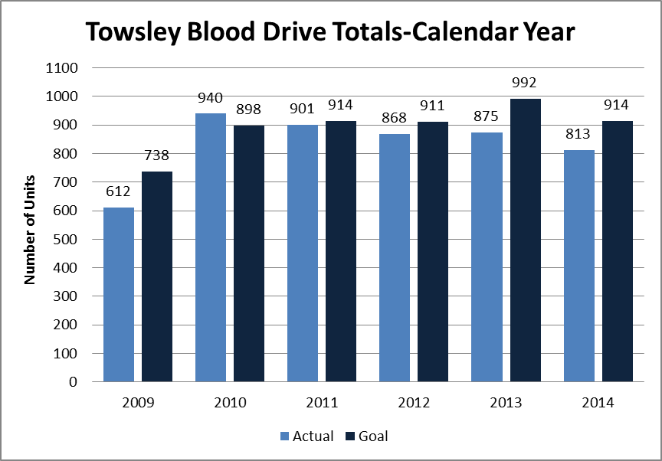
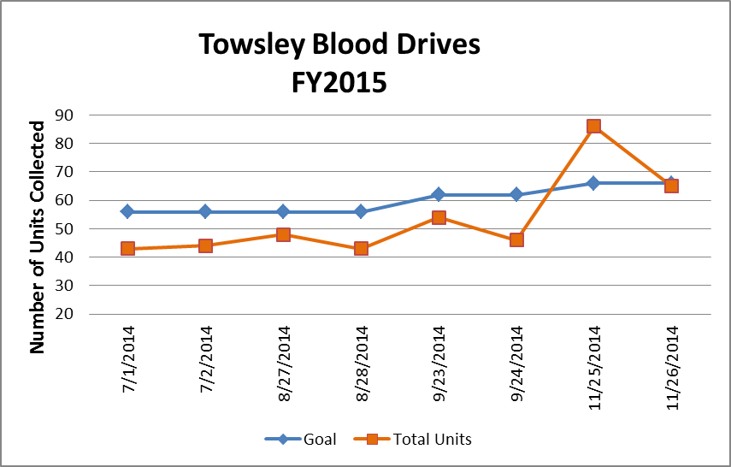
Clinical Pathology Patient Care Quality
Pathology-Blood Drive
We have not been able to meet our goal despite numerous endeavors to create incentives for donors. We’ve also teamed up with Wolverines for Life for donor recruitment and Blood Battle events. . A notable exception was the increase in donors at November’s Blood Battle with Ohio State.
Typically there are ~ 10 presenting donors per drive who are deferred either due to their current health status or answers on the donor questionnaire.
The number of no shows hovers around 25% per drive. This is due to people forgetting their appointment despite reminders from ARC, or being too busy to come to the appointment.
In response to donor need, we have moved the start time starting in August 2014 from 7am to 6am so more staff could donate before day shift begins or during midnight-day shift overlaps.
Blood drives are typically held monthly and can range from 1-2 days. There are numerous other drives held throughout the University of Michigan campus.
Donors can find upcoming drives by going to wwww.redcrossblood.org and searching under the Sponsor Code=goblue

Slide 3
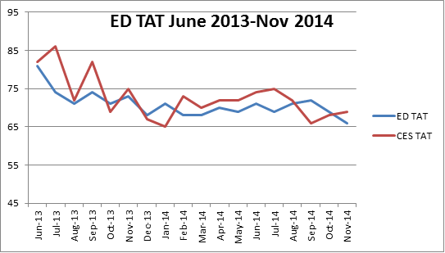
Clinical Pathology Patient Care Quality
Blood Bank
Minutes
The Blood Bank experienced an increase in TAT for Emergency Departments (ED=Adult, CES=Children’s) type and screen testing during the Soft go-live implementation starting in June 2013. As staff have gained more confidence using the new software and developed more efficient processes using the system, there has been a steady decrease in the TAT approaching pre-Soft conditions. The TAT goal is 60 minutes. The Blood Bank is looking at how to further modifications of their processes to meet this goal TAT.

Slide 4
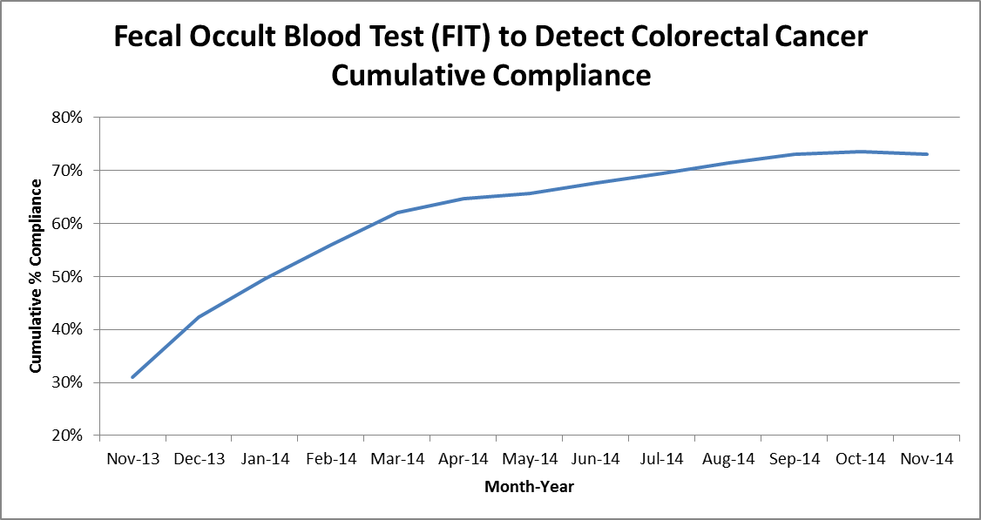
Clinical Pathology Patient Care Quality
Chemistry
Description of Problem: The guaiac method for detecting blood in the stool as a detection of colorectal cancer requires the patient to adhere to several dietary restrictions as well as to collect three separate stool samples. Due to this complexity, we had low compliance (<20%). Newer methodologies such as FIT are available that only require a single sample, no dietary restrictions, and have a higher sensitivity.
Impact of Problem:
Formerly, the guaiac cards we distributed had a low rate of return as indicated above
Reporter of Problem:
Laboratories, physician offices
Description of Solution:
Implement the immunochemical method for detection of colorectal cancer. Physicians would order the test in MiChart when the kit was handed to the patient.
Pre-stamped envelopes provided to the patient will be returned to the laboratory where the test will be run.
How we know it worked:
We continue to see a positive outcome relative to patient compliance with returning the kit for testing. For the past 6 months we’ve seen a 1-2% increase each month.
Since November 2013 we have increased compliance by 40%. Issues related to the date of order, release & collection are being investigated by MiChart & Chemistry.
Date Solution Implemented: October 29, 2013
Area for Improvement:
There continues to be some confusion from physicians relative to ordering this test vs. the former guaiac method that is used for non-colorectal occult bleeding screening by physicians. This is being addressed by the Lab Ambassador program and modifications to the Pathology Handbook.

Slide 5
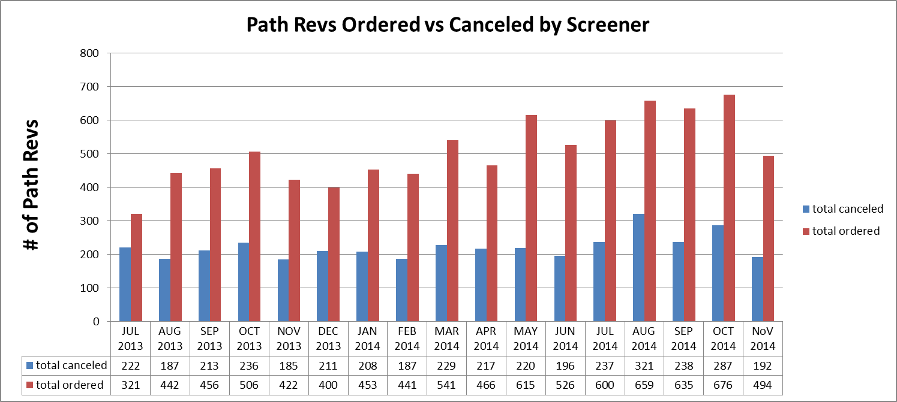
Clinical Pathology Patient Care Quality
Hematology
Description of Problem:
The Hematology lab created specific parameters related to the complete blood count (CBC) that reflex to the pathologist for a review starting in 2005.
Impact of Problem:
Inappropriate requests increase cost due to the additional pathologist review (path-rev) and impair the turnaround time for patients that require a pathologist review since there is no way to prioritize these if all of the slides are reviewed.
Reporter of Problem:
Hematology Pathologists/Staff
Description of Solution: Alter the current policy based on medical director guidance to allow specially trained, competency assessed technologists to prescreen path-rev slides. If screens are determined to be inappropriate for
pathologist review the path-rev would be canceled.
How we know it worked?
Over 40% of all path-rev orders requests received each month are canceled (blue bars in graph) thus improving turnaround time and decreasing the cost to the institution and patient. Technologist decisions are assessed monthly. Approximately, 10 cases per month are reviewed rotated between 5 screener technologists. This equates to each technologist being assessed twice per year.
Areas for continued improvement: On 11/10/14 the Hematology lab is implementing the revised criteria to reflex the path-rev. They are monitoring the outcome of via a spot-check QC process.

Slide 6
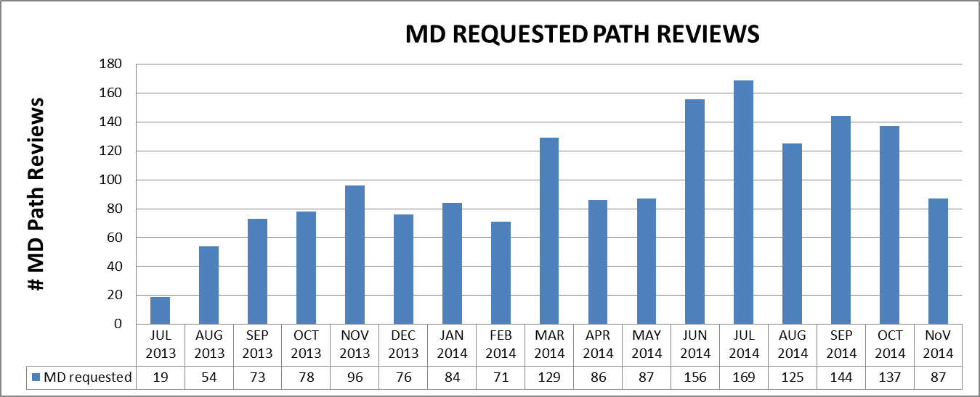
Clinical Pathology Patient Care Quality
Hematology
Description of Problem:
Historically, Medical Doctor (MD) requests have been processed as ordered. During the past year, there has been an upward trend in the number of Pathology Review requests from providers. There was a notable increase after the inpatient MiChart go-live in June 2014. Investigation into why this is occurring and whether the requests are appropriate and could be triaged in other ways is in progress.
Impact of Problem:
Inappropriate requests result in the unneeded cost of Pathologist review and delayed turnaround time for patients who require a pathologist to review their slide.
Reporter of Problem:
Hematology Pathologists/Staff
Description of Solution: Alter the current policy and allow technologists to prescreen MD request slides similarly to the Path-rev process used for CBCs. Work with MiChart team to remove ability for MD requests on standing orders.
To assure patient safety, an initial audit by a pathologist review of cases deemed not to require MD Path Review was performed. When the screens are deemed to be inappropriate, the MD Path Review will be canceled by the technologist. Techs are now allowed to verify positive crystals on urine specimens. This resulted in 17 fewer orders in November for a pathologist review.
How we know it worked?
Number of requests has decreased due to countermeasures with standing orders. Plans for implementation are ongoing.
Areas for continued improvement: Hematology is investigating reasons why orders are received in error from providers (e.g. errant orders, or improper understanding of the order code). Example of improper ordering: for one day a single patient had 18 path review orders. 1/1/15 MCV<65 will no longer need a path review.

Slide 7
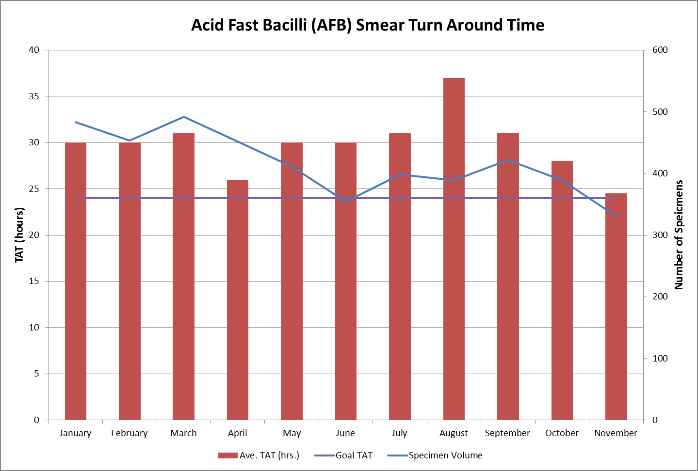
Clinical Pathology Patient Care Quality
Microbiology
Description of Problem: The American Thoracic Society has set a turn around time (TAT) standard of 24 hours or less for AFB smears. Since the beginning of 2014, the Microbiology laboratory has met this goal. In the past, AFB specimens were processed Sunday through Friday with a batch cutoff of 6 PM. Smears did not have set read out times scheduled, and were done as the workload permitted.
Impact of Problem:
The ability to identify potentially infectious tuberculosis patients via AFB smear identification is critical to treatment and isolation of the patient.
Reporter of Problem: Microbiology staff
Description of Solution:
Peggy Mahlmeister and the Microbiology staff implemented a change to read our smears by 10am the following day.
How we know it worked? For the past three months we have seen a continued decrease in the TAT.
Areas for continued improvement: The Microbiology laboratory is continuing to look for opportunities to further reduce the TAT to meet the goal TAT.

Slide 8
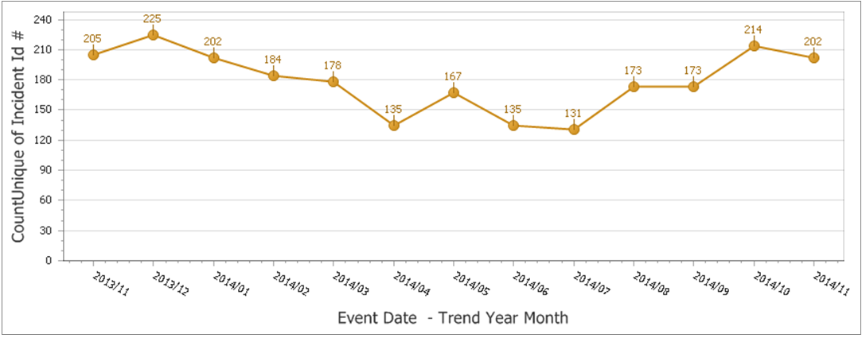
Clinical Pathology Patient Care Quality
Point of Care
Description of the Problem:
Once MiChart was implemented, a change occurred in how the patient was identified. In order to correlate billing information relative to the specific patient stay, the CSN number on the patient’s wristband is used rather than the MRN. The patient’s wristband was changed so that the glucometer CSN number is now a 1D barcode versus the MRN which is a 2D barcode. Since making this change, numerous errors have occurred where the MRN was manually entered by mistake into the glucometer. This then transmits to the RAALS middleware. The RAALS middleware requires the current CSN to function properly.
Impact of Problem: The errors cause a delay in results being reported to the patient record. Additionally, the corrective action requires the POC Coordinator to match the misidentified patient results and then manually report them to the correct CSN. This opens the opportunity for human transcription errors along with inefficient use of the coordinator’s time to work on other tasks.
Reporter of Problem: POC Coordinator & Nursing Leadership
Description of Root Causes Identified:
Nursing is not able to access the barcode and has to manually enter CSN. Manual entry may be incorrect or the MRN (traditionally used for other tasks to identify patients) may be used by mistake.
This is especially true of pediatric wristbands which are smaller. Nurse educators have refocused training on this aspect. Investigation into modifying the patient wristband to allow more barcodes to be visible and align vertically versus horizontally is ongoing by MiChart.
CSN mismatch-Examples of patients presenting at the ER or IPLV (Inpatient Like Venues) and then admitted on a different day (thus different CSN) still have their “old” wristband on that is no longer valid.
Wristband printing-future visit day used to print wristband. Practice change by nursing to replace patient wrist band every time patient comes or returns to the floor (e.g. go to OR or procedure area and come back).
Identified reasons why nurses are manually entering MRNs and implementing countermeasures to address delays in downloading patient names & results to the patient’s record.
Follow-up
During the month of November we saw a small decrease in the number of errors relative to October, however the number of occurrences is still higher than past months. Education Nurse Coordinator Sheryl Woloskie reiterated best practices on 12/4/14 to Nurse Educators & Managers.

Slide 9
Clinical Pathology Quality and Performance
Laboratory Safety Audits
Safety audits were performed by the Pathology Safety Liaisons between March and December 2014. Each Safety Liaison will work with the section supervisor & Compliance Manager to rectify the “needs attention” areas by December 31st, 2014.

Slide 10
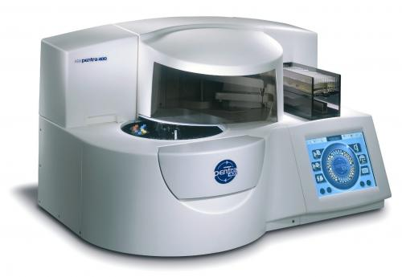
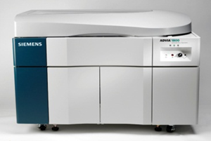
Monthly CP QA Highlight
Chemistry
ABX Pentra
Advia 1800
Background: Ethyl glucuronide typically is used by rehab/drug treatment centers to monitor recent alcohol intake. About 75-10 tests had been run per week. Tests had been run on the ABX Pentra and batched 2x per week. The assay took approximately 1.5-2 hours to perform. Only 4-5 % of results are considered positive (>500 ng/ml).
Impact of Problem: Tests are not available 24/7.
Description of the Change: Starting in January 2015 the test will be moved to a different platform. Utilizing 3rd party reagents the Advia 1800 that is connected to the automation line will be used to perform the test. This will allow the test to be run 24/7 and save over $20,000 based on the current volume of tests performed annually. The Pentra will still be used to confirm results that are >500ng/ml.
Follow-up:
Trend the TAT along with cost savings over the 2015 calendar year to ensure gains were actualized.

Slide 11
Clinical Pathology-Current Projects
**This is a highlight of projects ongoing in the CP labs. This list is not meant to be all inclusive of every activity occurring in the department.
Project | Brief Description | Owner
Customer Service/Call Center | Address multiple issues related to providing an appropriate level of customer service for UMHS care providers. | Dr. Newton
ER Specimen Issues | In coordination with the Emergency Department reduce the number of RMPRO specimen errors (e.g. hemolysis, mislabels etc.) | S. Butch/K. Martin/T. Morrow
Pathology Handbook | Maintain and update the Pathology handbook to be a robust resource for our customers. | K. Davis/K. Martin/J. Sica
NCRC Planning | Begin work to plan for the future state of the non-STAT Clinical Labs move to NCRC | PRR Committee
Lab Ready Labels | Installation of lab label printers in the ED & Ambulatory Care clinics. | K. Davis/K. Martin

Slide 12
Clinical Laboratory News, Notes, and Kudos
------------------------------------------------------------------------------------
Labs that are working on process improvement projects that would like to display data can contact Kristina Martin (martkris@umich.edu) for future dashboards.
Kudos
Suzanne Butch- Nomination to serve on the Centers for Medicare and Medicaid Services advisory panel for input on payment rates of new tests and factors used for coverage determinations.
Catherine Dixon, Michelle Russell & Brent Temple-Creation of a medical laboratory science internship webpage to house information tools & resources for prospective & current MLS students.
Chris Gaunt & Beth Lawless- Modifying the test codes for ordering porphyrin testing to align with other reference labs. Heme-Onc physicians have noted this will greatly help with confusion regarding ordering of these tests.

