Slide 1
Clinical Pathology
Quality Dashboard
February 2015

Slide 2
Monthly CP QA Highlight
Chemistry
Description of Monitor
Stat Turn and Routine around time (TAT) for automated testing. Two values are measured: the percentage of STAT specimens resulted within 60 minutes of receipt and the percentage of routine specimens resulted within 120 minutes of receipt.
Impact
Delayed results delay patient care.
Monitor Status
Despite the laboratory computer down and an automation line failure, TAT was above threshold values.
SoftLab down on 7/27 (1-5)
on that same day, the automation line went down on the evening shift due to a thunderstorm.
The average percentage of STAT specimens resulted in 60 minutes appears to be slightly lower that the values before the down in July of 2014.

Slide 3
Clinical Pathology Patient Care Quality
Pathology- Chemistry ED Lab
Description of Monitor
The average, median and time for 95% of the Troponin test to be reported from time of receipt.
Impact
Delayed results delay treatment of cardiac patients
Status
The change in average TAT in March of last year has not recurred. There has been a sustained improvement (reduction) in the minutes for 95% of the tests to be resulted.

Slide 4
Clinical Pathology Patient Care Quality
Pathology- Blood Bank
Description of Monitor
The number and type of Biological Product (blood component) Deviation Reports submitted as required to the FDA is compared to the previous year’s reports to look for trends.
Impact
While most reportable errors do not constitute a risk to patients, these errors are reported to a federal agency.
Status
Labeling errors have been reduced. Wrong product/patient errors increased with MiChart conversion. Root causes include layout of the order. Units not dispensed in the computer at the time of issue remain a problem.

Slide 5
Clinical Pathology Patient Care Quality
Molecular Diagnostics
Description of the Problem:
Amended reports cause confusion and rework. Threshold is no computer generated errors. Goal is to reduce the number of client errors.
Impact:
Caregiver may provide the patient with incorrect information/therapy if the initial report is used.
Reporter of the Problem:
Molecular Diagnostics Lab performance monitor.
Description of the Solution:
New version of Soft caused a reporting problem in October. Continued client feedback on ordering.
How we know it worked:
Validation protocols have been adjusted to assess the report function that caused this problem as new software is implemented.
Area for Improvement:
Continued client feedback to reduce the need to contact the client for additional information.

Slide 6
Clinical Pathology Patient Care Quality
Microbiology
Description of the Problem:
Turn-Around-Time (TAT) for reporting Acid Fast Bacillus.
Impact:
Delay in providing accurate treatment. Reporting goal is <24 hours.
Reporter of the Problem:
Routine monitor of lab performance.
Description of the Solution:
Changed time of reporting.
How we know it worked:
The average TAT has decreased and the percent within range has markedly increased beginning in August of 2014.
Area for Improvement:
Continue to make process improvements to reduce TAT.

Slide 7
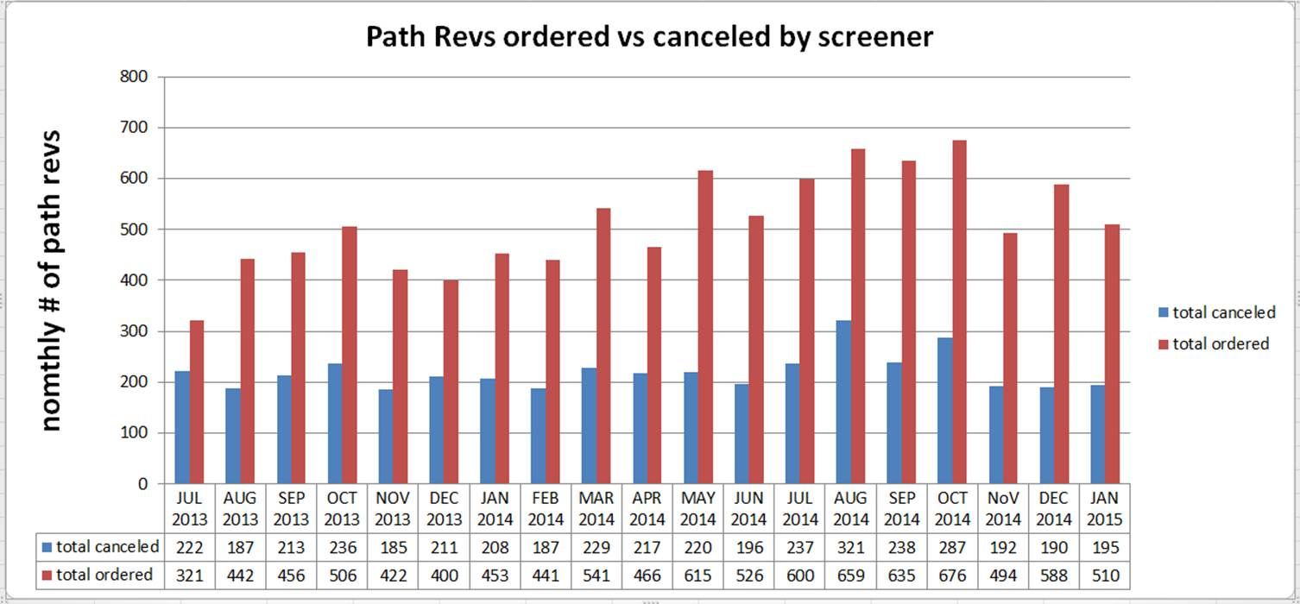
Clinical Pathology Patient Care Quality
Hematology
Description of Problem:
Increasing workload related to manual slide reviews.
Impact of Problem:
Delay in patient care because of the turn-around-time for test results that require a pathologist review. Increased cost for review function.
Reporter of Problem:
Hematology Pathologists/Staff
Description of Changes Initiated: A number of policy/procedure changes have been made over the years to best use the automated screening capabilities of instruments including the use of specially trained, competency assessed technologists to prescreen path-rev slides. If screens are determined to be unnecessary, the path-rev is canceled.

Slide 8
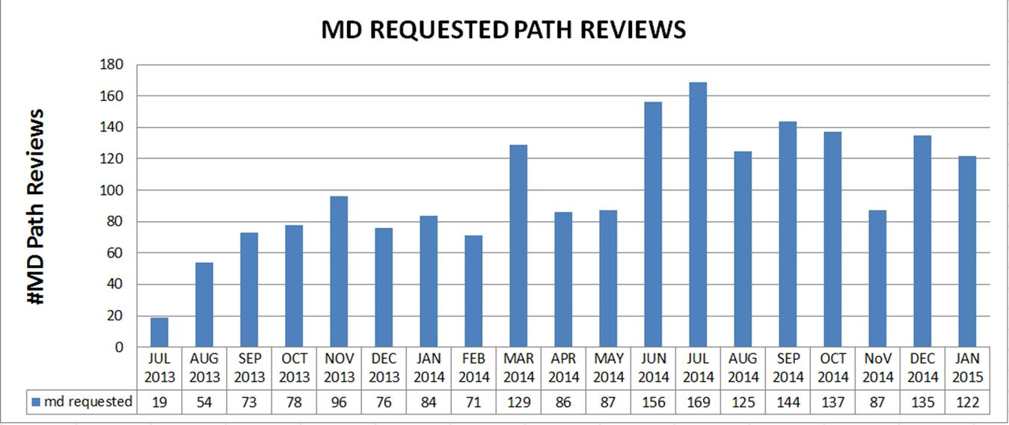
Clinical Pathology Patient Care Quality
Hematology
Outcome of Changes: Changes made on 10/10/14 to the criteria to reflex the path-rev did not have the impact expected in December and January. Additional interventions are being investigated.
Technologist decisions are assessed twice per year to ensure competency. No evidence that the additional screening and cancellation changes have negatively affected patient care.
Areas for Continued Improvement: To meet with clinical staff to understand the clinical need for MD requested reviews. Changes that are being considered for implementation are to cancel as duplicates MD reviews requested within 3 days of the previous request and allow screeners to cancel MD requests for anemia where this is no sign of hemolysis or anemia.

Slide 9
Clinical Pathology-Current Projects
**This is a highlight of projects ongoing in the CP labs. This list is not meant to be all inclusive of every activity occurring in the department.
Project | Brief Description | Owner
Customer Service/Call Center | Address multiple issues related to providing an appropriate level of customer service for UMHS care providers. | Dr. Newton
ER Specimen Issues | In coordination with the Emergency Department reduce the number of RMPRO specimen errors (e.g. hemolysis, mislabels etc.) | S. Butch/K. Martin/T. Morrow
Pathology Handbook | Maintain and update the Pathology handbook to be a robust resource for our customers. | K. Davis/K. Martin/J. Sica
NCRC Planning | Begin work to plan for the future state of the non-STAT Clinical Labs move to NCRC | PRR Committee
Lab Ready Labels | Installation of lab label printers in the ED & Ambulatory Care clinics. | K. Davis/K. Martin

Slide 10
Clinical Laboratory News, Notes, and Kudos
------------------------------------------------------------------------------------
Promotions
Congratulations to -
Grace Monteclaro Satellite Support/POC QA Technologist
Kudos
The Histocompatibility Laboratory had a successful inspection by the American Society for Histocompatibility and Immunogenetics (ASHI).

