Slide 1
Clinical Pathology
Quality Dashboard
February 2014

Slide 2
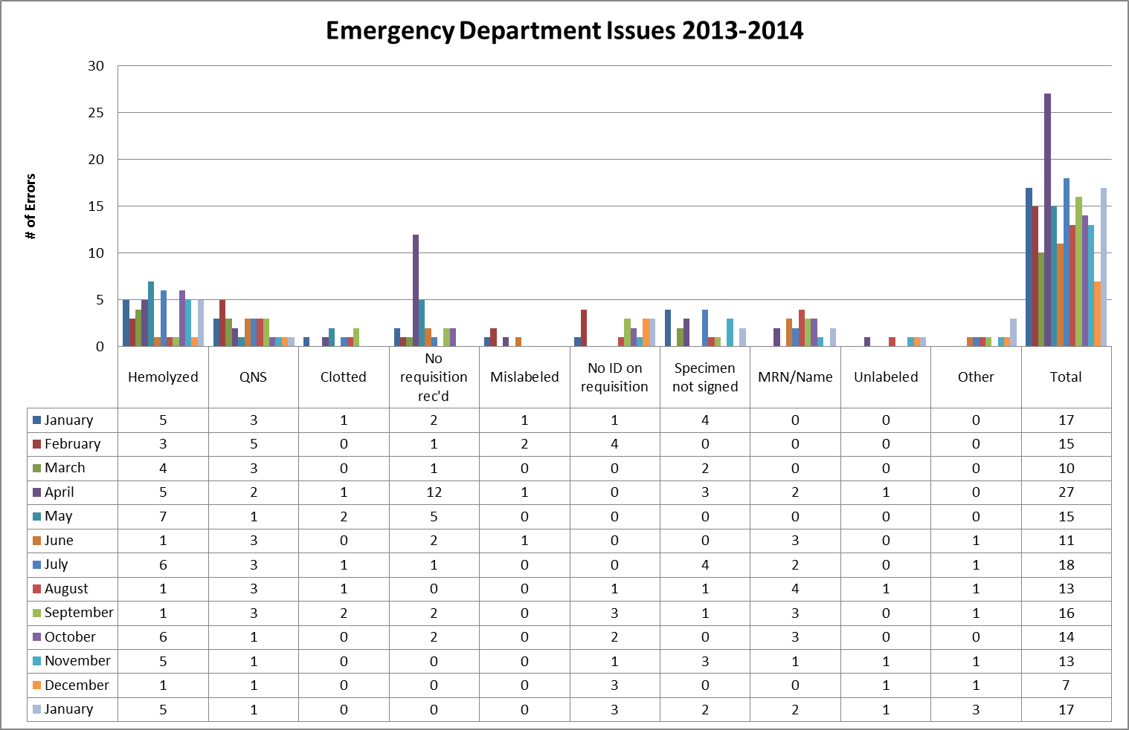
Clinical Pathology Patient Care Quality
Blood Bank
Pathology is pursuing a two pronged approach to “specimen quality” in the ED.
There is and has been ongoing discussions via Nursing Liaisons (Barb Wetula, RN, and Sheryl Woloskie) to addressing training for non-Pathology collected specimens. This focus has been on all of UMHS, with an emphasis on the ED.
Pathology and the Emergency Department are investigating possible deployment of additional Pathology personal in the ED POCT lab or utilization of the Soft ID system which has been shown to assist with patient identification/signature errors at other institutions.
While there was a decrease in January relative to the number of errors this was not sustained into January.

Slide 3
Clinical Pathology Patient Care Quality
Chemistry
Description of Problem: The guaiac method for detecting blood in the stool as a detection of colorectal cancer requires the patient to adhere to several diet restrictions as well as to collect three separate collections. Newer methodologies are available that only require a single sample, no diet restrictions, and have a higher sensitivity.
Impact of Problem:
Historically, the amount of guaiac cards distributed had a low rate of return. Use of the newer immunochemical method has increased the rate of return due to ease of collection by the patient alone.
Reporter of Problem:
Laboratories, physician offices
Description of Solution:
Implement the immunochemical method (FIT) for detection of colorectal cancer. Physicians would order the test when the kit was handed to the patient. Pre-stamped envelopes provided to the patient will be returned to the laboratory where the test will be run.
How we know it worked:
TBD-Using reports that pull data for the number of tests performed versus the number of tests pending we can calculate the rate of compliance.
Date Solution Implemented: October 29, 2013

Slide 4
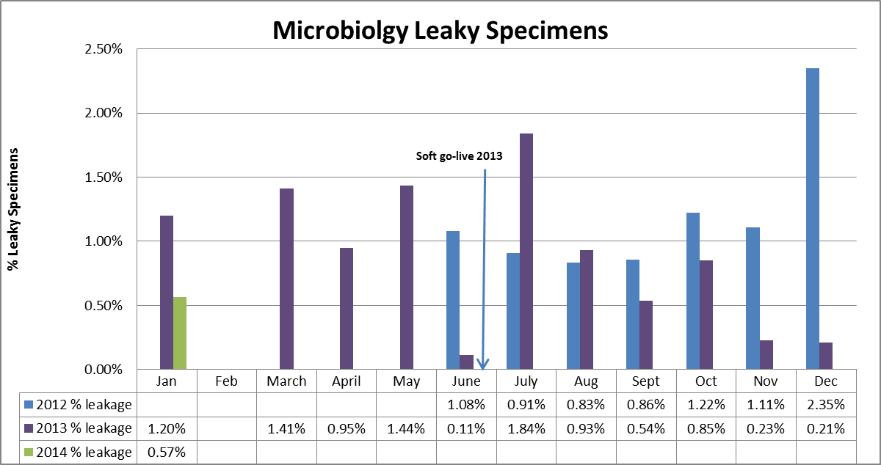
Clinical Pathology Patient Care Quality
Microbiology
Leaky specimens can be hazardous and can result in rejection of the specimen or delays in testing. The average total monthly volume illustrated on the graph is ~ 4800. Despite changes to the urinary cup used, leaky specimens continue to arrive in the Pathology laboratory. Most such specimens are sent to Microbiology. Cultures are canceled when the specimen cannot be salvaged or when multiple patient containers have leaked in the same specimen bag. In addition, if specimens are not processed within a relatively short period of time, contaminated bacterial growth occurs causing an increase in the number of false positives. This is particularly true for urine cultures that require the patient to perform a clean catch. These cultures are more prone to contaminants not related to a true infection. Due to these issues, an investigation has been ongoing into using the a vacutainer urine collection system that eliminates the need to tighten a screw cap for urine specimens which compose the majority of leaky specimens. Currently, Pathology Satellite labs, as well as the Emergency Department Lab use these containers for specimen transport and leakage does not occur. Coordination with Infection Control to migrate to this container type is ongoing. A pilot on the 6D CCMU is occurring relative to use of catheter adapters along with urine vacutainer collections is currently in progress.

Slide 5
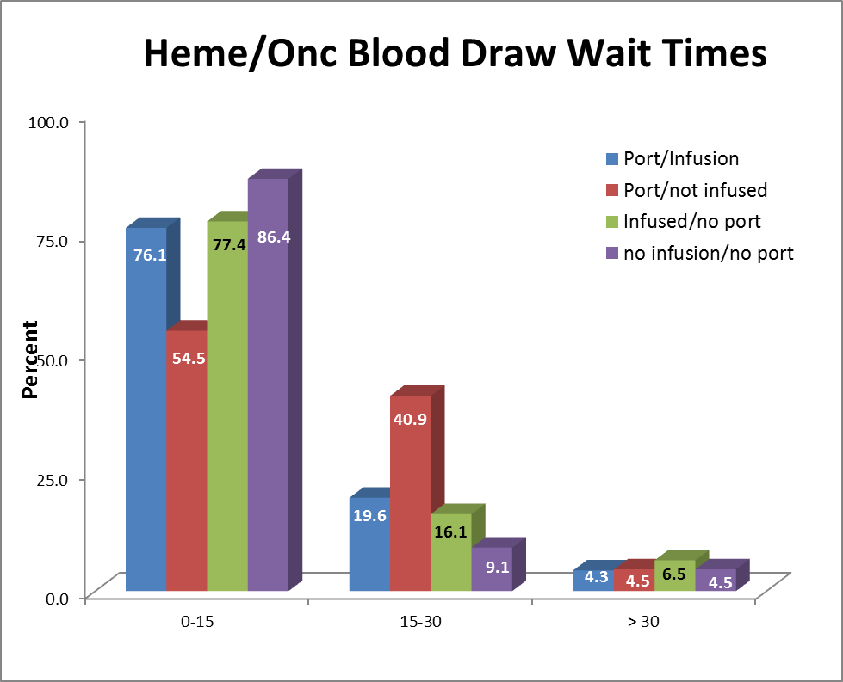
Clinical Pathology Patient Care Quality
Hematology & Phlebotomy
Description of Problem: Patients seen by the Hematology-Oncology service have lab testing followed by a clinic appointment where decisions as to whether the patient will receive an infusion treatment that day are made. A vast majority of specimens have results within the desired turn-around-time (TAT), however there continues to be outliers that impact delivery of care to the patients. These samples, due to the nature of the disease, often require more time to evaluate due to abnormal results and challenging blood smear differentials.
Impact of Problem: Patient treatment may be delayed because physicians wait for laboratory results to be available.
Reporter of Problem: Heme-Onc physicians and nurses
Description of Solution:
Although the in lab TAT is something that can be controlled more readily, the major portion of the delay in testing relates to the initial visit of the patient to the phlebotomy site: time waiting in line before draw, time for the draw, transport to the laboratory. A two week pilot at the C & W blood draw station started on November 11, 2013 to query patients whether they had an infusion appointment so they could be triaged ahead of other patients having blood work drawn that did not impact treatment for that day.
Preliminary surveys of the patient experience have been positive with the Heme-Onc clinic noting a reduction in the number of complaints. The goal of < 15 minute wait time was met for 82% of respondents.
The real time monitor was released in February 2014 to the clinic to assist with specimen tracking and eliminating wasted time calling the laboratory for specimens that had not been received or were still within the 60 minute in-lab TAT parameters.
Areas for Improvement: Below are comments from the patient survey for room for improvement.
15-30 min wait due to orders not being in the system.
Never got labs due to not getting orders~ 3rd or 4th time that we had to wait for orders confuses me since the apt. is made a month in advance.
All depends on arrival time before 10am 0-15 min, after 10am 15-30min. Blood labs are a good experience for us.
Our first clinic visit I had marked “port” on the sign in sheet, I get called back and they were going to do a blood draw from the arm. She hadn’t noticed I put “port” on the sheet. She went to get someone else and we waited 15-20 min for someone else to come, finally I had to find someone to help us.
Please install a clock!

Slide 6
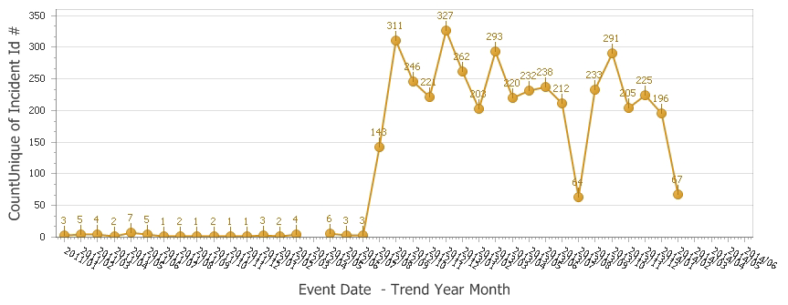
Clinical Pathology Patient Care Quality
Point of Care
*Note Aug 2013 data decreased due to POC coordinator absence and RMPRO reports not entered during this time frame.
*
Description of Problem:
Once Michart was implemented a change relative to how the patient is identified occurred. In order to correlate billing information relative to the specific patient stay, the CSN number is used derived from the patient wristband to scan versus the MRN. The patient wristband was changed so that the glucometer CSN number is now a 1D barcode versus the MRN which is a 2D. Since this time numerous errors end up in the RAALS laboratory middleware because they cannot associate to the patient record which is searching for a current CSN. Further investigation into the cause of these numerous errors has been ongoing.
Impact of Problem: The errors cause a delay in results being reported to the patient record. Additionally, the corrective action is for the POC Coordinator to match the misidentified patient results and then manually report them to the correct CSN. This opens the opportunity for human transcription errors along with inefficient use of the coordinator’s time to work on other tasks.
Reporter of Problem: POC Coordinator & Nursing Leadership
Description of Root Causes Identified:
Nursing is not able to access the barcode and has to manually enter CSN. This can be entered incorrectly or the MRN is used which is traditionally used for other methods of identifying patients. This is especially true of pediatric wristbands which are smaller. Nurse educators have refocused training on this aspect. Investigation into modifying the patient wristband to allow more barcodes to be visible is ongoing by Michart.
CSN mismatch-Examples of patients presenting at the ER or IPLV and then admitted on a different day (thus different CSN) still have their “old” wristband on which is no longer valid. Wristband printing-future visit day used to print wristband. Practice change by nursing to replace patient wrist band every time patient comes or returns to the floor (e.g. go to OR or procedure area and come back).
Future: New glucometers with wireless technology may help identify when CSN mismatches occur in real time on the glucometer monitor screen.

Slide 7
CP QA Meeting Highlight
Description of Problem: The Emergency Department was seeking certification as a Stroke Center which requires PT testing TAT to fall under 45 minutes.
Impact of Problem: Due to various factors related to collections & transport to the main lab obtaining results in this time frame would be nearly impossible to sustain with the current workflow. The graph above shows that the TAT to the lab trended towards 60 minutes.
Description of Solution: Implement a point of care instrument (Helena Cascade) in the Emergency Laboratory for defined patient populations that would be subject to stroke or related conditions. The patient population had to be restricted to suspect stroke patients and other similar conditions so the volume of testing on the POC analyzer could be accommodated.
How we know it worked: The new instrument correlates well with our main lab coagulation instrument with regard to the INR. Chart review of 56 patients revealed that 45 of these requests were appropriately ordered for the patient presentation originally agreed upon. The average TAT for the POC PT is now 15 minutes or less, which is well within the necessary 45 minute TAT required for stroke certification.
Date Solution Implemented:
November 2013

Slide 8
Clinical Pathology-Current Projects
**This is a highlight of projects ongoing in the CP labs. This list is not meant to be all inclusive of every activity occurring in the department.
Project | Brief Description | Owner
Customer Service/Call Center | Address multiple issues related to providing an appropriate level of customer service for UMHS care providers. | Dr. Newton
Leaky Specimens | Reduce the number of leaky specimens by exploring different transport containers and/or educational opportunities | Dr. Newton
CP Brochure | Compile information and photos from the Clinical Laboratories to create a generic CP overview for visitors/prospective clients. | K. Martin
Heme-Onc TAT for ANC results | In coordination with the heme-onc clinics explore opportunities to optimize TAT for patients receiving infusions. | J. Davis/U.Kota/K. Martin/H. Neusius
ER Specimen Issues | In coordination with the Emergency Department reduce the number of RMPRO specimen errors (e.g. hemolysis, mislabels etc.) | S. Butch/K. Martin/T. Morrow
Pathology Handbook | Maintain and update the Pathology handbook to be a robust resource for our customers. | K. Davis
Pathology Michart readiness | Ensuring that Pathology staff are prepared for the Michart Stage 3 go-live June 7 | S. Butch, K. Davis, K.Martin, H. Neusius, C. Rigney

Slide 9
Clinical Pathology Financials

Slide 10
Clinical Laboratory News, Notes, and Kudos
------------------------------------------------------------------------------------
Labs that are working on process improvement projects that would like to display data can contact Kristina Martin (martkris@umich.edu) for future dashboards.
Kudos
Kudos to the sterling performances of Joan Debusscher, Cheryl McGonigle, Stephanie Sheldon, Dawn Webb and our Blood Bank Director, Rob Davenport whose timely responses ensured that no patient specimens were compromised when the Cryo-Med freezers in the Blood Bank required significant maintenance last week.
Allen Ano, Kathy Davis, Brian Dziubinski, Bill Hubbard, Bob Killen, Tom Morrow, Sue Stern, Ramesh Surisetty, Denise Twarkowski, Nick Wesener for migrating the glucometer RALS interface successfully and with minimal service interruption during the weekend of February 22nd.
Poke Program that is supported by our Phlebotomy areas for receiving the UMHS Program of the Year honorable mention.

Slide 11
Clinical Laboratory News, Notes, and Kudos
Sue Stern & Dr. Newton-Addressing concerns related to STAT testing for pregnant women presenting in the triage area.
Jerry Davis & Dr. Vergilio-Implementing the SYSMEX in the Canton Laboratory.
Terrance Still-Persistent assistance for an outside physician to locate experts in a rare field for a second opinion on a unique case which resulted in 5 days of research.

