Slide 1

Clinical Pathology
Quality Dashboard
January 2014

Slide 2
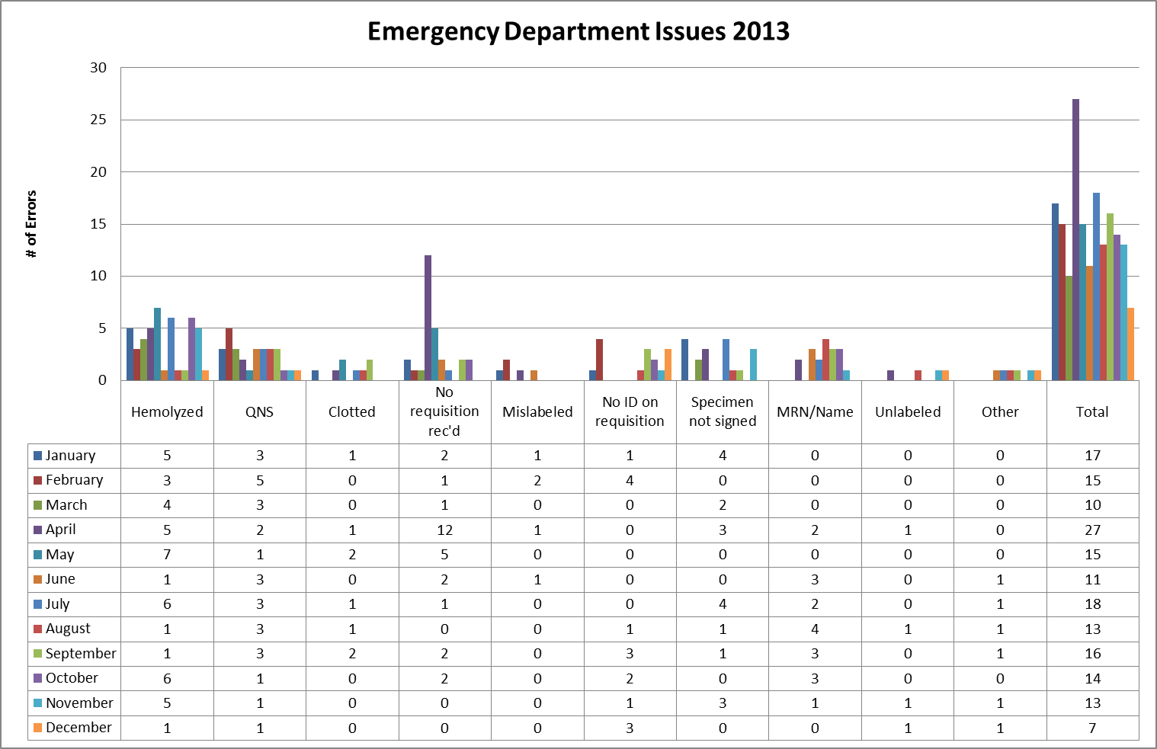
Clinical Pathology Patient Care Quality
Blood Bank
Pathology is pursuing a two pronged approach to “specimen quality” in the ED.
There is and has been ongoing discussions via Nursing Liaisons (Barb Wetula, RN, and Sheryl Woloskie) to addressing training for non-Pathology collected specimens. This focus has been on all of UMHS, with an emphasis on the ED.
Pathology and the Emergency Department are investigating possible deployment of additional Pathology personal in the ED POCT lab or utilization of the Soft ID system which has been shown to assist with patient identification/signature errors at other institutions.
There was a decrease in the number of errors for the month of December to the lowest value observed over the past twelve months. Subsequent months will be monitored to determine whether this is a true trend or an anomalous month.

Slide 3
Clinical Pathology Patient Care Quality
Chemistry
Description of Problem: The guaiac method for detecting blood in the stool as a detection of colorectal cancer requires the patient to adhere to several diet restrictions as well as to collect three separate collections. Newer methodologies are available that only require a single sample, no diet restrictions, and have a higher sensitivity.
Impact of Problem:
Historically, the amount of guaiac cards distributed had a low rate of return. Use of the newer immunochemical method has increased the rate of return due to ease of collection by the patient alone.
Reporter of Problem:
Laboratories, physician offices
Description of Solution:
Implement the immunochemical method (FIT) for detection of colorectal cancer. Physicians would order the test when the kit was handed to the patient. Pre-stamped envelopes provided to the patient will be returned to the laboratory where the test will be run.
How we know it worked:
TBD-Using reports that pull data for the number of tests performed versus the number of tests pending we can calculate the rate of compliance. This will be monitored over time to observe the compliance rather and determine if additional actions are required.
Date Solution Implemented: October 29, 2013

Slide 4
Clinical Pathology Patient Care Quality
Hematology & Phlebotomy
Description of Problem: Patients seen by the Hematology-Oncology service have lab testing followed by a clinic appointment where decisions as to whether the patient will receive an infusion treatment that day are made. A vast majority of specimens have results within the desired turn-around-time (TAT), however there continues to be outliers that impact delivery of care to the patients. These samples, due to the nature of the disease, often require more time to evaluate due to abnormal results and challenging blood smear differentials.
Impact of Problem: Patient treatment may be delayed because physicians wait for laboratory results to be available.
Reporter of Problem: Heme-Onc physicians and nurses
Description of Solution:
Although the in lab TAT is something that can be controlled more readily, the major portion of the delay in testing relates to the initial visit of the patient to the phlebotomy site: time waiting in line before draw, time for the draw, transport to the laboratory. A goal for < 5% for these outliers (red line) has been set by the hematology lab.
At the present time only in lab TAT can be accurately calculated due to complications of capturing an accurate draw time due to HIS/LIS interfaces. To improve the TAT related to processes outside of the in lab TAT, a pilot at the C & W blood draw station started on November 11, 2013 to query patients whether they had an infusion appointment so they could be triaged ahead of other patients having blood work drawn that did not impact treatment for that day. Preliminary surveys of the patient experience have been positive with the Heme-Onc clinic noting a reduction in the number of complaints. Survey data will be available in the coming months to illustrate this fact.
Areas for continued improvement:
Real time monitor profiles are being built and tested to monitor the TAT in with color coordination when specimens become “overdue”.

Slide 5
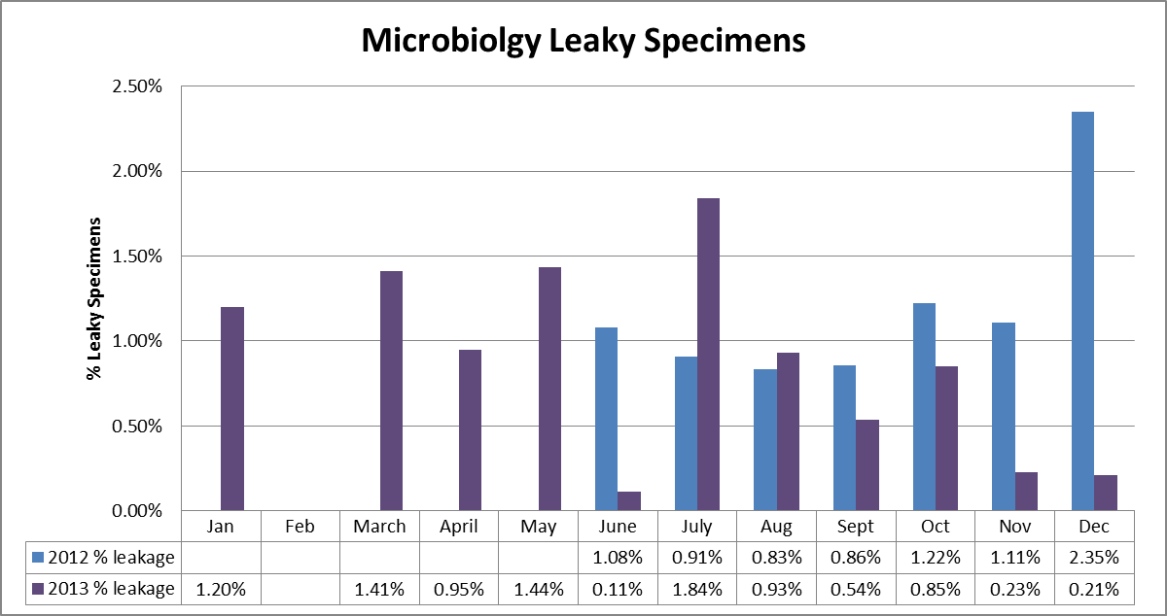
Clinical Pathology Patient Care Quality
Microbiology
Leaky specimens can be hazardous and can result in rejection of the specimen or delays in testing. The average total monthly volume illustrated on the graph is ~ 4800. Despite changes to the urinary cup used, leaky specimens continue to arrive in the Pathology laboratory. Most such specimens are sent to Microbiology. Cultures are canceled when the specimen cannot be salvaged or when multiple patient containers have leaked in the same specimen bag. In addition, if specimens are not processed within a relatively short period of time, contaminated bacterial growth occurs causing an increase in the number of false positives. This is particularly true for urine cultures that require the patient to perform a clean catch. These cultures are more prone to contaminants not related to a true infection. Due to these issues, an investigation has been ongoing into using the a vacutainer urine collection system that eliminates the need to tighten a screw cap for urine specimens which compose the majority of leaky specimens. Currently, Pathology Satellite labs, as well as the Emergency Department Lab use these containers for specimen transport and leakage does not occur. Coordination with Infection Control to migrate to this container type is ongoing. A pilot on the 6D CCMU is planned for the near future.

Slide 6
Clinical Pathology Patient Care Quality
Point of Care
*Note Aug 2013 data decreased due to POC coordinator absence and RMPRO reports not entered during this time frame.
*
Description of Problem:
Once Michart was implemented a change relative to how the patient is identified occurred. In order to correlate billing information relative to the specific patient stay, the CSN number is used derived from the patient wristband to scan versus the MRN. The patient wristband was changed so that the glucometer CSN number is now a 1D barcode versus the MRN which is a 2D. Since this time numerous errors end up in the RAALS laboratory middleware because they cannot associate to the patient record which is searching for a current CSN. Further investigation into the cause of these numerous errors has been ongoing.
Impact of Problem: The errors cause a delay in results being reported to the patient record. Additionally, the corrective action is for the POC Coordinator to match the misidentified patient results and then manually report them to the correct CSN. This opens the opportunity for human transcription errors along with inefficient use of the coordinator’s time to work on other tasks.
Reporter of Problem: POC Coordinator & Nursing Leadership
Description of Root Causes Identified:
Nursing is not able to access the barcode and has to manually enter CSN. This can be entered incorrectly or the MRN is used which is traditionally used for other methods of identifying patients. This is especially true of pediatric wristbands which are smaller. Nurse educators have refocused training on this aspect. Investigation into modifying the patient wristband to allow more barcodes to be visible is ongoing by Michart.
CSN mismatch-Examples of patients presenting at the ER or IPLV and then admitted on a different day (thus different CSN) still have their “old” wristband on which is no longer valid. Wristband printing-future visit day used to print wristband. Practice change by nursing to replace patient wrist band every time patient comes or returns to the floor (e.g. go to OR or procedure area and come back).
Future: New glucometers with wireless technology may help identify when CSN mismatches occur in real time on the glucometer monitor screen.

Slide 7

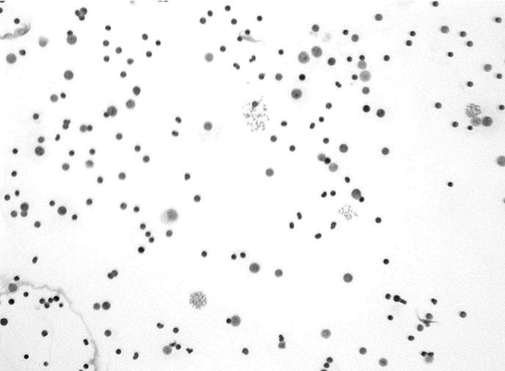
CP QA Meeting Highlight
Cytogenetics
Affected Slide
Unaffected Slide
Morning Harvest
 | A | B | C | D | E
Constitutional | ok | - | - | - | -
Oncology | - | ok | - | - | ok
Afternoon Harvest
 | A | B | C | D | E
Constitutional | - | ok | ok | ok | -
Oncology | ok | - | - | - | AFFECTED
Description of Problem: E cultures from a specific date were not producing metaphase cells and the cells viewed for FISH were not producing signals along with disrupted cell membranes. Since this occurred on several cases the technologists began to question whether something went wrong during processing.
Impact of Problem: Unable to properly analyze the specimens.
Description of Solution: The technologists narrowed down the type of cultures along with the date that appeared to have been impacted. They identified that on that date the water bath #2 was inadvertently changed to 55◦C when it should have been 37◦C, therefore negatively affecting the cultures.
Technologists only measure the temperatures during the morning and therefore the increase went unnoticed until the following day. Waterbath #2 was removed from this process and is only used for reagent thawing. All E cultures are now incubated in a slant rank that is equipped with alarms and is connected to a backup power generator. All specimens were re-tested from that date and time period and reported appropriately.
Date Solution Implemented:
October 2013

Slide 8
Clinical Pathology Safety
Proficiency Testing Performance

Slide 9
Clinical Pathology Financials

Slide 10
Clinical Pathology-Current Projects
**This is a highlight of projects ongoing in the CP labs. This list is not meant to be all inclusive of every activity occurring in the department.
Project | Brief Description | Owner
Customer Service/Call Center | Address multiple issues related to providing an appropriate level of customer service for UMHS care providers. | Dr. Newton
Leaky Specimens | Reduce the number of leaky specimens by exploring different transport containers and/or educational opportunities | Dr. Newton
CP Brochure | Compile information and photos from the Clinical Laboratories to create a generic CP overview for visitors/prospective clients. | K. Martin
Heme-Onc TAT for ANC results | In coordination with the heme-onc clinics explore opportunities to optimize TAT for patients receiving infusions. | J. Davis/U.Kota/K. Martin/H. Neusius
ER Specimen Issues | In coordination with the Emergency Department reduce the number of RMPRO specimen errors (e.g. hemolysis, mislabels etc.) | S. Butch/K. Martin/T. Morrow
Pathology Handbook | Maintain and update the Pathology handbook to be a robust resource for our customers. | K. Davis
Relative-Of Specimens | Address gaps in policy/workflow regarding specimens associated with associated patient/donor, or patient/relative-of testing. | S. Butch, K. Davis, K. Young
Glucometer Errors | Numerous POC glucometer errors where correct CSN is not identified for various reason and therefore cannot be automatically uploaded to the patient record. | S. Butch, D. Keren, K. Martin, T. Morrow, D. Twarkowski

Slide 11
Clinical Laboratory News, Notes, and Kudos
------------------------------------------------------------------------------------
Labs that are working on process improvement projects that would like to display data can contact Kristina Martin (martkris@umich.edu) for future dashboards.
Kudos
A special thank you to all staff who were able to make it to work during the severe winter storm this month.
Ann Postiff, Annette Collino & the Canton Lab staff-passing the COLA inspection with ZERO citations.

