Slide 1
Clinical Pathology
Quality Dashboard
January 2015

Slide 2
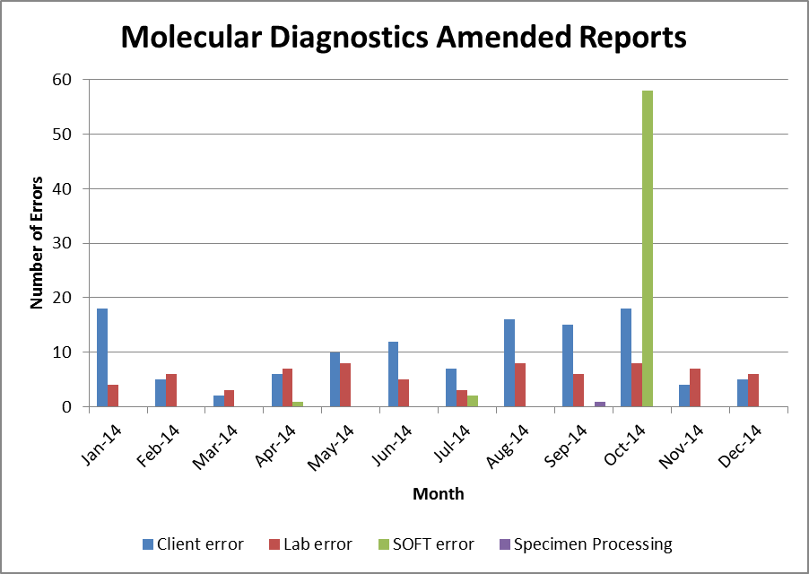
Clinical Pathology Patient Care Quality
Pathology- Molecular Diagnostics
.
Description of the Problem:
Increasing number of amended reports.
Impact: Potential for patient treatment errors based on incorrect reports and the time needed to correct the report and notify the clinician. Reports were missing data..
Reporter of the Problem:
Molecular Laboratory Staff
Description of the Solution:
Investigated origin or spike seen in corrected reports in October. Problem occurred after a software fix was installed.
How we know it worked: Backed out of software enhancement.
The total number of reported incidents decreased over 30% from 391 to 262.
2014 Errors
Client error = 46%
Molecular Lab error = 28%
SOFT Computer error = 25%
Specimen Processing error = 1%
Area for Improvement:
Reduce laboratory error and continue education of clients to reduce the remaining errors.

Slide 3
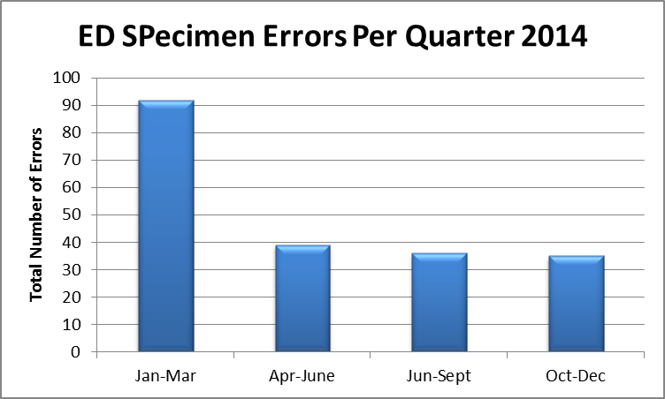
Clinical Pathology Patient Care Quality
Pathology- Blood Bank
Description of the Problem:
Unusable specimens being submitted by the Emergency Department.
Impact: Delay in providing blood components; waste as the specimen had to be redrawn. Description of Solution:
Providing information to the ED staff collecting specimens.
How we know it worked:
The number of ED specimen problems per quarter has dropped from over 90 per quarter to less than 40 due to enhanced training of ED staff.
Area for Improvement:
Low volume (QNS), hemolyzed and clotted specimens.

Slide 4
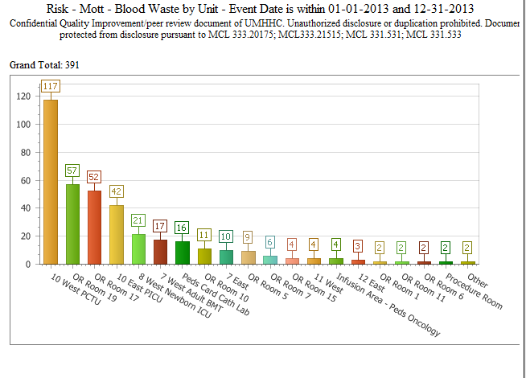
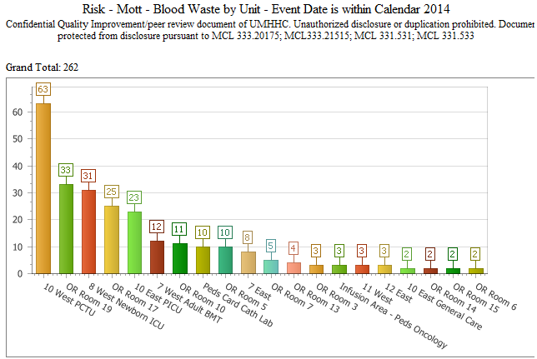
Clinical Pathology Patient Care Quality
Blood Bank
Description of the Problem: The waste of blood components rose significantly with the move to the New Mott Hospital in December of 2013.
Impact: Waste of a valuable resource and the financial loss of unusable products.
Reporter of the Problem:
Blood Bank Staff
Description of the Solution:
Interventions included training staff to read temperature
indicators, use of insulated
containers to transport blood
that goes to the floor with
patients and designation of a person responsible for placing blood into the refrigerator.
How we know it worked:
The total number of reported incidents decreased over 30% from 391 to 262 events.
Area for Improvement:
Efforts to reduce waste are continuing. The primary focus remains on 10 W PTCU and OR room 19.

Slide 5
Clinical Pathology Patient Care Quality
Chemistry
Description of Problem: Troponin is essential to the diagnosis and treatment of patients who may have had a heart attack. The time to get the specimen to the laboratory was adding so much time that the Turn-around-time (TAT) was unacceptable.
Impact of Problem:
Treatment was being delayed.
Reporter of Problem:
Emergency Department (ED) physicians
Description of Solution:
Implement point of care (POC) Troponin testing in the ED.
How we know it worked:
The TAT for Troponin testing was monitored since before and after the change. The average, median and 95th percentile TAT dropped after implementation. This drop has been sustained.
Date Solution Implemented:
July 2013
Area for Improvement:
Continue to reduce the variation in the TAT so that the median and the average TAT are equal.

Slide 6
Clinical Pathology Patient Care Quality
Pathology-Blood Drive
The ability to meet our donation goals is dependent on donor motivation as well as the logistics of the donation site. The January blood drives were reduced in the number of available hours because of newly installed carpet in the intended location. This resulted in the drive being moved and the hours shortened due to scheduling conflicts.
In response to donor need, we have moved the start time starting in August 2014 from 7am to 6am so more staff could donate before day shift begins or during midnight-day shift overlaps.
Blood drives are typically held monthly and can range from 1-2 days. There are numerous other drives held throughout the University of Michigan campus.
Typically there are ~ 10 presenting donors per drive who are deferred either due to their current health status or answers on the donor questionnaire. The number of no shows hovers around 25% per drive. This is due to people forgetting their appointment despite reminders from ARC, or being too busy to come to the appointment.
Donors can find upcoming drives by going to wwww.redcrossblood.org and searching under the Sponsor Code=goblue

Slide 7
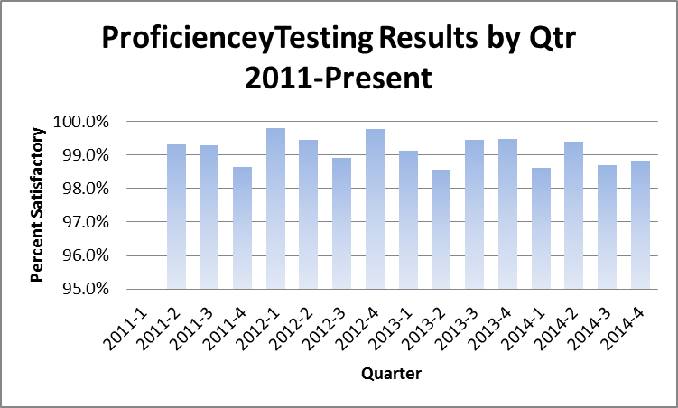
Clinical Pathology Patient Care Quality
Pathology
Proficiency Testing is required for laboratory accreditation. It is unrealistic to expect scores of 100% as some items are not scored due to lack of consensus or specimen quality issues.
Each failure is investigated to determine the cause.
If the percent satisfactory falls below 98.5 %, a root case analysis is performed.
We continue to show excellent performance.

Slide 8
Monthly CP QA Highlight
Chemistry
Description of the Problem:
Stat Turn around time (TAT) dipped in July.
Impact:
Timely results improve patient care. Threshold is that 95% of stat tests on the automation line are reported within 45 minutes and routine tests are reported within 120 minutes.
Investigation:
Dip was due to a series of events including: One of two sample managers was down for 4 days earlier in July.
SoftLab down on 7/27 (1-5), and on that same day, the automation line went down on the evening shift due to a thunderstorm.
Area for Improvement:
The separation between the STAT and Routine has widened with a decrease in the number of Stat samples not meeting the threshold. This started in June 2014 and has continued through December 2014. It is believed to be due to the implementation of Michart in the inpatient setting.

Slide 9
Clinical Pathology Quality and Performance
Laboratory Safety Audits
Off-Site Clinic Laboratories
Safety audits were performed by the Pathology Safety Liaisons between March and December 2014. Each Safety Liaison will work with the section supervisor & Compliance Manager to rectify the “needs attention” areas by December 31st, 2014.

Slide 10
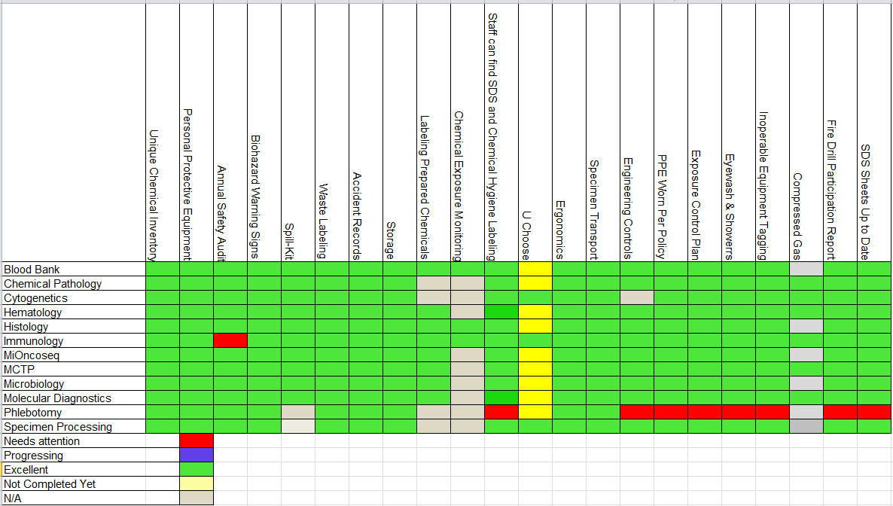
Laboratory Safety Audits
University Hospital, Traverwood II & IV Laboratories
Audits are performed to ensure safety is a priority and not a once a year training event.
Updated Phlebotomy report is pending.

Slide 11
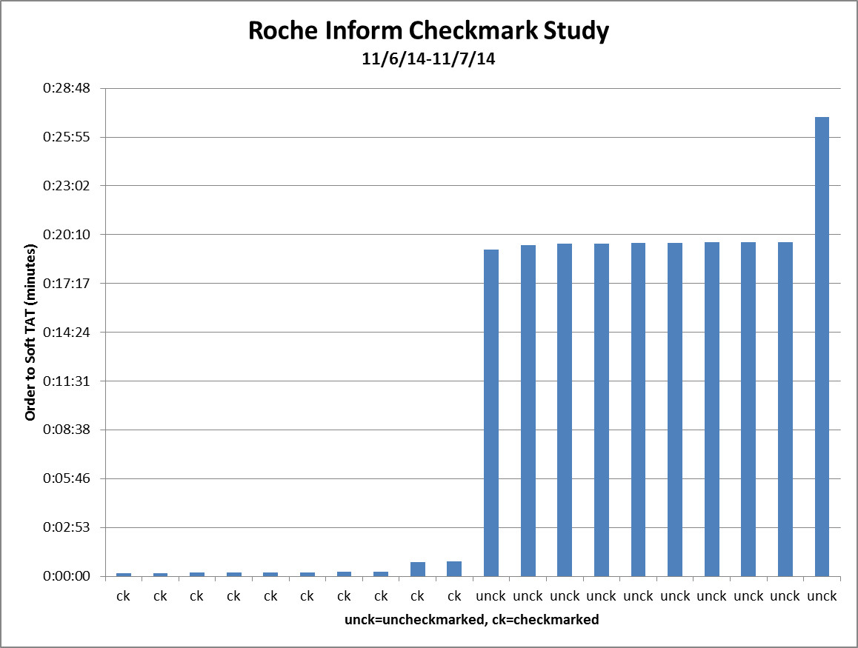
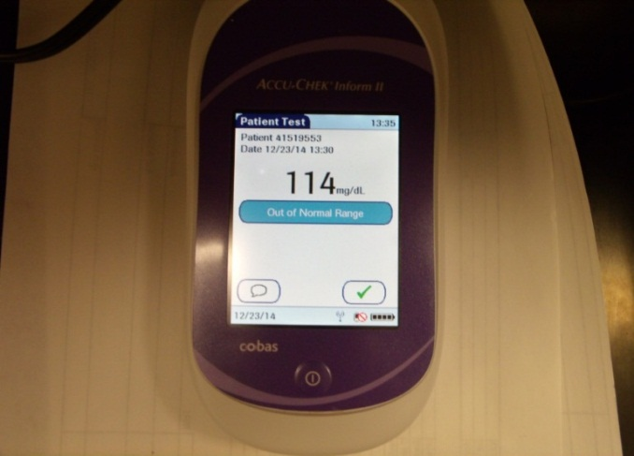
Clinical Pathology Patient Care Quality
Point of Care
Description of the Problem:
With the implementation of new glucose meters and software there was the expectation that glucose results would be instantaneously available on MiChart. In reality Point of Care (POC) glucose results are delayed in getting to the patient chart as long as 20 minutes in some cases.
Impact of Problem:
Delay in patient care and double entry of results. This leads to a false number of high glucose results potentially leading to a reduction in CMS reimbursement.
Reporter of Problem: POC Coordinator & Nursing Leadership, MCIT.
Description of Root Causes Identified:
Root cause analysis identified multiple causes including:
Failure of the end user to press the green check button
Failure of the end user to dock the device
End user of the device turning it off immediately after obtaining the reading.
Both docking and charging devices are used.
Follow-up
The nursing training and competency blitz is schedule for the end of January. Training tools will be developed to reinforce good practices.

Slide 12
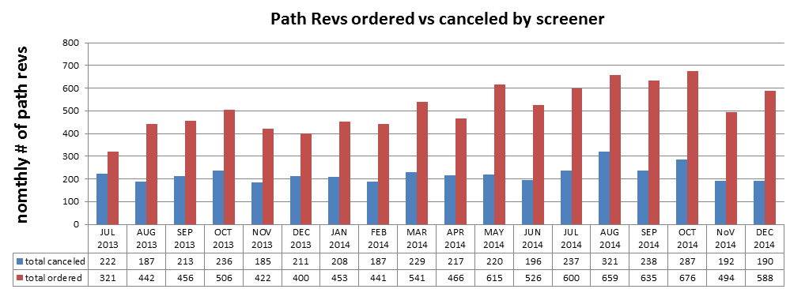
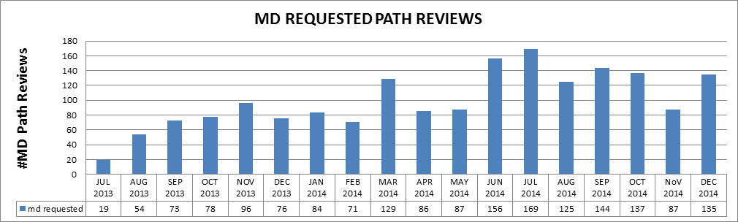
Clinical Pathology Patient Care Quality
Hematology
Description of Problem:
Increasing workload related to manual slide reviews.
Impact of Problem:
Delay in patient care because of the turn-around-time for test results that require a pathologist review. Increased cost for review function.
Reporter of Problem:
Hematology Pathologists/Staff
Description of Solution: A number of policy/procedure changes have been made over the years to best use the automated
screening capabilities of instruments including the use of specially trained, competency assessed technologists to prescreen path-rev slides. If screens are determined to be unnecessary, the path-rev is canceled.
How we know it worked?
Technologist decisions are assessed twice per year to ensure competency.
Areas for continued improvement: On 11/10/14 the Hematology lab implemented revised criteria to reflex the path-rev. They are monitoring the outcome of via a spot-check QC process.

Slide 13
Clinical Pathology-Current Projects
**This is a highlight of projects ongoing in the CP labs. This list is not meant to be all inclusive of every activity occurring in the department.
Project | Brief Description | Owner
Customer Service/Call Center | Address multiple issues related to providing an appropriate level of customer service for UMHS care providers. | Dr. Newton
ER Specimen Issues | In coordination with the Emergency Department reduce the number of RMPRO specimen errors (e.g. hemolysis, mislabels etc.) | S. Butch/K. Martin/T. Morrow
Pathology Handbook | Maintain and update the Pathology handbook to be a robust resource for our customers. | K. Davis/K. Martin/J. Sica
NCRC Planning | Begin work to plan for the future state of the non-STAT Clinical Labs move to NCRC | PRR Committee
Lab Ready Labels | Installation of lab label printers in the ED & Ambulatory Care clinics. | K. Davis/K. Martin

Slide 14
Clinical Laboratory News, Notes, and Kudos
------------------------------------------------------------------------------------
Promotions
Congratulations to -
Theresa Downs, MT(ASCP)SBB, Administrative Manager of the Blood Bank & Transfusion Service
John Ko, MLS(ASCP)^{CM}, Supervisor of the Transfusion Service Day and Midnight shifts
Turquessa Brown, CG(ASCP)^{CM}, Supervisor of the Cytogenetics and FISH Laboratory
Kudos
Beth Cox, Leslie Ernst, Teri Scott, Jennifer Vezina & Lynn Knudson-Horneber Developing a protocol along with Specimen Processing to alter how chorionic villus specimens are transported to the Cytogenetics laboratory to optimize technologist time and maintain a presence in the laboratory.

