Slide 1
Clinical Pathology
Quality Dashboard
June 2014

Slide 2
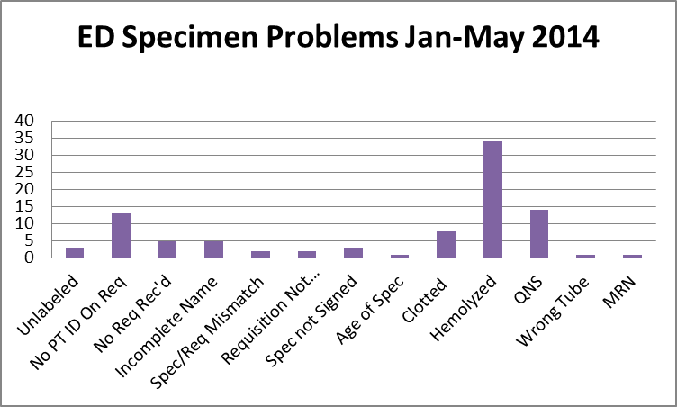
Clinical Pathology Patient Care Quality
Blood Bank
Pathology is pursuing a two pronged approach to “specimen quality” in the ED.
There is and has been ongoing discussions via Nursing Liaisons (Barb Wetula, RN, and Sheryl Woloskie) to addressing training for non-Pathology collected specimens. This could include global training along with direct training based on RMPRO feedback.
Pathology and the Emergency Department are investigating possible deployment of additional Pathology personal in the ED POCT lab or utilization of the Soft ID system which has been shown to assist with patient identification/signature errors at other institutions.

Slide 3
Clinical Pathology Patient Care Quality
Chemistry
Description of Problem: The guaiac method for detecting blood in the stool as a detection of colorectal cancer requires the patient to adhere to several diet restrictions as well as to collect three separate stool samples. Due to this complexity, we had low compliance (<20%). Newer methodologies such as IFOB are available that only require a single sample, no diet restrictions, and have a higher sensitivity.
Impact of Problem:
Historically, the amount of guaiac cards distributed had a low rate of return as indicated above. Use of the newer immunochemical method has increased the rate of return more than two-fold due to ease of collection by the patient.
Reporter of Problem:
Laboratories, physician offices
Description of Solution:
Implement the immunochemical method for detection of colorectal cancer. Physicians would order the test when the kit was handed to the patient. Pre-stamped envelopes provided to the patient will be returned to the laboratory where the test will be run.
How we know it worked:
Starting this month we used a different report to extract data. This altered the results slightly from prior months, however this is a more accurate representation of the compliance rate. The graph continues to show a positive outcome relative to patient compliance with returning the kit for testing.
Date Solution Implemented: October 29, 2013

Slide 4
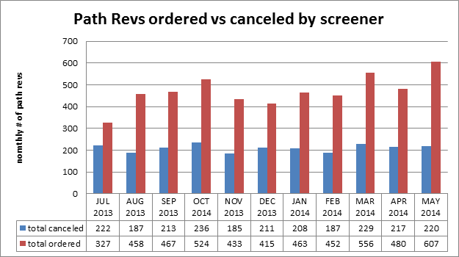
Clinical Pathology Patient Care Quality
Hematology
Description of Problem:
The Hematology lab created specific parameters related to the complete blood count that reflex to the pathologist for a review starting in 2005.
Impact of Problem:
If requests are not appropriate this can increase cost due to the additional Pathologist review. It can also increase the turnaround time for patients that should have a Pathologist review since there is no way to prioritize these if all of the slides are reviewed.
Reporter of Problem:
Hematology Pathologists/Staff
Description of Solution: Alter the current policy and allow technologists to prescreen MD request slides. If screens are determined to be inappropriate the MD Path Review would be canceled by the technologist.
How we know it worked?
Over 40% of all orders requests received each month are canceled before reaching the pathologist thus saving time and decreasing the cost to the institution and patient. Technologists are assessed monthly. Approximately, 10 cases per month are reviewed rotated between 5 screener technologists. This equates to each technologist being assessed twice per year.
Areas for continued improvement:
The procedure is reviewed annually to evaluate whether the parameters are appropriate.

Slide 5
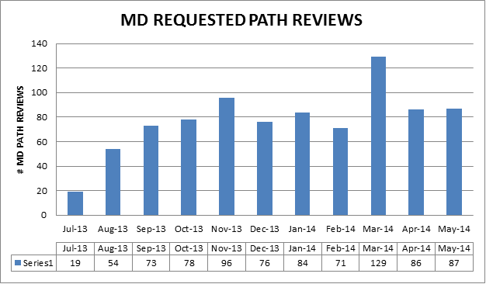
Clinical Pathology Patient Care Quality
Hematology
Description of Problem:
Historically, any MD requests are processed as ordered. There has been an upward trend in the number of Pathology Review requests from providers. Investigation into why this is occurring and whether the requests are appropriate and could be triaged in other ways is being investigated.
Impact of Problem:
If requests are not appropriate this results in the unneeded cost of Pathologist review. It can also delay the turnaround time for patients that should have a Pathologist review since there is no way to prioritize these if all of the slides are reviewed.
Reporter of Problem:
Hematology Pathologists/Staff
Description of Solution: Alter the current policy and allow technologists to prescreen MD request slides. If screens are determined to be inappropriate the MD Path Review would be canceled by the technologist.
How we know it worked?
TBD
Areas for continued improvement:
Is there a specific specialty or physician that is ordering pathologists reviews inappropriately?
Is there an educational opportunity?

Slide 6
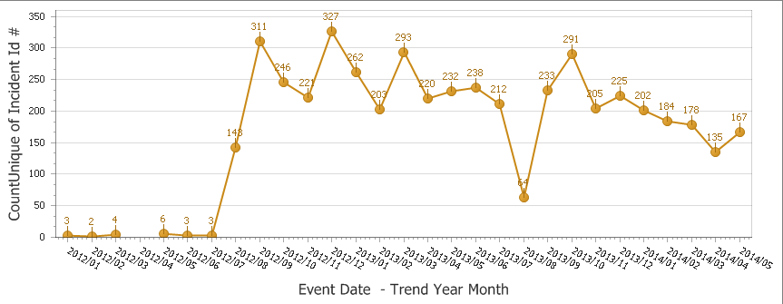
Clinical Pathology Patient Care Quality
Point of Care
*Note Aug 2013 data decreased due to POC coordinator absence and RMPRO reports not entered during this time frame.
Began documenting glucometer errors
*
Description of Problem:
Once Michart was implemented, a change occurred in how the patient was identified. In order to correlate billing information relative to the specific patient stay, the CSN number on the patient’s wristband is used rather than the MRN. The patient’s wristband was changed so that the glucometer CSN number is now a 1D barcode versus the MRN which is a 2D barcode. Since making this change, numerous errors have occurred where the MRN was manually entered by mistake into the RAALS laboratory middleware.
Impact of Problem:
Errors cause a delay in results being reported to the patient record. Additionally, the corrective action is for the POC Coordinator to match the misidentified patient results and then manually report them to the correct CSN. This opens the opportunity for human transcription errors along with inefficient use of the coordinator’s time to work on other tasks.
Reporter of Problem: POC Coordinator & Nursing Leadership
Description of Root Causes Identified:
Nursing is not able to access the barcode and has to manually enter CSN. This can be entered incorrectly or the MRN is used which is traditionally used for other methods of identifying patients. This is especially true of pediatric wristbands which are smaller. Nurse educators have refocused training on this aspect. Investigation into modifying the patient wristband to allow more barcodes to be visible is ongoing by MiChart.
CSN mismatch-Examples of patients presenting at the ER or IPLV and then admitted on a different day (thus different CSN) still have their “old” wristband on which is no longer valid. Wristband printing-future visit day used to print wristband. Practice change by nursing to replace patient wrist band every time patient comes or returns to the floor (e.g. go to OR or procedure area and come back).
How we know it worked:
We continue to see a decrease in the number of incidents that are largely composed of glucometer errors. In the coming months it’s anticipated this will continue to decrease because our new glucometers have screens that display the patient’s name when entered correctly.

Slide 7
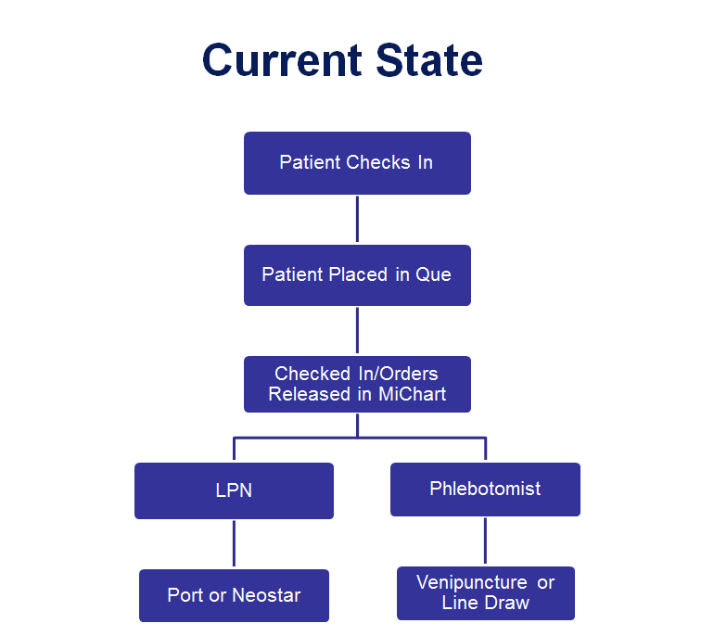
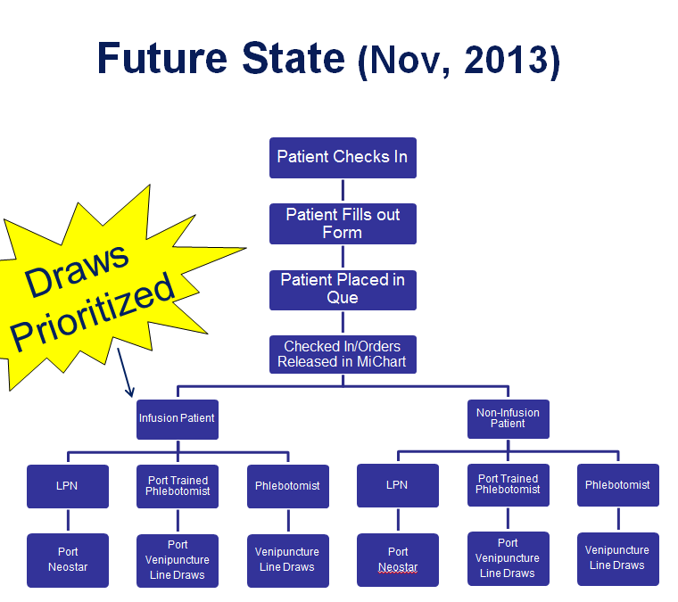
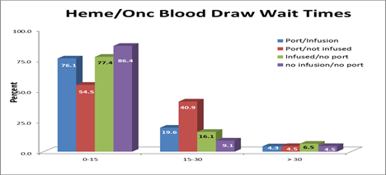
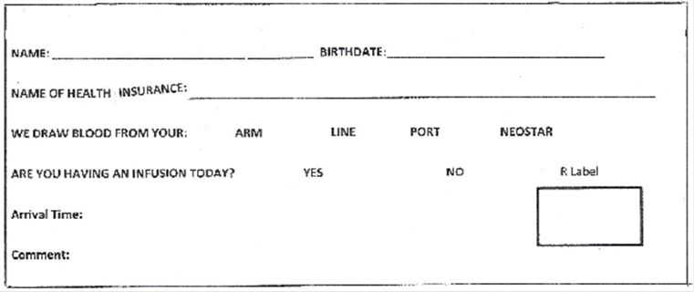
CP QA Meeting Highlight
C & W Phlebotomy
Description of Problem: Laboratory results can be delayed for infusion clinic patients. These patients arrive approximately an hour before their appointment to have blood work completed. The draw sites operate on a first come first serve basis. Patients who have labs drawn for future follow-up or non-urgent care are also being seen at the same locations. There is not a way for phlebotomy to discriminate between the patients waiting for lab results for treatment that day vs. the non-urgent patients.
Impact of Problem: Patients who are scheduled to have an infusion or treatment based upon the laboratory values during the same day clinic visit can be delayed. This can delay treatment for that specific patient as well as impact the treatment of other patients in queue to be seen after the delayed patient. There is often added complexity with this patient type relative to additional training required to obtain blood from the patient that can also add to the overall TAT (e.g. port/neostar/line draws).
Description of Solution:
Use a small form for the patient at check-in to help triage the patient into the appropriate queue. Use the form to prioritize patients who will be receiving an infusion treatment on the same day as their blood draw appointment. Develop communication signs to publicize to patients that this will be occurring thereby setting expectations that patients who arrive after them maybe drawn first.
How we know it worked:
Patient comments from the Infusion Clinics have been positive and TAT data collected by the clinic can be seen to the left. Wait times will continue to be monitored by phlebotomy and data is being aggregated.
Date Solution Implemented:
November 2013

Slide 8
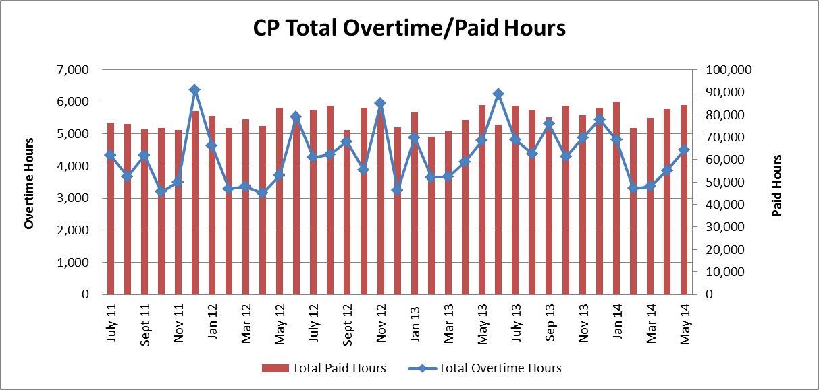
Clinical Pathology Financials

Slide 9
Clinical Pathology-Current Projects
**This is a highlight of projects ongoing in the CP labs. This list is not meant to be all inclusive of every activity occurring in the department.
Project | Brief Description | Owner
Customer Service/Call Center | Address multiple issues related to providing an appropriate level of customer service for UMHS care providers. | Dr. Newton
ER Specimen Issues | In coordination with the Emergency Department reduce the number of RMPRO specimen errors (e.g. hemolysis, mislabels etc.) and look at opportunities to use Soft ID to address some of these issues along with order management. | J./Alfsen/S. Stern/S. Butch/K. Martin/T. Morrow
Pathology Handbook | Maintain and update the Pathology handbook to be a robust resource for our customers. | K. Davis
Pathology Relocation & Renovation | Phased plans for the relocation of the Pathology department to the NCRC complex followed by renovation in the current 2UH location along with former Mott space. | Multi-disciplinary team with Christine Baker acting as the project manager

Slide 10
Clinical Laboratory News, Notes, and Kudos
------------------------------------------------------------------------------------
Labs that are working on process improvement projects that would like to display data can contact Kristina Martin (martkris@umich.edu) for future dashboards.
Kudos
Congratulations to Dee LeBlanc who will be migrating to the Northville Health Center, assuming the position of Allied Health Associate Supervisor.
Congratulations to the Blood Bank laboratory for successfully passing the June FDA inspection with zero citations.
Teresa Thomas-Thinking ahead and providing excellent service to a patient who was going to be out of state for several months, but needed to ensure their anti-coagulation testing continued.

