Slide 1
Clinical Pathology
Quality Dashboard
June 2015

Slide 2
Clinical Pathology Patient Care Quality
Pathology-Blood Drive
Monitor: Blood Drive Units Collected
Goal: Plan to date was to collect 470 units. Current donations total 417 or ~12% below the goal.
Impact: Less blood available for the region and UMHS
Status: We remain behind our goals. Logistics continue to hamper some drives:
    Starting the drive on time-could not get security to open gate for ARC ~5AM to unload supplies.
    Chairs and tables not put away by ARC staff.

Slide 3
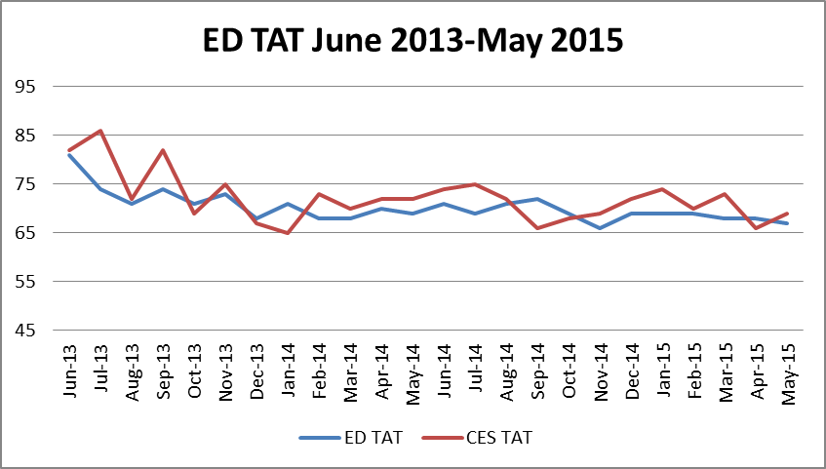
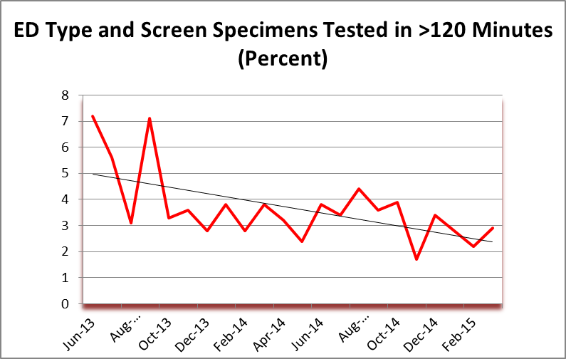
Clinical Pathology Patient Care Quality
Blood Bank
Minutes
Percent
Purpose: Turn Around Time (TAT) from specimen receipt to result reporting is monitored to determine if institutional goals have been met. ED= Emergency Department Adult; CES = Children’s (Mott) Emergency Department
Goal:
Impact: Delay in results may cause treatment delays.
Status: The current system does not have the capacity to reduced the TAT for routinely processed specimens beyond current range of 66-72 minutes.
The focus of the second monitor is to reduce the amount of variation in the processing time for ED specimens by reducing the percent of specimens that exceed 120 minutes processing time. We have made steady progress since June of 2013.

Slide 4
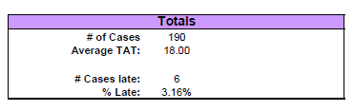
Clinical Pathology Patient Care Quality
MMGL
Purpose: Turn Around Time (TAT) from specimen receipt to result reporting is monitored to determine if institutional goals have been met. Analytic time varies with the analyte and ranges from 10-28 days. Test results reported in over 28 days are considered late.
Goal: <10% late reports
Impact: Delay in results may cause treatment delays.
Status:. Although there is some variation, goal of less than 10% late reports has been met.

Slide 5
Clinical Pathology Patient Care Quality
Microbiology
Monitor:
TAT for AFB Smears
Goal:
24 hours or less for AFB smears. The green arrow in the AFB Smear TAT indicates that the better performance is fewer hours.
Impact:
The ability to identify potentially infectious tuberculosis patients via AFB smear identification is critical to treatment and isolation of the patient.
Status: The best performance on this monitor occurred in April. However, in May, there was some regression.

Slide 6
Monthly CP QA Highlight
Chemistry
Monitor:
Emergency Department (ED) Prothrombin Time (PT) Sample Turn-Around-Time (TAT) from collection to verification
Goal:
95% of results available in <= 30 minutes.
Impact:
Stroke Certification Guideline for appropriate care.
Status: Outliers in April to 80 minutes to reach the laboratory and the outliers in May too 30 minutes.

Slide 7
Clinical Pathology Patient Care Quality
Chemistry
Monitor:
Emergency Department (ED) Troponin Sample Turn-Around-Time (TAT) from in-laboratory to completion
Goal: 95% of results available in <= 30 minutes.
Impact: Delay in treatment for heart attack if results are delayed
Status: 95% are resulted within 25 minutes. The average TAT of 15 minutes remains stable.

Slide 8
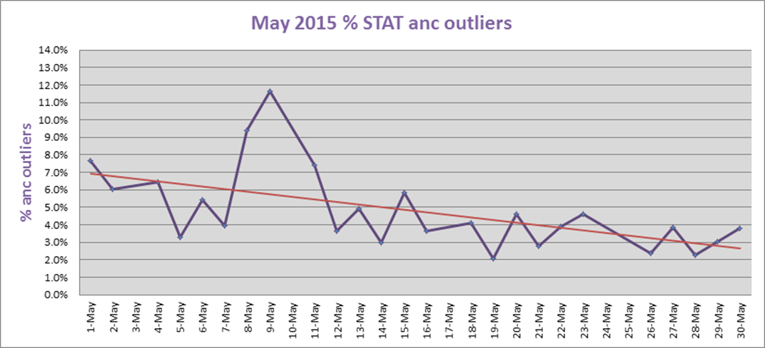
Clinical Pathology Patient Care Quality
Hematology
Monitor: The percentage of Absolute Neutrophil Counts (ANC) exceeding established 60 minute Turn-Around-Time (TAT) of 60 from receipt to verification.
Goal: <5% STAT anc outliers.
Impact: Outpatient infusions are delayed until testing results of are received.
Status: Outliers are trending downward. The reduction in the % of outliers and % of time overdue in the past 6 months is due to:
  Better training on releasing the ANC properly when leaving a path rev
  More awareness of staff when they see the tiered huddle graphs
  Blast flag IANC
  Fewer buffer tubes when bad ER labels got replaced
  More awareness of buffer tubes
  Fewer service calls leading to fewer interruptions in workflow
  Better marrow scheduling, receiving a lot of help from marrows techs to help with differentials
  Using the float position to help with diffs when they aren’t busy
  Additional action being investigated:
  Looking at ways to reduce time in identifying samples that require Albumin Preps- the biggest reasons for outliers over 90 minutes.
  Tweaking ANC release using data from our Sysmex technology

Slide 9
Clinical Pathology Patient Care Quality
Chemistry
Monitor: Turn-Around-Time (TAT) for routine chemistry tests from the time to receipt (in-laboratory) to completion for the past 18 months.
Goal: Percent of specimens resulted in greater than 120 minutes for routine tests less than 0.2%; Stat tests results exceeding 45 minutes TAT for less than 1% of specimens.
Impact: Delay in patient treatment or discharge
Status: Trend observed for Stat test results to be above the goal of <45 minutes since the implementation of MiChart.

Slide 10


Clinical Pathology-Current Projects
**This is a highlight of projects ongoing in the CP labs. This list is not meant to be all inclusive of every activity occurring in the department.
Project | Brief Description | Owner
Cancelled Tests- No specimen Received | Determine the root cause(s) of tests being ordered but the associated specimen not arriving in the Clinical Laboratory | Kristina Martin, Suzanne Butch
Phlebotomy | Inpatient Order Management to reduce unnecessary draws & TAT and increase patient satisfaction | H. Neusius, B. Tolle, S. Butch
Test Utilization | Pilot – use of Troponin Testing | L. Schroeder, D. Giacherio, S. Owens, H. Gurm - Internal Medicine, S. Kronick -Emergency Department
Lost Specimen Swat Team | Standardize process for investigation of “lost specimens”. | Brian Tolle, Kristina Martin, Chris Rigney, John Perrin, Suzanne Butch
ER Specimen Issues | In coordination with the Emergency Department reduce the number of RMPRO specimen errors (e.g. hemolysis, mislabels etc.) | S. Butch/K. Martin/T. Morrow
Pathology Handbook | Maintain and update the Pathology handbook to be a robust resource for our customers. | K. Martin/C. Sobeck
NCRC Planning | Begin work to plan for the future state of the non-STAT Clinical Labs move to NCRC | PRR Committee
Lab Ready Labels | Installation of lab label printers in the ED & Ambulatory Care clinics. | K. Davis/K. Martin
New Project Launch
Project Completed

Slide 11
Clinical Laboratory News, Notes, and Kudos
------------------------------------------------------------------------------------
Kudos
Mary Dies – while doing a laboratory safety self inspection noticed that none of the elevators near the labs have the signage “ In Case Of Fire Do Not Use Elevator. Take the Stairs.”
Grace Monteclaro, Sue Clark and the Staff at the Briarwood Center for Women and Children who got compliments from the CMS Inspector for performing 6 point competency assessment and proficiency testing programs.

