Slide 1
Clinical Pathology
Quality Dashboard
March 2014

Slide 2
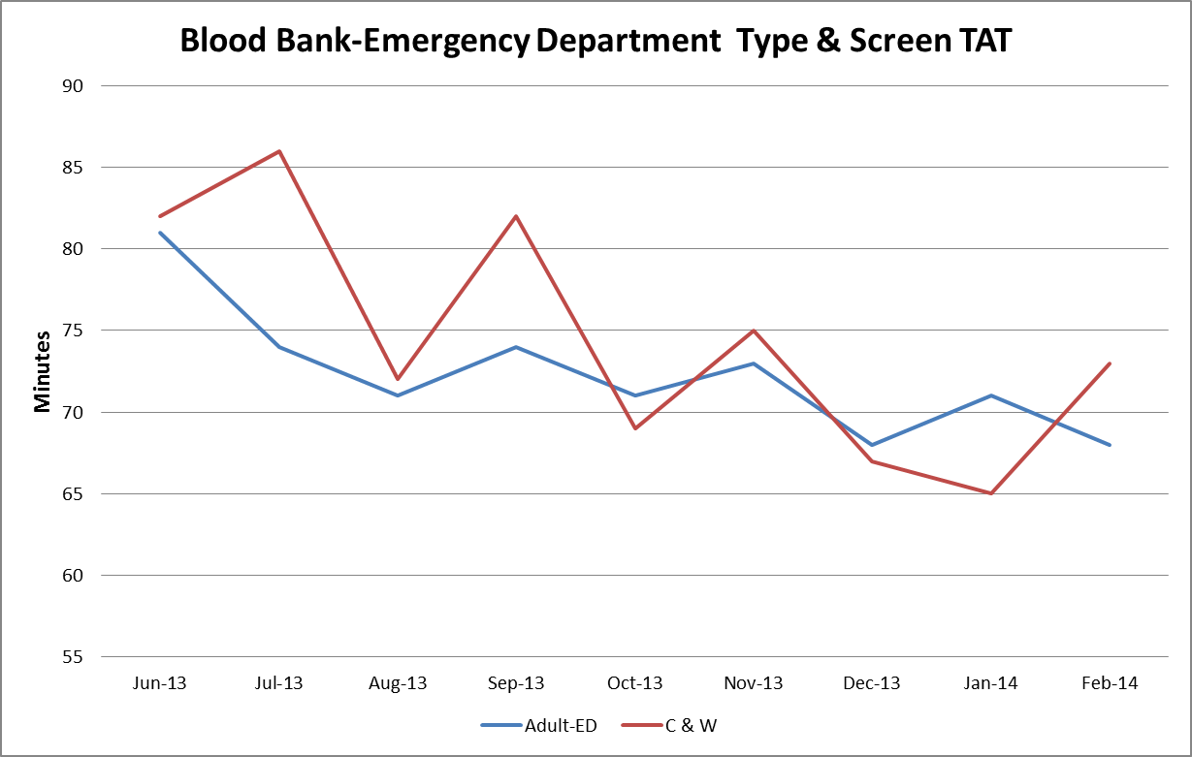
Clinical Pathology Patient Care Quality
Blood Bank
The Blood Bank experienced an increase in TAT for Emergency Department type and screen testing during the Soft go-live implementation. As staff have gained more confidence using the new software, there has been a steady decrease in the TAT approaching pre-Soft conditions. Blood Bank is working with the Infusion areas on a new process to prioritize the infusion patients using a new test code (PTS3D). This test code will distinguish itself from the current PTS test and we will be prioritizing these samples. Collection of the infusion patient TAT is ongoing and will be featured in future CP Dashboards.

Slide 3
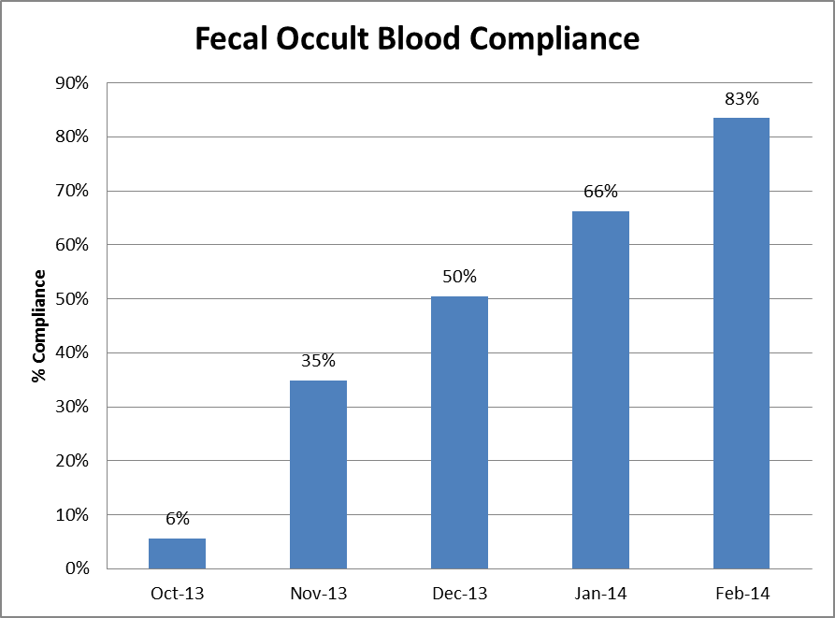
Clinical Pathology Patient Care Quality
Chemistry
Description of Problem: The guaiac method for detecting blood in the stool as a detection of colorectal cancer requires the patient to adhere to several diet restrictions as well as to collect three separate collections. Newer methodologies are available that only require a single sample, no diet restrictions, and have a higher sensitivity.
Impact of Problem:
Historically, the amount of guaiac cards distributed had a low rate of return. Use of the newer immunochemical method has increased the rate of return due to ease of collection by the patient alone.
Reporter of Problem:
Laboratories, physician offices
Description of Solution:
Implement the immunochemical method (FIT) for detection of colorectal cancer. Physicians would order the test when the kit was handed to the patient. Pre-stamped envelopes provided to the patient will be returned to the laboratory where the test will be run.
How we know it worked:
Data is collected for the number of tests performed versus the number of tests pending so we can calculate the rate of compliance. In the first 5 months of implementation we have seen a positive increase in compliance.
Date Solution Implemented: October 29, 2013

Slide 4
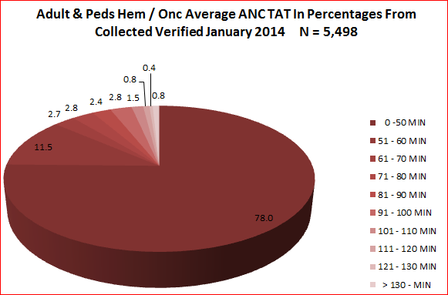
Clinical Pathology Patient Care Quality
Hematology & Phlebotomy
Description of Problem: Patients seen by the Hematology-Oncology service have lab testing followed by a clinic appointment where decisions as to whether the patient will receive an infusion treatment that day are made. A vast majority of specimens have results within the desired turn-around-time (TAT), however there continues to be outliers that impact delivery of care to the patients. These samples, due to the nature of the disease, often require more time to evaluate due to abnormal results and challenging blood smear differentials.
Impact of Problem: Patient treatment may be delayed because physicians wait for laboratory results to be available.
Reporter of Problem: Heme-Onc physicians and nurses
Description of Solution:
Although the in lab TAT is something that can be controlled more readily, the major portion of the delay in testing relates to the initial visit of the patient to the phlebotomy site: time waiting in line before draw, time for the draw, transport to the laboratory.
Due to the workflow associated with the informatics system it is difficult to obtain an accurate collection time and many times this is actually the order or release time.
A pilot at the C & W blood draw station started on November 11, 2013 to query patients whether they had an infusion appointment so they could be triaged ahead of other patients having blood work drawn that did not impact treatment for that day. Preliminary surveys of the patient experience have been positive with the Heme-Onc clinic noting a reduction in the number of complaints. Survey data will be available in the coming months to illustrate this fact.
Areas for continued improvement:
Real time monitor profiles have been built for the C & W clinics to monitor the TAT in with color coordination when specimens become “overdue”. This is expected to eliminate waste associated with calling the laboratory when the specimen has been in the lab for a short period of time.

Slide 5
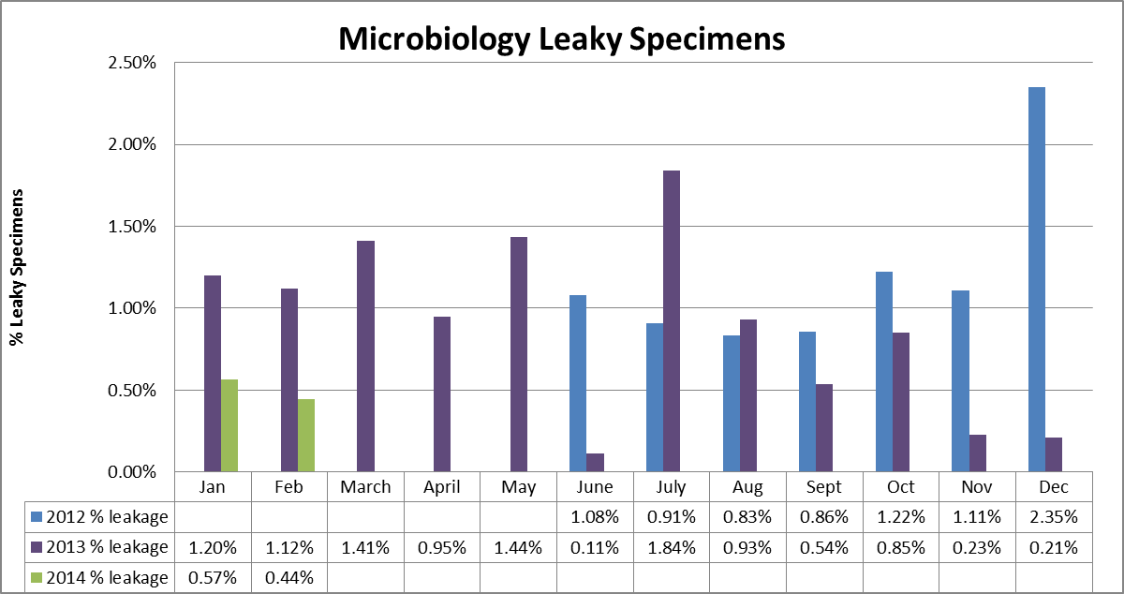
Clinical Pathology Patient Care Quality
Microbiology
Leaky specimens can be hazardous and can result in rejection of the specimen or delays in testing. The average total monthly volume illustrated on the graph is ~ 4800. Despite changes to the urinary cup used, leaky specimens continue to arrive in the Pathology laboratory. Most such specimens are sent to Microbiology. Cultures are canceled when the specimen cannot be salvaged or when multiple patient containers have leaked in the same specimen bag. In addition, if specimens are not processed within a relatively short period of time, contaminated bacterial growth occurs causing an increase in the number of false positives. This is particularly true for urine cultures that require the patient to perform a clean catch. These cultures are more prone to contaminants not related to a true infection. Due to these issues, an investigation has been ongoing into using the a vacutainer urine collection system that eliminates the need to tighten a screw cap for urine specimens which compose the majority of leaky specimens. Currently, Pathology Satellite labs, as well as the Emergency Department Lab use these containers for specimen transport and leakage does not occur. Coordination with Infection Control to migrate to this container type is ongoing. A pilot on the 6D CCMU is ongoing as well as reaching out to various OB/GYN outpatient clinics. There are concerns that recent reductions are resultant from missing data collection and not necessarily improvements with the reduction of leaky specimens. This is being addressed and future months will indicate whether this assumption is correct.

Slide 6
Clinical Pathology Patient Care Quality
Point of Care
*Note Aug 2013 data decreased due to POC coordinator absence and RMPRO reports not entered during this time frame.
*
Data until 3/25/14
Description of Problem:
Once Michart was implemented, a change occurred in how the patient was identified. In order to correlate billing information relative to the specific patient stay, the CSN number on the patient’s wristband is used rather than the MRN. The patient’s wristband was changed so that the glucometer CSN number is now a 1D barcode versus the MRN which is a 2D barcode. Since making this change, numerous errors have occurred where the MRN was manually entered by mistake into the RAALS laboratory middleware. The RAALS middleware requires the current CSN to function properly. Further investigation into the cause of these numerous errors has been ongoing.
Impact of Problem: The errors cause a delay in results being reported to the patient record. Additionally, the corrective action is for the POC Coordinator to match the misidentified patient results and then manually report them to the correct CSN. This opens the opportunity for human transcription errors along with inefficient use of the coordinator’s time to work on other tasks.
Reporter of Problem: POC Coordinator & Nursing Leadership
Description of Root Causes Identified:
Nursing is not able to access the barcode and has to manually enter CSN. This can be entered incorrectly or the MRN is used which is traditionally used for other methods of identifying patients. This is especially true of pediatric wristbands which are smaller. Nurse educators have refocused training on this aspect. Investigation into modifying the patient wristband to allow more barcodes to be visible is ongoing by Michart.
CSN mismatch-Examples of patients presenting at the ER or IPLV and then admitted on a different day (thus different CSN) still have their “old” wristband on which is no longer valid. Wristband printing-future visit day used to print wristband. Practice change by nursing to replace patient wrist band every time patient comes or returns to the floor (e.g. go to OR or procedure area and come back).
Future: New glucometers with wireless technology may help identify when CSN mismatches occur in real time on the glucometer monitor screen. Anticipated go live is 2014.

Slide 7
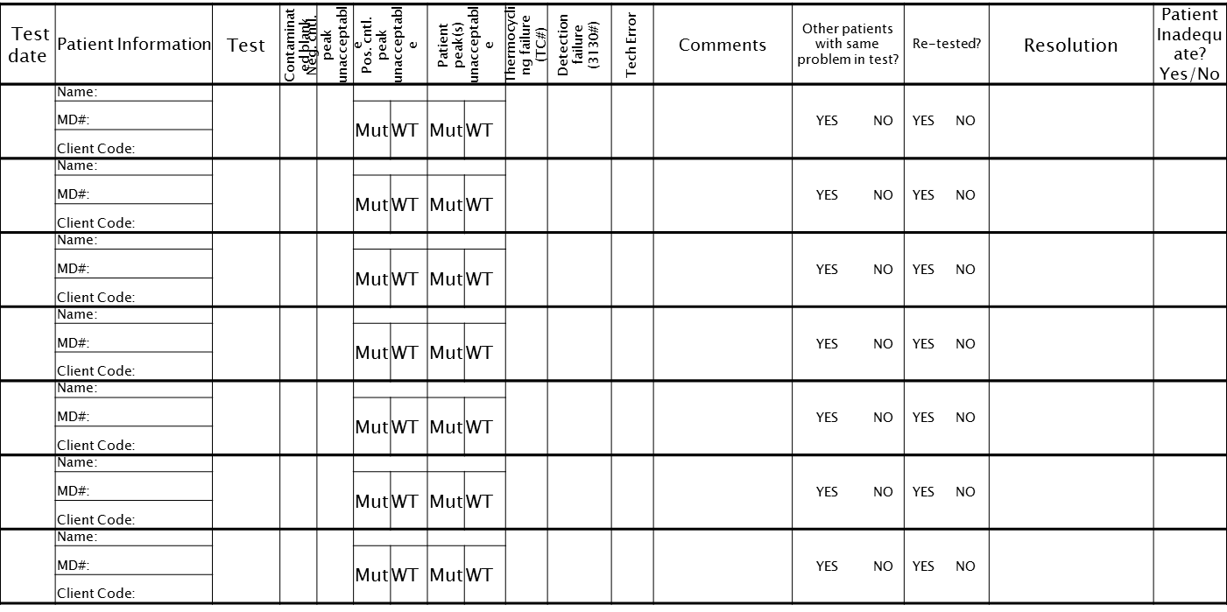
CP QA Meeting Highlight
Molecular Diagnostics
Old Problem Form
New Problem Form
Description of Problem: Technologists not completing the Problem logs.
Impact of Problem:
Original form felt punitive to the technologists
Problems were hidden
Unable to track/trend problems with assays, controls not working, assay failures or drift in the assay.
Unable to identify training gaps
Trending of assays left for supervisor to monitor at case review.
Description of Solution:
Create a new log to identify problems without being punitive.
Create log that was easier to complete (checkboxes)
One problem log for each rotation.
Data compiled monthly
Use huddles to help with entering problems
How we know it worked:
Data is now entered frequently and able to be analyzed more readily.
Staff offer feedback now for follow-up
Date Solution Implemented:
January 2014

Slide 8
Clinical Pathology-Current Projects
**This is a highlight of projects ongoing in the CP labs. This list is not meant to be all inclusive of every activity occurring in the department.
Project | Brief Description | Owner
Customer Service/Call Center | Address multiple issues related to providing an appropriate level of customer service for UMHS care providers. | Dr. Newton
Leaky Specimens | Reduce the number of leaky specimens by exploring different transport containers and/or educational opportunities | Dr. Newton
CP Brochure | Compile information and photos from the Clinical Laboratories to create a generic CP overview for visitors/prospective clients. | K. Martin
Heme-Onc TAT for ANC results | In coordination with the heme-onc clinics explore opportunities to optimize TAT for patients receiving infusions. | J. Davis/U.Kota/K. Martin/H. Neusius
ER Specimen Issues | In coordination with the Emergency Department reduce the number of RMPRO specimen errors (e.g. hemolysis, mislabels etc.) | S. Butch/K. Martin/T. Morrow
Pathology Handbook | Maintain and update the Pathology handbook to be a robust resource for our customers. | K. Davis

Slide 9
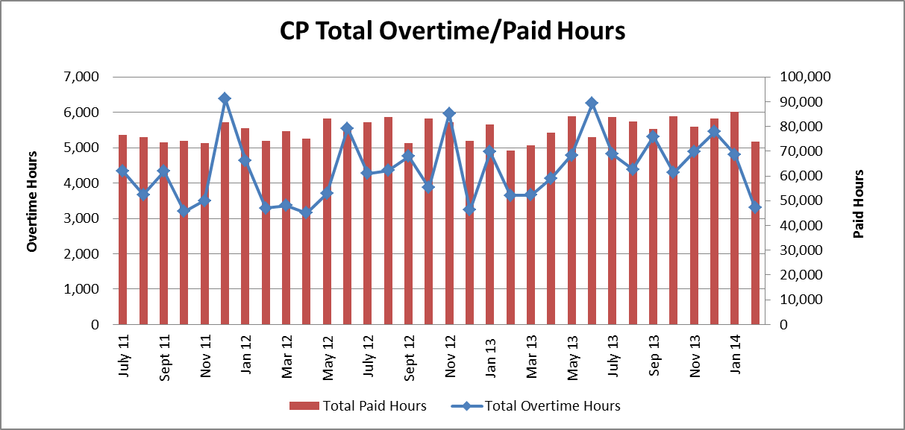
Clinical Pathology Financials

Slide 10
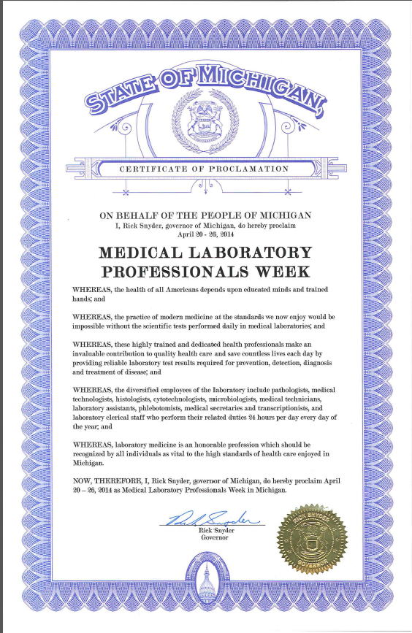

Slide 11
Clinical Laboratory News, Notes, and Kudos
------------------------------------------------------------------------------------
Labs that are working on process improvement projects that would like to display data can contact Kristina Martin (martkris@umich.edu) for future dashboards.
Kudos
Renee Stoklosa- selected to be the new Clinic Coordinator in the Cancer Center
Hematology Lab via Jerry Davis-The problem with the VM/Applications/network today took WAM and the Flow Cytometry lab down for approximately 2 hrs. (1145 to 1345). This was peak time for WAM dependent Hem/Onc clinic specimens. We switched two of our Sysmex XE devices from WAM (TCP/IP) to auxiliary serial transmission mode during this time. This is not the first time we’ve needed to do this since being on the Sysmex platform. We have done this successfully a half dozen times during the last two years for different reasons, but on those occasions only a few to a few dozen specimens were ran because the down was planned or lasted only minutes. Today during this down we ran hundreds of specimens on two devices switched to serial mode. Today was different. We made that difference.

