Slide 1
Clinical Pathology
Quality Dashboard
May 2014

Slide 2
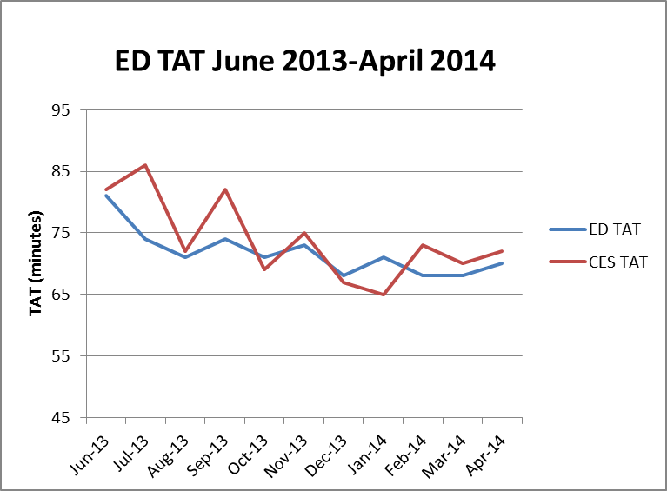
Clinical Pathology Patient Care Quality
Blood Bank
The Blood Bank experienced an increase in TAT for Emergency Departments (ED=Adult, CES=Children’s) type and screen testing during the Soft go-live implementation. As staff have gained more confidence using the new software, there has been a steady decrease in the TAT approaching pre-Soft conditions. Blood Bank is working with the Infusion areas on a new process to prioritize the infusion patients using a new test code (PTS3D). This test code will distinguish itself from the current PTS test and we will be prioritizing these samples. Collection of the infusion patient TAT is ongoing and will be featured in future CP Dashboards.

Slide 3
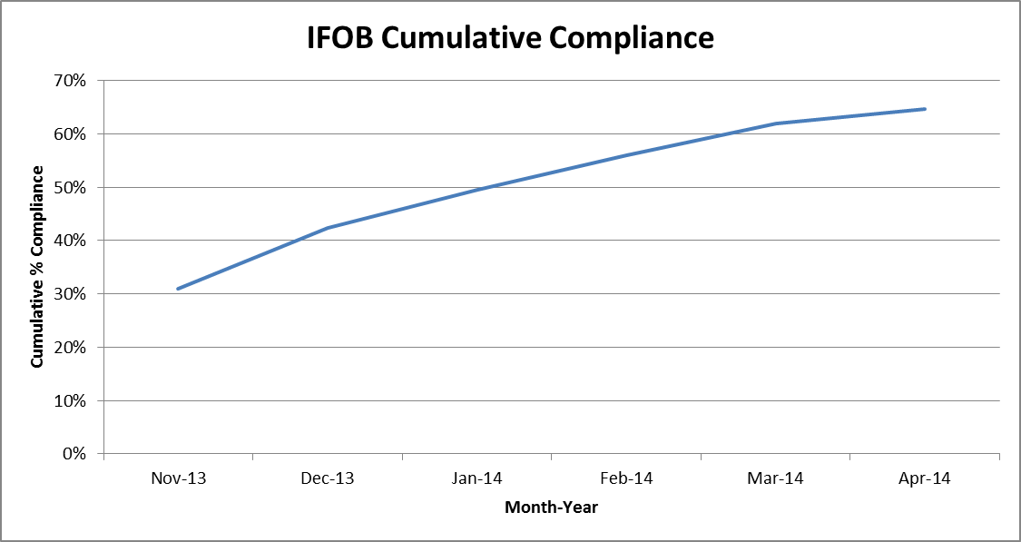
Clinical Pathology Patient Care Quality
Chemistry
Description of Problem: The guaiac method for detecting blood in the stool as a detection of colorectal cancer requires the patient to adhere to several diet restrictions as well as to collect three separate collections. Newer methodologies are available that only require a single sample, no diet restrictions, and have a higher sensitivity.
Impact of Problem:
Historically, the amount of guaiac cards distributed had a low rate of return. Use of the newer immunochemical method has increased the rate of return due to ease of collection by the patient.
Reporter of Problem:
Laboratories, physician offices
Description of Solution:
Implement the immunochemical method (FIT aka IFOB) for detection of colorectal cancer. Physicians would order the test when the kit was handed to the patient. Pre-stamped envelopes provided to the patient will be returned to the laboratory where the test will be run.
How we know it worked:
Starting this month we used a different SQL report to extract data. This altered the results slightly from prior months, however this is a more accurate representation of the compliance rate. The graph continues to show a positive outcome relative to patient compliance with returning the kit for testing.
Date Solution Implemented: October 29, 2013

Slide 4
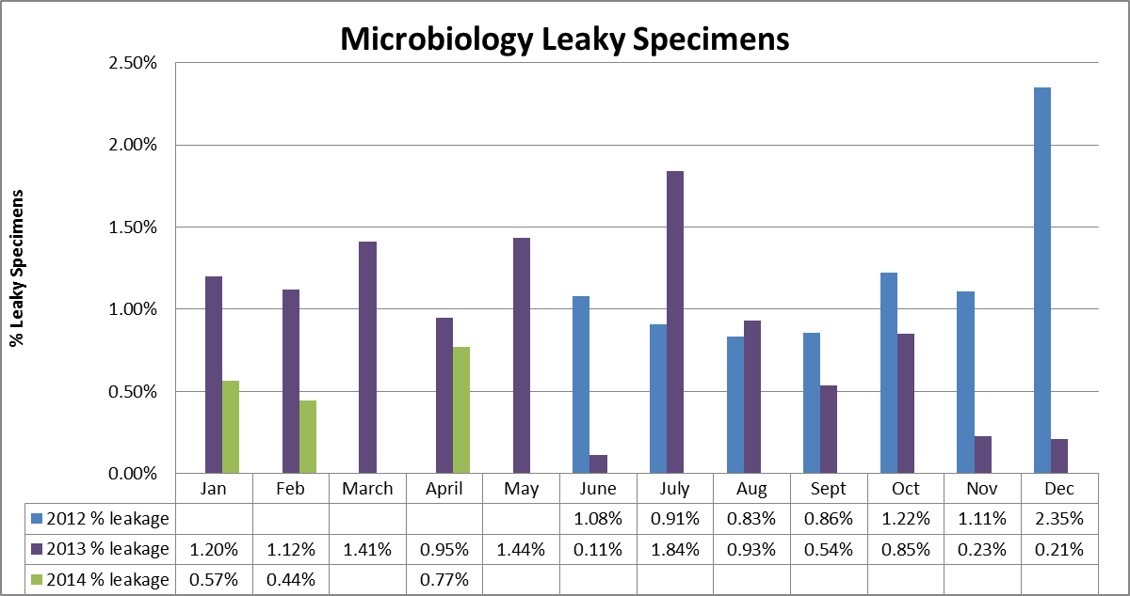
Clinical Pathology Patient Care Quality
Microbiology
Leaky specimens can be hazardous and can result in rejection of the specimen or delays in testing. The average total monthly volume illustrated on the graph is ~ 4800. Despite changes to the urinary cup used, leaky specimens continue to arrive in the Pathology laboratory. Most such specimens are sent to Microbiology. Cultures are canceled when the specimen cannot be salvaged or when multiple patient containers have leaked in the same specimen bag. In addition, if specimens are not processed within a relatively short period of time, contaminated bacterial growth occurs causing an increase in the number of false positives. This is particularly true for urine cultures that require the patient to perform a clean catch. These cultures are more prone to contaminants not related to a true infection. Due to these issues, an investigation has been ongoing into using the a vacutainer urine collection system that eliminates the need to tighten a screw cap for urine specimens which compose the majority of leaky specimens. Data is not available for March due to issues with the front end collection of this metric. Currently, Pathology Satellite labs, as well as the Emergency Department Lab use these containers for specimen transport and leakage does not occur. Coordination with Infection Control to migrate to this container type is ongoing. The 6D CCMU piloted the use of the vacutainer system at the beginning of 2014. This protocol for urine collections is anticipated to spread to other inpatient units in the near future, however more units would need to be actively using the system to influence the amount of leaky specimens received.

Slide 5
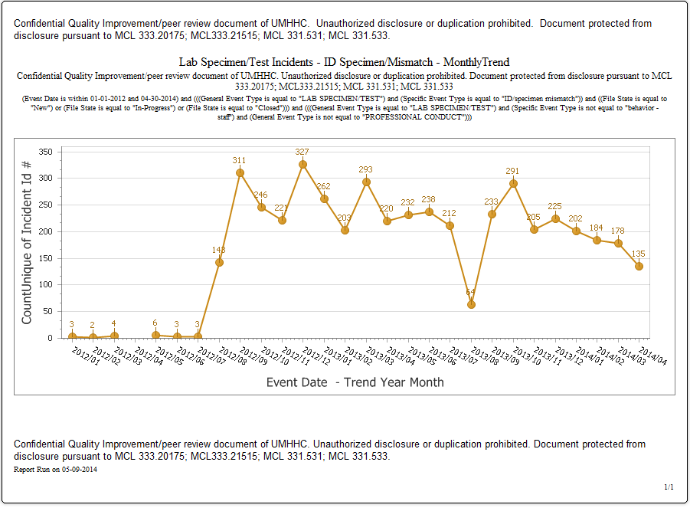
Clinical Pathology Patient Care Quality
Point of Care
*Note Aug 2013 data decreased due to POC coordinator absence and RMPRO reports not entered during this time frame.
Began documenting glucometer errors
*
Description of Problem:
Once Michart was implemented, a change occurred in how the patient was identified. In order to correlate billing information relative to the specific patient stay, the CSN number on the patient’s wristband is used rather than the MRN. The patient’s wristband was changed so that the glucometer CSN number is now a 1D barcode versus the MRN which is a 2D barcode. Since making this change, numerous errors have occurred where the MRN was manually entered by mistake into the RAALS laboratory middleware. The RAALS middleware requires the current CSN to function properly.
Impact of Problem: The errors cause a delay in results being reported to the patient record. Additionally, the corrective action is for the POC Coordinator to match the misidentified patient results and then manually report them to the correct CSN. This opens the opportunity for human transcription errors along with inefficient use of the coordinator’s time to work on other tasks.
Reporter of Problem: POC Coordinator & Nursing Leadership
Description of Root Causes Identified:
Nursing is not able to access the barcode and has to manually enter CSN. This can be entered incorrectly or the MRN is used which is traditionally used for other methods of identifying patients. This is especially true of pediatric wristbands which are smaller. Nurse educators have refocused training on this aspect. Investigation into modifying the patient wristband to allow more barcodes to be visible is ongoing by Michart.
CSN mismatch-Examples of patients presenting at the ER or IPLV and then admitted on a different day (thus different CSN) still have their “old” wristband on which is no longer valid. Wristband printing-future visit day used to print wristband. Practice change by nursing to replace patient wrist band every time patient comes or returns to the floor (e.g. go to OR or procedure area and come back).
How we know it worked:
We continue to see a decrease in the number of incidents that are largely composed of glucometer errors. In the coming months it’s anticipated this will continue to decrease because our new glucometers have screens that display the patient’s name when entered correctly.

Slide 6
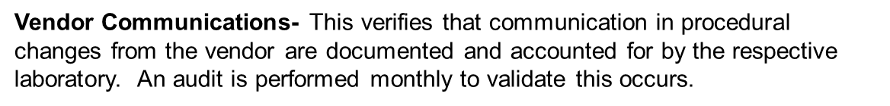
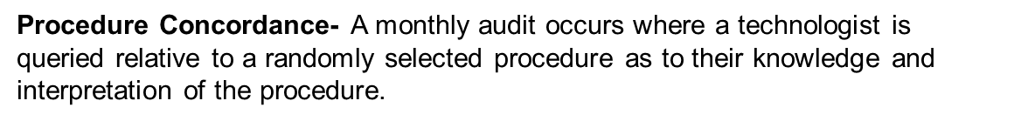
Date | Lab | Test/ Procedure/ Instrument | Documentation of Communication (email, pkg insert, etc) | Procedure Changes Communicated to Technologist
4/1/14 | Molecular Diagnostics | Ewing | Y | Y
4/1/14 | Molecular Diagnostics | Pre-BMT Analysis by Capillary Electrophoresis | No Pkg Insert | Y
4/1/14 | Cytogenetics | Bone Marrow Set Up | Y | Y
4/1/14 | Cytogenetics | Chorionic Villi CVS Culture | Y | Y
4/2/14 | Chemistry | Chloride-Urine | Y | Y
4/2/14 | Chemistry | A1C | Y | Y
4/21/14 | Adult Blood Gas | Arterial | Y | Y
4/21/14 | Adult Blood Gas | Arterial | Y | Y
4/21/14 | Adult Blood Gas | Venous | Y | Y
4/21/14 | Adult Blood Gas | Venous | Y | Y
Date | Lab | Test/Procedure | Relevent questions answered (Y/N) | Corrective Action
4/1/14 | Molecular Diagnostics | Ewing | Y | None
4/1/14 | Molecular Diagnostics | Pre-BMT Analysis by Capillary Electrophoresis | Y | None
4/1/14 | Cytogenetics | Bone Marrow Set Up | Y | None
4/1/14 | Cytogenetics | Chorionic Villi CVS Culture | Y | None
4/2/14 | Chemistry | Chloride-Urine | Y | None
4/2/14 | Chemistry | A1C | Y | None
4/21/14 | Adult Blood Gas | Arterial | Y | None
41750 | Adult Blood Gas | Arterial | Y | None
41750 | Adult Blood Gas | Venous | Y | None
41750 | Adult Blood Gas | Venous | Y | None

Slide 7
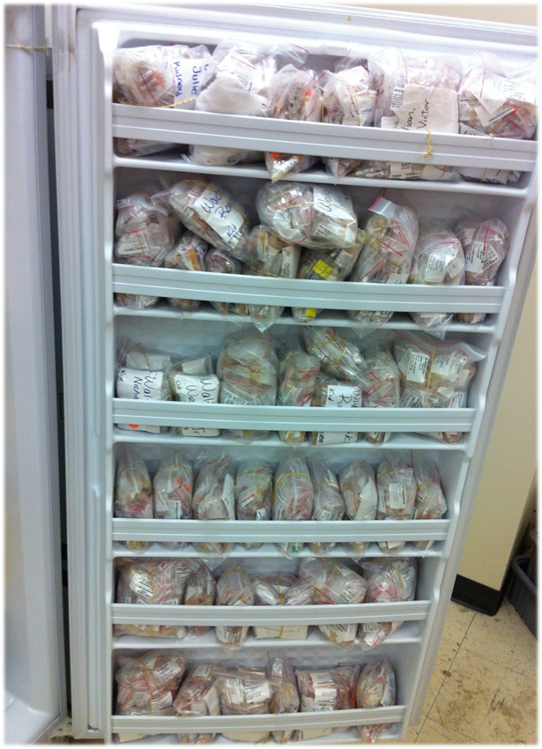
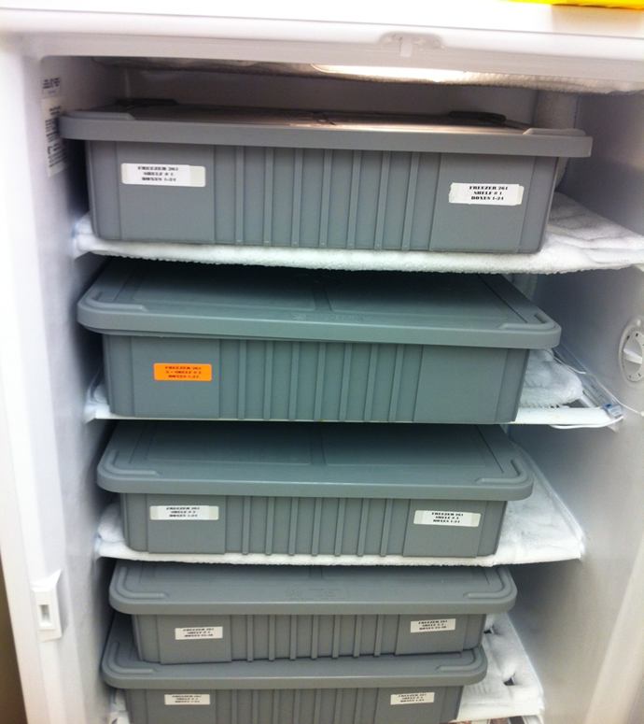
CP QA Meeting Highlight
Histocompatibility
Before
After
Description of Problem: Specimens are stored in many freezers within the Histocompatibility lab leading to lack of space for additional storage and issues with tracking where specimens were stored efficiently.
Impact of Problem:
Seals breaking on the refrigerator from the excess weight on the door
Time consuming filing and retrieval of specimens
Due to the length of time that freezers were open, condensation built up in the freezer and also in the bags where the specimens were stored
Several time consuming manual filing methods were used and specimens were sorted alphabetically
Freezers required frequent de-thawing due to ice build up
Description of Solution: Using the storage functionality within Histotrak bins with unique identifiers were purchased. Specimens are placed into unique slots within these storage containers. When a specimen is retrieved the exact location can be identified. Archived specimen have been split from specimens that are actively being tested to segregate the needs for retrieval.
How we know it worked: The seals on the refrigerators no longer break. Decrease of the amount of space required by two freezers. Tremendous saving of time. Previously it could take ½ hr to locate a specimen, now it’s less than 5 minutes. Less frequent freezer thawing.
The process is now organized, controlled and manageable.
Date Solution Implemented:
May 2013

Slide 8
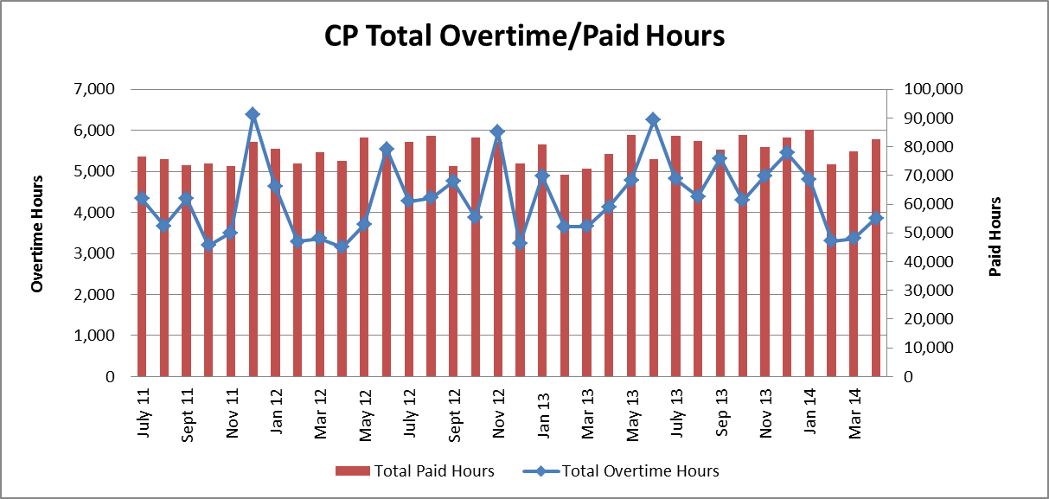
Clinical Pathology Financials

Slide 9
Clinical Pathology-Current Projects
**This is a highlight of projects ongoing in the CP labs. This list is not meant to be all inclusive of every activity occurring in the department.
Project | Brief Description | Owner
Customer Service/Call Center | Address multiple issues related to providing an appropriate level of customer service for UMHS care providers. | Dr. Newton
Leaky Specimens | Reduce the number of leaky specimens by exploring different transport containers and/or educational opportunities | Dr. Newton
CP Brochure | Compile information and photos from the Clinical Laboratories to create a generic CP overview for visitors/prospective clients. | K. Martin
Heme-Onc TAT for ANC results | In coordination with the heme-onc clinics explore opportunities to optimize TAT for patients receiving infusions. | J. Davis/U.Kota/K. Martin/H. Neusius
ER Specimen Issues | In coordination with the Emergency Department reduce the number of RMPRO specimen errors (e.g. hemolysis, mislabels etc.) | S. Butch/K. Martin/T. Morrow
Pathology Handbook | Maintain and update the Pathology handbook to be a robust resource for our customers. | K. Davis

Slide 10

Clinical Laboratory News, Notes, and Kudos
------------------------------------------------------------------------------------
Labs that are working on process improvement projects that would like to display data can contact Kristina Martin (martkris@umich.edu) for future dashboards.
Kudos
Jon Jennings-assisted an elderly patient that fell in the Briarwood parking lot in early May. Jon also helped her into her vehicle after the incident.
The 2014 External CAP Team who inspected a large medical center in the southwest United States during the last week of April.

