Slide 1
Clinical Pathology
Quality Dashboard
September 2014

Slide 2
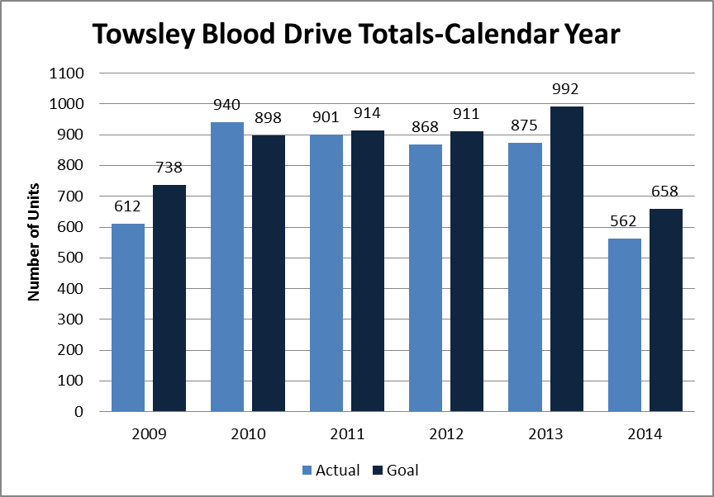
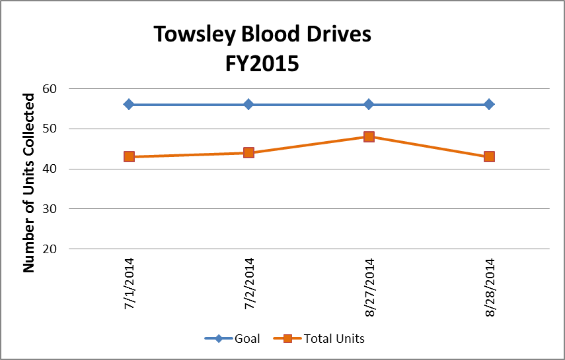
Clinical Pathology Patient Care Quality
Pathology-Blood Drive
We have not been able to meet our goal despite numerous endeavors to create incentives for donors. We’ve also teamed up with Wolverines for Life for donor recruitment and Blood Battle events.
Typically there are ~ 10 presenting donors per drive that are deferred either due to their current health status or answers on the donor questionnaire.
We’ve consistently had a large number of no shows that hovers around 25% per drive. Several investigations with direct communication to donors indicated people either forgot or were too busy to come to the appointment.
In response to donor need we have moved the start time starting in August from 7am to 6am so more staff could donate before work.
Blood drives are typically held monthly and can range from 1-2 days. There are numerous other drives held throughout the University of Michigan campus.
Donors can find upcoming drives by going to wwww.redcrossblood.org and searching under the Sponsor Code=goblue

Slide 3
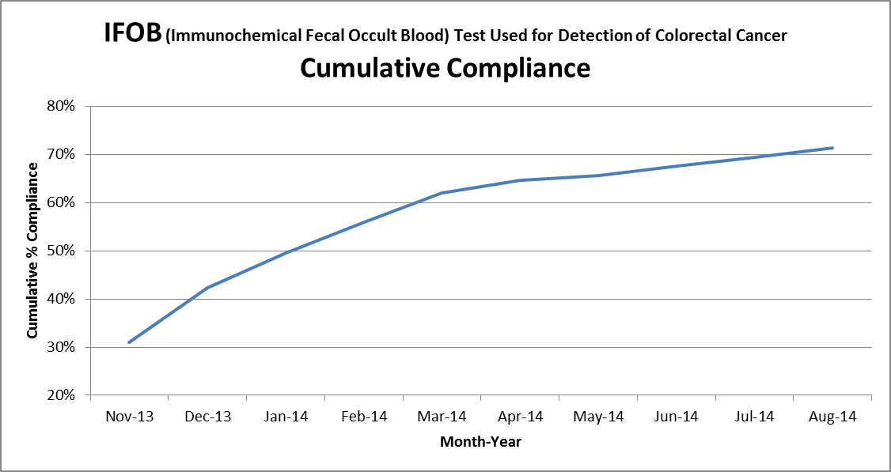
Clinical Pathology Patient Care Quality
Chemistry
Description of Problem: The guaiac method for detecting blood in the stool as a detection of colorectal cancer requires the patient to adhere to several diet restrictions as well as to collect three separate stool samples. Due to this complexity, we had low compliance (<20%). Newer methodologies such as IFOB are available that only require a single sample, no diet restrictions, and have a higher sensitivity.
Impact of Problem:
Historically, the amount of guaiac cards distributed had a low rate of return as indicated above. Use of the newer immunochemical method has increased the rate of return more than two-fold due to ease of collection by the patient.
Reporter of Problem:
Laboratories, physician offices
Description of Solution:
Implement the immunochemical method for detection of colorectal cancer. Physicians would order the test when the kit was handed to the patient. Pre-stamped envelopes provided to the patient will be returned to the laboratory where the test will be run.
How we know it worked:
We continue to see a positive outcome relative to patient compliance with returning the kit for testing. For the past 6 months we’ve seen a 1-2% increase each month.
Since November 2013 we have increased compliance by 40%.
Date Solution Implemented: October 29, 2013

Slide 4
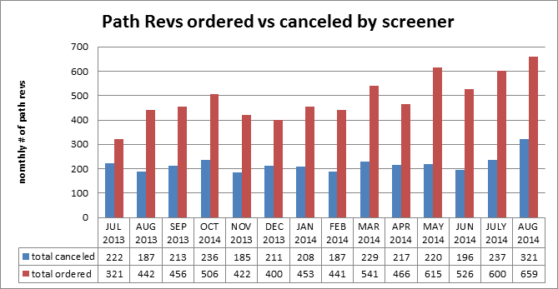
Clinical Pathology Patient Care Quality
Hematology
Description of Problem:
The Hematology lab created specific parameters related to the complete blood count that reflex to the pathologist for a review starting in 2005.
Impact of Problem:
If requests are not appropriate this can increase cost due to the additional pathologist review(path-rev). It can also impair the turnaround time for patients that require a pathologist review since there is no way to prioritize these if all of the slides are reviewed.
Reporter of Problem:
Hematology Pathologists/Staff
Description of Solution: Alter the current policy based on medical director guidance to allow specially trained, competency assessed technologists to prescreen path-rev slides. If screens are determined to be inappropriate the
path-rev would be canceled by the technologist.
How we know it worked?
Over 40% of all orders requests received each month are canceled before reaching the pathologist thus saving time and decreasing the cost to the institution and patient. Technologists are assessed monthly. Approximately, 10 cases per month are reviewed rotated between 5 screener technologists. This equates to each technologist being assessed twice per year.
Areas for continued improvement: The Hematology lab is in the process of reviewing the criteria set to reflex the path-rev to determine which criteria require a pathologist intervention versus review by qualified technologists.

Slide 5
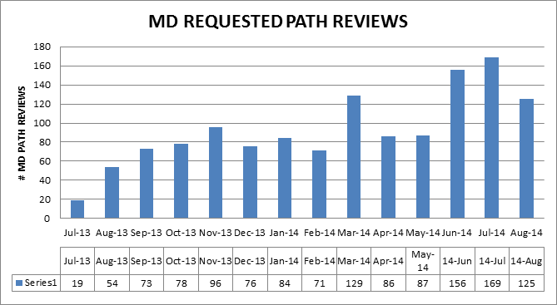
Clinical Pathology Patient Care Quality
Hematology
Description of Problem:
Historically, any MD requests have been processed as ordered. During the past year, there has been an upward trend in the number of Pathology Review requests from providers. Investigation into why this is occurring and whether the requests are appropriate and could be triaged in other ways in progress.
Impact of Problem:
If requests are not appropriate this results in the unneeded cost of Pathologist review and delays turnaround time for patients that should have a Pathologist review.
Reporter of Problem:
Hematology Pathologists/Staff
Description of Solution: Alter the current policy and allow technologists to prescreen MD request slides after an initial audit by pathologist review of cases deemed not to require MD Path Review assures patient safety. If screens are determined to be inappropriate the MD Path Review would be canceled by the technologist.
How we know it worked?
TBD-Late 2014 is the anticipated target date for implementation.
Areas for continued improvement: Hematology will be investigating reasons why orders are received in error to providers (e.g. standing orders, errant orders, or improper reasons).

Slide 6
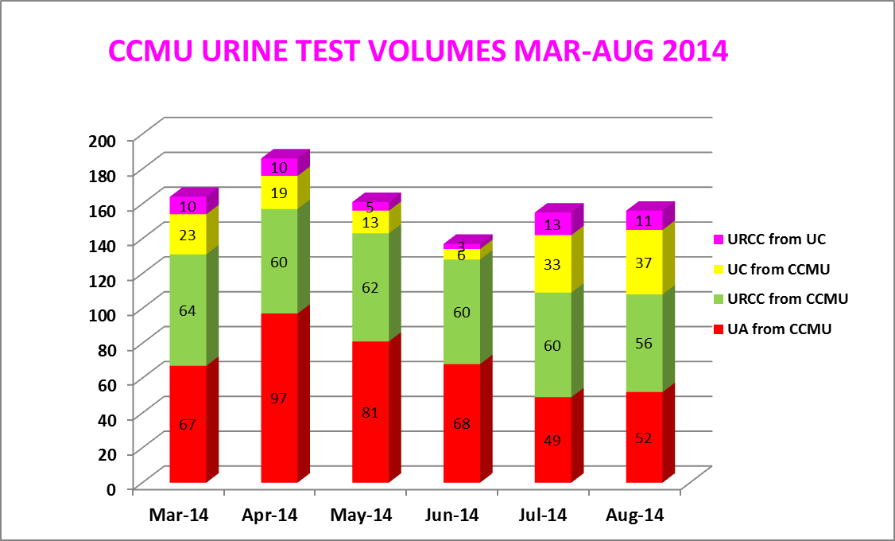
Clinical Pathology Patient Care Quality
Microbiology
Areas for continued improvement:
Data pertaining to the use of the UC and UA/URCC orders indicates that re-education regarding use of the test codes is warranted. This is being facilitated by Infection Control.
Continue to revise Microbiology protocol for culture work-up
The CCMU CAUTI rate has dropped to 4.3 since countermeasures have been implemented, however rates need to meet the NHSN benchmark of 2.9.
Root Cause | Follow-up
Ordering cultures on asymptomatic patients | Training for care providers on proper test utilization
Collecting specimens from urine catheter bag not the catheter line | Training implemented for nursing
Delays in transport cause bacterial growth=false positives | Use BD urine vacutainers for collections to increase storage time at room temp
Triage screening test UC (UA with reflex URCC) not available for inpatients | Made UC available for inpatients
Urine cultures being “over worked” | Modify protocols for urine specimens to be consistent with guidelines
URCC=urine culture
UA=urinalysis
UC=UA with reflex URCC if UA=positive
Description of Problem: Rates of catheter associated urinary tract infections (CAUTI) are a metric benchmarked for quality of care for patients. The inpatient population is particularly prone to high rates of infection. The CCMU (6D) is a focus of attention due to their patient population and propensity for positive urine cultures. The NHSN (National Healthcare Safety Network) benchmark is 2.9 infections per 1000 catheter days. In 2013 the CCMU rate was 5.5. While investigating the CCMU it was discovered that the rate was falsely elevated due to a large number of false positive cultures (>80 % non-pathogen yeast with 20% of these indicating a negative urinalysis).
Impact of Problem:
Clinically irrelevant positive urine cultures can lead to additional testing and antibiotics, both of which may be unnecessary. Inefficient use of resources to process these specimens is also a concern.
Reporter of Problem: CCMU, Microbiology leadership & Infection Control
Description of Solution:
Several countermeasures are being implemented or addressed.

Slide 7
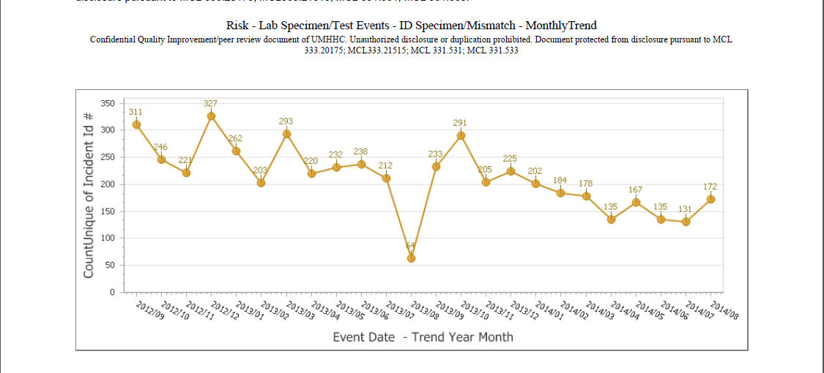
Clinical Pathology Patient Care Quality
Point of Care
*Note Aug 2013 data decreased due to POC coordinator absence and RMPRO reports not entered during this time frame.
*
Description of Problem:
Once MiChart was implemented, a change occurred in how the patient was identified. In order to correlate billing information relative to the specific patient stay, the CSN number on the patient’s wristband is used rather than the MRN. The patient’s wristband was changed so that the glucometer CSN number is now a 1D barcode versus the MRN which is a 2D barcode. Since making this change, numerous errors have occurred where the MRN was manually entered by mistake into the RAALS laboratory middleware. The RAALS middleware requires the current CSN to function properly.
Impact of Problem: The errors cause a delay in results being reported to the patient record. Additionally, the corrective action is for the POC Coordinator to match the misidentified patient results and then manually report them to the correct CSN. This opens the opportunity for human transcription errors along with inefficient use of the coordinator’s time to work on other tasks.
Reporter of Problem: POC Coordinator & Nursing Leadership
Description of Root Causes Identified:
Nursing is not able to access the barcode and has to manually enter CSN. This can be entered incorrectly or the MRN is used which is traditionally used for other methods of identifying patients.
This is especially true of pediatric wristbands which are smaller. Nurse educators have refocused training on this aspect. Investigation into modifying the patient wristband to allow more barcodes to be visible is ongoing by MiChart.
CSN mismatch-Examples of patients presenting at the ER or IPLV(Inpatient Like Venues) and then admitted on a different day (thus different CSN) still have their “old” wristband on which is no longer valid. Wristband printing-future visit day used to print wristband. Practice change by nursing to replace patient wrist band every time patient comes or returns to the floor (e.g. go to OR or procedure area and come back).
Identified reasons why nurses are manually entering MRNs and implementing countermeasures to address delays in downloading patient names & results to the patient’s record.
How we know it worked:
We continue to see a decrease in the number of incidents that are largely composed of glucometer errors. In the coming months it’s anticipated this will continue to decrease because our new glucometers have screens that display the patient’s name when the barcode is scanned. We are also working with nursing to address the core reasons why nurses might manually enter an ID. This may involve modifications of the patient wristband.

Slide 8
Clinical Pathology Quality and Performance
Health Center Safety Audits
Safety Audits were performed by the Pathology Safety Liaisons between March and September 2014.

Slide 9
Clinical Pathology Quality and Performance
Laboratory Safety Audits
Safety Audits were performed by the Pathology Safety Liaisons between March and September 2014.

Slide 10
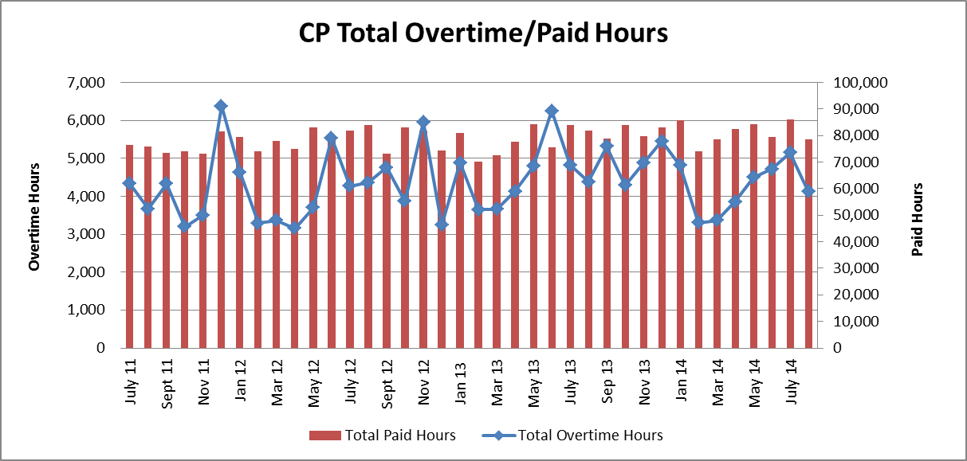
Clinical Pathology Financials

Slide 11
Clinical Pathology-Current Projects
**This is a highlight of projects ongoing in the CP labs. This list is not meant to be all inclusive of every activity occurring in the department.
Project | Brief Description | Owner
Customer Service/Call Center | Address multiple issues related to providing an appropriate level of customer service for UMHS care providers. | Dr. Newton
ER Specimen Issues | In coordination with the Emergency Department reduce the number of RMPRO specimen errors (e.g. hemolysis, mislabels etc.) | S. Butch/K. Martin/T. Morrow
Pathology Handbook | Maintain and update the Pathology handbook to be a robust resource for our customers. | K. Davis/K. Martin
NCRC Planning | Begin work to plan for the future state of the non-STAT Clinical Labs move to NCRC | PRR Committee

Slide 12
Clinical Laboratory News, Notes, and Kudos
------------------------------------------------------------------------------------
Labs that are working on process improvement projects that would like to display data can contact Kristina Martin (martkris@umich.edu) for future dashboards.
Kudos
Dr. Daniel Ramon & Timm Williams-Histocompatibility - Leading the way to promote blood, tissue & organ donations by organizing a running group for the Wolverines for Life. This group will meet for fun runs along with attending races to volunteer and provide a face to this cause.
http://www.wolverinesforlife.org/
Carol Young-Microbiology-Presenting at the Michigan Fall SCACM Meeting on September 26th titled Rapid Rewards: Identification from Positive Blood Cultures
Louann Dake-Blood Bank- Receiving the Michigan Association of Blood Banks 2014 Founders Award

