Slide 1
Clinical Pathology
Quality Dashboard
March 2015

Slide 2
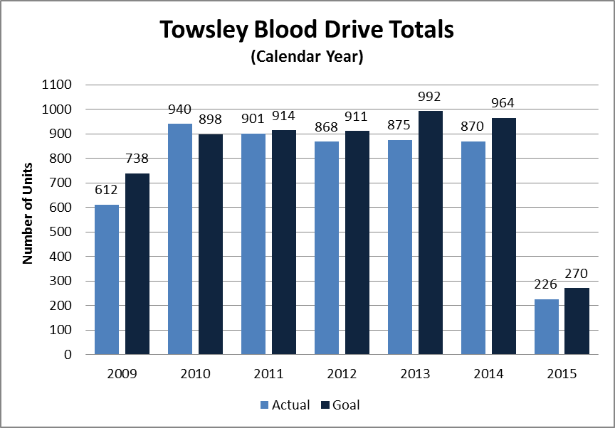
Clinical Pathology Patient Care Quality
Pathology-Blood Drive
We did not meet our goal of 270 donations for this period.
January drive was compromised by shortened donation hours (4 hours) and sudden relocation of the drive. This was due to fumes from newly installed carpet.
While it will be challenging to make up the 44 units, we continue to recruit donors and make the donation process run more smoothly. This should result in an increase in donations.

Slide 3
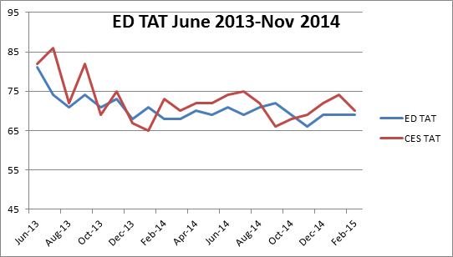
Clinical Pathology Patient Care Quality
Blood Bank
Minutes
Monitor: Type and Screen TAT for the Emergency Departments (ED=Adult, CES=Children’s)
Goal: TAT <= 60 minutes.
Impact: Increased use of emergency issue blood components.
Status: The Blood Bank is looking at how to further modifications of their processes to meet the TAT goal.

Slide 4
Clinical Pathology Patient Care Quality
Chemistry
Emergency Services – Adult
Monitor: TAT for BASIC biochemical panel for Emergency Department adult patients (ESA) from time of collections to result reporting.
Goal: TAT <= 60 minutes. For the TAT for 95% of the specimens, the goal is as close to 60 minutes as possible.
Impact: Delay in diagnosis and providing appropriate care.
Status: Continue to monitor for trends.

Slide 5
Clinical Pathology Patient Care Quality
Phlebotomy – Outpatient Cancer Center
November 2013
Patient Checks In
Patient Fills out Form
Patient Placed in Que
Infusion Patient
Non-Infusion Patient
LPN
LPN
Checked In/Orders Released in MiChart
Port Trained Phlebotomist
Phlebotomist
Port Trained Phlebotomist
Port
Neostar
Port
Venipuncture
Line Draws
Port
Neostar
Port
Venipuncture
Line Draws
Venipuncture
Line Draws
Phlebotomist
Venipuncture
Line Draws
Description of Problem: In November of 2013, patients needing an infusion were prioritized over routine collections in the blood draw clinics in order to improve the TAT for testing result. Analysis of current delays indicated infusion patients had the longest wait time, but has the greatest need for a faster TAT to avoid treatment delays.
Impact of Problem:
Delay in patient care waiting for test results.
Reporter of Problem:
OP Clinic Staff and patients.

Slide 6
Clinical Pathology Patient Care Quality
Phlebotomy – Outpatient Cancer Center Continued
Percent
Description of Solution:
When the data was displayed based on the type of draw, the infusion patients required more highly trained staff because of the draw type and their wait limes were longer. The solution implemented was to train additional staff to perform port draws.
How we know it worked?
No clinic complaints. We will be monitoring TAT over the next few months.
Areas for continued improvement and monitoring:
Maintain levels of trained staff.

Slide 7
Clinical Pathology Patient Care Quality
Send Out Testing
Creutzfeldt-Jakob Disease (CJD) Testing
Since implementing the use of the spreadsheet tracking mechanism on October 27th, 2014
  Twelve patients have been sent out since then
  5 reported back in less than 14 days
  5 were >14 days
  2 are still awaiting results
  Dr. Keren, as Medical Director, has had to follow up 3 times.
Description of Problem:
Cerebrospinal fluid (CSF) is sent to the National Prion Surveillance Center for CJD testing. Reports were not being received in a timely manner.
Impact of Problem:
Delay of CJD precautions for affected patients/staff.
Reporter of Problem:
Pathology and Infection Prevention and Epidemiology
Description of Solution:
Set up monitor for outgoing tests. This test does not have a separate test code so a manual monitor is required. If the routine TAT is exceeded, the
laboratory is called and a the report requested.
How we know it worked?
Reports are received in a timely manner.
Areas for continued improvement:
The problem continues in that the reference laboratory indicates reports are being sent but not they are not always received. Root cause yet to be identified. Currently, reports are faxed to two separate numbers. It was still necessary for the medical director to call the reference laboratory to obtain the reports required for three events. We have spoken to the Medical Director of that facility about this.

Slide 8
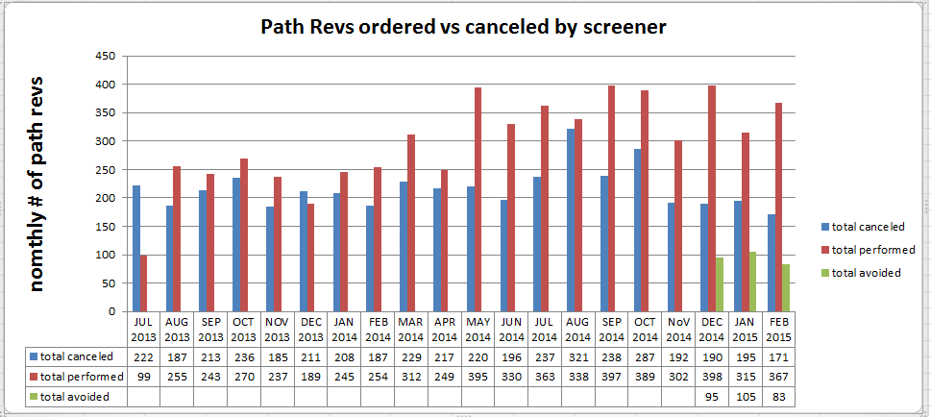
Clinical Pathology Patient Care Quality
Hematology
Description of Problem:
The Hematology lab created specific parameters related to the complete blood count (CBC) that reflex to the pathologist for a review starting in 2005. There is an increasing number of Path Rev ordered.
Impact of Problem:
Inappropriate requests increase cost due to the additional pathologist review (path-rev) and impair the turnaround time for patients that require a pathologist review since there is no way to prioritize these if all of the slides are reviewed.
Reporter of Problem:
Hematology Pathologists/Staff

Slide 9
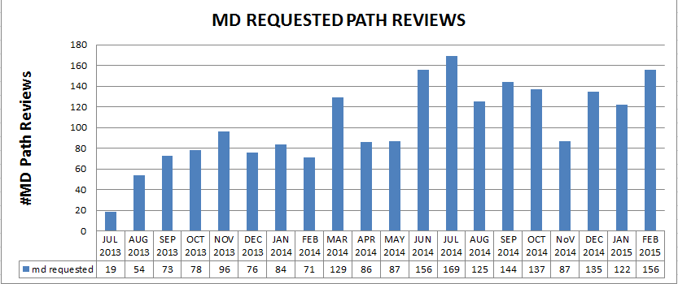
Clinical Pathology Patient Care Quality
Hematology - Continued
Interventions to Date:
Nov 2014: Eliminated the ability to Path Rev on standing order
Nov 2014: Implemented tech verification of positive crystals
Jan 2015: Eliminated sending <65 MCVs the first time it was seen for Path reviews.
Assessment of Interventions Implemented:
After an initial reduction in the number of Path Rev requests in November 2014, the number has continued to rise.
Areas for continued improvement:
Add a parameter to the report to include the number of tests avoided to get a better picture of the workload.
Consider additional options for reducing the number of Path Rev requests.

Slide 10
Clinical Pathology Patient Care Quality
Microbiology
Monitor:
TAT for AFB Smears
Goal:
24 hours or less for AFB smears
Impact:
The ability to identify potentially infectious tuberculosis patients via AFB smear identification is critical to treatment and isolation of the patient.
Status:
Change made in reporting time continues to positively affect TAT for AFB smears.

Slide 11
Clinical Pathology-Current Projects
**This is a highlight of projects ongoing in the CP labs. This list is not meant to be all inclusive of every activity occurring in the department.
Project | Brief Description | Owner
Customer Service/Call Center | Address multiple issues related to providing an appropriate level of customer service for UMHS care providers. | Dr. Newton
ER Specimen Issues | In coordination with the Emergency Department reduce the number of RMPRO specimen errors (e.g. hemolysis, mislabels etc.) | S. Butch/K. Martin/T. Morrow
Pathology Handbook | Maintain and update the Pathology handbook to be a robust resource for our customers. | K. Davis/K. Martin/J. Sica
NCRC Planning | Begin work to plan for the future state of the non-STAT Clinical Labs move to NCRC | PRR Committee
Lab Ready Labels | Installation of lab label printers in the ED & Ambulatory Care clinics. | K. Davis/K. Martin

Slide 12
Clinical Laboratory News, Notes, and Kudos
------------------------------------------------------------------------------------
Promotion - Peter Heyboer has been promoted to afternoon Sr. Clinical Technologist
Kudos - to those Pathology Employees who received “Making a Difference Award” Nominations by patients or other staff members.
Date Name Nominated by
12/1/2014 | ABBY | MEJEUR | Family
12/3/2014 | ALEXANDRA | CASTILLIO | Staff
12/5/2014 | JACKIE | GOODMAN | Staff
12/5/2014 | H. STEVEN | GREGG | Staff
12/10/2014 | LISA | BROWN | Staff
12/15/2014 | ANDREA | HAWK | Staff
12/15/2014 | TERI | SCOTT | Staff
12/16/2014 | SUE | PAPA | Patient
12/16/2014 | LUANNE | DALY | Staff
12/17/2014 | CHRISTINE | GAUNT | Staff
12/17/2014 | STEVE | ESKESEN | Staff
12/21/2014 | CHRISTIAN | NORRIS | Staff
12/23/2014 | NEL | AMR | Patient
12/23/2014 | JOLYNN | CROSBY | Patient
12/23/2014 | EMERITA | CROSS | Patient
12/23/2014 | CHARNBIR | KAUR | Patient
12/23/2014 | DEE | LEBLANC | Patient
12/23/2014 | HOLLY | LONGO-MINOR | Patient
12/23/2014 | JILL | GOSSELIN | Patient
12/23/2014 | STEPHANIE | PARRISH | Staff
12/26/2014 | LAURA | PARKS | Patient
12/31/2014 | LEANN | VANCE | Staff
1/6/2015 | TERRI | BAUER | Patient
1/6/2015 | LAURA | PARKS | Patient
1/9/2015 | LAURIE | GREEN | Patient
1/14/2015 | CHRISTOPHER | SMITH | Staff
1/22/2015 | MEREDITH | HOAG | Staff
1/23/2015 | OLIVER | BICHAKJIAN | Staff
1/26/2015 | KELLY | PRUITT | Patient
2/5/2015 | BETTY | RIGGS | Staff
2/13/2015 | MICHELE | CENTI | Staff
2/16/2015 | JOHN | FREDERIKSEN | Staff

