Slide 1


educate • fund • connect • support

Slide 2

Why
educate • fund • connect • support
Created in 2006, awarded a $55M CTSA grant from the NIH in 2007, and renewed in May 2012. MICHR is part of a consortium of 62 CTSA institutions working together to accelerate discoveries toward better health.
MICHR serves the entire U-M campus.

Slide 3
Phases of Translational Research
T0
Basic Research
Discovery Sciences
Health Care
Delivery &
Policy
T4
Health Care
Improvements
Translation
To Humans
T1
Translation
To
Patients
Dissemination
To Practice
T3
T2

Slide 4




MICHR At A Glance
Fund
Connect
Pilot Grants
Research Grant Consultation
Study Participant Recruitment
Community Outreach
Educate
Support
Clinical Research Unit
Clinical Trials Office
Biorepository
Biostatistics
Study Consultation
Database Development
Regulatory Support
Informatics Tools
Workshops, symposia, & mentored programs to support research & career development

Slide 5

Fund – Pilot Grants: October, April
T1 – BENCH TO BEDSIDE AWARD: For projects designed to identify basic science discoveries that have significant potential for impacting human health. $50-75K ea.
T1 – ENDOWMENT FOR BASIC SCIENTISTS (EBS partnership): The PI’s primary appointment must be in one of the participating units in the Endowment for Basic Sciences and partnered with a non-EBS researcher. $50K ea.
T2 – Translational Sciences Award: Transition clinical findings in research into community practice and patient oriented initiatives. $50K ea.
T3 – CURES (Community University Research Partnership). $25K ea.
NEW – Implementing Research-Based Practices to Improve Quality of Care. $20K ea.

Slide 6
Fund – Pilot Grants: Continuous
PGP Seed Grants – Funds should be used for a new stand-alone project, or to enhance an existing research project. $5K ea.
Translational Technology Seed Grant – This grant mechanism is designed to support access to comprehensive translational research cores; providing vouchers to researchers interested in purchasing core services. $10K ea.
Partnership Planning Grant for Implementation Science – designed as a planning grant to forge relationships among 1) scientists and 2) clinicians from non-academic health science centers and representatives of community-based organizations or the public. $10K ea.

Slide 7
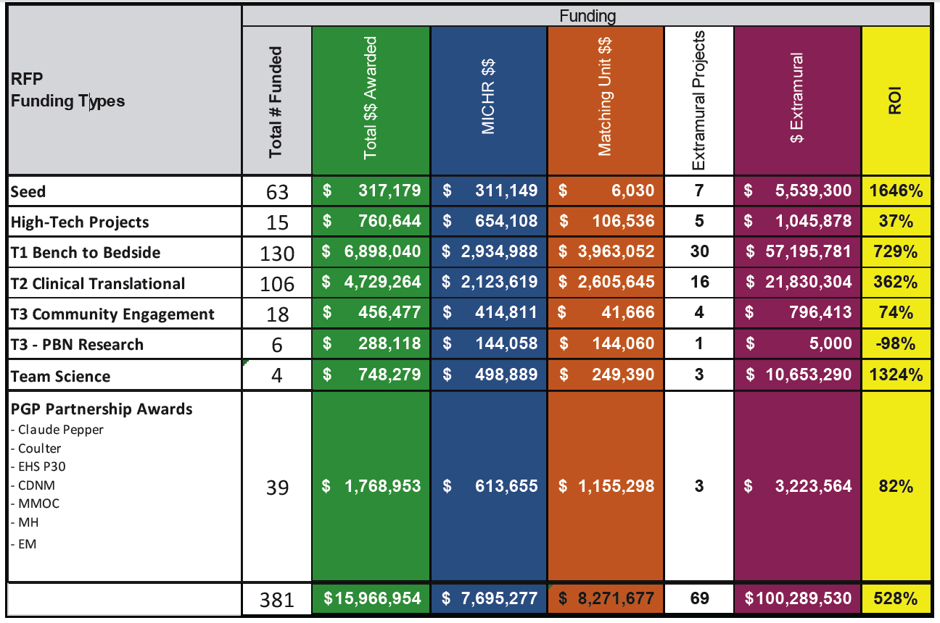

Slide 8
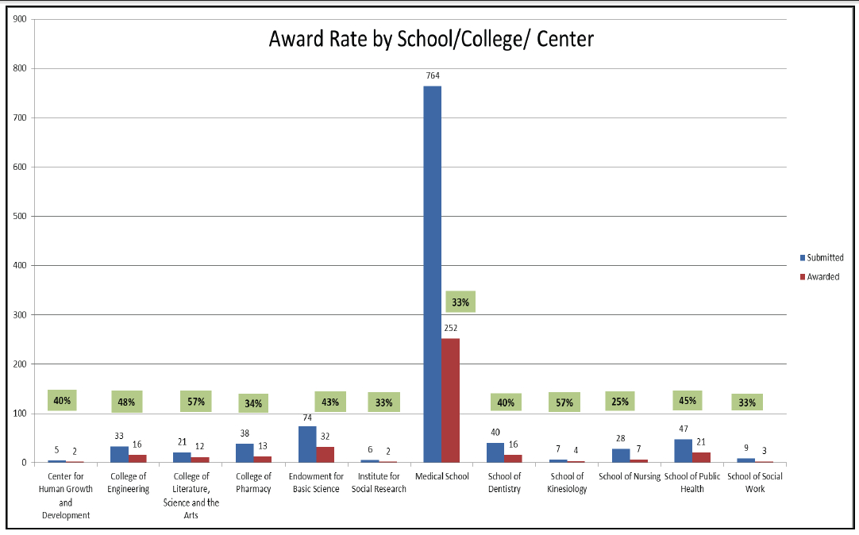

Slide 9
MICHR At A Glance
Fund
Connect
Pilot Grants
Research Grant Consultation
Study Participant Recruitment
Community Outreach
Educate
Support
Clinical Research Unit
Clinical Trials Office
Biorepository
Biostatistics
Study Consultation
Database Development
Regulatory Support
Informatics Tools
Workshops, symposia, & mentored programs to support research & career development

Slide 10

Pre-Doctoral Progams
Master of Science in Clinical Research
Clinical Research Summer Program
Health Disparities Summer Program
Global Summer Research Program
Translational Research Education Certificate

Slide 11
Post-Doctoral Programs
MICHR K Award
Post-Doctoral Translational Scholars Program (PTSP)
Clinical Research Masters Program

Slide 12
Mentored Program
(March 18)
The Postdoctoral Translational Scholars
Program (PTSP)
Prepare PhDs in a biomedical or social science discipline for independent careers in translational research
2 years, up to $100,000. Training includes a translational research project, clinical immersion, and didactic course work
Requires a basic science and clinical mentor along with a MICHR mentor

Slide 13
Training
MICHR’s Education and Mentoring Group provides engaging and effective education, career development, and mentoring programs.
Clinical research workshops (online & in person) for faculty and postdocs, with no or little experience in translational research
Grant writing workshops
Manuscript writing coursework
Preparing Translational education programs for Trainees (T32)

Slide 14
Research Development Consultation
(RDC)
educate • fund • connect • support
Notes:
Let’s first focus on RDC.

Slide 15
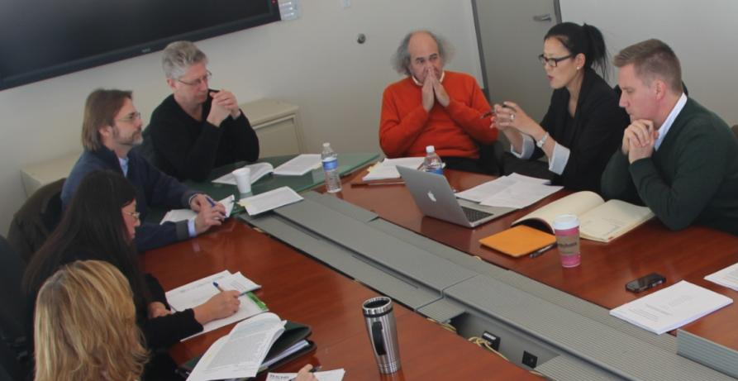
RDC provides free services and consultation to strengthen grant proposals
educate • fund • connect • support
Notes:
Our central service is the one-hour consultation meeting.

Slide 16
RDC Services
Help scientists to…
  Develop clinical concepts for basic research
  Build collaborations with clinical scientists
  Explore funding sources
  Biostat and study design
  Grant editing service
  Assist with reviewer concerns for revisions
  Career development funding (K08, K99, etc.)
  Assist with entrepreneur activities

Slide 17
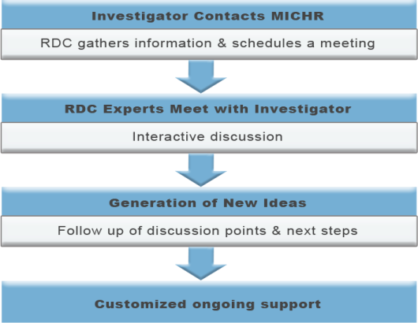
Consultation Process
RDC Services
Notes:
Investigator contacts MICHR.
RDC staff gather basic information to determine their project needs, and assemble accordingly the experts for the consultation meeting.
Consultation meeting.
Follow up with new ideas, new collaborations and mentors.
Investigators send back revised proposals for another round of comments and/or editing.

Slide 18
RDC Services
Notes:
TMRS data RDC consult meetings 2006 – September 30, 2012.
2006 0
2007 33
2008 60
2009 49
2010 53
2011 111
131
36 Jan. to May
Total 473

Slide 19
Clients
Anesthesiology
Medical School
Surgery
Psychiatry
Physical Medicine
& Rehabilitation
Internal Medicine
Pediatrics &
Communicable
Diseases
OBGYN
Neurology
Notes:
Data from January 1 through December, 2012.

Slide 20

Biorepository
MICHR’s Biorepository provides long-term storage for investigator-initiated research specimens of a variety of clinical populations.
DNA isolation, whole blood, serum, plasma, urine, and tissue processing and/or storage
A resource for translational research and building collaborations
** Has now partnered with Office of Research for a centralized facility
Predicted date for operation: June, 2014?

Slide 21
Support
Providing valuable support services for research studies
CLINICAL RESEARCH MANAGEMENT SERVICES
Biostatistical design
Recruitment strategy consultation
Regulatory assistance with IND/IDE submission & support (MIAP)
Database development & data management platforms
  REDCap, OpenClinica (validated), and VELOS

Slide 22
Support
Providing valuable support services for research studies
THE MICHIGAN CLINICAL RESEARCH UNIT (MCRU) IS HERE TO SUPPORT HUMAN CLINICAL RESEARCH PROTOCOLS WITH SERVICES INCLUDING:
Extended stay and outpatient facility in the CVC and outpatient facility in the community
Research nurses, medical assistants, dietitians, and lab personnel
Mobile clinical research team (MCRU2U) including a community-based research nurse to support all protocol-specific services
A specimen collection, processing, and shipping core laboratory with a computerized specimen management and tracking system*
A Phase 1 cleanroom facility

Slide 23
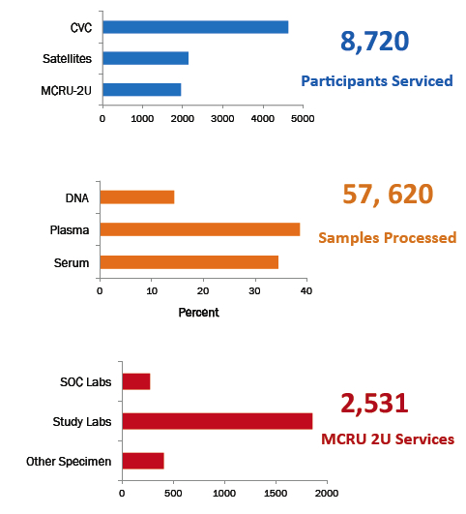
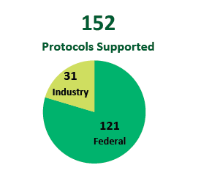
MCRU
Michigan Clinical Research Unit

Slide 24

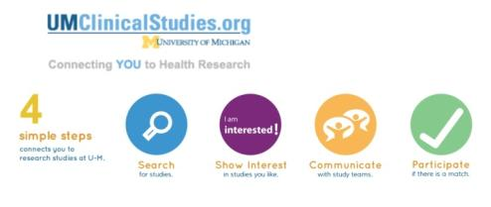
Connect
Recruiting study participants
Our Recruitment Program PROVIDES EXPERTISE AND TOOLS TO FACILITATE PARTICIPANT RECRUITMENT AND ENHANCE RETENTION:
www.UMClinicalStudies.org study participant recruitment website
www.michrrecruitingtoolkit.org recruitment toolkit
Recruitment feasibility assessments
Recruitment consultations
Community engagement outreach events connecting researchers with the public
Education and training
Goals: Moving registrants into studies; hit target accruals for NIH-funded clinical trials
>15,000 registered

Slide 25
Support
Support clinical trials
CLINICAL TRIALS OFFICE (Industry-sponsored):
Proposal Approval Forms (PAF)
Recruitment feasibility assessment
Draft budgets and billing calendar
Negotiate budget with sponsor
Initial IRB application and consent/assent forms
Facilitate approval of contract
786 Active Clinical Trials at U-M

Slide 26

Connect
Engaging communities
Outreach, partnerships, and implementation science (OPIS) aims to meet the needs of U-M and our community partners
Developing long-standing, collaborative,
and equitable community-university partnerships
Creating and testing new innovative methods for
community engagement and community-based
participatory research
Creating education and training opportunities that
promote bi-directional knowledge flow
Address community research priorities and perform clinical, translation, and outcomes effectiveness research

Slide 27
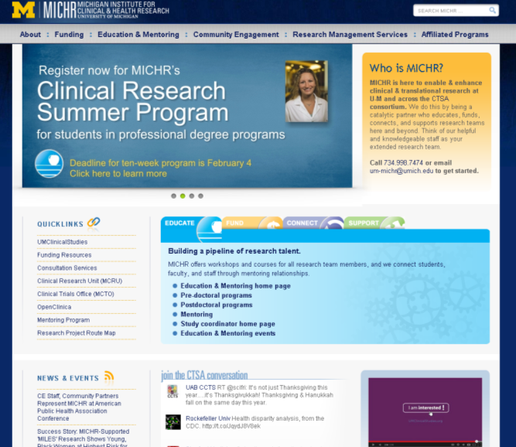


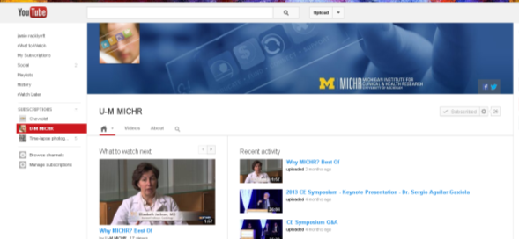

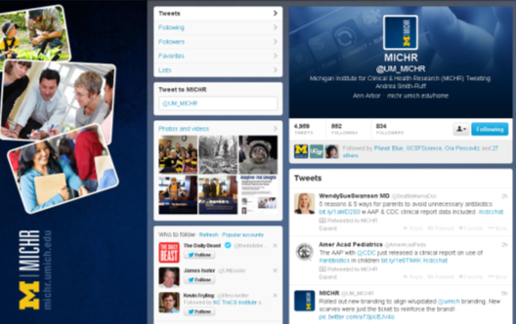


Staying Connected
“Visit” www.michr.umich.edu
“Read” Breakthrough
“Like” Facebook
“Follow” Twitter
“Watch” YouTube
“Call” 734-998-7474
“Email” um-michr@umich.edu

