Slide 1
Pathology Faculty Promotions
November, 2013 Faculty Meeting
Notes:
Once your new faculty member is appointed, we will invite him or her to our annual orientation - which we just held. Those who attended felt it worthwhile - but I wish we could have captured more of the new faculty. Better luck next year, I say.

Slide 2

The University of Michigan Medical School Mission
To educate students, physicians, and biomedical scholars and to provide a spectrum of comprehensive knowledge, research, patient care and service of the highest quality to the people of the State of Michigan and beyond

Slide 3
Faculty at U-M
Faculty appointed to one of three tracks
  Instructional (tenure)
  Clinical
  Research
Other appointments: Clinical Lecturers
Right track?

Slide 4
Instructional Track
Tenure Track
Traditional University faculty track
  Concept and timing of tenure
Tenure is based on:
  Contributions that substantially impact and improve a field of work and study
  Recognition at a national level
  Independent grant funding

Slide 5
Tenure Probationary Period
(Tenure Clock)
The maximum probationary period
Tenure for instructional track faculty
must be achieved by the end of the tenth (10) year of the tenure probationary period
Instructional track faculty undergo departmental review for promotion and tenure prior to the seventh (7) year of the tenure probationary period
Usually coming up for tenure in the sixth (6) year

Slide 6
Assistant to Associate (Instructional)
Time in rank:
6.35 avg
6 med
7 mode
(must be < 10 years)
Coherent body of work
Grant Funding
National reputation & unique contribution in an independent field
Publications: 33, 29, 32 (avg, med, mode) 1998-2012 Range 9-108
Teaching quality
Organizational citizenship
Competence in teaching & scholarship
Potential for success in field based upon publications and funding
10-15 publications
ASSISTANT
ASSOCIATE

Slide 7
Clinical Track
(Clinician-Educator Track)
This track was established in 1986.
Create a clinician-educator rank without the contingency of a tenure clock.
  Clinical services and teaching
  Scholarship, the backbone of any higher educational organization, is expected for ascent in rank (Publications)

Slide 8
Clinical Instructor to Clinical Assistant Professor
Competence in teaching & scholarship
Potential for success in field
Publications: 4.32, 3, 2 (avg, med, mode) 2007-2012 Range 0-85
Time in rank:
4.32 avg
3.0 med
2.0 mode

Slide 9
Assistant to Associate
(Clinical)
Clinical excellence
Regional/National Reputation
Teaching Quality
Publications: 18,16,13 (avg, med, mode) 1998-2012 Range 3-93
Organizational citizenship
Time in rank:
6.94 avg
6 med/mode
Competence in teaching & scholarship
Potential for success in field
ASSISTANT
ASSOCIATE

Slide 10
Research Track
This track was established in 1974.
Asymmetric career track focused primarily on original research
Support the other (educational and clinical) missions
  Teaching – graduate student and post-doctoral levels
  Service committees

Slide 11
Research Track

Slide 12
Research Professor Track
Rank | Activity and requirements | Time-in-rank
Research Assistant Professor | Peer-reviewed Publications Evidence of funding (extramural) Teaching (non-didactic) National visibility Service | 3rd year review Medical School 8 year Promotion OVPR/Provost
Research Associate Professor | Independent Funding (R01) Senior Authorship Teaching (non-didactic) National/International visibility Service | No Limit
Research Professor | Independent Funding (R01) Senior Authorship Teaching (non-didactic) National/International visibility Service | No Limit

Slide 13
Research Investigator to Research Assistant Professor
Publications: 21.03, 18.5, 22 (avg, med, mode) 2007-2012 Range 4-77
Time in rank:
5.65 avg
4.0 med
4.0 mode

Slide 14

Assistant to Associate
(Research)
Time in rank
7.12 avg
6.5 med
4.0 mode
External funding
Coherent body of work
National reputation & unique contribution in independent field
Publications: 40, 38, 44 (avg, med, mode) 1998-2012 Range 15-96
Teaching quality
Organizational
citizenship
Competence in teaching & scholarship
Potential for success in field
ASSISTANT
ASSOCIATE

Slide 15
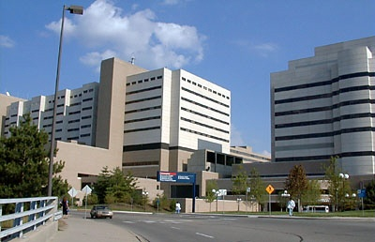
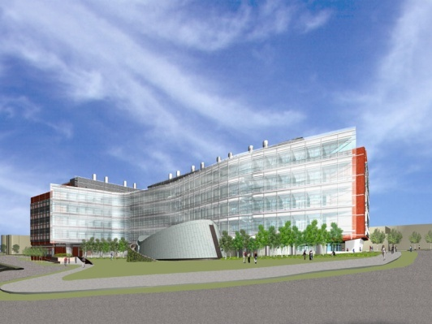
Faculty Tracks
Scholarship
Teaching
Instructional
Org. Service
Prof. Work
Professional Work
Teaching
Clinical
Scholarship
Org. Service
Scholarship
Teaching
Research
Org. Service

Slide 16
Snapshot of the Faculty
FY 2012
                FY2012 FY2008
Instructional Track 901 819
Research Track 340 308
Clinical Track 985 771
Lecturers 301 293
Total 2,527 2,191

Slide 17
Women Faculty at Michigan
FY 2012
Instructional Track 26% (24%)
Research Track 36% (40%)
Clinical Track 49% (47%)
Lecturers 55% (42%)
Total 42% (38%)
(2008 numbers)
Notes:
Headcount 6/1/04

Slide 18
Appointments
Instructional track
  Clinical Lecturer or
  Assistant Professor (Clock starts)
Clinical track
  Clinical Instructor
  Clinical Assistant Professor
Research Track
  Research Investigator
  Research Assistant Professor
However, appointments are made at any level depending on prior experience

Slide 19
Promotions – Yearly Cycle
Departments:
  Winter/Spring: promotions committees recommend Faculty for advancement
  Summer: packages are assembled
Medical School:
  October 1: Promotion packages due to Faculty Affairs
  Review
    Medical School Promotion Committees (elected peer-review)
    Executive Committee (Dean and elected faculty members)
    EVPMA

Slide 20
Promotions - Yearly Cycle
University:
  February: Provost’s Office, OVPR, Regents
  Mid-May final word
Promotion takes effect Sept 1
So to get promoted, the process starts in the spring the year before

Slide 21
Preparing for Promotion
Determination of readiness
- Discussion with candidate at yearly review
- Third year review by Medical School
- Departmental promotion committee
Chair Decision !

Slide 22
The Promotion Package
Candidate:
  Talking points
  CV
  Educator’s Portfolio
  Research Portfolio
  5 key papers with bibliographic notes
Department:
  External letters (for clinical track/senior level only)
  Summary Form “B”
  Teaching evaluation summaries
  Prepares the package
Guidelines are on the website
http://www.med.umich.edu/medschool/faculty/promopackage/index.htm

Slide 23
Educator’s Portfolio
Overview of all your teaching
  Amount
  Learner groups
  Documentation
    Get and keep your evaluations
    Read them yearly
    Improve where needed
Highlight one or two major accomplishments as a teacher
http://www.med.umich.edu/medschool/faculty/resources/portfolio.htm

Slide 24
Research Portfolio
Gives the candidate an opportunity to describe their research and their unique contributions to the field.
This is especially important to team scientists. The candidate should detail their roles and contributions on various teams. Letters can be solicited from fellow team members attesting to the candidate’s critical contributions and role that the candidate played on the team.

Slide 25
Third Year Reviews
All Assistant Professors in their third year on track
Assistant Deans for Faculty Affairs
Purpose: Review of career progression and satisfaction
  To identify areas of strength and potential weakness
  To discuss any concerns the faculty member may have in terms of their academic life
  To inform about the promotion process

Slide 26
Third Year Reviews
Supplemental to annual departmental review
After the initial review:
  A second meeting is set if desired
  If there are any concerns – follow up with you and possibly with the department leaders

Slide 27
What to do
During the Years?
Keep documentation of all your evaluations and accomplishments
Keep updating your CV regularly (M-CV)
Set goals during your annual reviews with departmental leadership
GET INVOLVED
  Department, medical school, university

Slide 28
Office of Faculty Affairs
Margaret Gyetko, Sr. Associate Dean for Faculty & Faculty Development
Assistant Deans:
  Kevin Chung, Instructional Track
  Lies Quint, Clinical Track
  Nick Lukacs, Research Track
Great staff that supports all our careers

Slide 29
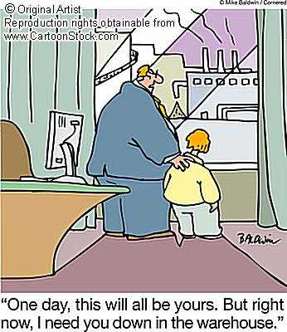
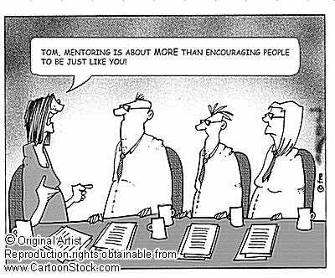
Mentoring

Slide 30
Mentoring
Shared responsibility
  the faculty member
  the departmental leadership
  all of us as colleagues
Sometimes it is offered, sometimes you need to look for it
Mentors fulfill different roles at different times:
  Research
  Clinical
  Personal Issues
  Career

Slide 31
Mentoring
Seek and cultivate mentorship(s) you need
And, actively seek and cultivate the mentorships you can offer

Slide 32
Questions?

