Slide 1
AP/HP Conference

Slide 2
Case Presentation

Slide 3
Clinical history
66 year old male
Caucasian
No prior history of malignancy
Gross hematuria
Urine cytology
Positive

Slide 4
Clinical history
Cystoscopic exam
Small papillary mass on posterior bladder wall
Surrounding urothelium flat, erythematous
Transurethral resection with removal of all grossly visible disease

Slide 5
Bladder biopsy
Notes:
This low power view of the largest portion of tumor is exophytic and papillary

Slide 6
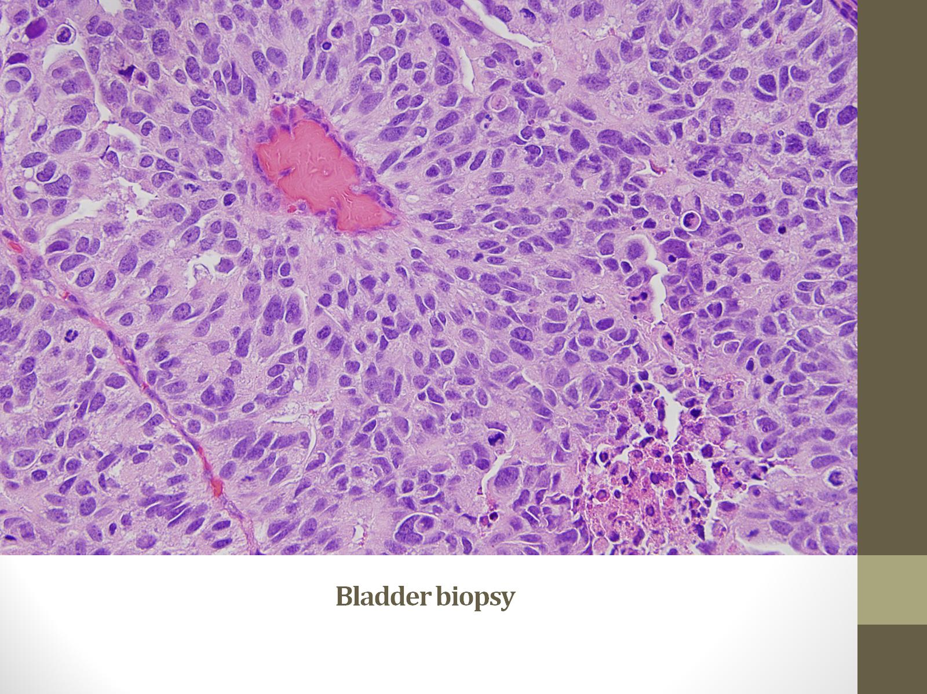
Bladder biopsy
Notes:
The high power view of one of the papillae shows the vascular core lined by a thickened urothelium with cells with abundant cytoplasm, marked nuclear enlargement, pleomorphism and numerous mitoses. All common findings of high grade papillary urothelial carcinoma.

Slide 7
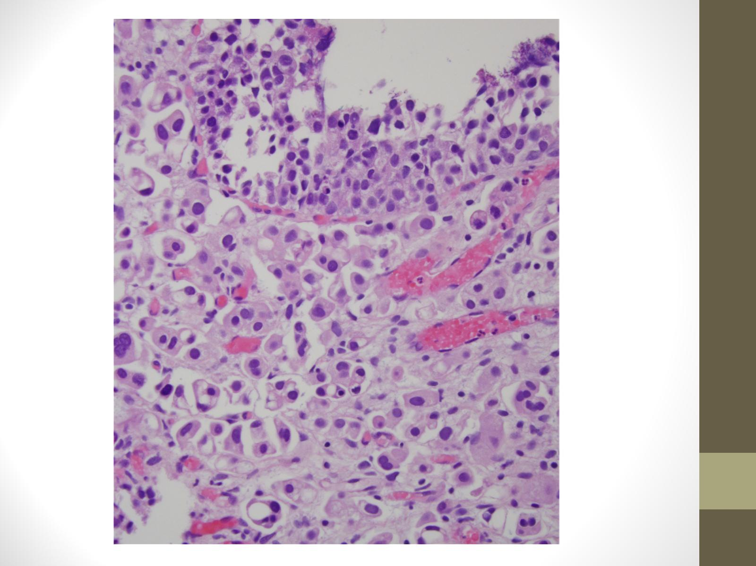
Notes:
Other pieces have areas of carcinoma in situ and one out of all the tissue one piece show an areas of invasion in the lamina propria

Slide 8
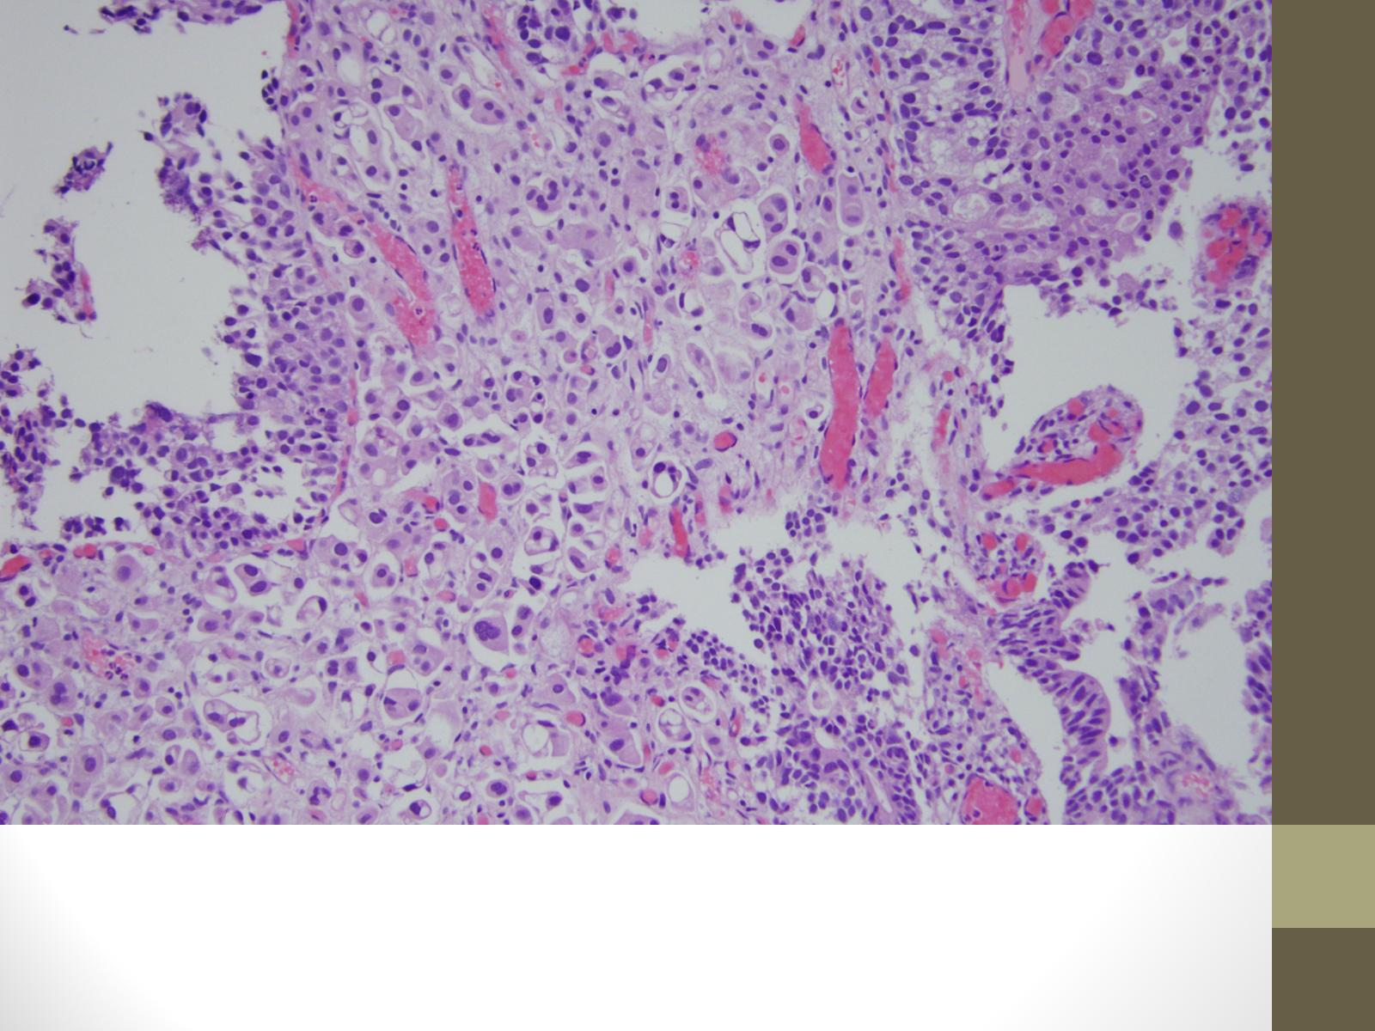
Notes:
The cells are aggregated in small groups of two to three cells with occasional single cells scattered throughout. In addition there are areas of retraction around the groups and single cells which create an empty space. As you can see in some area there are mulitple small nests within the same lacune. The invasive cells have high grade nuclear features similar to those seen in-situ components.

Slide 9
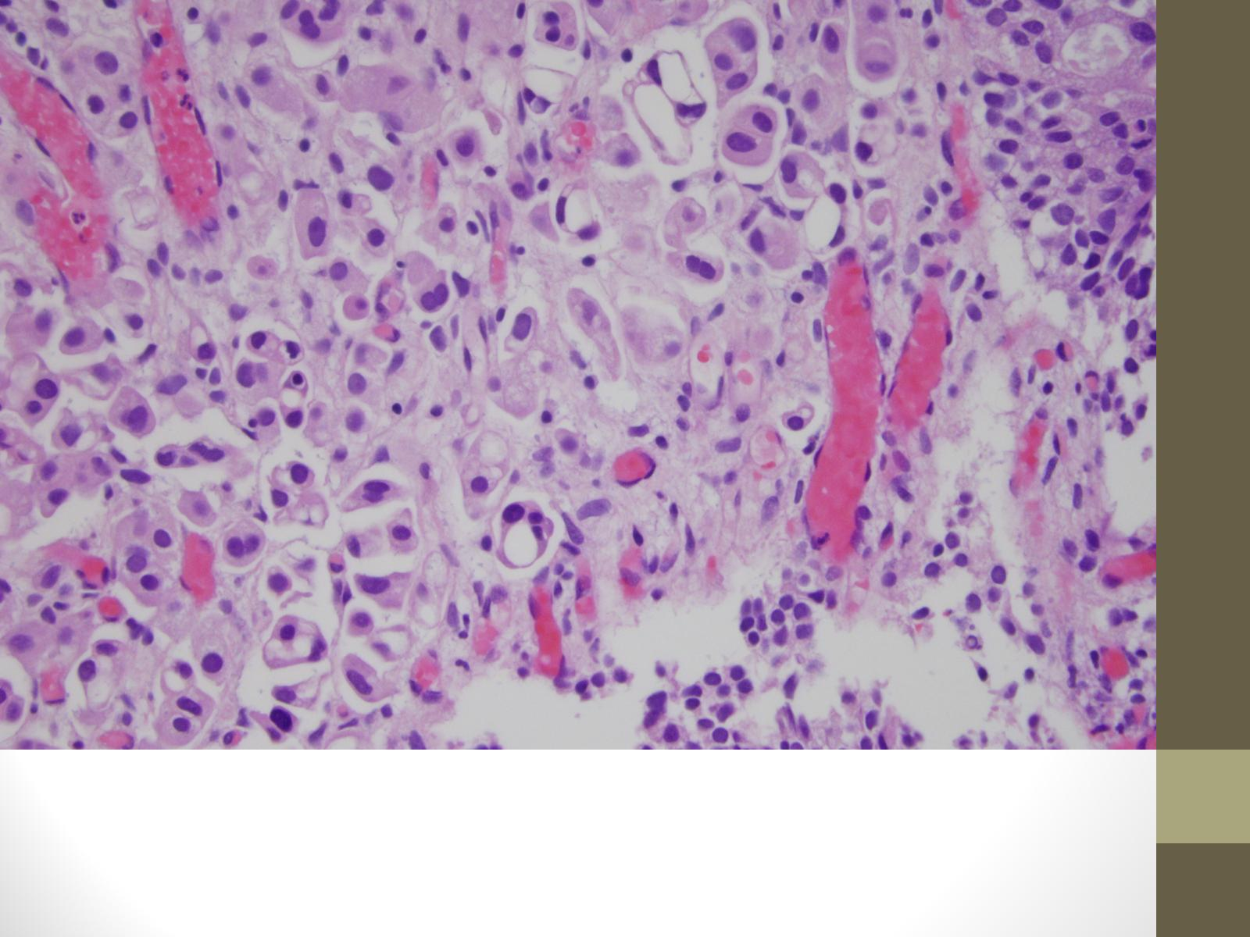
Notes:
At high power epithelial ring forms

Slide 10
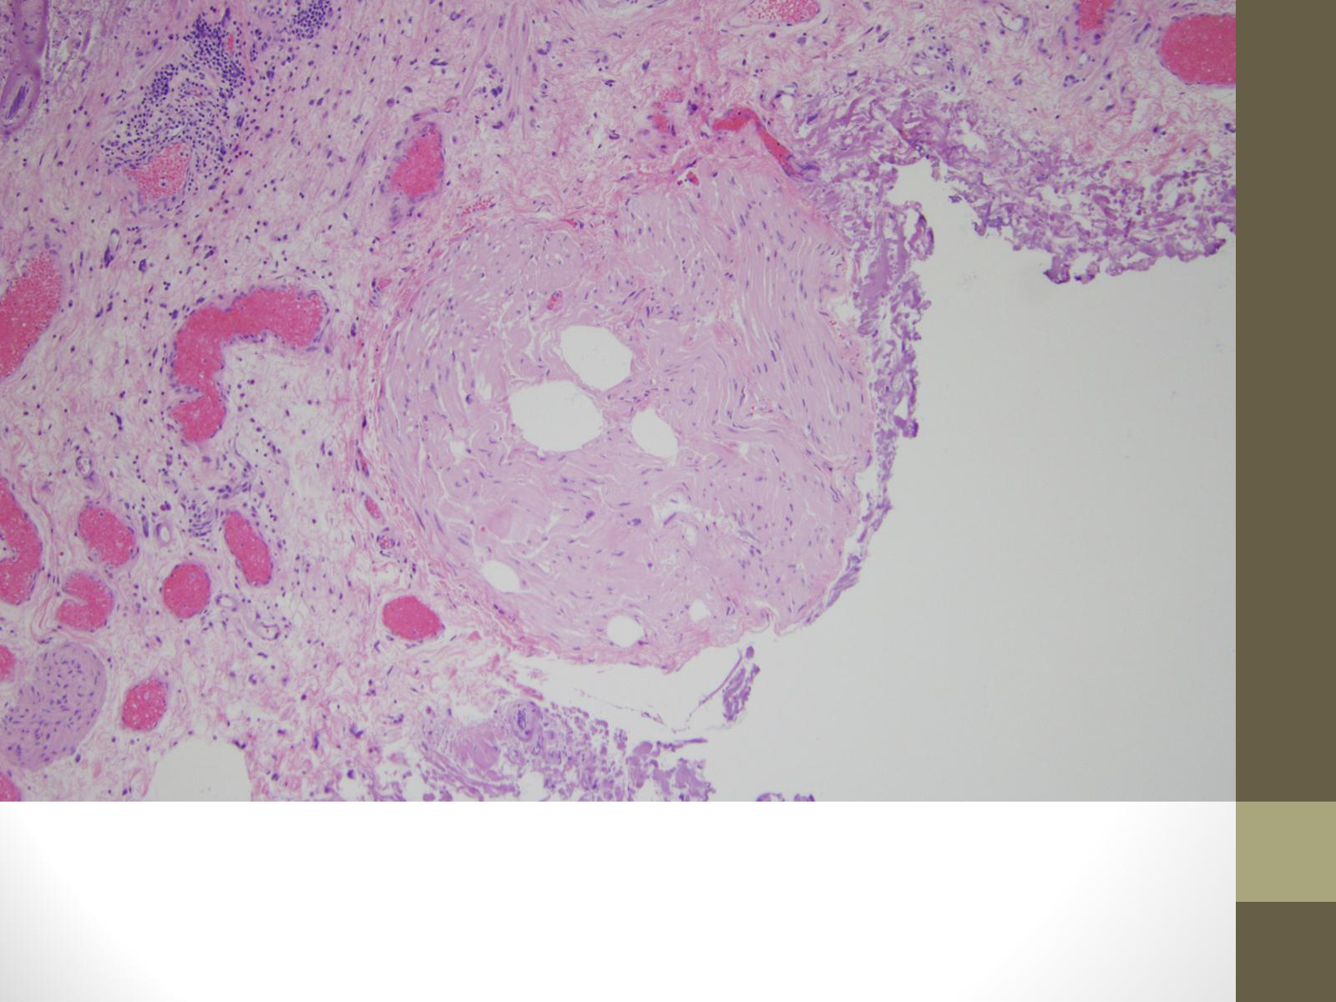
Notes:
The remainder of the resection is remarkable only for areas of uninvolved lamina propria and muscularis propria. As you can see these are thick bands of smooth muscle, that are to large to represent hypertrophic muscularis mucosae.

Slide 11
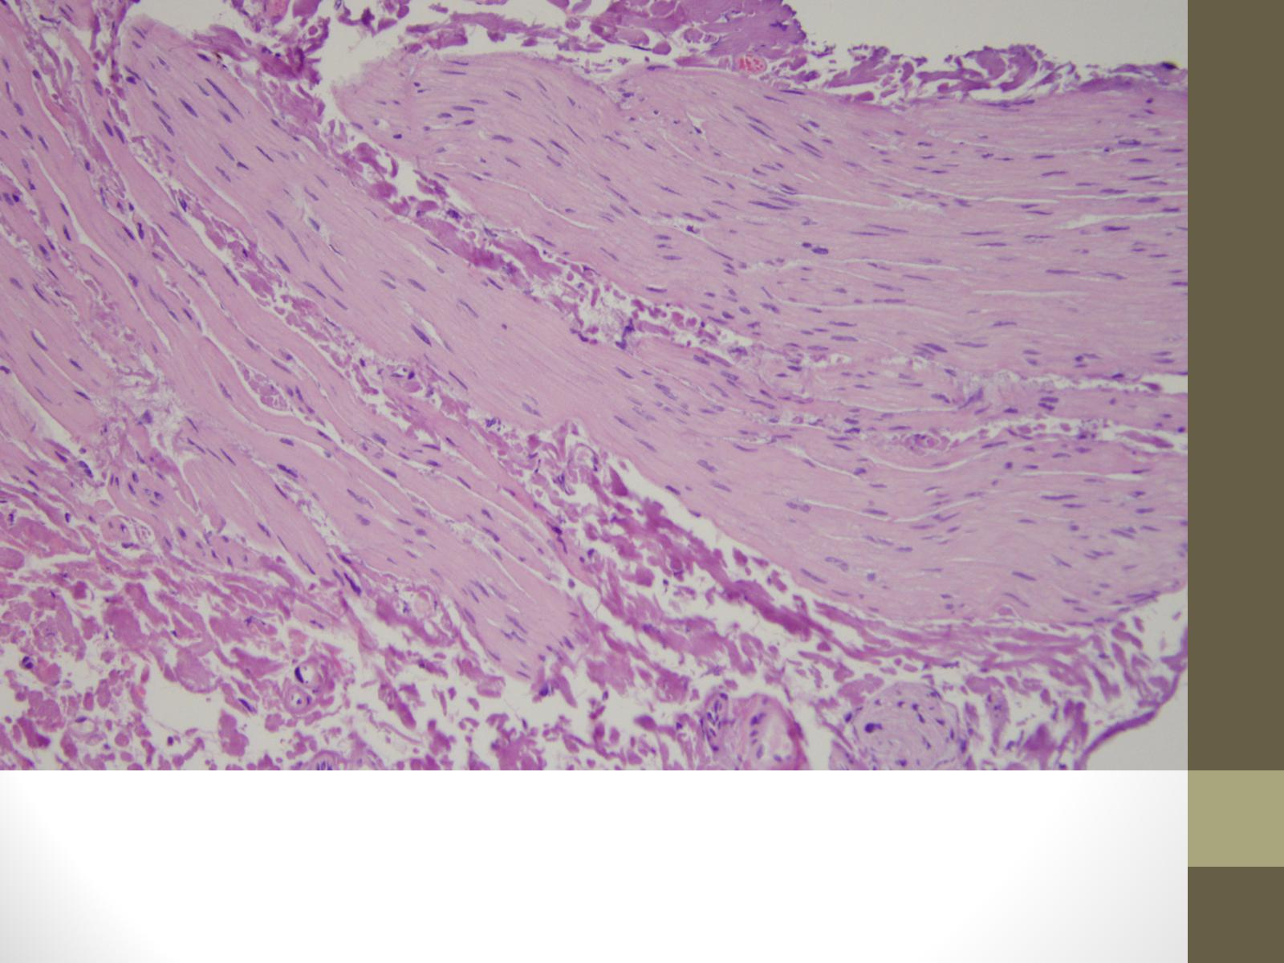
Notes:
So the muscularis propria is well sampled and is uninvolved by the tumor

Slide 12
Differential diagnosis
High grade papillary urothelial carcinoma invading lamina propria
High grade papillary urothelial carcinoma with micropapillary differentiation invading lamina propria
Notes:
Based on the morphology the differential diagnosis for the invasive component is conventional urothelial carcinoma with extensive retraction or invasive carcinoma with micropapillary differentiation. This is a differential that is encountered on occasion in GU however it is almost always in the setting of a TUR showing extensive invasion of the muscularis propria . In a case such as this, in which the invasive component is small and even more importantly limited to the lamina propria with a adequately sampled muscularis propria that (meaning pT1 or superficially invasive disease) the diagnosis will determine the treatment options available to this patient which I will review later. So unlike many things that we worry about in GU that are only interesting to us and will not affect the treatment this diagnosis will.

Slide 13
Differential diagnosis
H&E
Overlapping features
Stromal retraction vs. micropapillary differentiation
IHC
CK7+, CK 20+/-
MUC1,CA-125^{1,2}
Her 2³
Notes:
So how can the two be differentiated? Primarily it is based upon the morphology seen on H&E.
Immunohistochemistry is not utilized in the differential
Both micropapillary and conventional urothelial carcinoma are CK 7 positive and show variable CK 20 expression.
Initially staining MUC1 and CA-125 were thought to be specific for micropapillary differentiation however additional studies did not support that observation and as it lacked specificity as morphologically conventional urothelial carcinoma can also express those markers.There maybe utility in Her2 expression however it is not yet utilized on a clinical basis
for Lopez beltran A, Montrioni R, Cheng L et al Invasive micropapillary of the urinary bladder. Hum Pathol 2009. While both conventional urothelial and micropapillary are CK7 + with variable 20 expression. Reports of MUC 1, Her2 and CA-125 expression being specific for MPC were not supported additional studies.

Slide 14
Histologic features
In situ⁴
Delicate filiform processes
Most avascular
Glomeruloid
Invasive
Tumor cells form small tight nests
Nests form aggregates within lacunae
Mimics vascular invasion
High grade nuclei
Vascular invasion
Conspicuous absence of psammoma bodies
Notes:
So what are the morphologic criteria for micropapillary differentiation? When it was first described it was noted that the in situ and invasive components had different features. The in situ component has delicate filiform processes that most often lack a vascular core. When cut in cross section these filiform processes appear as glomeruloid bodies

Slide 15
Micropapillary carcinoma in situ
Notes:
Here you can see an exophytic papillary architecture with areas of smaller, more filiform processses

Slide 16
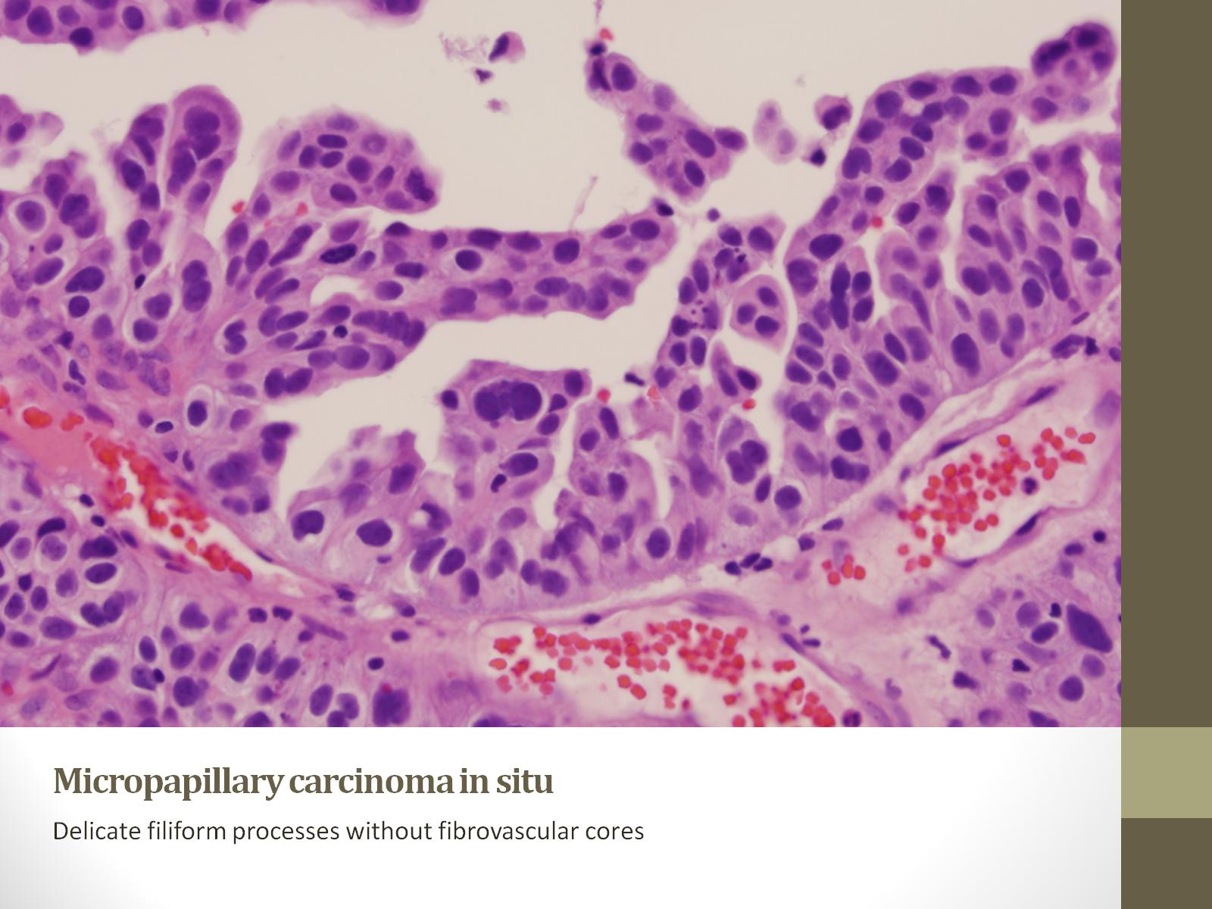
Micropapillary carcinoma in situ
Notes:
At high power you can see they are smaller that the papillae of conventional urothelial carcinoma, more delicate and in addition are avascular

Slide 17
Micropapillary carcinoma in situ
Notes:
Here you can see that when those processes are cut in cross section they appear as glomeruloid bodies

Slide 18
Histologic features
In situ
Delicate filiform processes
Most avascular
Glomeruloid
Invasive⁴
Tumor cells form small tight nests
Nests form aggregates within lacunae
Mimics vascular invasion
High grade nuclei
Absence of psammoma bodies
Notes:
In the invasive components the tumor cells form small tight nests which aggregate in stromal retraction spaces or lacunes. Many times there is no evidence of a stromal response in the form of desmoplasia or marked inflammation. The small nests with extensive retraction can mimic vascular invasion. The nuclear features are almost exclusively high grade. Also unlike papillary serous carcinoma of the ovary that shares many histologic features, psammomatous calcifications are almost never present.

Slide 19
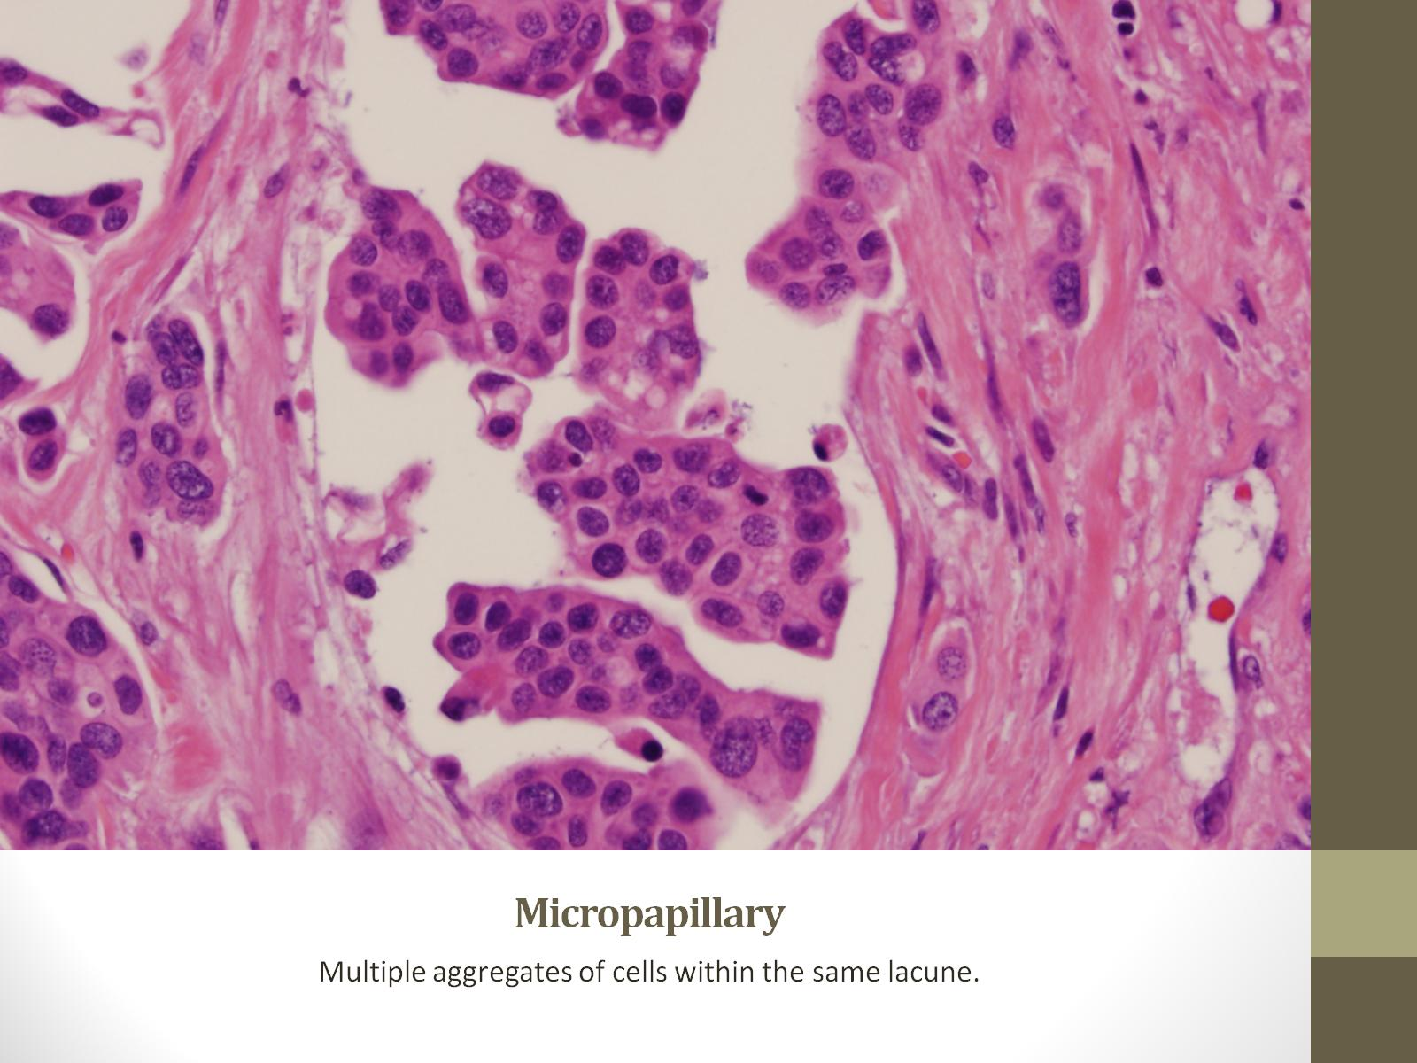
Micropapillary

Slide 20
Micropapillary
Notes:
In this section from a cystectomy the micropapillary carcinoma has invaded through the muscularis propria and is into the perivesical adipose tissue. From this low power picture see that psammomatous calicifications are not present. And also a stromal response is lacking.

Slide 21
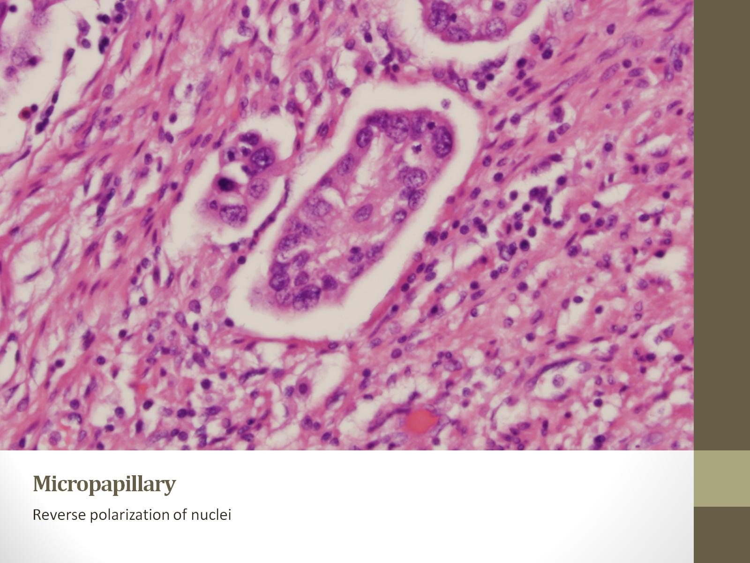
Micropapillary
Notes:
Reverse polarization, when the, nuclei are displaced toward the apical surface is another helpful feature. In addition in areas such as this where there is a small single nest with surrounding retraction without a significant stromal response you can appreciate how it often mimics vascular invaison.

Slide 22
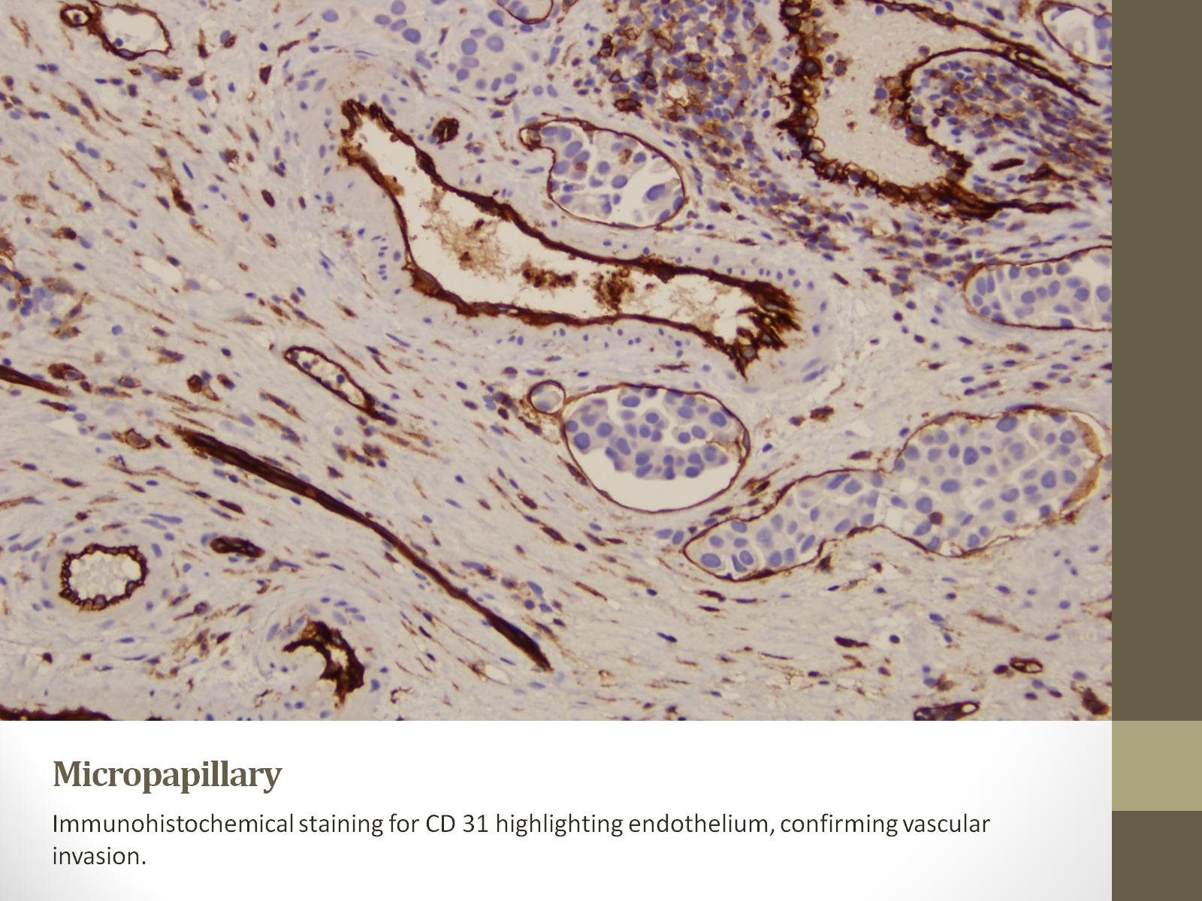
Micropapillary
Notes:
However vascular invasion is often seen with this entity illustarted here with immunohistochemistry highlighting endothelial cells with numerous areas of vascular invasion of the tumor

Slide 24
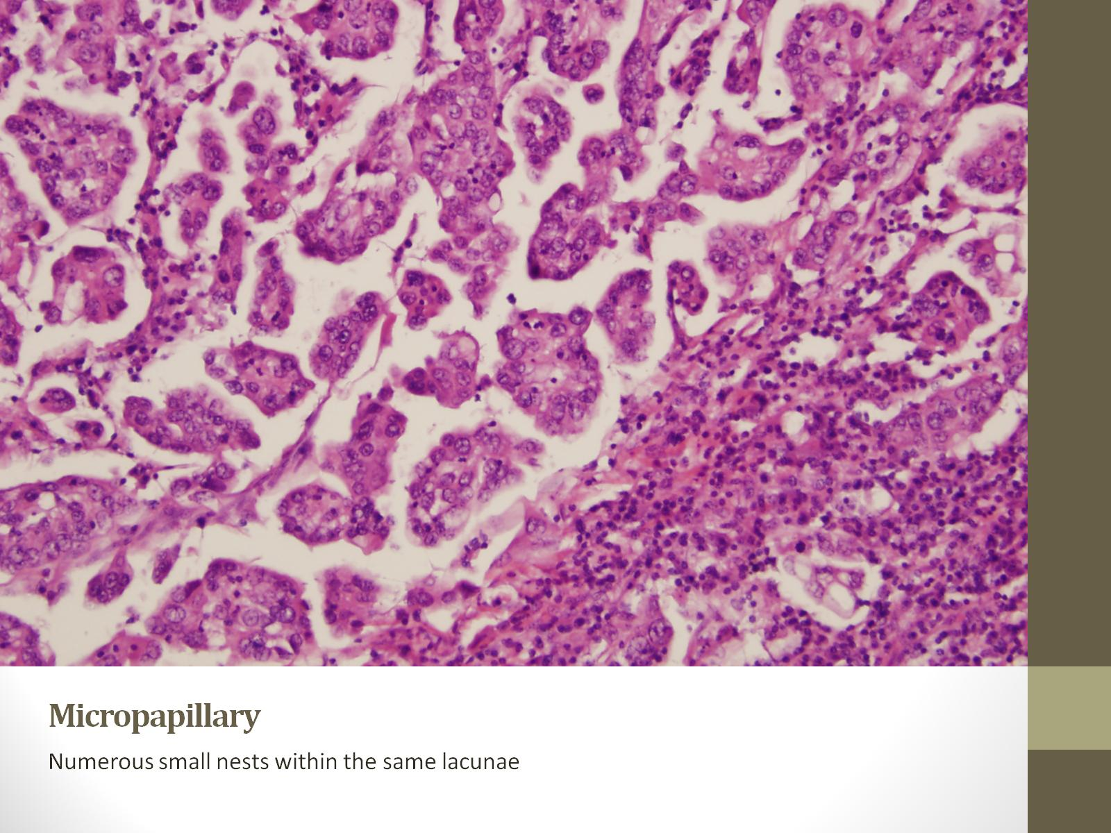
Micropapillary

Slide 25
Micropapillary

Slide 26
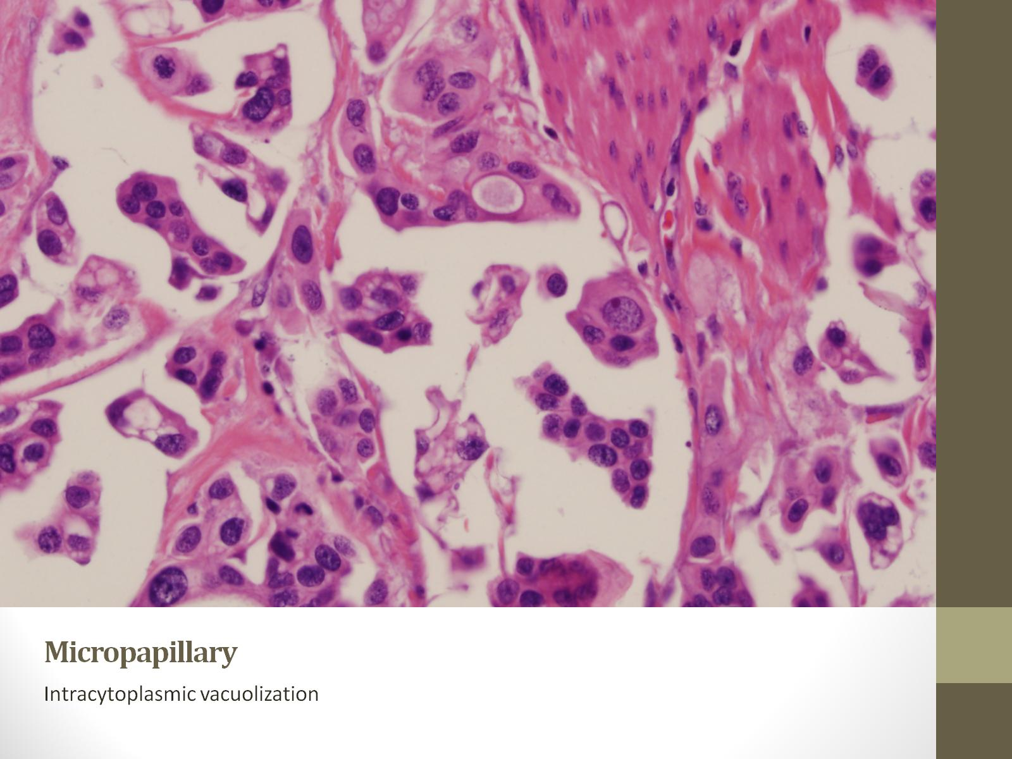
Micropapillary
Notes:
In addition epithelial ring forms and intracytoplasmic vacuolization are helpful features

Slide 27
Conventional urothelial carcinoma
Notes:
Usually invasion of conventional urothelial carcinoma is morphologically distinct from MP differention. The invasive component is often in the form of large jagged nests, or in sheets and strands.

Slide 28
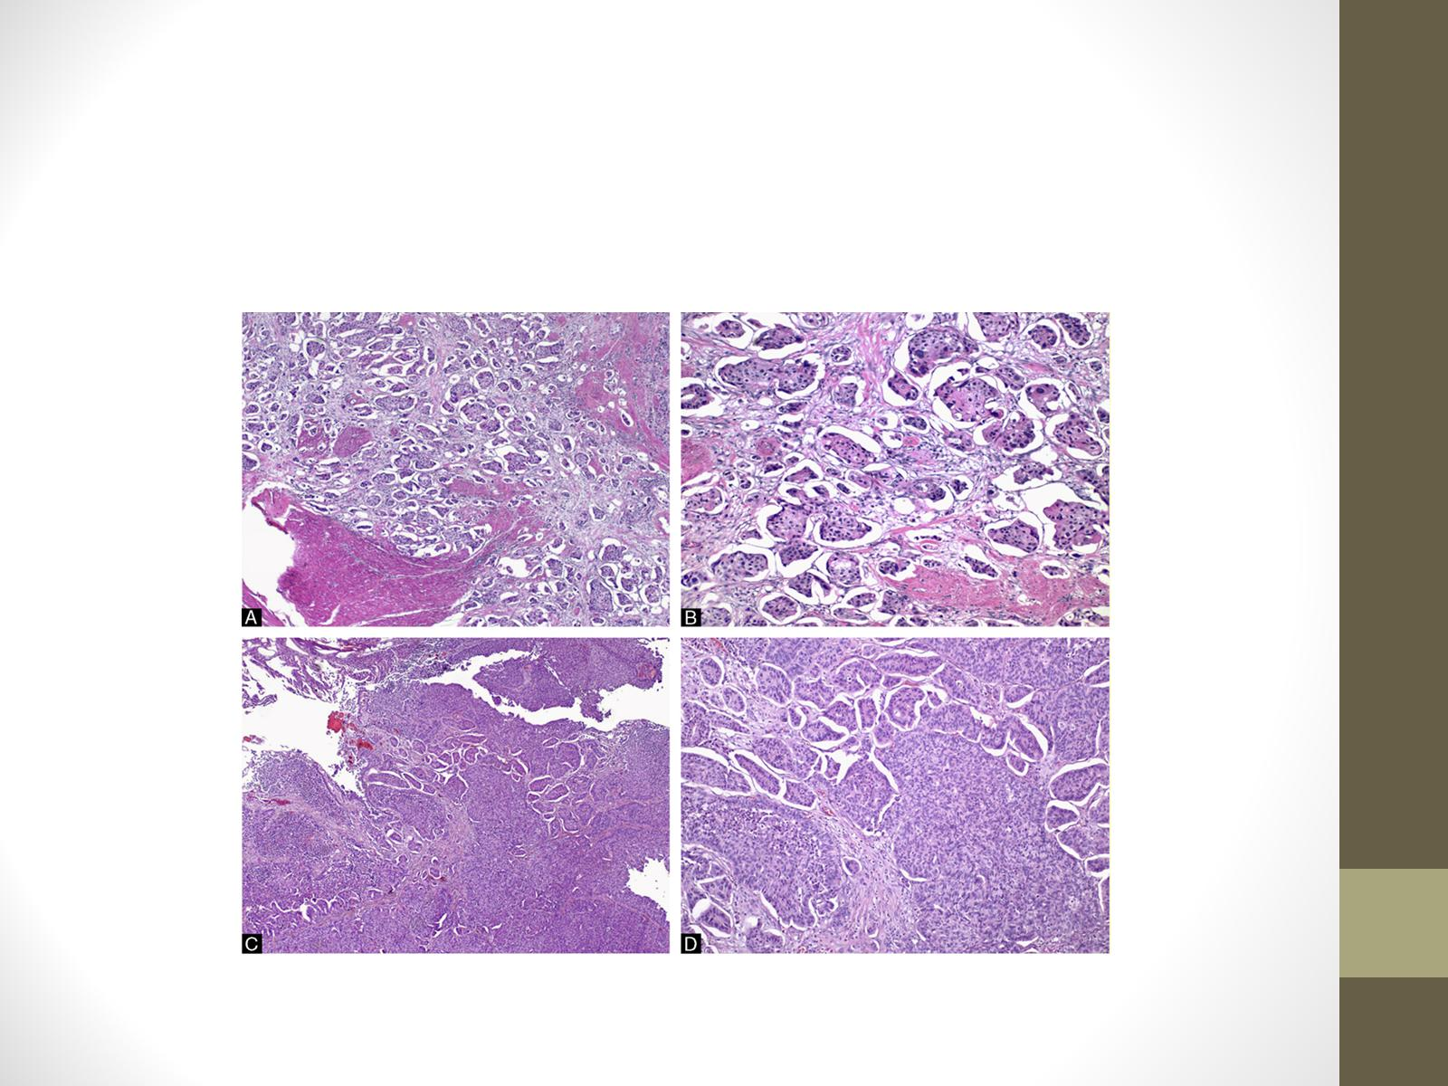
Urothelial carcinoma with extensive retraction⁵
Sangoi A, Beck A, Amin M et al.Interobservor reproducibility in the diagnosis of invasive micropapillary
Carcinoma of the urinary tract among urologic pathologists. Am Jour Surg Path
2010.34: 1367.
Notes:
However, conventional urothelial carcinoma can also show marked stromal retraction. Stromal retraction is common in urothelial carcinoma and is even of the features that is used to help identify invasion. However when the retraction is extensive differentiating between micropapillary and conventional carcinoma becomes more problematic.
A study addressing the reproducibilty of diagnosing micropapillary carcinoma this problem was highlighted by a lack of consensus in these cases above c it was recommended that more restrictive criteria should be applied to diagnose invasive micropapillary carcinoma in the urothelial tract. that small tumor cellt was reported that the presence of multiple nests within the same lacunar space was most closely associated with classic micropapillary differentiation and in addition, epithelial ring forms \ epithelial ring forms, micropapillae, and reverse polarization could all be utilized to identify mpd.

Slide 29
Notes:
So looking at his biopsy the nests are small, and there are multiple within the same lacune and epithelila rings are present. Based on those features

Slide 30
Diagnosis
Invasive high grade papillary urothelial carcinoma involving lamina propria
Micropapillary differentiation
Muscularis propria uninvolved
Notes:
Based on the morphologic criteria, with the nests being small, and numerous nests within the same lacune as well as the epithelial ring forms this was diagnosed as invasive papillary urothelial carcinoma with micropapillary differentiation with invasive disease limited to the lamina propria.

Slide 31
discussion

Slide 32
Micropapillary
Reported in 1994⁴
Amin et al
18 cases
Filiform processes or tight papillary clusters reminiscent of papillary serous carcinoma of the ovary
Poor outcome
Form of divergent differentiation
Notes:
MPC 1st reported in the urothelium by Amin and colleuges in 1994 in a case series of 18 patients. It was noted that it beared resemblance to histologically to papillary serous carcinoma of the ovary aside from its absence of psammomatous calcifications. In addition they noted that in their case series the disease exhibited aggressive behavior in comparison to conventional urothelial carcinoma. Since its regocnition it has been regarded as one of many forms of divergent differentation that can be seen in urothelial carcinomas.

Slide 33
Divergent differentiation recognized by W.H.O.
Nested
Microcystic
Micropapillary
Lymphoepithelioma like
Lymphoma like
Plasmacytoid
Sarcomatoid
Giant cell
Undifferentiated
With squamous differentiation
With glandular differentiation
With trophoblastic differentiation
Notes:
There are many types of divergent differentiation and most of which are recognized in the current WHO. Studies on the types of divergent differentation, outside of their morphologic features are limited. This is in part due to their rarity precluding large trials. And as such current data regarding their behavior is primarly limited to case series and retrospective studies. In addition when they are reported they have been excluded from clinical trial due to the presence of variant morphology. Of the forms of divergent differentiation, although micropapillary is not the most common it is perhaps the one most studied in regards to its behavior and treatment response. In some large centers its presence dictates the treatment the patient recieves and in most places at minimun plays a role in determining treatment options offered to the patient.

Slide 34
Divergent differentiation
Rare or underreported?
Some form of divergent differentiation reported in up to 40% of transurethral resections⁵
Most common types⁶
Squamous
Glandular
Association with high grade urothelial carcinoma⁶⁻⁷
Aggressive
Independent predictor of extravesical disease at cystectomy ⁸
Decreased disease free survival ⁹
Notes:
In the past, divergent differentiation was thought to be quite uncommon. However ,recent data suggests it is underreported and that at large centers is noted in up to 40% of all transurethral resections. The most common types of divergent differentiation are squamous followed by glandular differentiation Looking at all forms of divergent differentiation together it is known that they occur almost exclusively in the setting of high grade disease with vast majority occuring in association with invasion. It is believed that its presence is associated with aggressive course. When present in transurethral resections it is an independent predictor of extravesical disease at cytectomy and when divergent differentiation is present in cystectomy in amounts over 20% those patients have decreased disease free survival compared to those with conventional urothelial carcinoma.

Slide 35
Micropapillary incidence and associations
Uncommon
0.7-8.0% of invasive urothelial carcinomas²⁻⁴
Mean 3%
Men>> Women^{3,10}
5:1-10:1
Presentation
Gross hematuria
CIS 60%¹¹
Notes:
Micropapillary carcinoma is relatively rare with this differentiation present on average in 3% of all invasive urothelial carcinomas . In roughly 60% of cases micropapillary differentiation is accompanied by flat urothelial carcinoma in situ. MPUC is much more common in men than woman, far surpassing the 3:1 male to female ratio noted for those diagnoses with conventional urothelial carcinoma. Like conventional urothelial carcinoma and all other forms of divergent differentiation its most common presentation is with gross painless hematuria.

Slide 36
Differential diagnosis
Metastatic disease
Micropapillary
Breast
Lung
Ovary (papillary serous)
Colon
Pancreas
Salivary gland
IHC
Notes:
I have discussed the salient morphologic features that allow differentiation of invasive micropapillary urothelial carcinoma from conventional urothelial carcinoma with extensive retraction artifact. Another differential involving micropapillary urothelial carcinoma occurs in the setting of metastatic micropapillary carcinoma when the primary site is unknown. As we know micropapillary architecture is not unique to the urothelium and this morphology can be seen in carcinomas arising from the ovary, breast lung, colon, pancreas and others. In some of thesse cases an immunohistochemical panel may be of use to determine its site of originatio

Slide 37
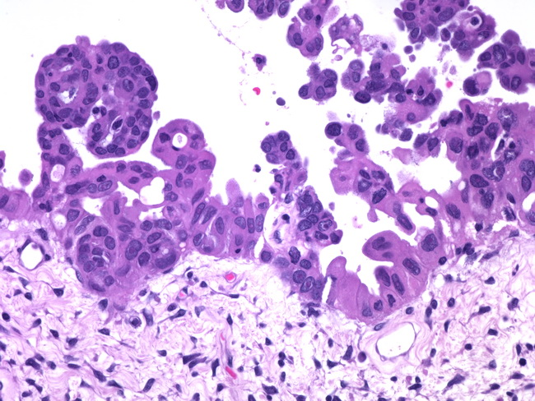
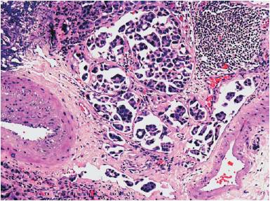
Notes:
Here we have carcinomas from various organ sites all exhibiting micropapillary differentiation. When these occur in their respective organs the source if most often obvious. However when present in a node or in patients with mulitple tumors and immunohistochemical panel can be utilized.

Slide 38
Differential diagnosis
Lotan T, et al Immunohistochemical panel to identify primary site of invasive micropapillary carcinoma
IHC staining on tissue microarray
47 cases of invasive micropapillary carcinoma
Breast
Lung
Ovary
Urothelium
Notes:
A study by Epstein and colleagues reported a panel of eight stains that can aid in differentiation of the site of orign in such cases In their study micropapillary carcinomas from the breast, lung, urothelium and ovary and were tested with various ihc markers evaluated with tissue microarrays. Based on their findings they recommened a panel of eight stains incluing uroplakin, CK 20, TTF-1, ER, mammoglobin and either PAX-8 or WT1 that can be utilized to differentiate the carcinomas among these organ sites

Slide 39
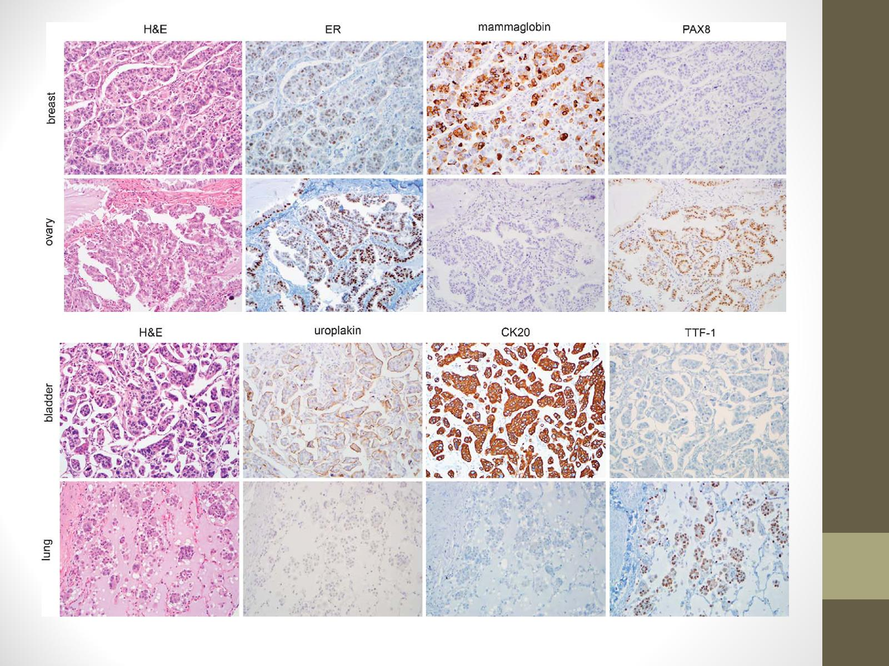
Lotan T, Ye H,Melamed J et al Immunohistochemical panel to identify primary site of invasive micropapillary carcinoma. Am J Surg Path 2009.33; 1037-41.
Notes:
The best markers for identifing urothelial uroplakin and CK20
Breast ER mammaglobin positive and PAX-8 negative
While ovarian was pax-8 and er positive and negative for mammaglobin
Lung was uniformly ttf1 +

Slide 40
Behavior
Aggressive
Presents at higher stage than conventional¹³
More likely lymphovascular invasion
Amount significant¹⁴
Micropapillary differentiation under 10%
84% pTa or pT1
Micropapillary differentiation over 10%
Majority with pT3 or above
Notes:
The aggressive nature of mpc of the urothelium is well established. One study noted the that percentange of micropapillary differentiation correlated with the stage of disease. In cases showing less that 10% mp the disease was more likely to be of low stage and that at percentages over that 10% over half of all patients would be at stage pT3 or above

Slide 41
Treatment
Intravesical BCG therapy ineffective^{3,7}
High rate of progression
67% of the patients administered intravesical chemotherapy progression (pT2 or higher)
22% developed metastases within 8 months on average after treatment
Notes:
Noting MP histology does effect the treatment of the patients. For conventional urothelial carcinoma that is in situ or invading the lamina propria potentially bladder sparing treatment with intravesical BCG therapy are often utilized.
However several studies have demonstrated a lack of efficacy for BCG therapy for micropapillary carcinoma in either in situ or lamina propria invasive disease. In the largest series of patients with 100 consecutive patients with micropapillary differentiation the authors found patients with micropapillary histology 67% of cTIS/cT1 progressed within median of 8 months and of those that progressed 22% had metastatic disease.
Based upon those findings some have recommended radical cystectomy for mpd even when limited to the lamina propria. In discussion with our urologists they do recommend cystectomy in this setting but only in select circumstances. However they prefer to do an addiotional tranuretheral resection, as often times muscle invasive disease is found.
Of those who had a radical cystectomy (cT4a or less) those who received neoadjuvant chemotherapy had a 5 year survival rate of 32% compared to those who were treated with initial cystectomy with a 5 year survival rate of 71%. As such they concluded that recommended early cystectomy for all surgically resectable carcinomas with micropapillary histology is indicated.
As for chemotherapy, Kamat el al reported that those receiving neoadjuvant chemotherapy prior to cystectomy did not improve survival at five years (63% neo 71% surg alone, not statistically significant)
Adjuvant chemotherapy has not shown success either, in your series of the 15 patients receiving adjuvant chemotherapy (gem-cis) the overall 5 year survival was 40%.

Slide 42
Second transurethral resection
Notes:
So for our patient based on the diagnoses, bladder sparing therapy was not offered, and because they felt all disease had been removed, yet aware of the aggressiveness of micropapillary differentiation the patient opted to undergo another TUR before deciding to undergo radical cystectomy. Shown here is the most recent TUR that did not contain an exophtyic component but more importantly shows muscle invasive disease. As such the patient is currently scheduled to undergo cystectomy in the near future.

Slide 43
References
1. Amin MB, Ro JY, el-Sharkawy T, et al. Micropapillary variant of transitional cell carcinoma of the urinary bladder. Histologic pattern resembling ovarian papillary serous carcinoma. Am J Surg Pathol 1994;18:1224–1232.
2.Samaratunga H, Khoo K. Micropapillary variant of urothelial carcinoma of the urinary bladder; a clinicopathological and immunohistochemical study.Histopathology 2004;45:55–6
3.Kamat AM, Gee JR, Dinney CP, et al. The case for early cystectomy in the treatment of nonmuscle invasive micropapillary bladder carcinoma. J Urol2006;175:881–885.
4. Alvarado-Cabrero I, Sierra-Santiesteban FI, Mantilla-Morales A, et al. Micropapillary carcinoma of the urothelial tract. A clinicopathologic study of 38 cases. Ann Diagn Pathol 2005;9:1–5
5. Lotan T, et al Immunohistochemical panel to identify primary site of invasive micropapillary carcinoma. Am J Surg Ppath 2010.
6. .J. I. Lopez, K. Elorriaga, I. Imaz, and F. J. Bilbao, “Micropapillary transitional cell carcinoma of the urinary bladder,” Histopathology, vol. 34, no. 6, pp. 561–562, 1999.
7 .A. M. Kamat, C. P. N. Dinney, J. R. Gee et al., “Micropapillary bladder cancer: a review of the University of Texas M. D. Anderson Cancer Center experience with 100 consecutive patients,” Cancer, vol. 110, no. 1, pp. 62–67, 2007
8. E. Compérat, M. Roupret, J. Yaxley et al., “Micropapillary urothelial carcinoma of the urinary bladder: a clinicopathological analysis of 72 cases,” Pathology, vol. 42, no. 7, pp. 650–654, 2010.6.A.
9. R. Sangoi, A. H. Beck, M. B. Amin et al., “Interobserver reproducibility in the diagnosis of invasive micropapillary carcinoma of the urinary tract among urologic pathologists,” American Journal of Surgical Pathology, vol. 34, no. 9, pp. 1367–1376, 2010.7
10. K. E. Watts and D. E. Hansel, “Emerging concepts in micropapillary urothelial carcinoma,” Advances in Anatomic Pathology, vol. 17, no. 3, pp. 182–186, 2010
11.A. R. Sangoi, J. P. Higgins, R. V. Rouse, A. G. Schneider, and J. K. McKenney, “Immunohistochemical comparison of MUC1, CA125, and Her2Neu in invasive micropapillary carcinoma of the urinary tract and typical invasive urothelial carcinoma with retraction artifact,” Modern Pathology, vol. 22, no. 5, pp. 660–667, 2009.
12L. Lotan, H. Ye, J. Melamed, X. R. Wu, I. M. Shih, and J. I. Epstein, “Immunohistochemical panel to identify the primary site of invasive micropapillary carcinoma,” American Journal of Surgical Pathology, vol. 33, no. 7, pp. 1037–1041, 2009
13. Johansson SL, Borghede G, Holmäng S. Micropapillary bladder carcinoma: a clinicopathological study of 20 cases. J Urol. 1999;161:1798–1802. 2. Jozwicki et al
14. Wasco MJ, Daignault S, Zhang Y et al. Urothelial Carcinoma with Divergent Histologic Differentiation (Mixed Histologic Features) Predicts the Presence of Locally Advanced Bladder Cancer When Detected at Transurethral Resection. Jour of Urol 2007.70 (1)69-74.

Slide 44
Questions

