Slide 1
Medical School Faculty Career Development : Supporting Faculty Achievement and Enhancing the Michigan Experience
October 23, 2013
Sonya Jacobs, M.S.
Director, Faculty Development

Slide 2
Objectives
Share faculty development opportunities
Understand unique challenges facing Pathology Faculty
Discuss opportunities for synergy amongst efforts
Notes:
Specifically leadership development

Slide 3
Overarching Goals
To support faculty skill acquisition in teaching, research and navigating the complex organizational structures in which they practice
To maintain high levels of faculty satisfaction with their professional experience at UMMS
To remain competitive with our peer Medical Schools
  To maximize UMMS’ ability to recruit and retain high quality faculty
Notes:
Since the last time this group was convened

Slide 4
Areas of Focus
Engaging faculty in their career development
Improving understanding of and communications about career progression
A structured, effective approach to career advising/mentoring
Faculty leadership development
Notes:
Initial Areas of Focus:
Supporting a more structured, effective approach to career advising/mentoring and expanding the Medical School’s mentoring culture
Tactic: Providing guidance for mentoring relationships
Tactic: Develop mentorship culture within the institution
Engage faculty in taking responsibility for their career development- (self-directed approach)
Improving understanding of and communications about career progression, including development of a curriculum focused on non-clinical skills
Tactic: Clarify career path options and requirements for progression for each track, including providing guidance about how to accomplish requirements
Helping faculty develop and apply leadership skills appropriate to their roles

Slide 5
Faculty Career Development
Faculty Development supports the academic careers of our faculty through
  Skill development workshops (teaching, research, conflict management, management/leadership development)
    Follow-up sessions to reinforce learning
  Mentoring and Coaching
  One on One consultation
  Level-specific leadership development

Slide 6
Career Progression/Advancement
One-Stop-Shopping Wiki site and mobile app
  Promotional benchmarks
  Inventory of skill development opportunities (career advancement, people management, leadership, clinical teaching, publishing, grant writing, mentoring, etc.)
    Multi-modal approach (videos, links to instructor led courses, leader panel workshops, on-line learning, etc.)
  Mentoring
Notes:
Inventory of development opportunities are categories by domains; career advancement including topics such as grants writing, lab management,
Team science/people management including team building, managing conflicts.
Leadership development
managing people, leader
Some of you may have received a set of slides to use during faculty meetings to introduce the site with the link to access the site.
we plan to send a message and link to all faculty on Monday. Plus we'll get it included in the Med School's weekly E-News and Daily Bulletin and it will be included on the internal home page news carousel for a few days.

Slide 7
Accessing the Site
Two ways to quickly access the site:
https://wiki.umms.med.umich.edu/display/
FAFD/Faculty+Career+Development
Or
Via Medical School home page in the yellow bar at the bottom of the page, “Faculty”
Contact Sonya Jacobs at sonyjaco@umich.edu

Slide 8
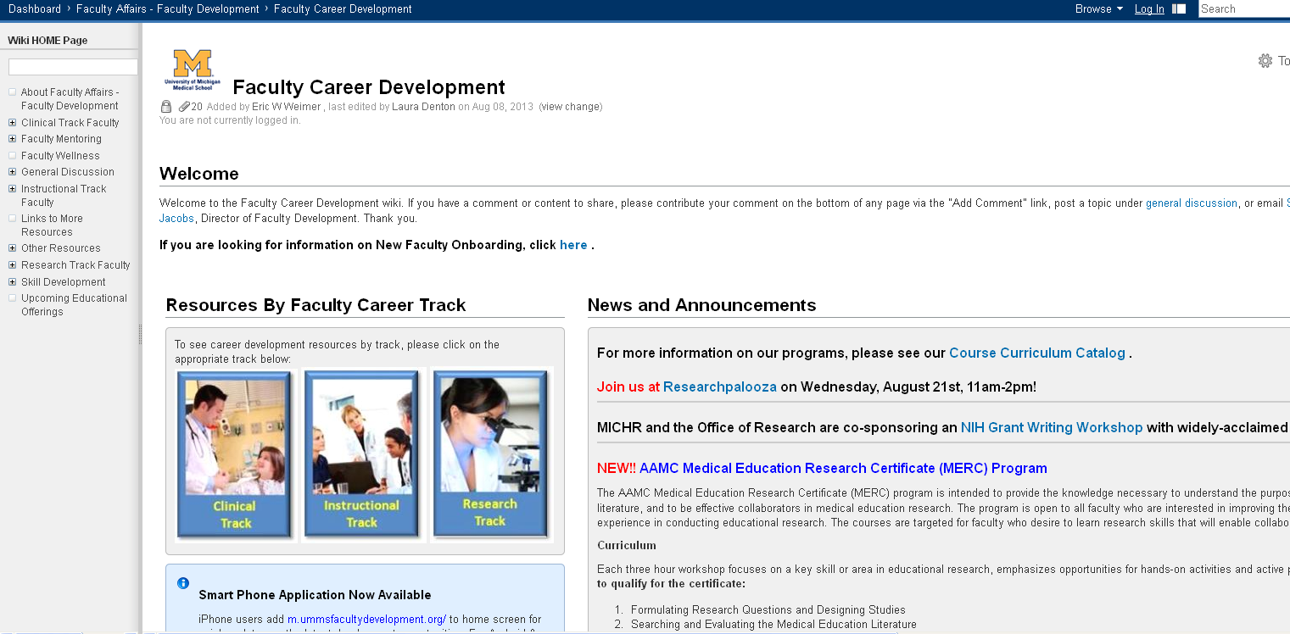
Faculty Development Web Portal Home Page
https://wiki.umms.med.umich.edu/display/FAFD/Faculty+Career+Development

Slide 9
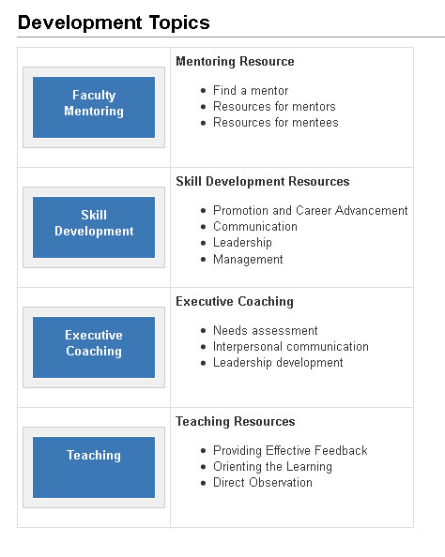
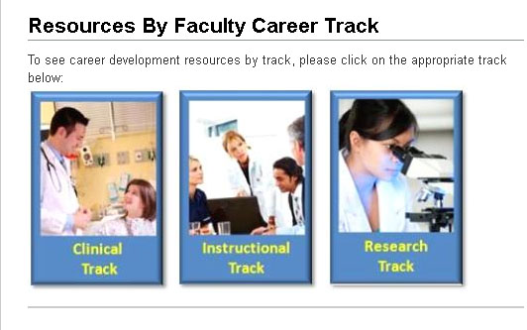
Search by Track or Development Topic

Slide 10
Skill Development Opportunities
Early Career Faculty
Crucial Confrontations
Essential Skills for Successful Leadership
Mid-Level Faculty
Crucial Confrontations
Senior Faculty
Crucial Confrontations
Preparing Scientific Papers
Master’s Series Leadership
Enhancing Clinical Teaching Skills
Enhancing Clinical Teaching Skills
Mentoring and Sponsorship
Mentoring and Sponsorship
Mentoring and Sponsorship
Linkage Leadership Institute
Women in Academic Leadership Coming Soon
Women in Academic Leadership Coming Soon
Basic Negotiation Skills
Advanced Negotiation Skills

Slide 11
Skill Development Workshops
Enhancing clinical teaching skills
Crucial Accountability– 1-day workshop on addressing gaps in expectation
Presentation Skills
Time Management
Mentoring and Sponsorship
Writing Scientific Papers
Patient Safety and Quality Leadership Scholars Program

Slide 12
Skill Development
Upcoming Workshops
  Essential Skills for Successful Leadership (Feb 24)
  Crucial Accountability (Oct 29)
  Writing Winning Proposals (Jan 7)

Slide 13
Upcoming Offerings
  Enhancing Clinical Teaching:
    Turning Observation into Education (Nov. 7)
  Publish or Perish (October 24)
  Crucial Accountability (October 29)
  MERC (Nov. 6+)
  Write Winning Grant Proposals (Jan. 7)
  New Faculty Onboarding (February 6)
  Essential Skills for Successful Leadership (February 24)
  Presentation Skills (Feb 20)
  Time Management (May 22)

Slide 14
Crucial Confrontations
This will be a 1-day workshop, with a 90 minute follow-up session, on Crucial Accountability. Participants will work to acquire tools for resolving broken promises, violated expectations, and bad behavior. In this workshop participants will develop the skills to step up to controversial issues, and then professionally discuss them in a way that makes it safe for everyone to speak.

Slide 15
Leadership Development
Three levels of Leadership Development
  Early-Career Faculty – Essential Skills for Successful Leadership, 1-day workshop
  Mid-Career – UMHS Masters Series Leadership Program, 5-day immersion program
  Senior Leaders – Linkage Leadership Academy, 4-day immersion program

Slide 16
Leadership Development
Components of each program
  Assessment (communication, conflict management and leadership behaviors)
  Workshops (1 day overview or immersion)
  Follow-up sessions – reinforce learning, reconnect and coaching
  Supplemental learning – book discussions, webcasts, etc.

Slide 17
Essential Skills for Successful Leadership
This one-day workshop is designed to assist faculty in developing the essential leadership and management skills necessary to run a lab, start a program or manage a center or division. This workshop will highlight topics such as hiring, leadership, management, diversity, communication, conflict resolution, and managing performance.

Slide 18
Masters Series Leadership Program
This 5-day immersion program is designed to develop the leadership competencies necessary to lead in an ever-changing health care environment. The target audience is mid-level managers with programmatic responsibilities. Change Management serves as the foundation for this 5-day program.
  Participants learn through a combination of assessment, discussion, skill practice, practical application and sharing ideas with one another.
  Participants, also, identify a project on which to focus throughout the program. Each participant leaves the program with a preliminary business case for their project.

Slide 19
Linkage Leadership Institute
This program focuses on the development of the individual senior leader (such as Division Chiefs, Section Heads, Program or Medical Directors and Chairs). This world-class program is an accelerated 4-day immersive learning experience:
  draws on the leader's 360 leadership and personality assessment data and includes 1:1 feedback/coaching
  focuses on 3 major themes; Leading Self, Leading Others and Leading for Results. The first two days will concentrate on self and teams and the last two days on the organization (specifically leading/managing change and driving results).
  includes interactive and aligned development programs, leveraging a dynamic mix of concepts, activities, practical tools, self-assessments, case studies, and team learning

Slide 20
Career Advising and Mentoring
Supporting effective mentoring relationships
Resources to determine the appropriate need (mentoring, sponsorship or career advising)

Slide 21
Mentoring and Coaching
Mentor matrix – help facilitate matching across domains
  Video introductions
  Resources on effective mentoring for both mentor and mentee
  Research articles
Coaching – provide 1:1 consultation

Slide 22
Career Advising/Mentoring Areas of Expertise
Mentoring across differences
Negotiation skills
Grant writing
Managing a lab
Leadership
Tenure review
Work/life balance
Life in Ann Arbor
Career navigation
Teaching
Clinical Translational Health Services
Building a Database (navigating services provided by MICHR)
Navigating IRB

Slide 23
Questions
Specific Needs of Pathology faculty

