Slide 1
Soft – Signout
The New Laboratory System
By Soft Computer Consultants

Slide 2
How to Log In
On your desktop, in the bottom tray, lower right corner:
Double click the icon, select QA
Click SoftPathDx
Click Start
When login screen appears, use your UNIQUE NAME AND LEVEL 2 PASSWORD
Verify your workstation (bottom right corner)

Slide 3
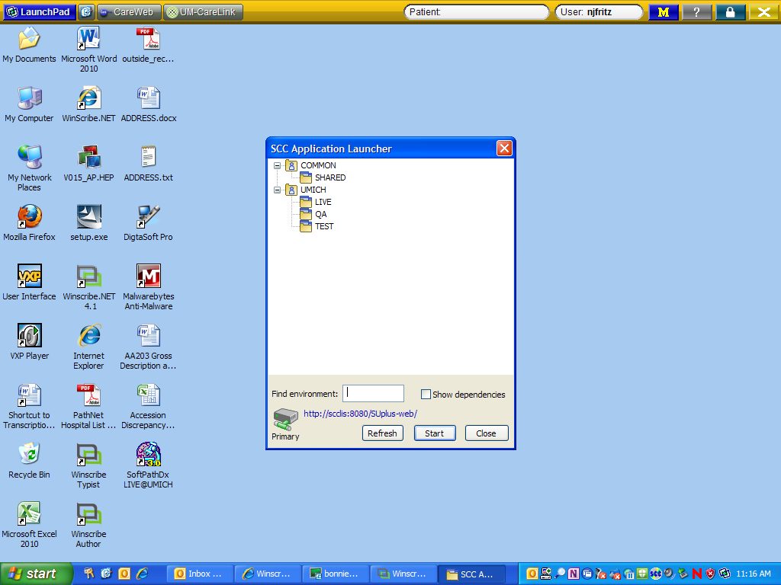

Slide 4
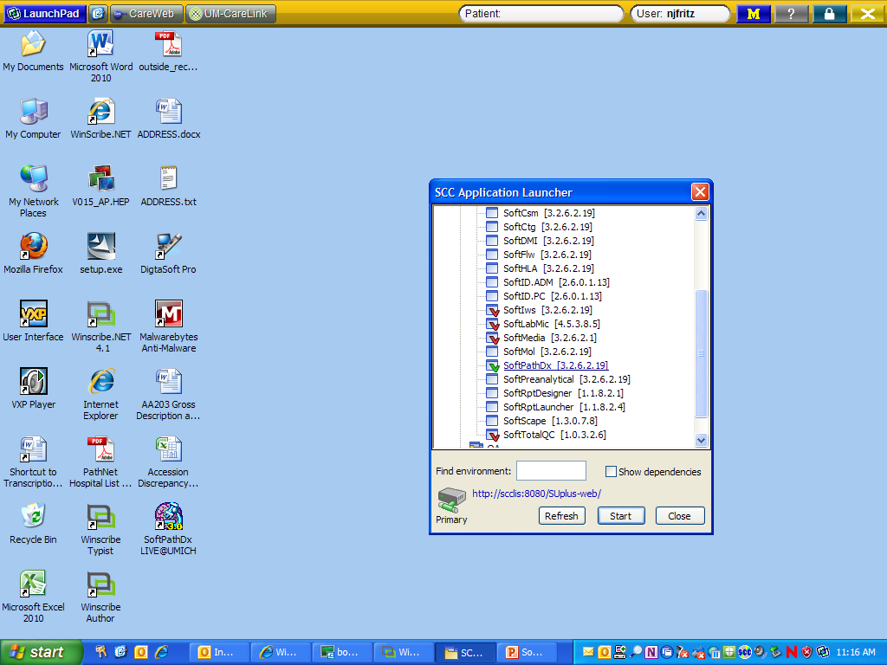

Slide 5
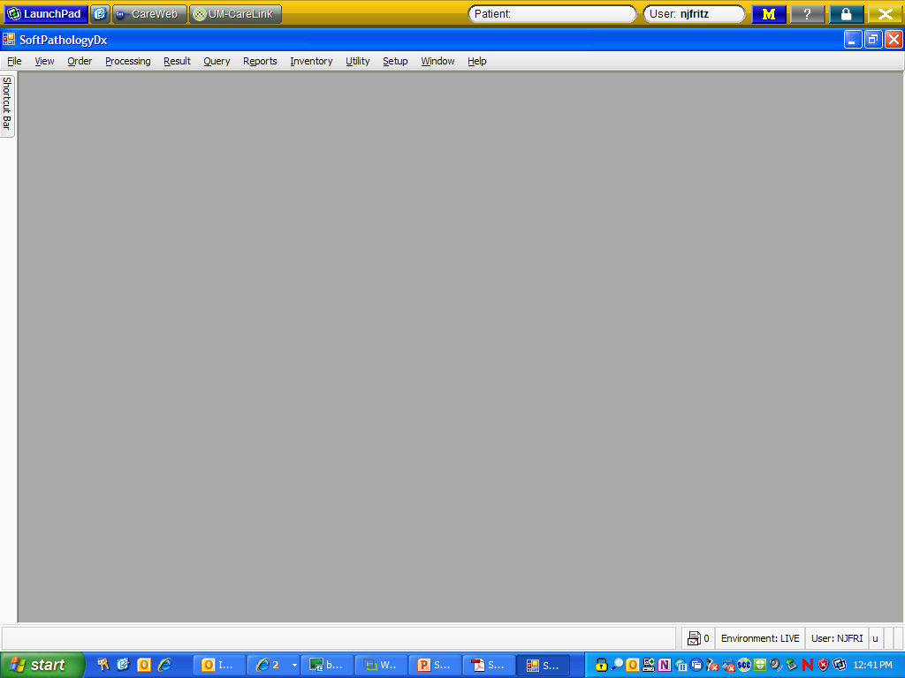
This is what the opening screen looks like……..

Slide 6
Working across the tabs from left to right……….
File
  Change workstation
  Change password
View
  Shortcut bar (you can design this so you do not have to work through menus to get to your workflow)
Order, Order Entry:
  This is where all new surgical specimens are entered/created in Soft

Slide 7
Working across the tabs from left to right……….
Processing: This is where the histology lab works
  Grossing, processing, embedding, slide prep, staining, etc.
Outgoing Consults: This is where we will track materials we send out

Slide 8
Result tab
Interpretation Result Entry: This is where all the report typing is done
Interpretation Review Entry: This is where the pathologists sign out cases
Sign Out Entry: This is another way for the pathologists to sign out cases
My Orders: This is another way for the pathologists to sign out cases

Slide 9
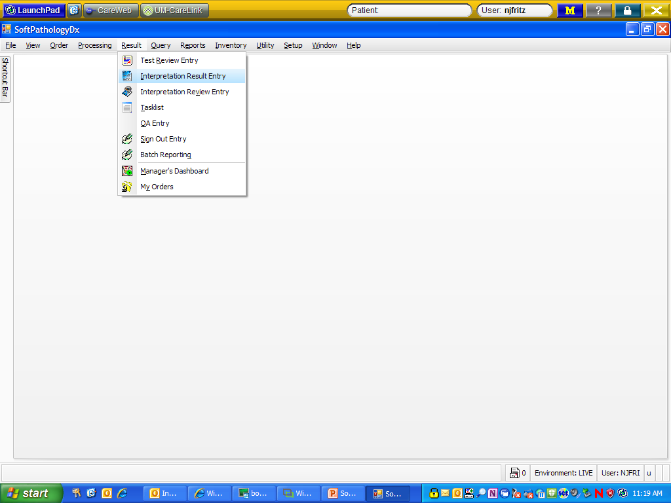
SIGN OUT ENTRY

Slide 10
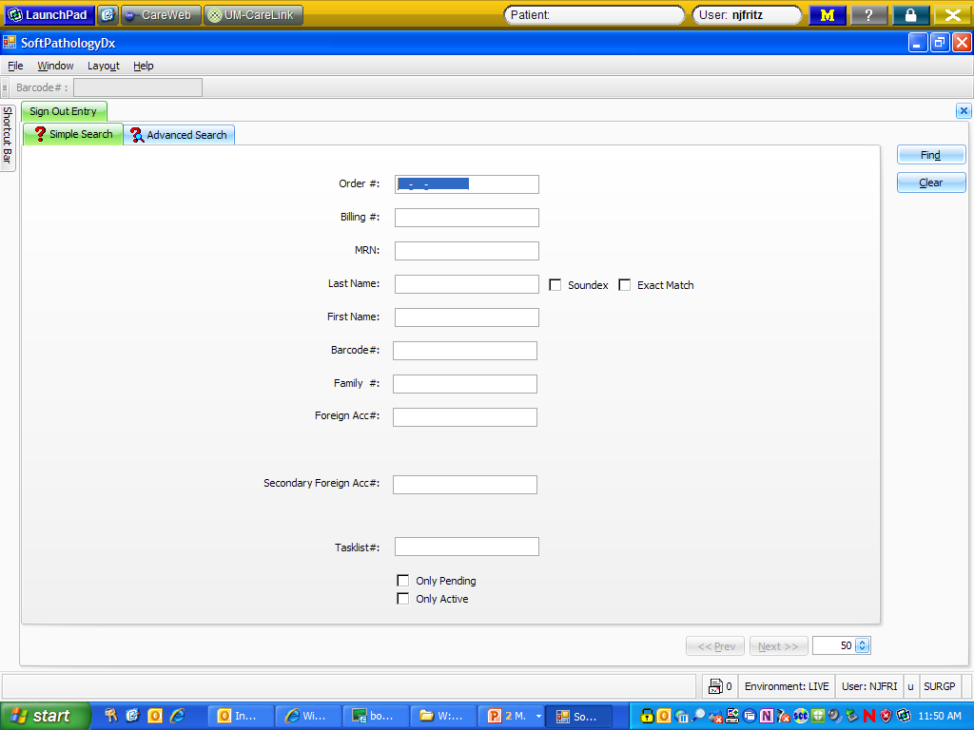
Simple Search – scan or type order #

Slide 11
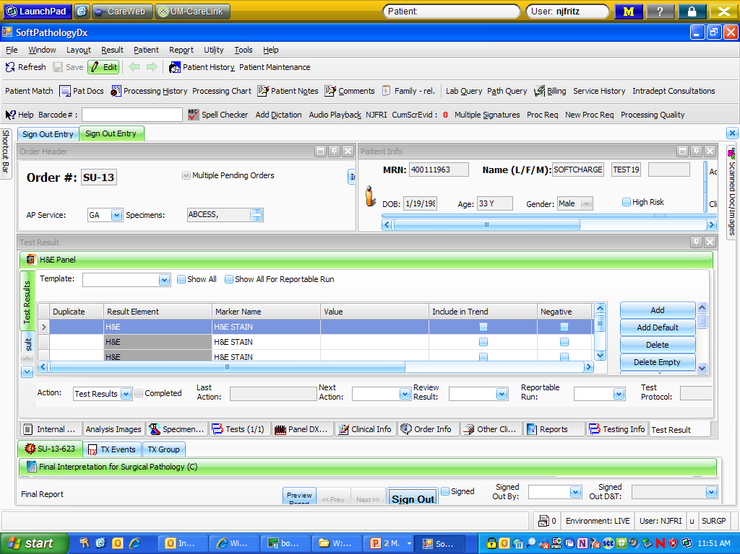
How the screen is laid out in an open order:
Order info
Test info
Patient info

Slide 12
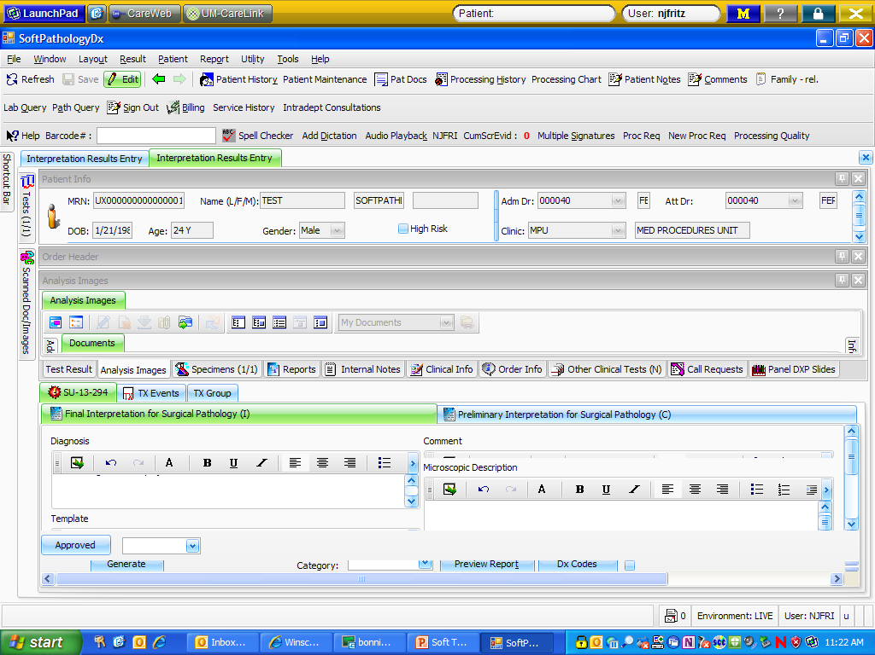
Scanned documents

Slide 13
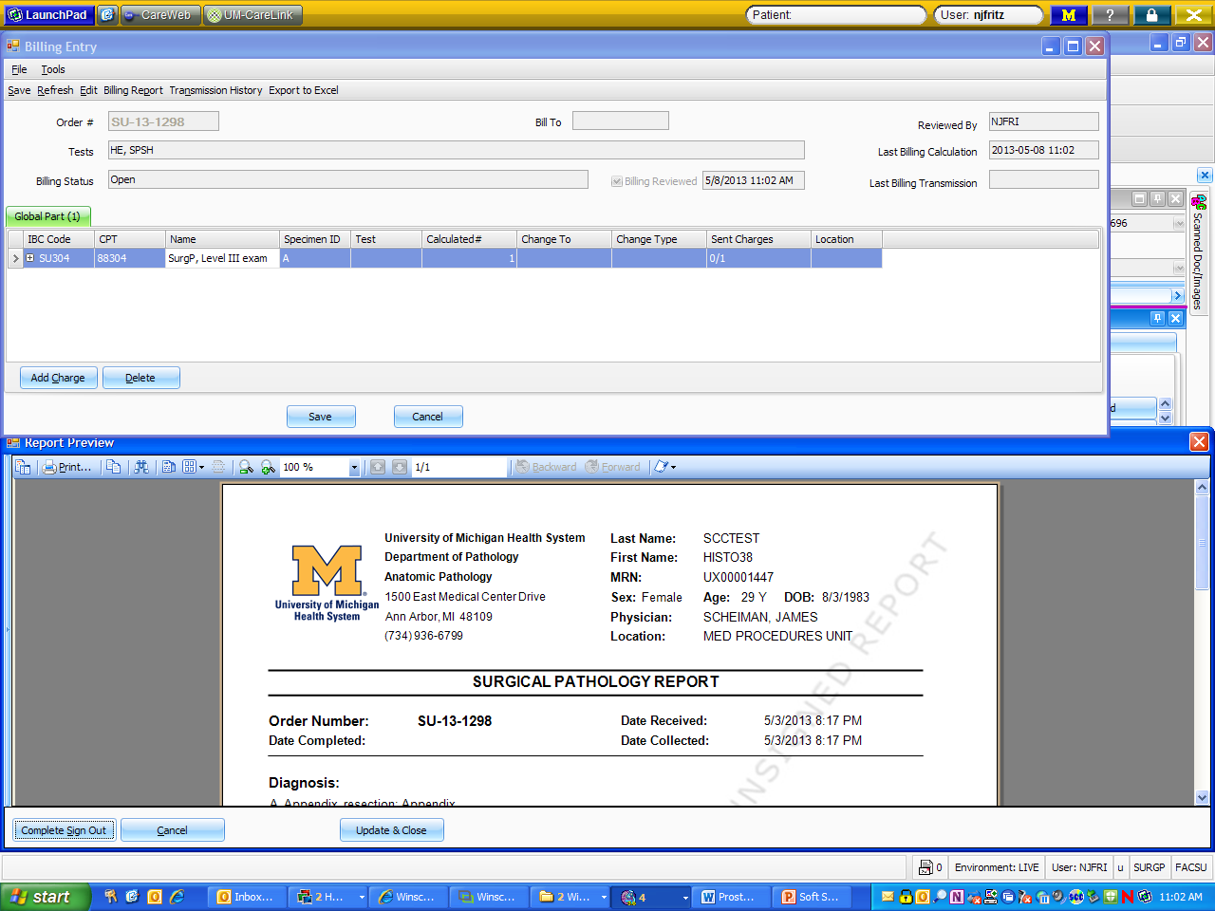
Check the billing – (Global tab)

Slide 14
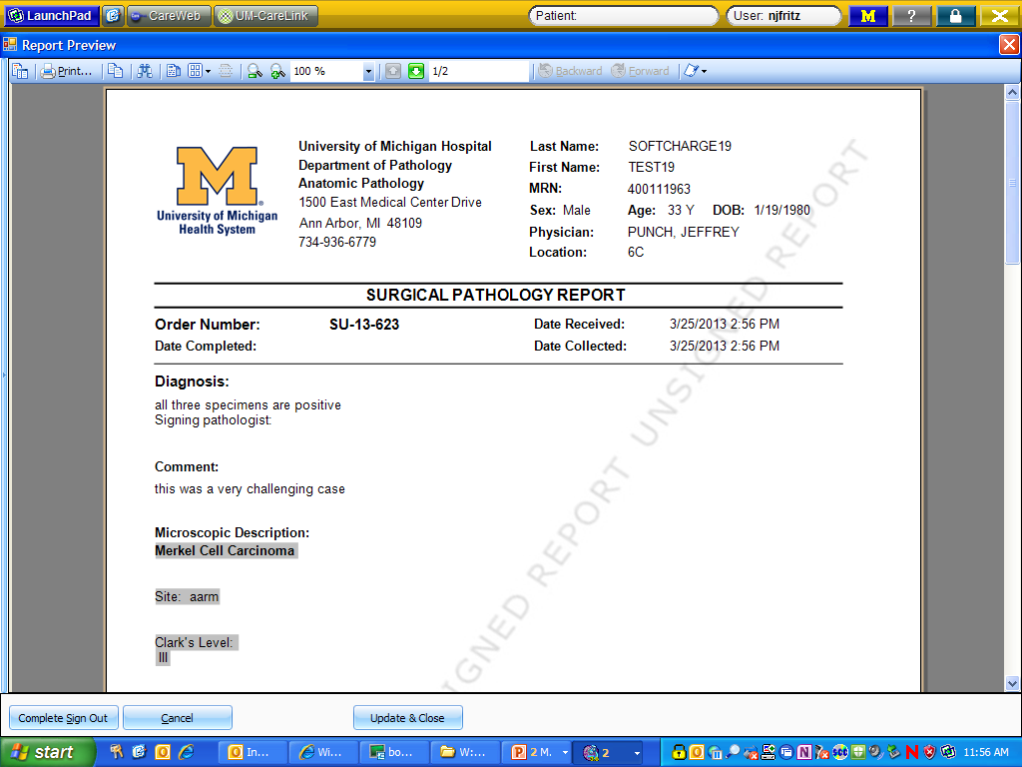
A pdf of the report – you can edit the document from here, or

Slide 15
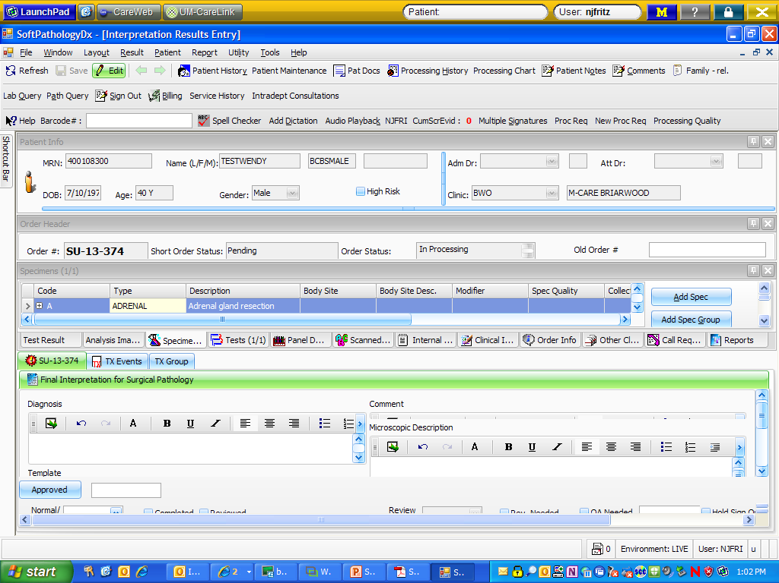
Double click on the picture of the paper to open the typing boxes

Slide 16
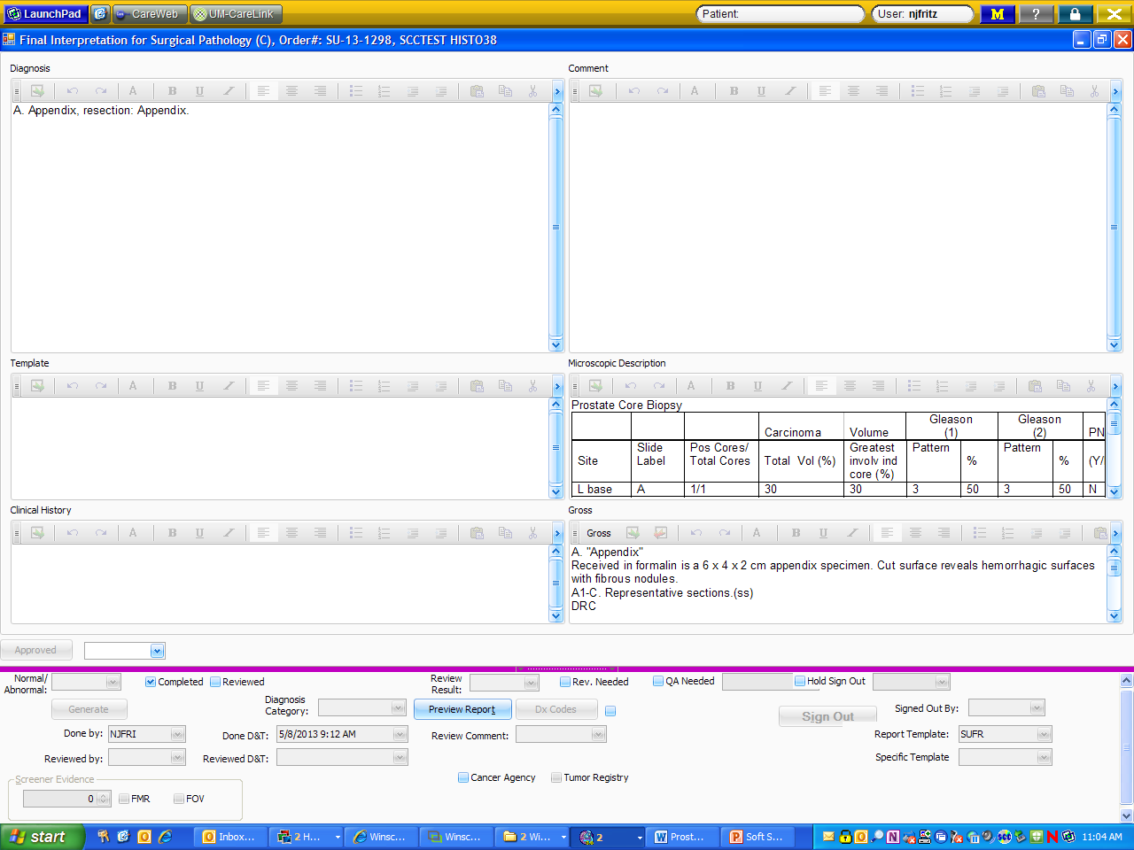

Slide 17
Typing macros/tools:
Canned messages: phrases and paragraphs created to shorten the typing
Tools: Auto Text Settings – macro expander (like in PathNet f9 or MSWord)
UDx: Cancer templates where we just fill in click boxes as dictated

Slide 18
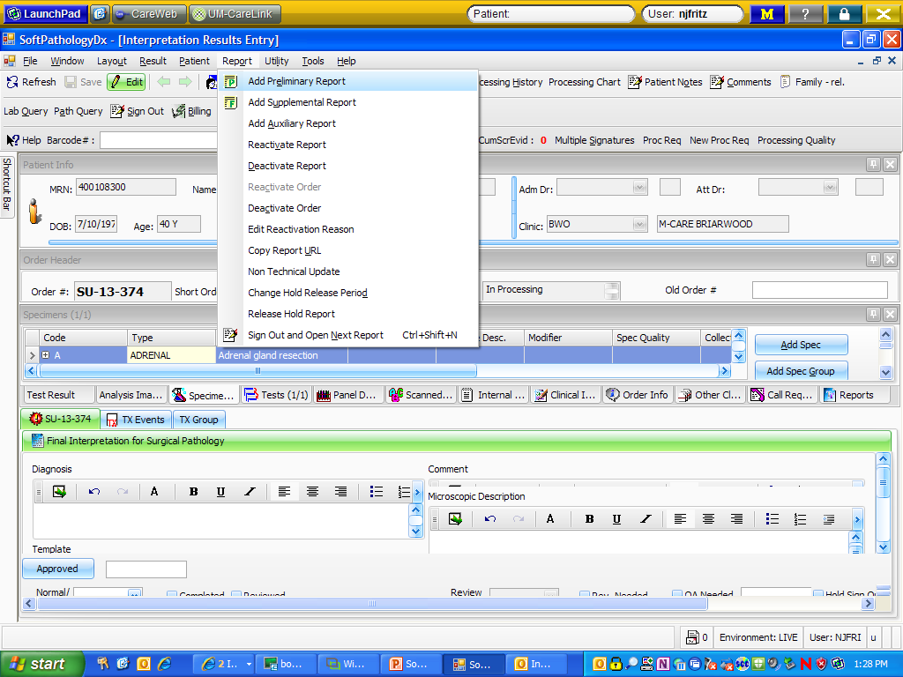
Frozen Section Reports – same workflow as currently used – dictate, transcription creates report

Slide 19
FS workflow
Pink sheets to continue to document:
  FS blocks and pathologist performing FS for each block
  Time FS was received, time surgeon notified, reason if TAT>target time
  FS Gross
Pink sheets to be scanned at grossing
Grosser to dictate FS diagnosis, block(s) and performing pathologist

Slide 20
FS workflow
Transcription to create preliminary report, transcribe FS diagnosis, assign blocks to performing pathologist, enter FS TAT
Final pathologist to sign out preliminary report prior to signing out final report
QA procedure(s) to be performed by final report pathologist

Slide 21
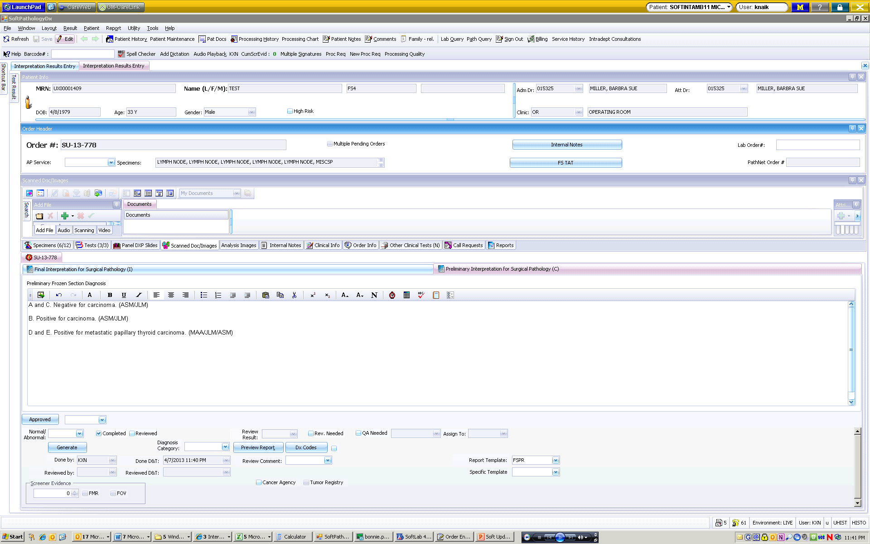
FS workflow
Transcription to create preliminary report, transcribe FS diagnosis…..

Slide 22
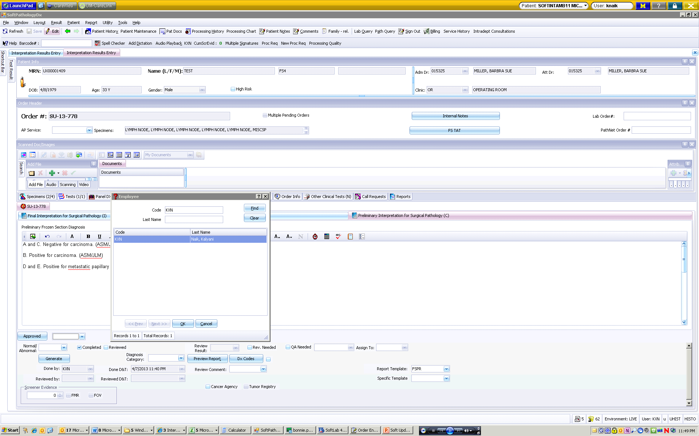
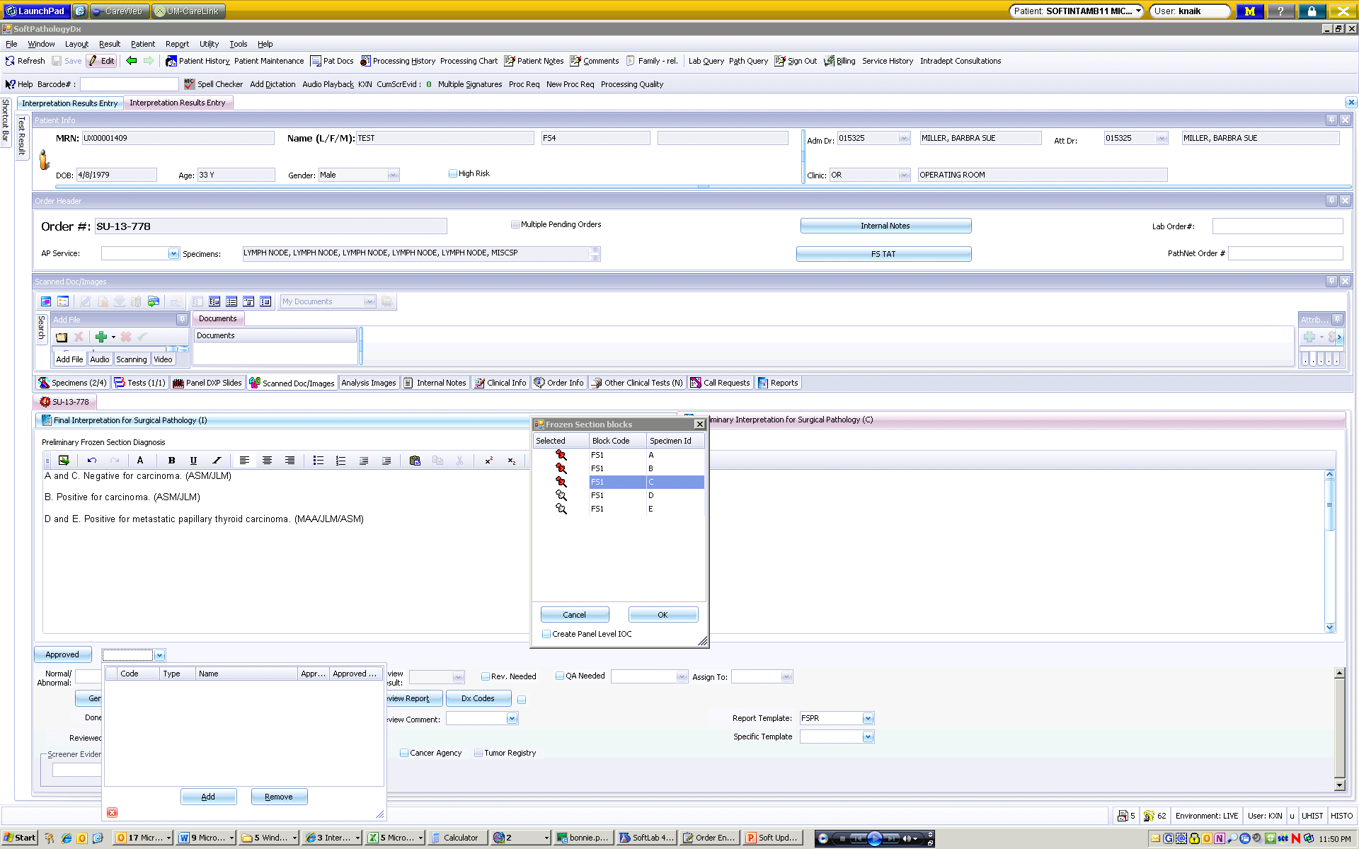
FS workflow
…..assign blocks to performing pathologist….

Slide 23
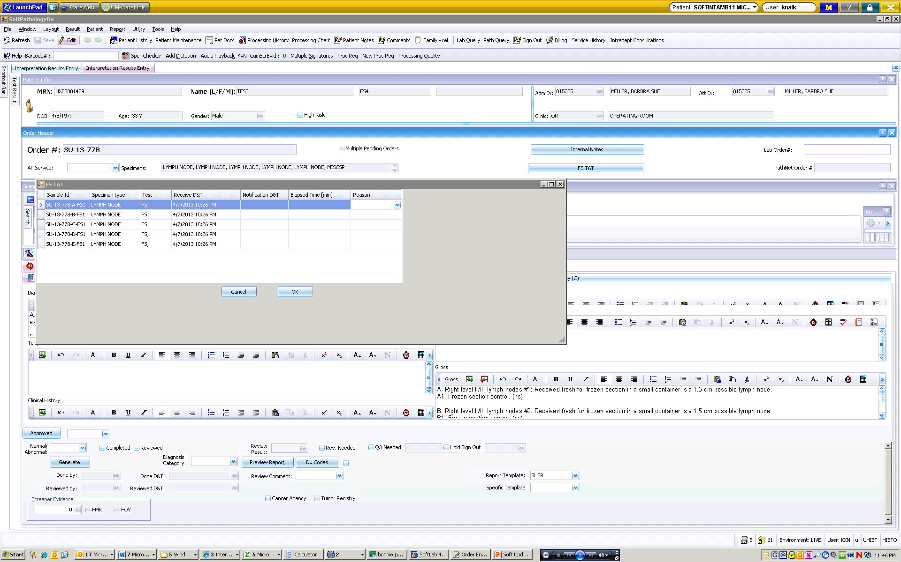
FS workflow
….. enter FS TAT

Slide 24
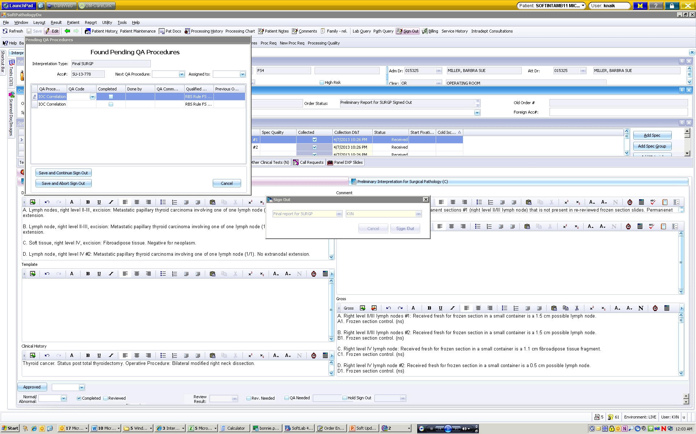
FS workflow
Final pathologist to sign out preliminary report PRIOR to signing our final report, complete QA procedure(s), sign out final report

Slide 25
“Addendums”
Old Pathnet
Addendum
Supplemental Report
Revised Report

Slide 26
Supplemental Reports
Used for reporting additional information not included in the original report
  If additional relevant clinical history arrives
  If we receive results from a molecular diagnostics test that do not change the diagnosis, etc.

Slide 27
Supplemental Reports
Please dictate the following information:
  A supplemental report needs to be created for OC-13-XXXXX
  Reactivation Reason – Choose from one of the following:
    ADDITIONAL INFORMATION
    ADDITIONAL TEST RESULTS
    CASE REVIEWED BY EXTERNAL FACILITY
    CONFERENCE CONSENSUS
    NEUROPATHOLOGIC EXAM
Report collates with original final report in MiChart

Slide 28
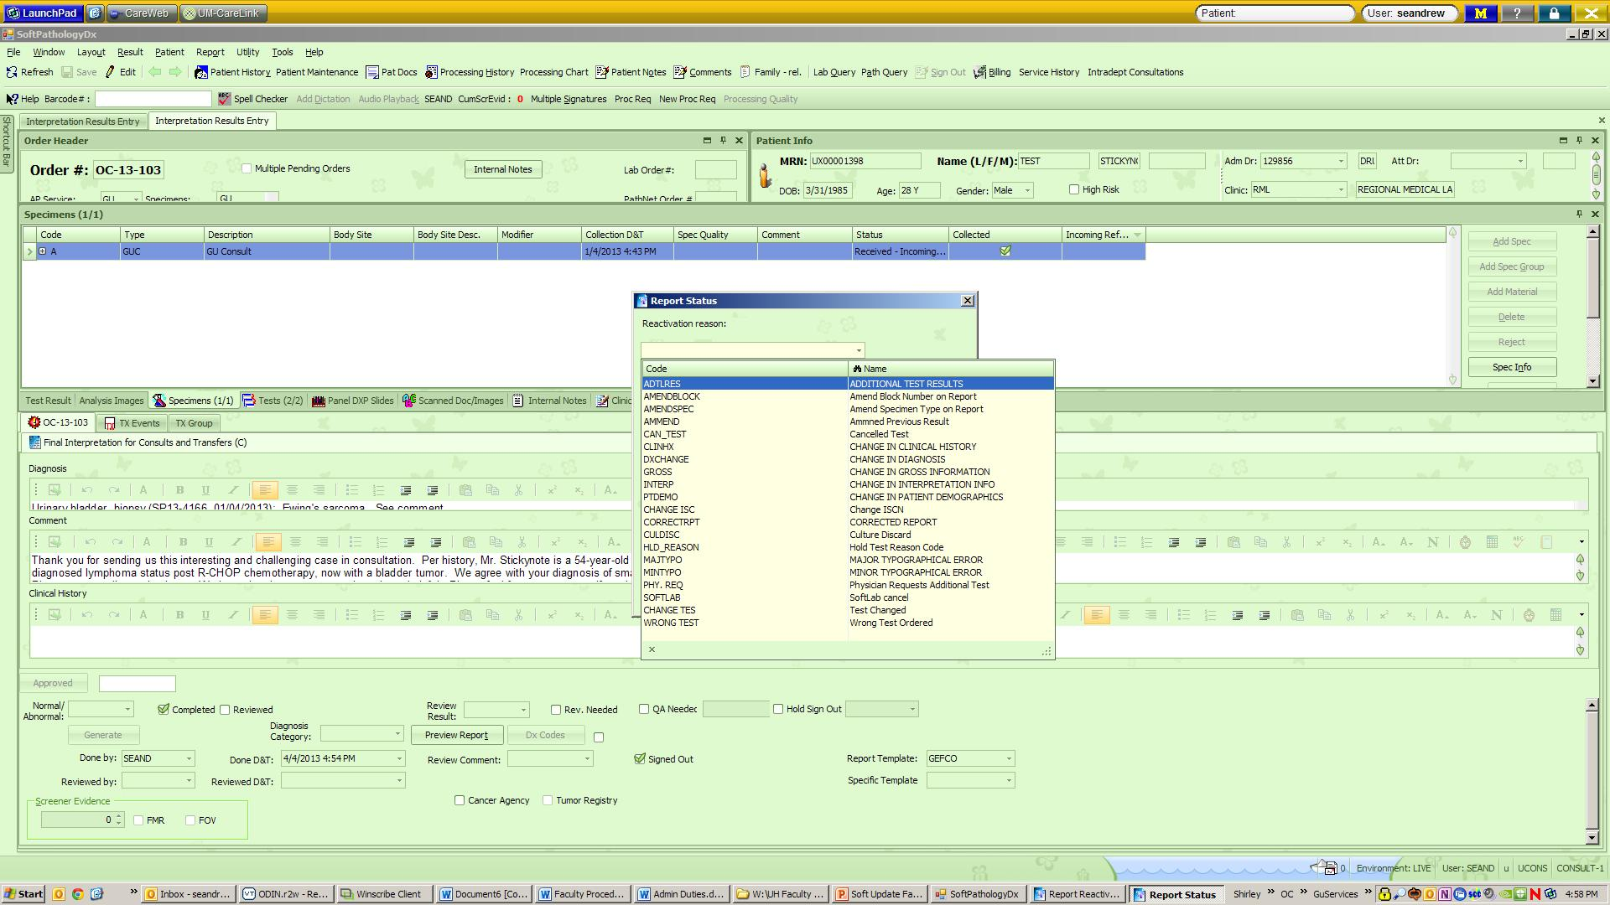
Supplemental/revised reports
Must dictate/select a reason for the supplemental/revised report – dropdown menu choices

Slide 29
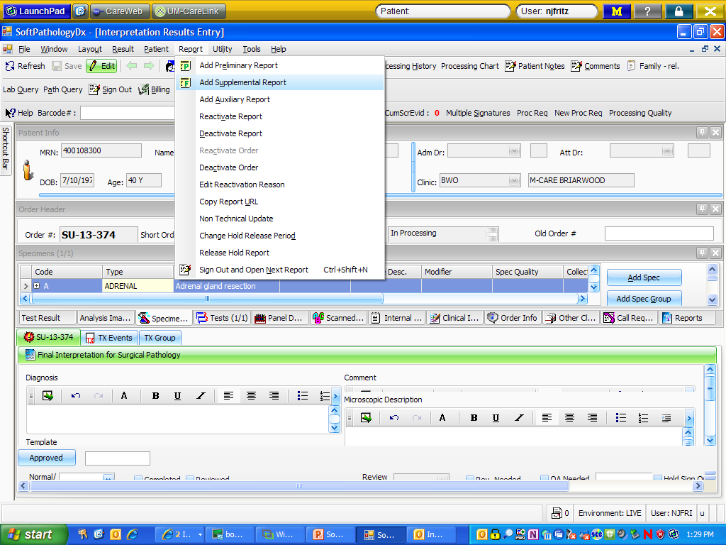
Supplemental/Revised Reports – same workflow as currently used – dictate, transcription creates report
Like a PathNet addendum
  Revised: Reactivate Report
  Supplemental: Reactivate Order, Add Supplemental Report

Slide 30
Revised Reports
Used for editing or correcting information included in the original report
  If an error is made in the diagnosis, the gross, etc.
  If a typographical error is made in the report
Replaces original final report in MiChart

Slide 31
Revised Reports
Please dictate the following information:
  A revised report needs to be created for OC-13-XXXXX.
  Reactivation Reason:
  Comment: “This revised report was issued to correct an error in the diagnosis. The diagnosis previously was typed as ‘Negative for adenocarcinoma.’ The new diagnosis is ‘Negative for neoplasm.’”
ADDITIONAL TEST RESULTS
CHANGE IN CLINICAL HISTORY
CHANGE IN DIAGNOSIS
CHANGE IN GROSS INFORMATION
CHANGE IN INTERPRETATION INFO
CHANGE IN PATIENT DEMOGRAPHICS
CORRECTED REPORT
MAJOR TYPOGRAPHICAL ERROR
MINOR TYPOGRAPHICAL ERROR

Slide 32
Revised Reports

Slide 33
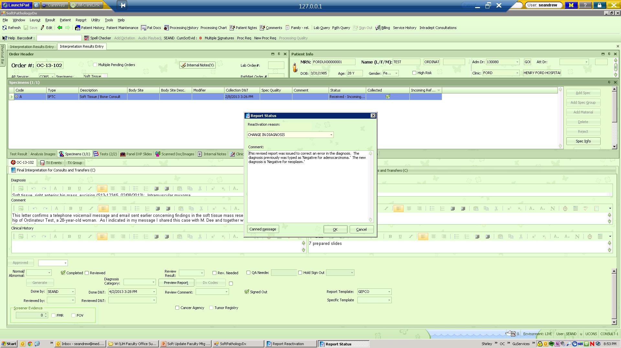
Revised Reports

Slide 34
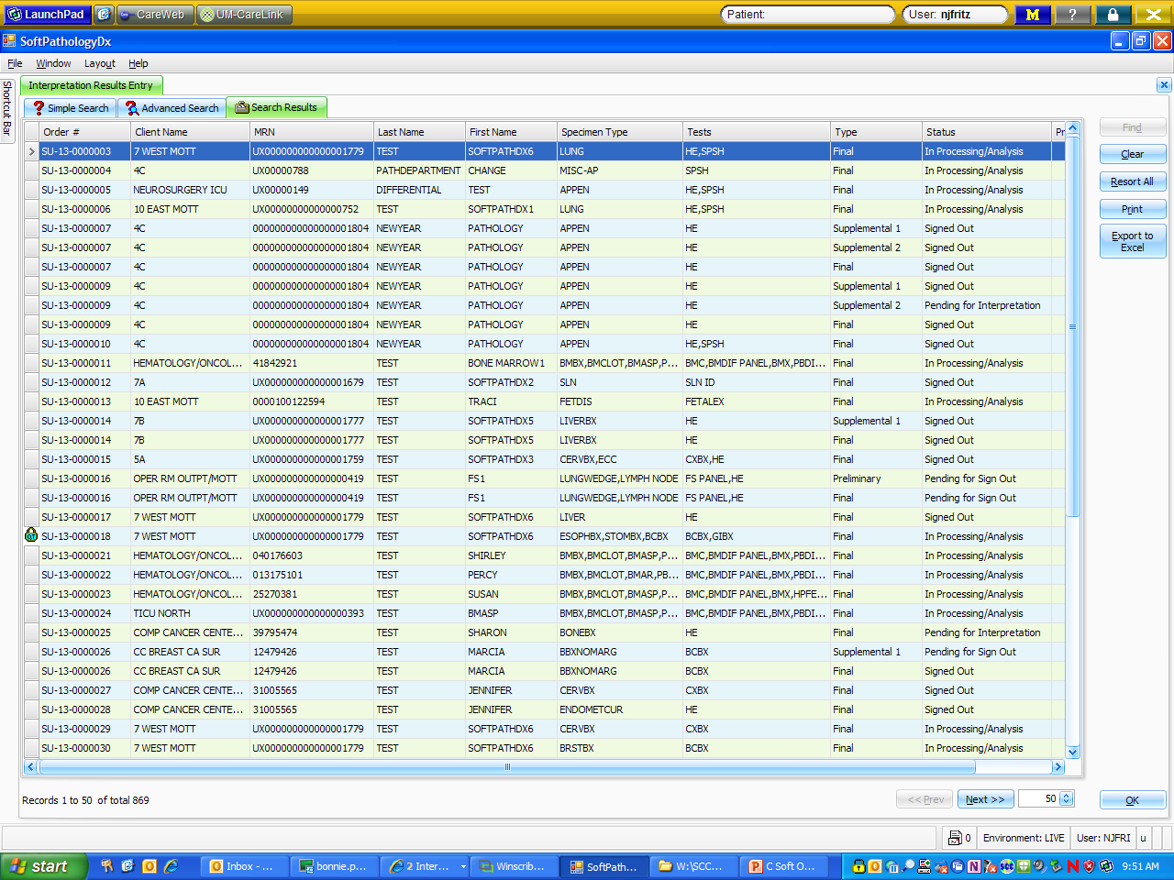
Searching for patients
Result tab: Shows status of case
  Interpretation Result Entry: Can search by Order #, MRN, Last Name, Barcode

Slide 35
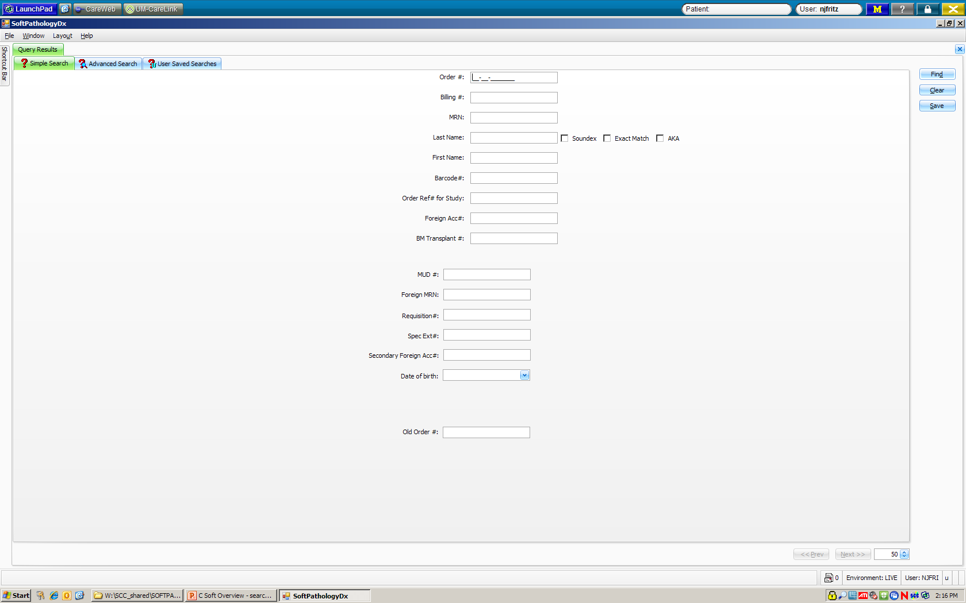
Searching for patients: Query tab

Slide 36
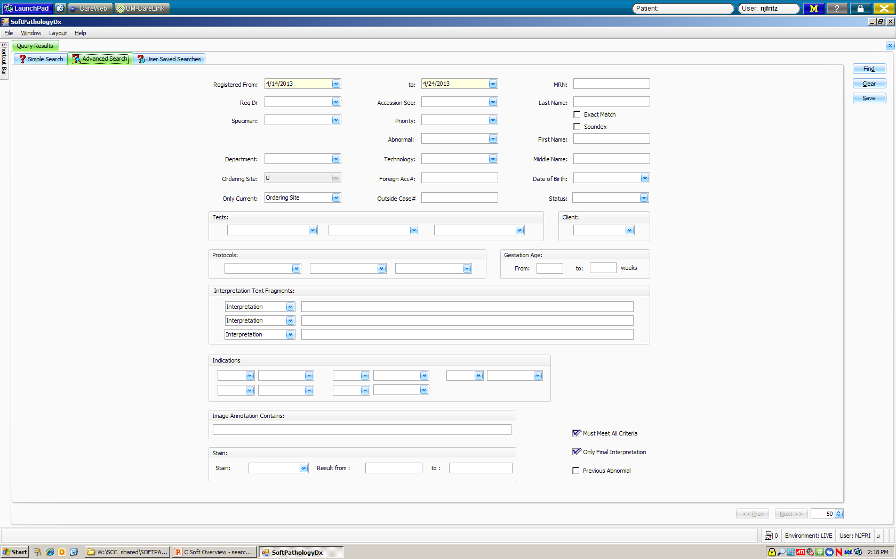
Searching for patients: Query advanced:

Slide 37
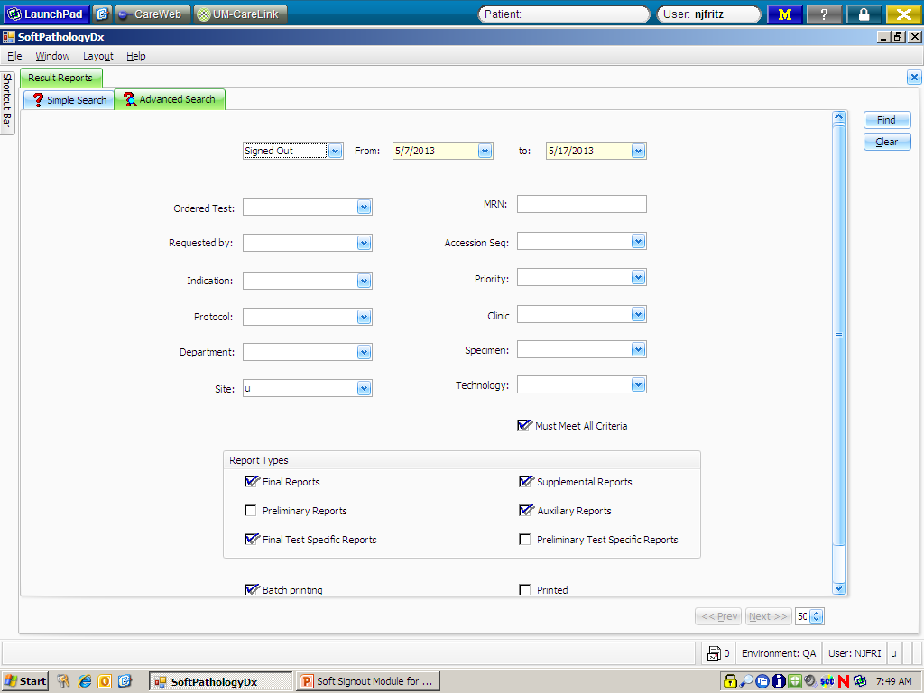
Searching for patients: reports: result reports

Slide 38
Cool new tools!
In a case:
  Patient history: All of the patient’s previous records from PathNet can be viewed
  Processing history: A list of all procedures that have been performed on this order
  Processing chart: Icon drawing showing processes completed on this order
  Patient Notes and Family-rel: Places to store more information

Slide 39
PathNet to Soft
PDI = Reports – Result Reports
CNI = Simple search screen: shows status of case and lists all cases for a patient
ATR = Results – Interpretation Result Entry
OID = All information is on the opening screen of every case
API to see if cases are typed = Reports – Result Reports
Stalled Case List = My Orders
Order or look up status of stain order = in case, click Proc Req

Slide 40
More stuff………….
  Ordering Special Stains/Levels: Proc Req
  Save Layout: You can set your screen to a specific layout and it will stay there until you change it:
  Help: Color Schema

Slide 41
Interdepartmental consultation
Internal consult
Can print on the report

