Slide 1
Soft – supplemental and revised reports
The New Laboratory System
By Soft Computer Consultants

Slide 2
How to Log In
On your desktop, in the bottom tray, lower right corner:
Double click the icon, select LIVE
Click SoftPathDx
Click Start
When login screen appears, use your UNIQUE NAME AND LEVEL 2 PASSWORD

Slide 3
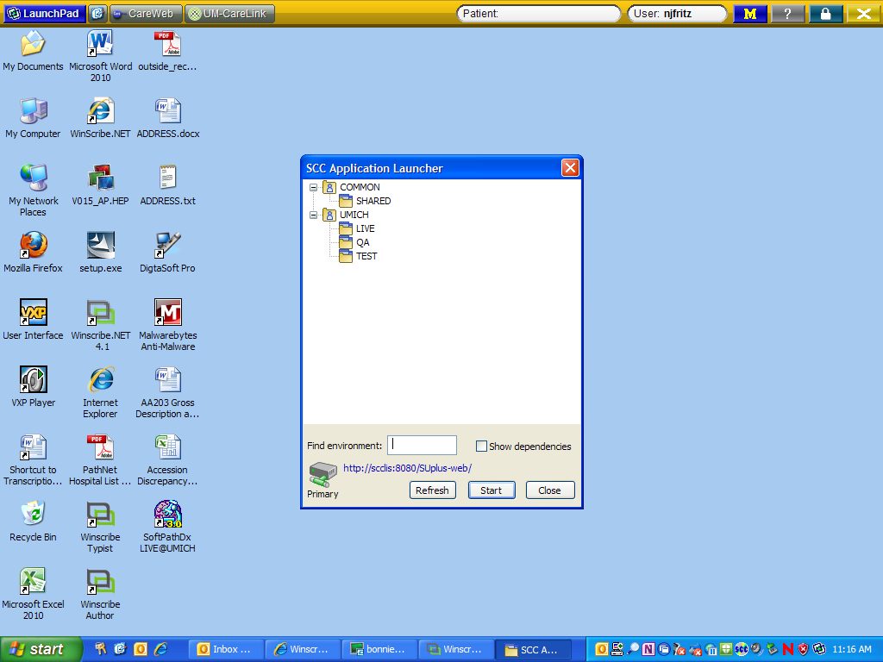

Slide 4
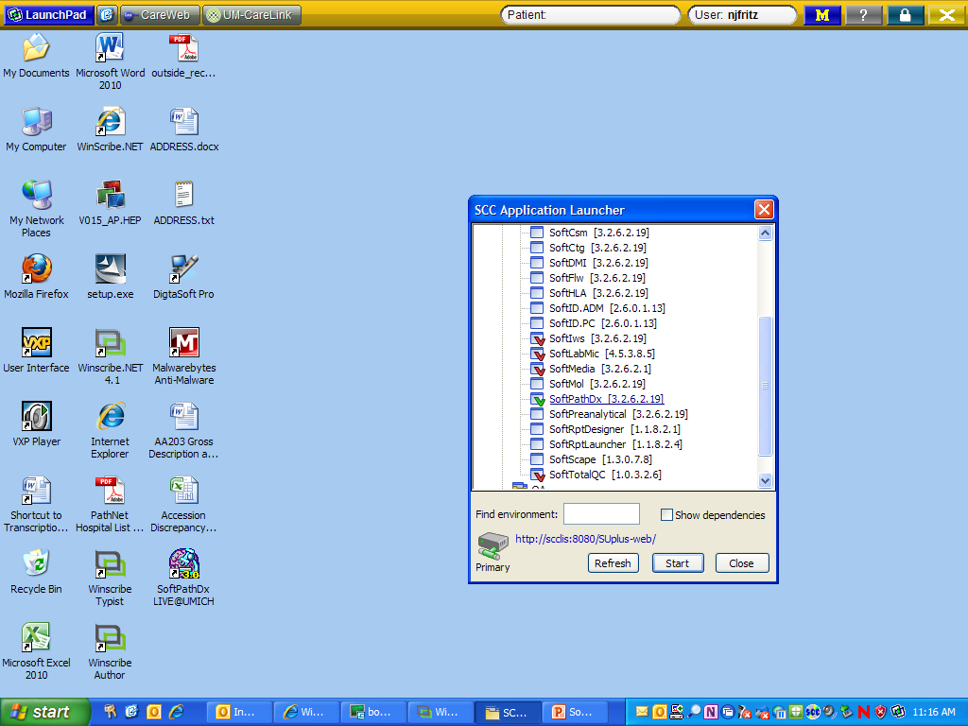

Slide 5
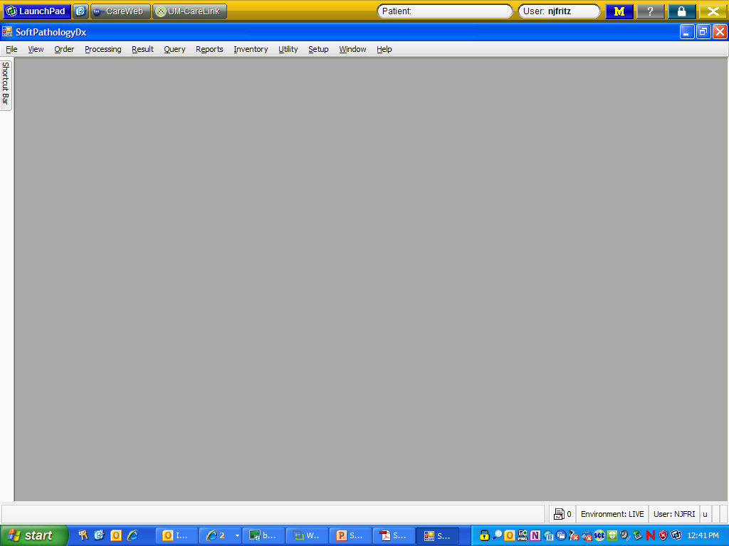
This is what the opening screen looks like……..

Slide 6
“Addendums”
Old Pathnet
Addendum
Supplemental Report
Revised Report

Slide 7
Supplemental Reports
Used for reporting additional information not included in the original report
  If additional relevant clinical history arrives
  If we receive results from a molecular diagnostics test that do not change the diagnosis, etc.

Slide 8
Supplemental Reports
Please dictate the following information:
  A supplemental report needs to be created for OC-13-XXXXX
  Reactivation Reason – Choose from one of the following:
    ADDITIONAL INFORMATION
    ADDITIONAL TEST RESULTS
    CASE REVIEWED BY EXTERNAL FACILITY
    CONFERENCE CONSENSUS
    NEUROPATHOLOGIC EXAM

Slide 9
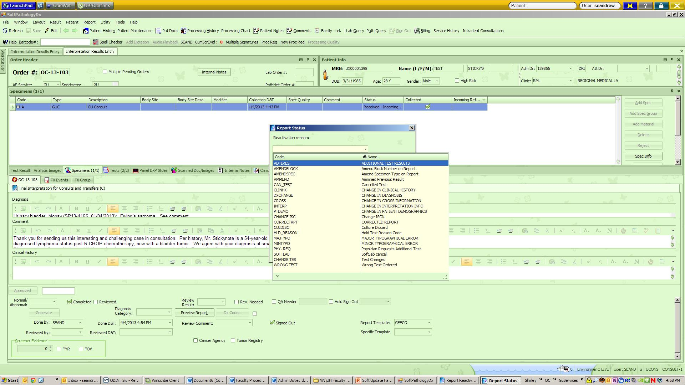
Supplemental/revised reports
Must dictate/select a reason for the supplemental/revised report – dropdown menu choices

Slide 10
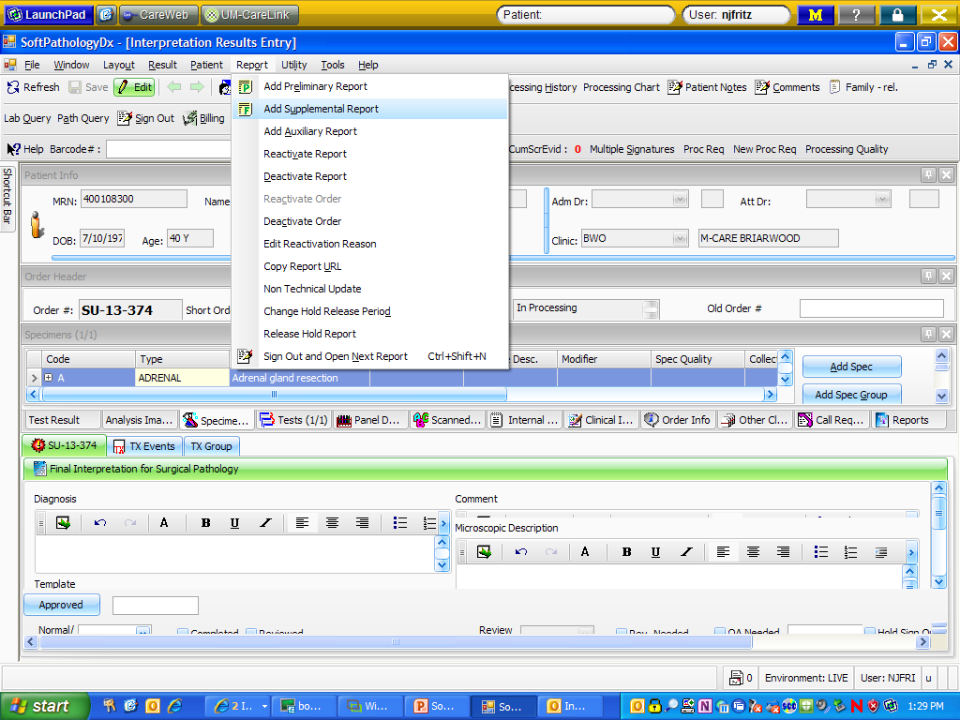
Supplemental/Revised Reports – same workflow as currently used – dictate, transcription creates report
Like a PathNet addendum
  Revised: Reactivate Report
  Supplemental: Reactivate Order, Add Supplemental Report

Slide 11
Revised Reports
Used for editing or correcting information included in the original report
  If an error is made in the diagnosis, the gross, etc.
  If a typographical error is made in the report

Slide 12
Revised Reports
Please dictate the following information:
  A revised report needs to be created for OC-13-XXXXX.
  Reactivation Reason:
  Comment: “This revised report was issued to correct an error in the diagnosis. The diagnosis previously was typed as ‘Negative for adenocarcinoma.’ The new diagnosis is ‘Negative for neoplasm.’”
  ALL CHANGES MUST BE MADE IN CAPS!
ADDITIONAL TEST RESULTS
CHANGE IN CLINICAL HISTORY
CHANGE IN DIAGNOSIS
CHANGE IN GROSS INFORMATION
CHANGE IN INTERPRETATION INFO
CHANGE IN PATIENT DEMOGRAPHICS
CORRECTED REPORT
MAJOR TYPOGRAPHICAL ERROR
MINOR TYPOGRAPHICAL ERROR

Slide 13
Revised Reports

Slide 14
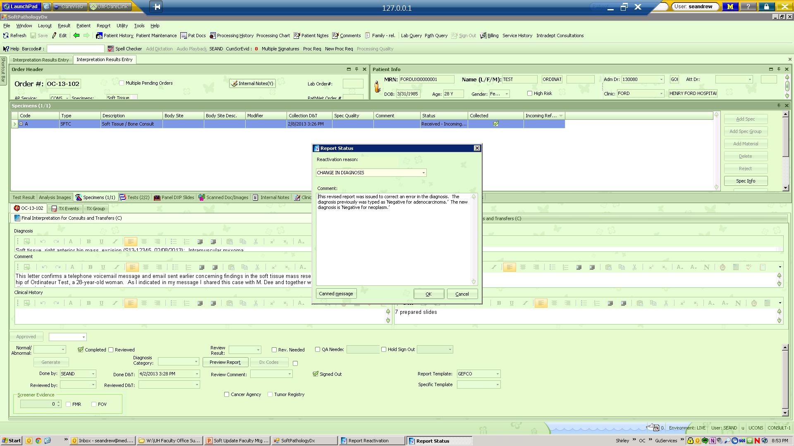
Revised Reports

Slide 15
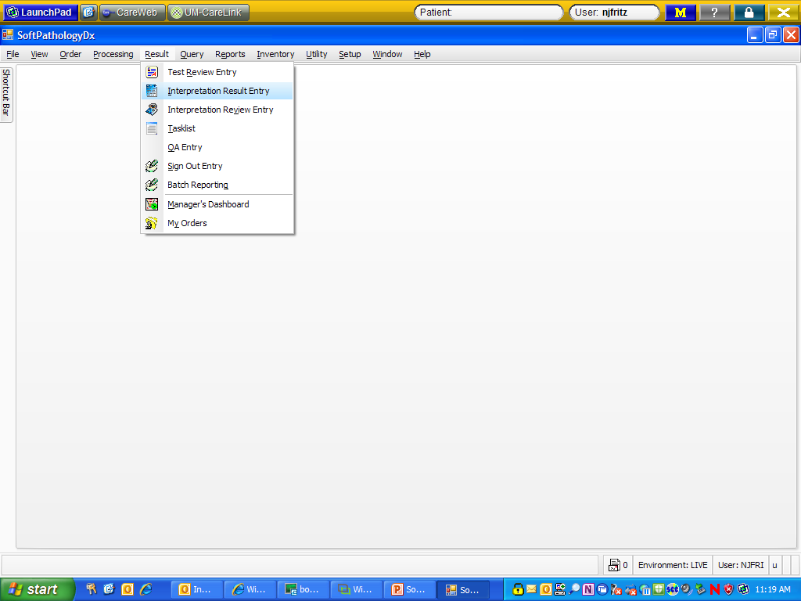
SIGN OUT ENTRY

Slide 16
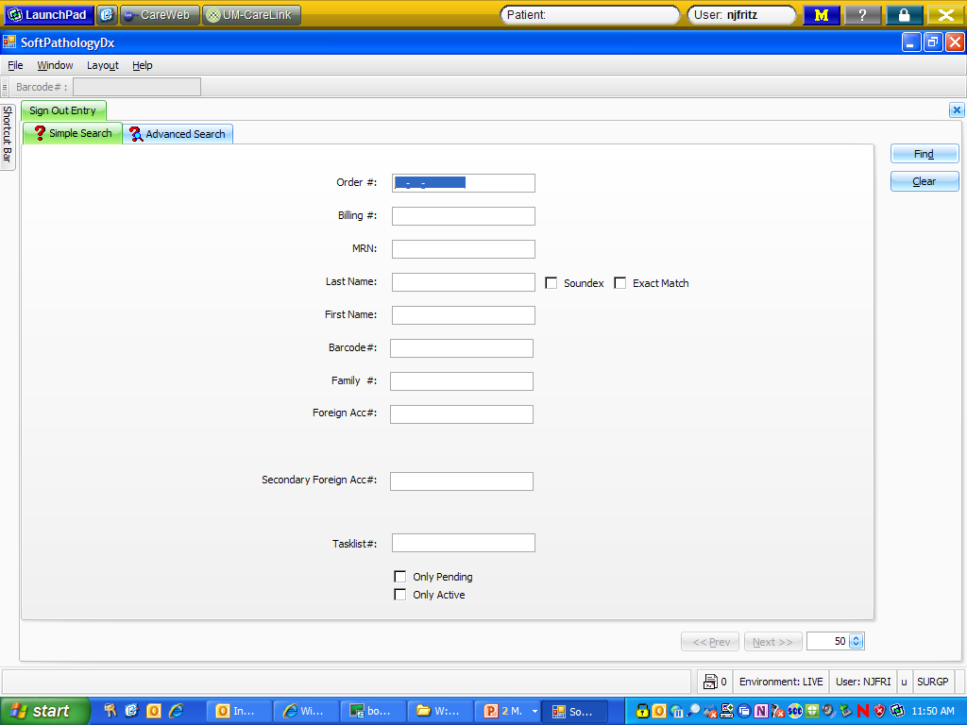
Simple Search – scan or type order #

Slide 17
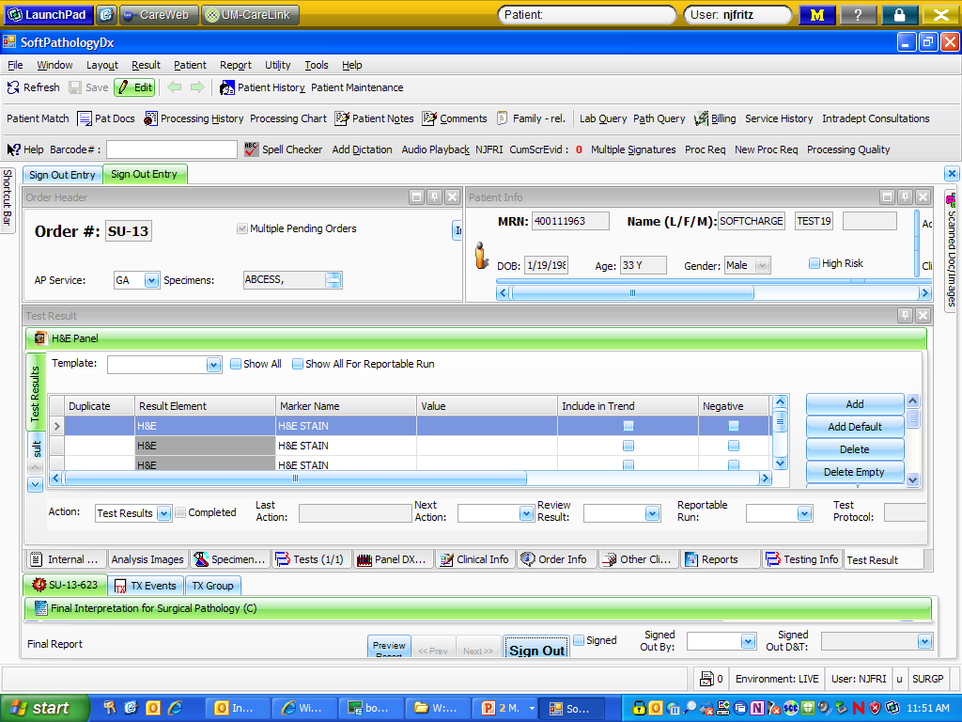
How the screen is laid out in an open order:
Top portion =
patient info
Middle portion = order info
Bottom portion =
test info

Slide 18
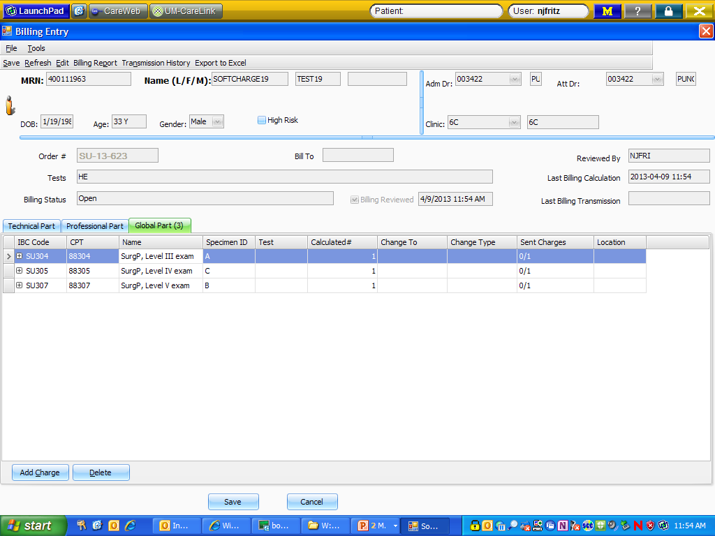
Check the billing -
c

Slide 19
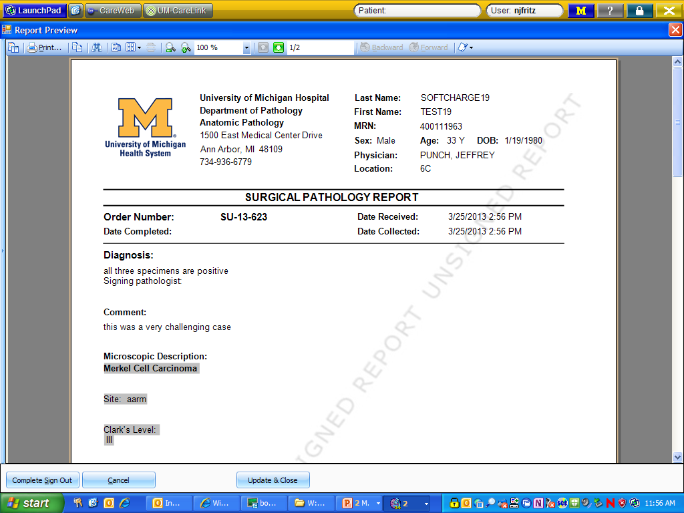
A pdf of the report appears – you can edit the document from here, or…

Slide 20
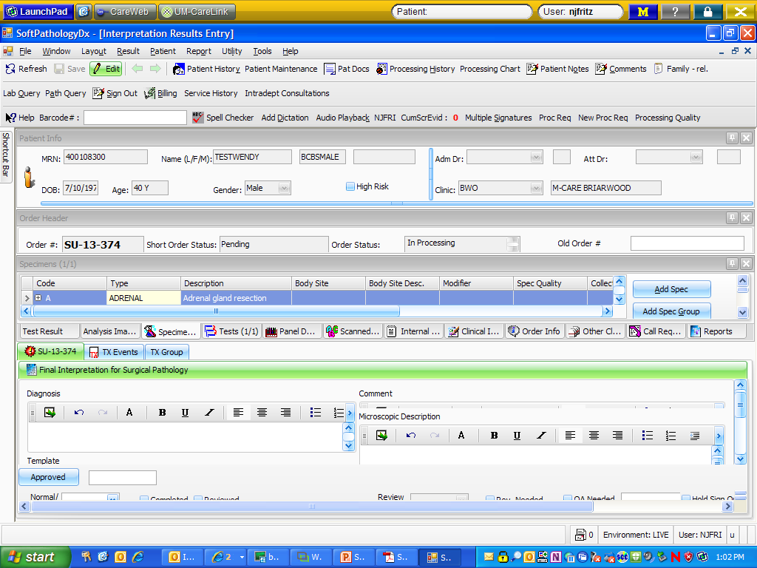
Double click on the picture of the paper to open the typing boxes

Slide 21
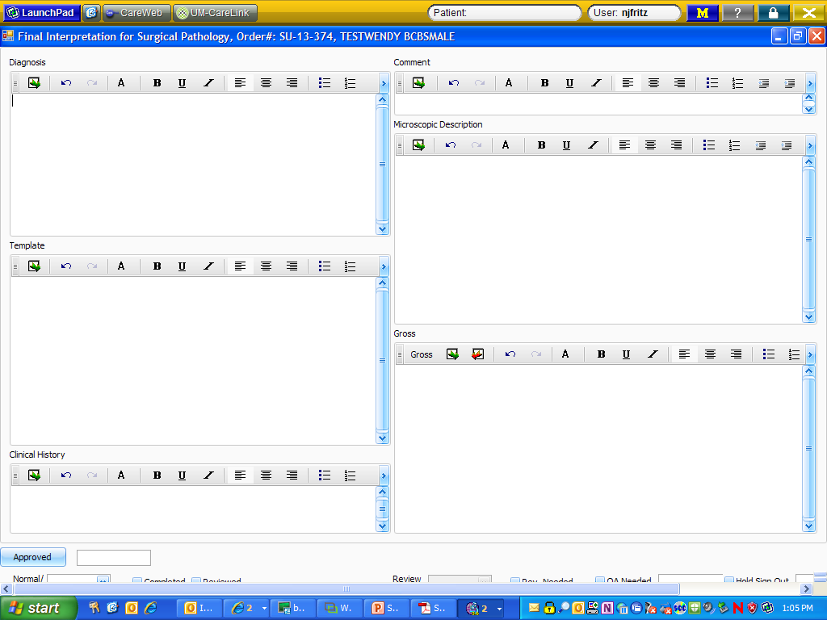

Slide 22
Typing macros/tools:
Canned messages: phrases and paragraphs created to shorten the typing
Tools: Auto Text Settings – macro expander (like in PathNet f9 or MSWord)
UDx: Cancer templates where we just fill in click boxes as dictated

