Slide 1
Soft – Transcription
The New Laboratory System
By Soft Computer Consultants

Slide 2
How to Log In
On your desktop, in the bottom tray, lower right corner:
Double click the icon, select LIVE
Click SoftPathDx
Click Start
When login screen appears, use your UNIQUE NAME AND LEVEL 2 PASSWORD
Verify your workstation (bottom right corner)

Slide 3
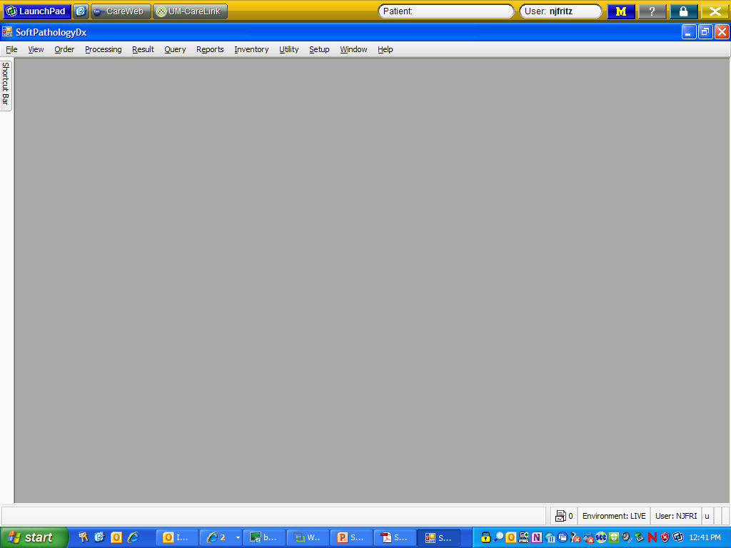
This is what the opening screen looks like……..

Slide 4
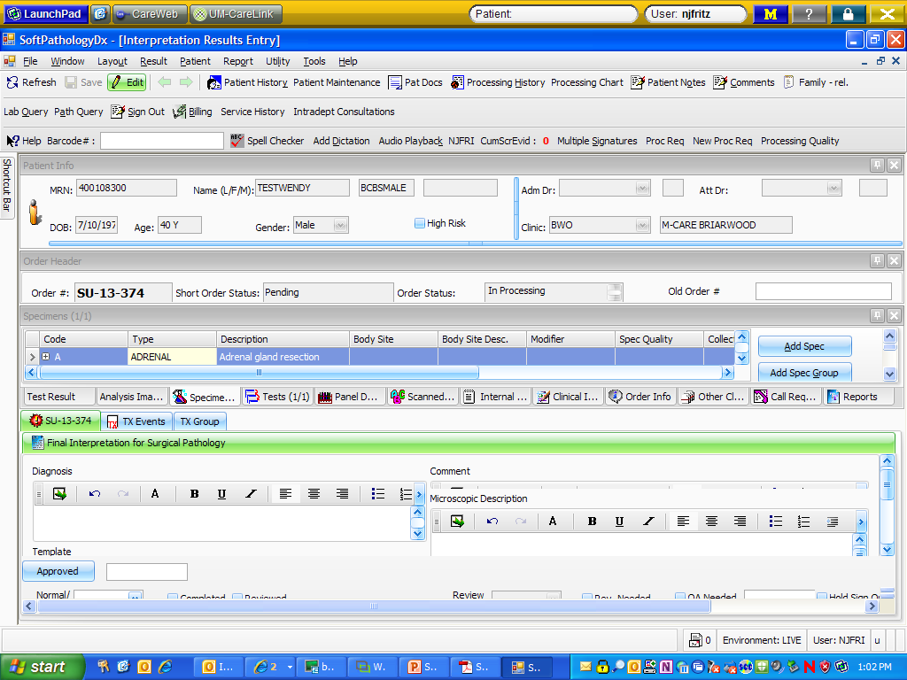
Typing Reports
Interpretation Result Entry: Scan or type your Order #

Slide 5
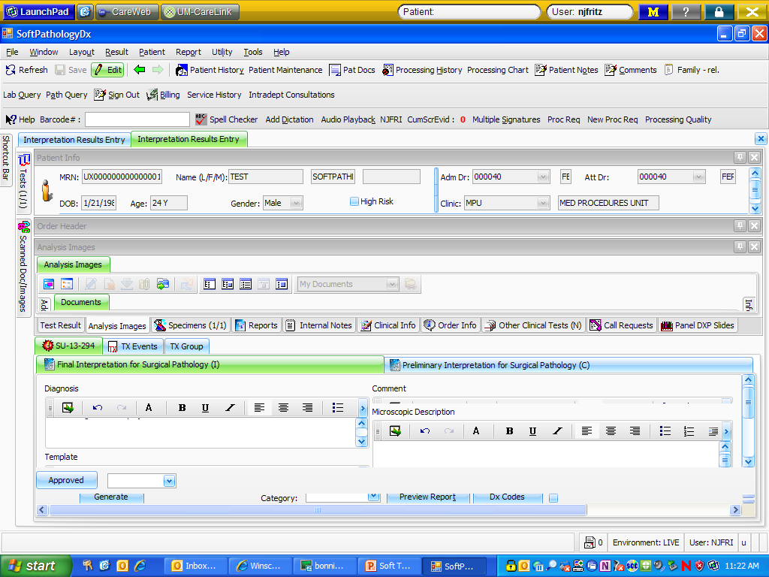
Scanned documents

Slide 6
Double click on the picture of the paper to open the typing boxes

Slide 7
What goes where?
Diagnosis = interpretation field and comment (if pathologist dictates for comment to be part of diagnosis)
Comment = letter portion

Slide 8
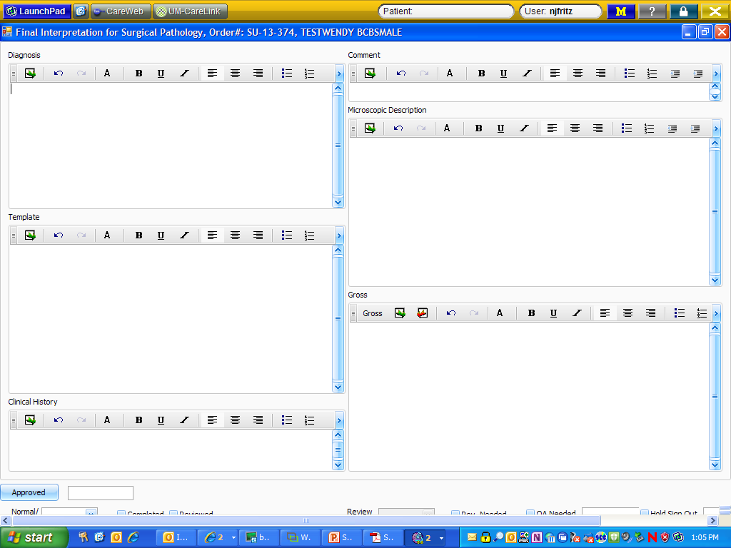

Slide 9
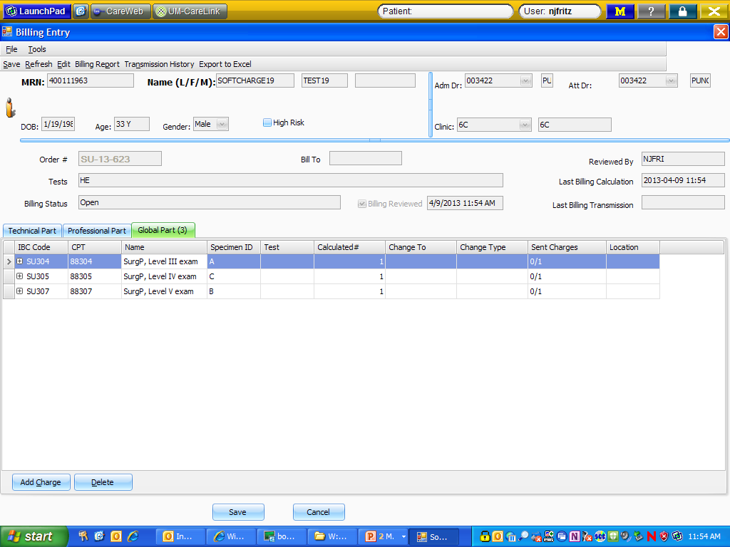
Check the billing -

Slide 10
When typing is completed:
Close the “typing boxes” window
  Check the completed box – VERY IMPORTANT
Click the dropdown next to “Approved” and look through the menu to select the resident/fellow who dictated the case

Slide 11
Typing macros/tools:
Canned messages: phrases and paragraphs created to shorten the typing
Tools: Auto Text Settings – macro expander (like in PathNet f9 or MSWord)
UDx: Cancer templates where we just fill in click boxes as dictated

Slide 12
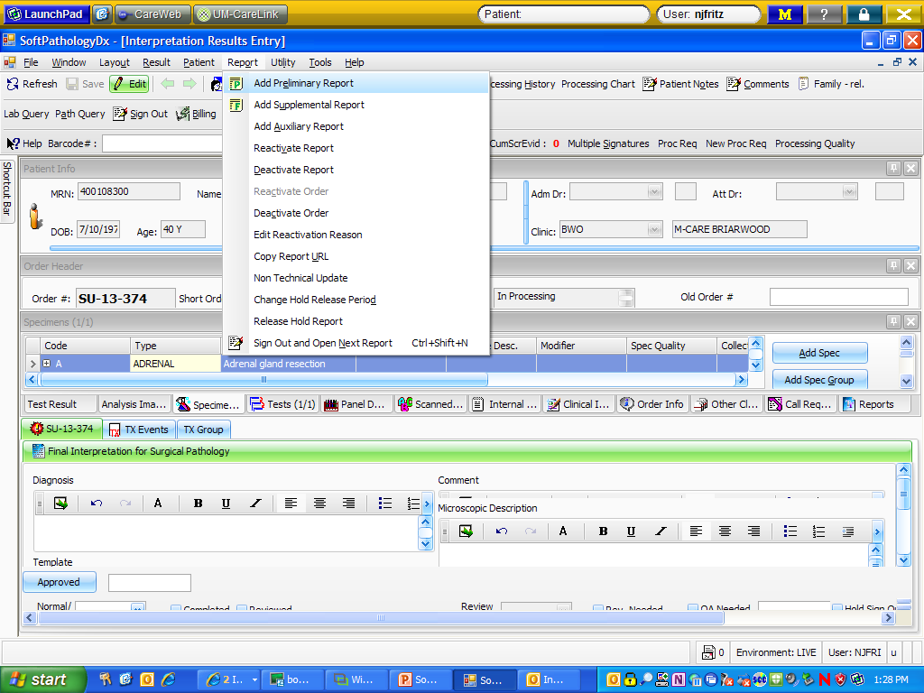
Frozen Section Reports

Slide 13
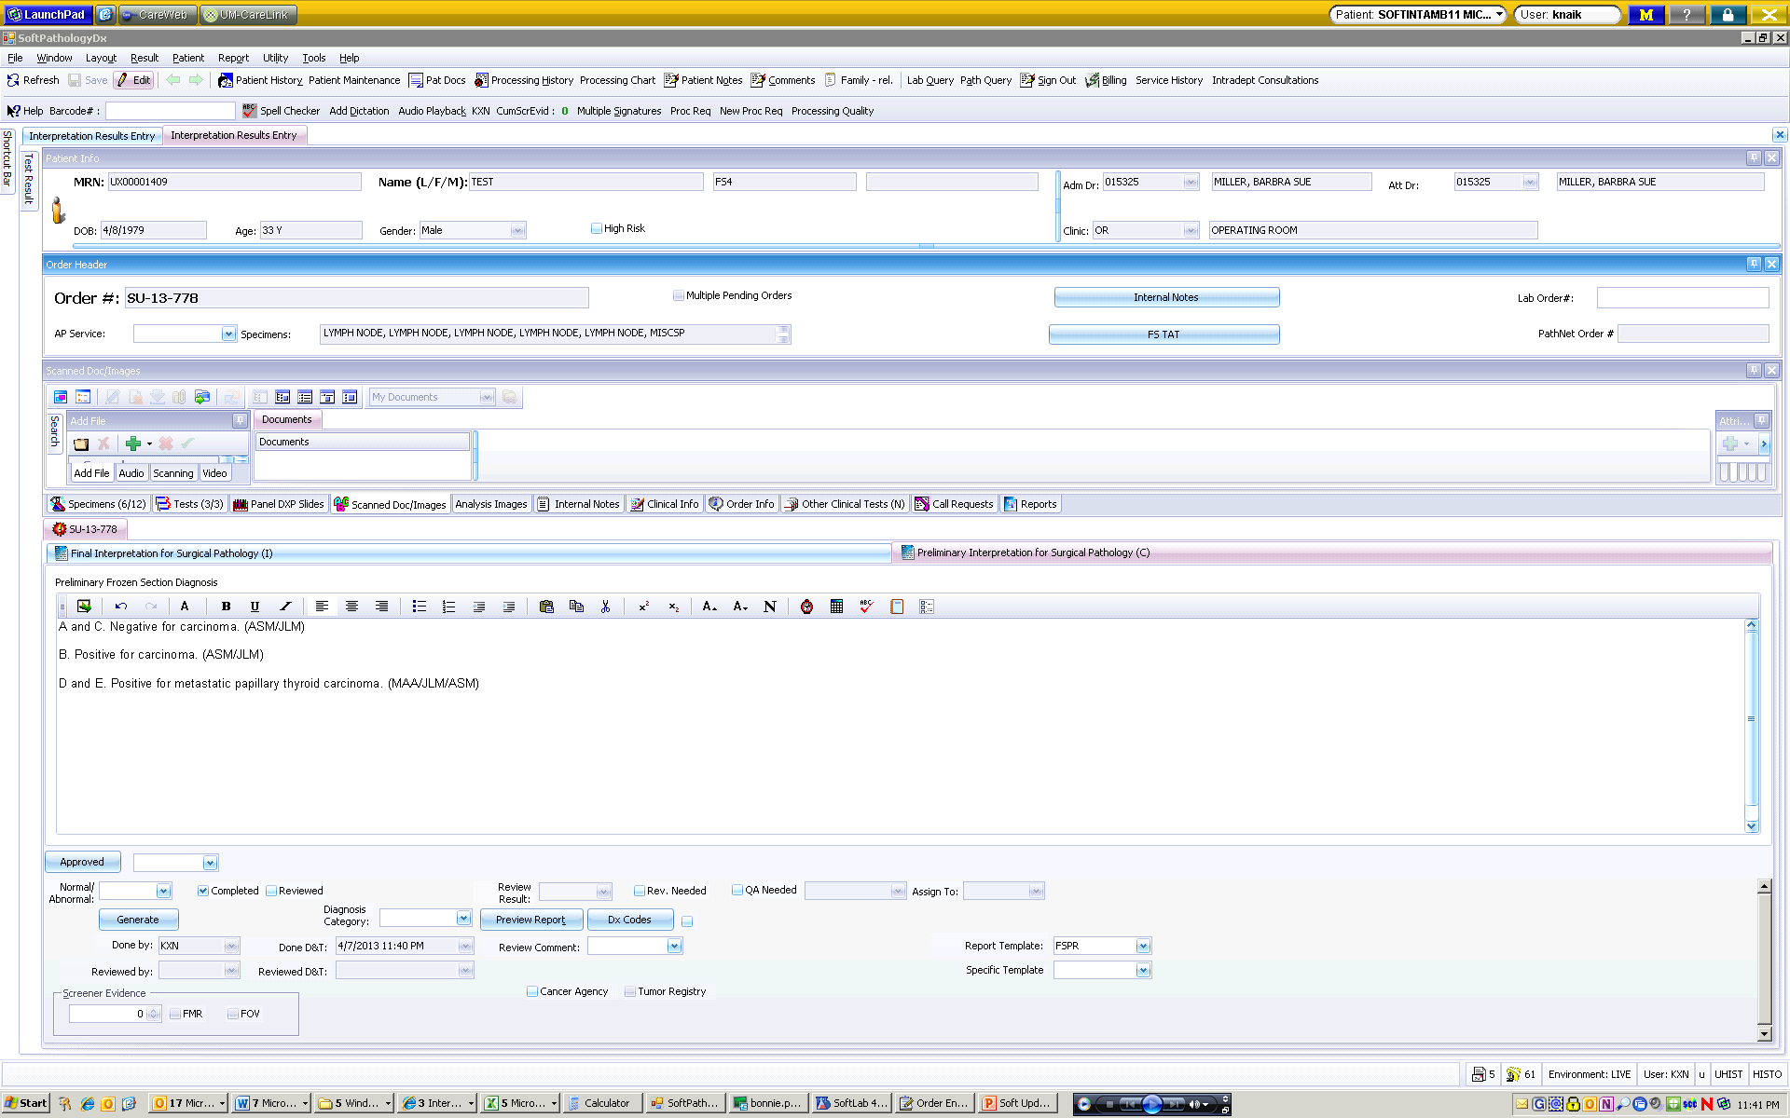
Frozen section report becomes a new tab

Slide 14
Frozen Section Reports – same workflow as currently used – dictate, transcription creates report

Slide 15
FS workflow
Pink sheets to continue to document:
  FS blocks and pathologist performing FS for each block
  Time FS was received, time surgeon notified, reason if TAT>target time
  FS Gross
Pink sheets to be scanned at grossing
Grosser to dictate FS diagnosis, block(s) and performing pathologist

Slide 16
FS workflow
Transcription to create preliminary report, transcribe FS diagnosis, assign blocks to performing pathologist, enter FS TAT
Final pathologist to sign out preliminary report prior to signing out final report
QA procedure(s) to be performed by final report pathologist

Slide 17
FS workflow
Transcription to create preliminary report, transcribe FS diagnosis…..

Slide 18
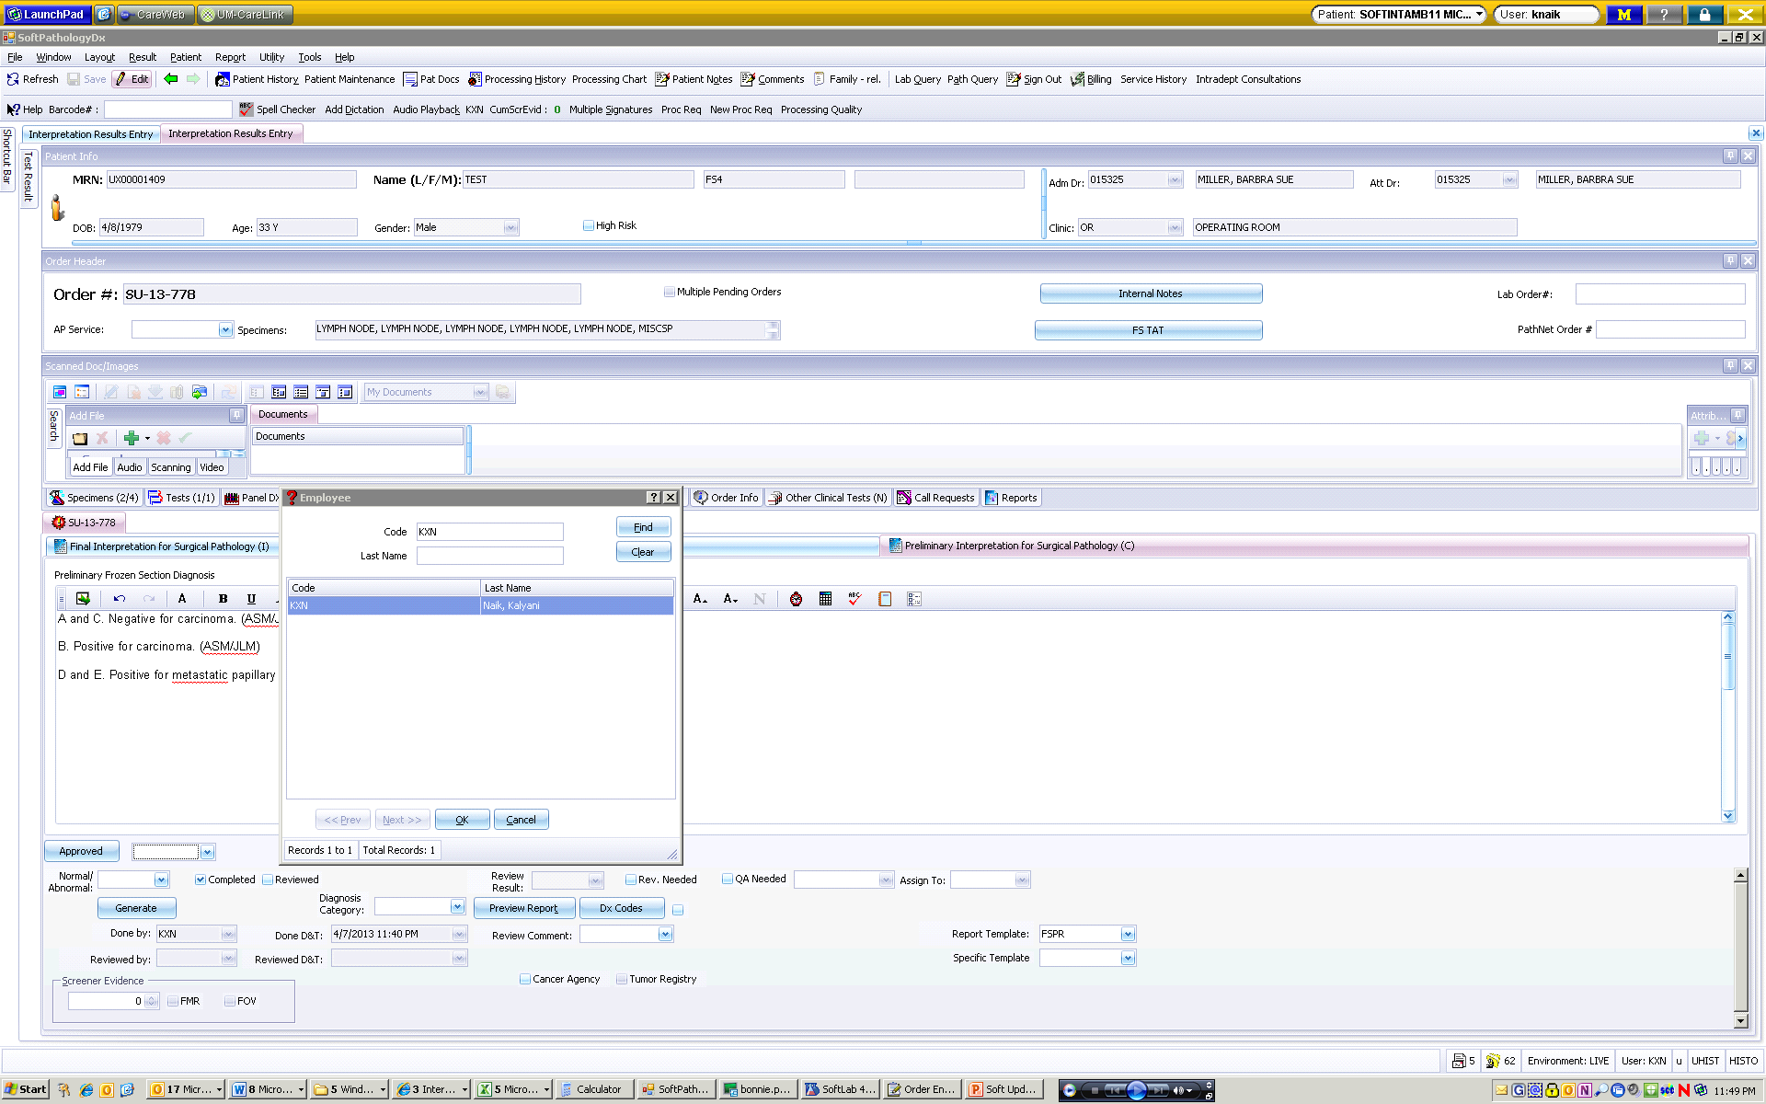
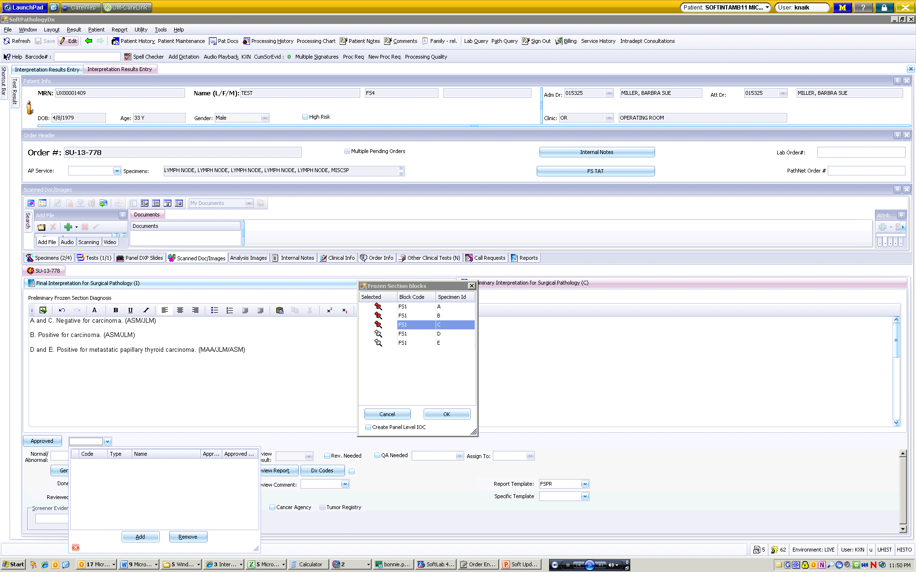
FS workflow
…..assign blocks to performing pathologist….

Slide 19
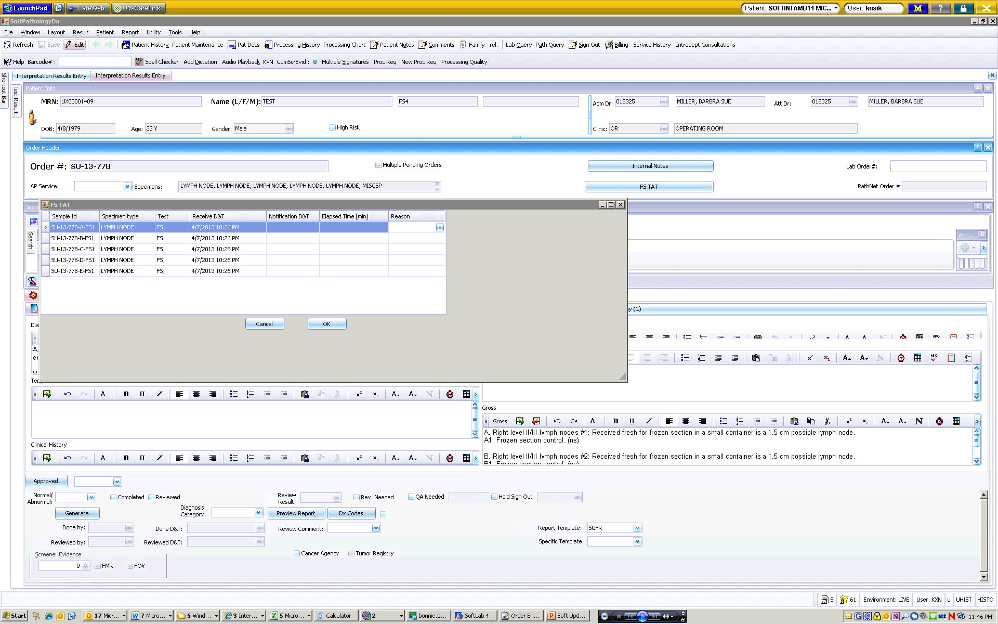
FS workflow
….. enter FS TAT

Slide 20
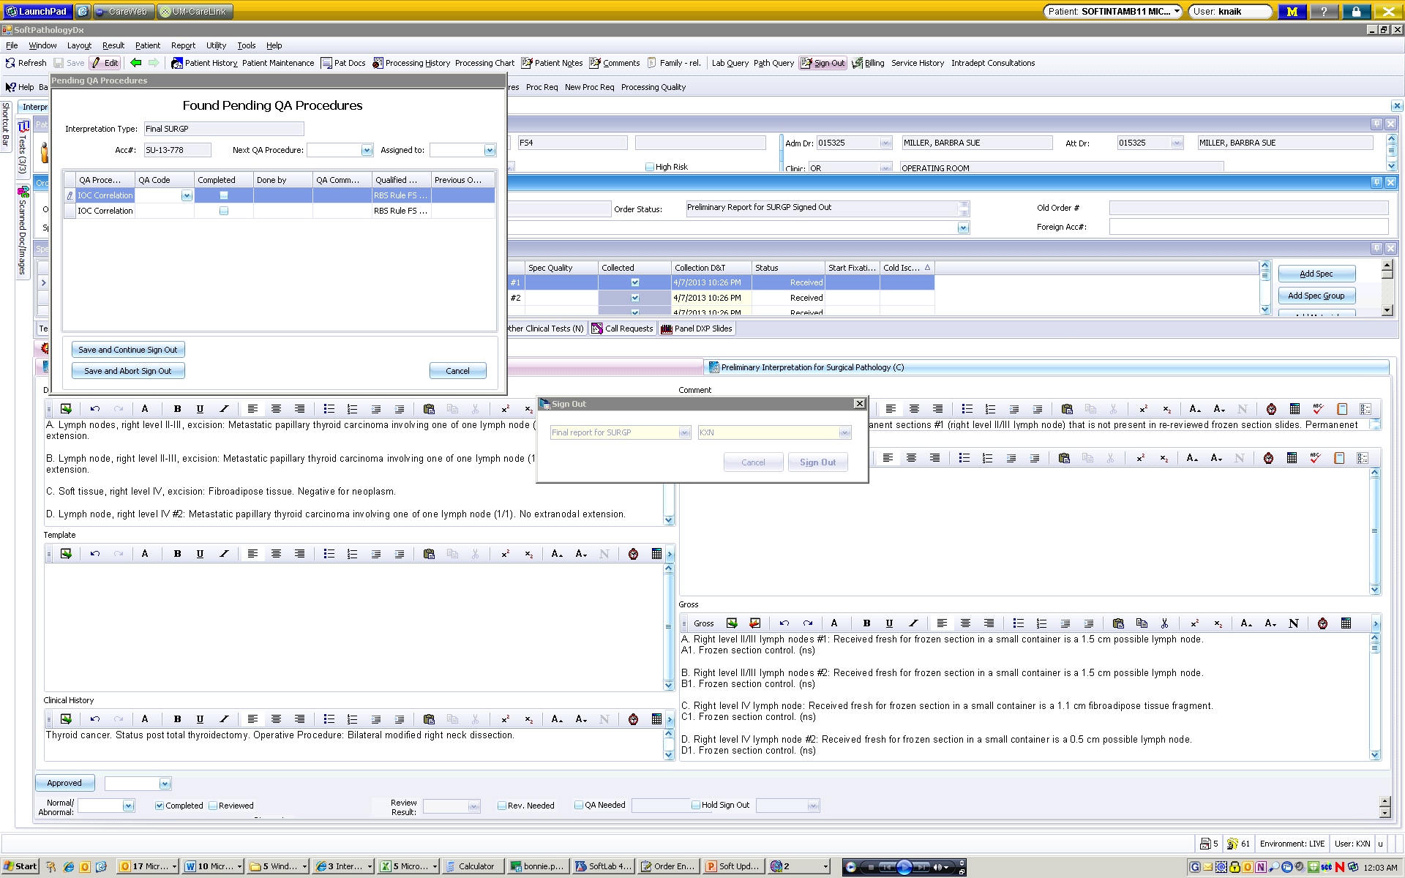
FS workflow
Final pathologist to sign out preliminary report PRIOR to signing our final report, complete QA procedure(s), sign out final report

Slide 21
“Addendums”
Old Pathnet
Addendum
Supplemental Report
Revised Report

Slide 22
Supplemental Reports
Used for reporting additional information not included in the original report
  If additional relevant clinical history arrives
  If we receive results from a molecular diagnostics test that do not change the diagnosis, etc.

Slide 23
Supplemental Reports
Please dictate the following information:
  A supplemental report needs to be created for OC-13-XXXXX
  Reactivation Reason – Choose from one of the following:
    ADDITIONAL INFORMATION
    ADDITIONAL TEST RESULTS
    CASE REVIEWED BY EXTERNAL FACILITY
    CONFERENCE CONSENSUS
    NEUROPATHOLOGIC EXAM
Report collates with original final report in MiChart

Slide 24
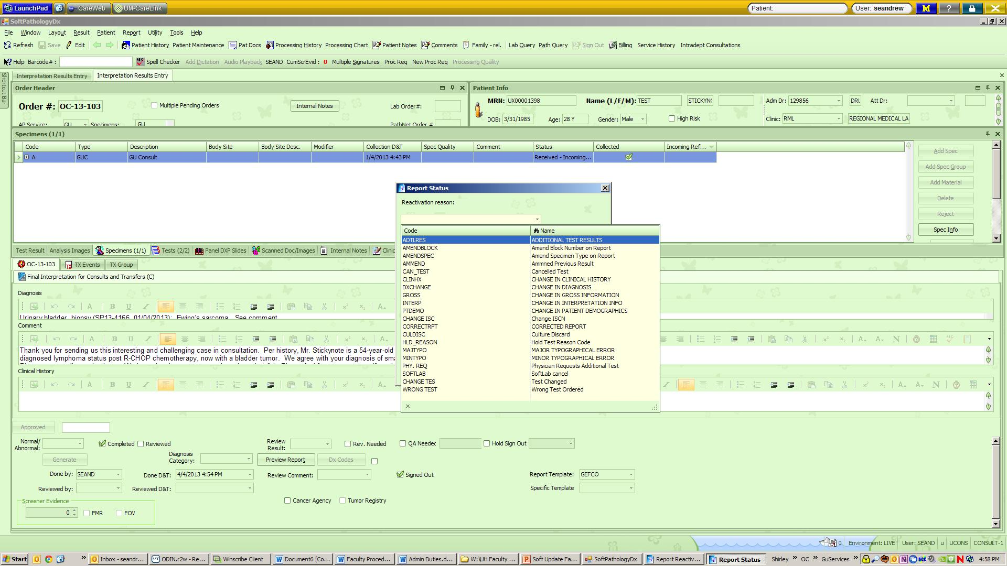
Supplemental/revised reports
Must dictate/select a reason for the supplemental/revised report – dropdown menu choices

Slide 25
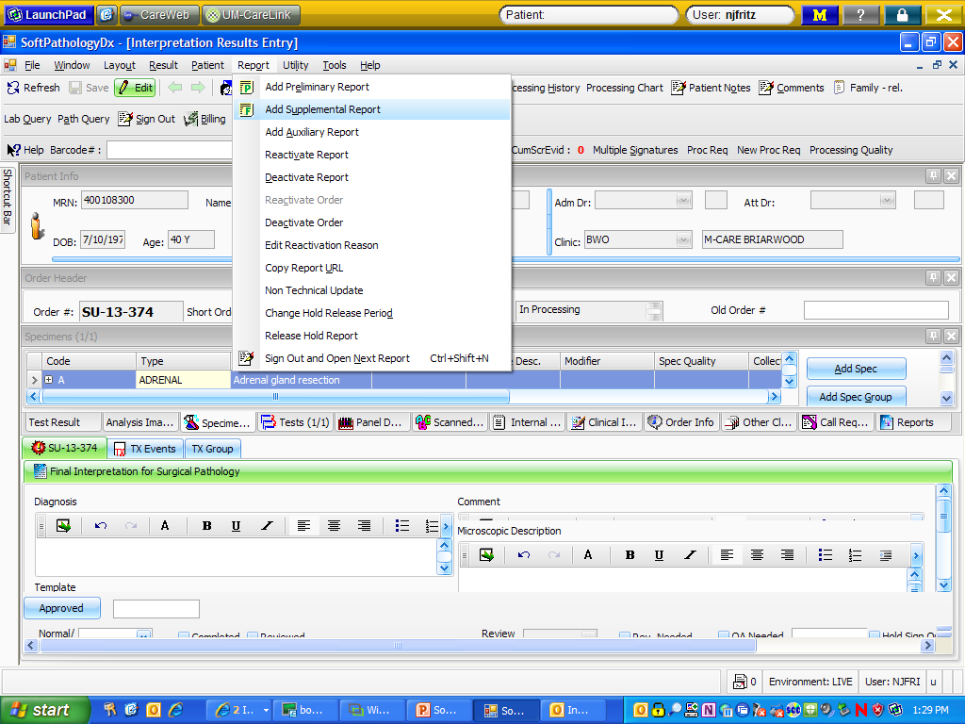
Supplemental/Revised Reports – same workflow as currently used – dictate, transcription creates report
Like a PathNet addendum
  Revised: Reactivate Report
  Supplemental: Reactivate Order, Add Supplemental Report

Slide 26
Revised Reports
Used for editing or correcting information included in the original report
  If an error is made in the diagnosis, the gross, etc.
  If a typographical error is made in the report
Replaces original final report in MiChart

Slide 27
Revised Reports
Please dictate the following information:
  A revised report needs to be created for OC-13-XXXXX.
  Reactivation Reason:
  Comment: “This revised report was issued to correct an error in the diagnosis. The diagnosis previously was typed as ‘Negative for adenocarcinoma.’ The new diagnosis is ‘Negative for neoplasm.’”
ADDITIONAL TEST RESULTS
CHANGE IN CLINICAL HISTORY
CHANGE IN DIAGNOSIS
CHANGE IN GROSS INFORMATION
CHANGE IN INTERPRETATION INFO
CHANGE IN PATIENT DEMOGRAPHICS
CORRECTED REPORT
MAJOR TYPOGRAPHICAL ERROR
MINOR TYPOGRAPHICAL ERROR

Slide 28
Revised Reports

Slide 29
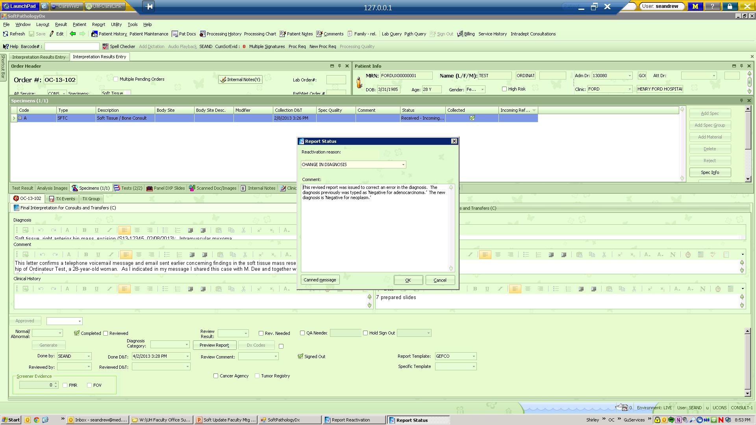
Revised Reports

Slide 30
Layout
You can set your screen to a specific layout and it will stay there until you change it:

Slide 31

Supplemental Reports
Like a PathNet addendum
Reactivate Order, Add Supplemental Report

Slide 32
billing
In the event that a pathologist dictates billing codes, the typist can go to the billing for this case and check/change the billing.
While in the case, choose the Billing button
    Global – check to see if the billing code that was entered at accessioning (surg path cases) is correct. You can add/change/delete billing here.

Slide 33
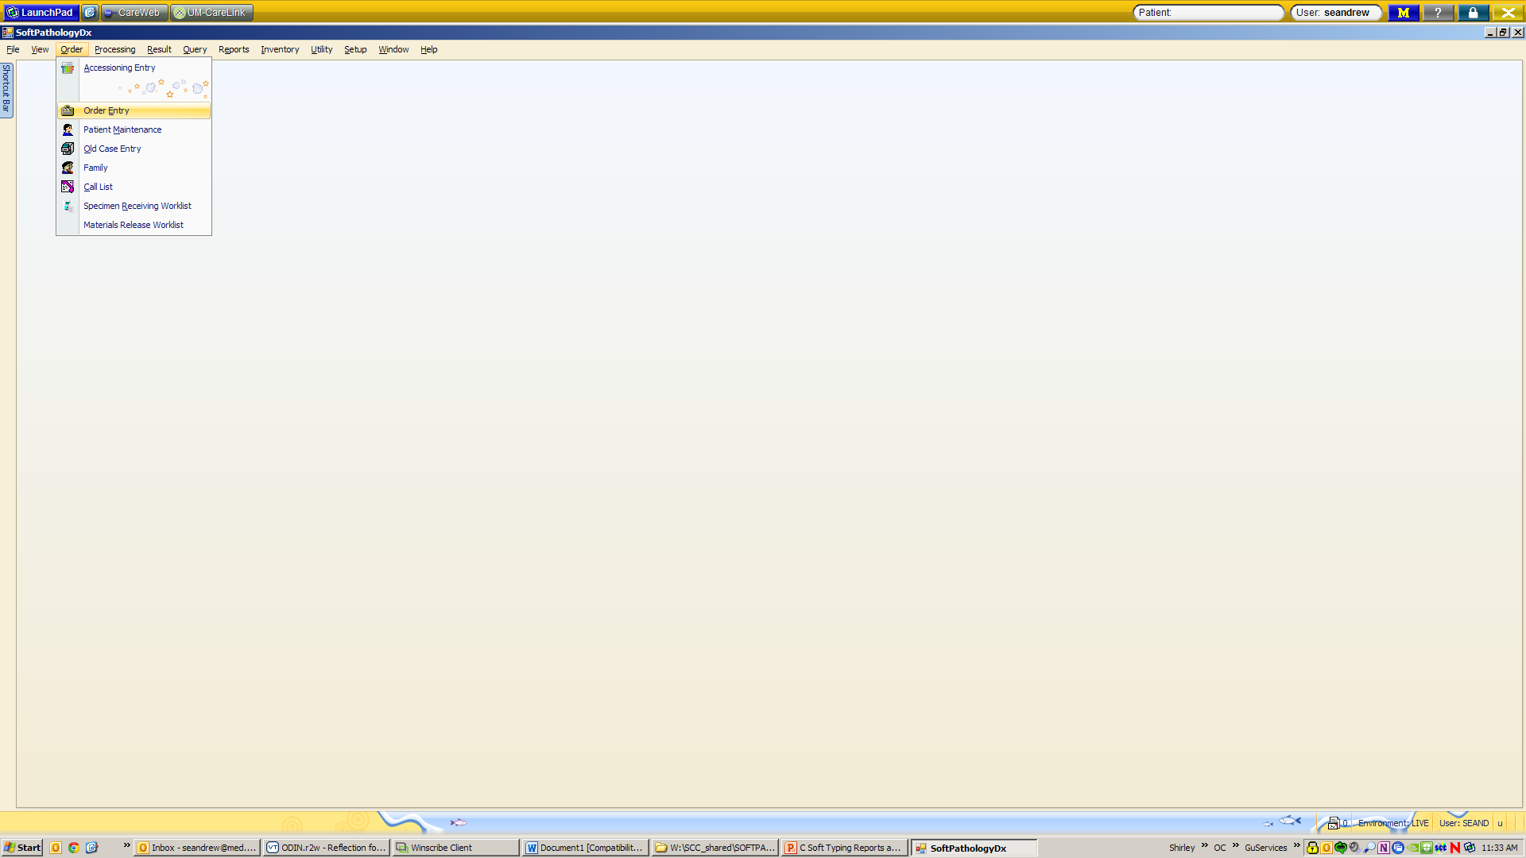

Order Entry (to re-assign a case)

Slide 34
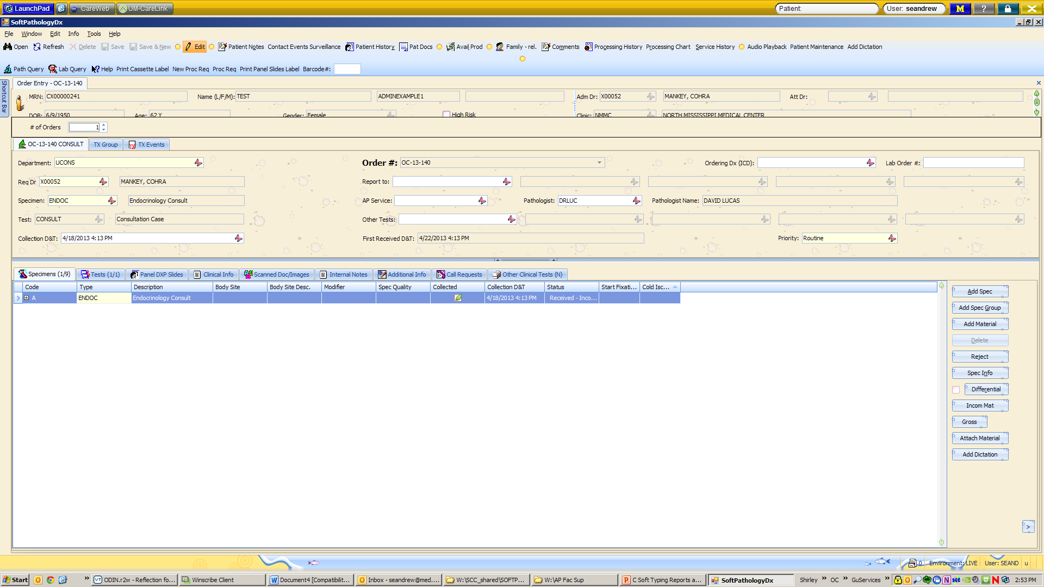

Order Entry (to re-assign a case)

Slide 35
Re-assigning cases
After re-assigning the case through Order Entry, double check to see that the correct template is in place for the pathologist receiving the case

Slide 36
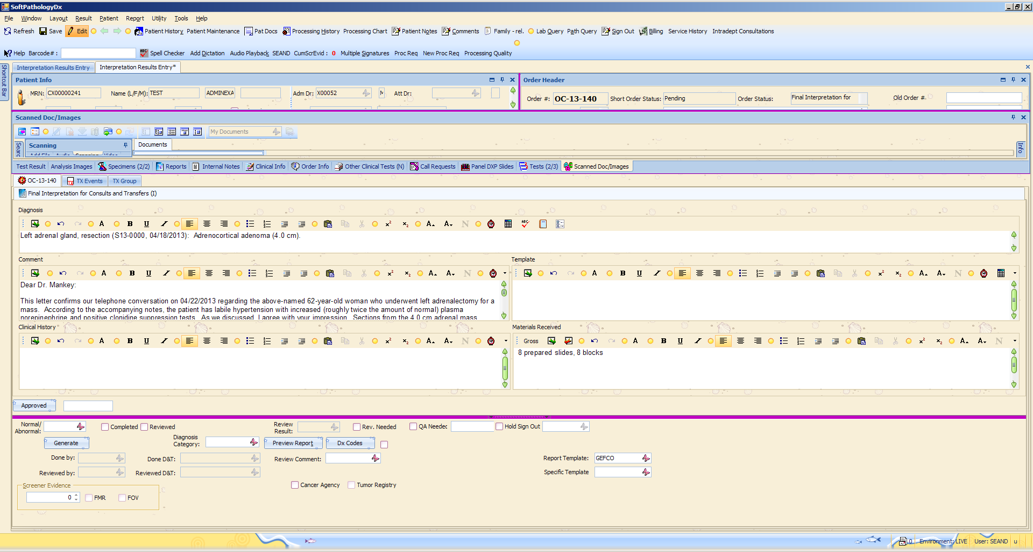

Changing templates
Interpretation Result Entry: Scan or type your Order #

Slide 37
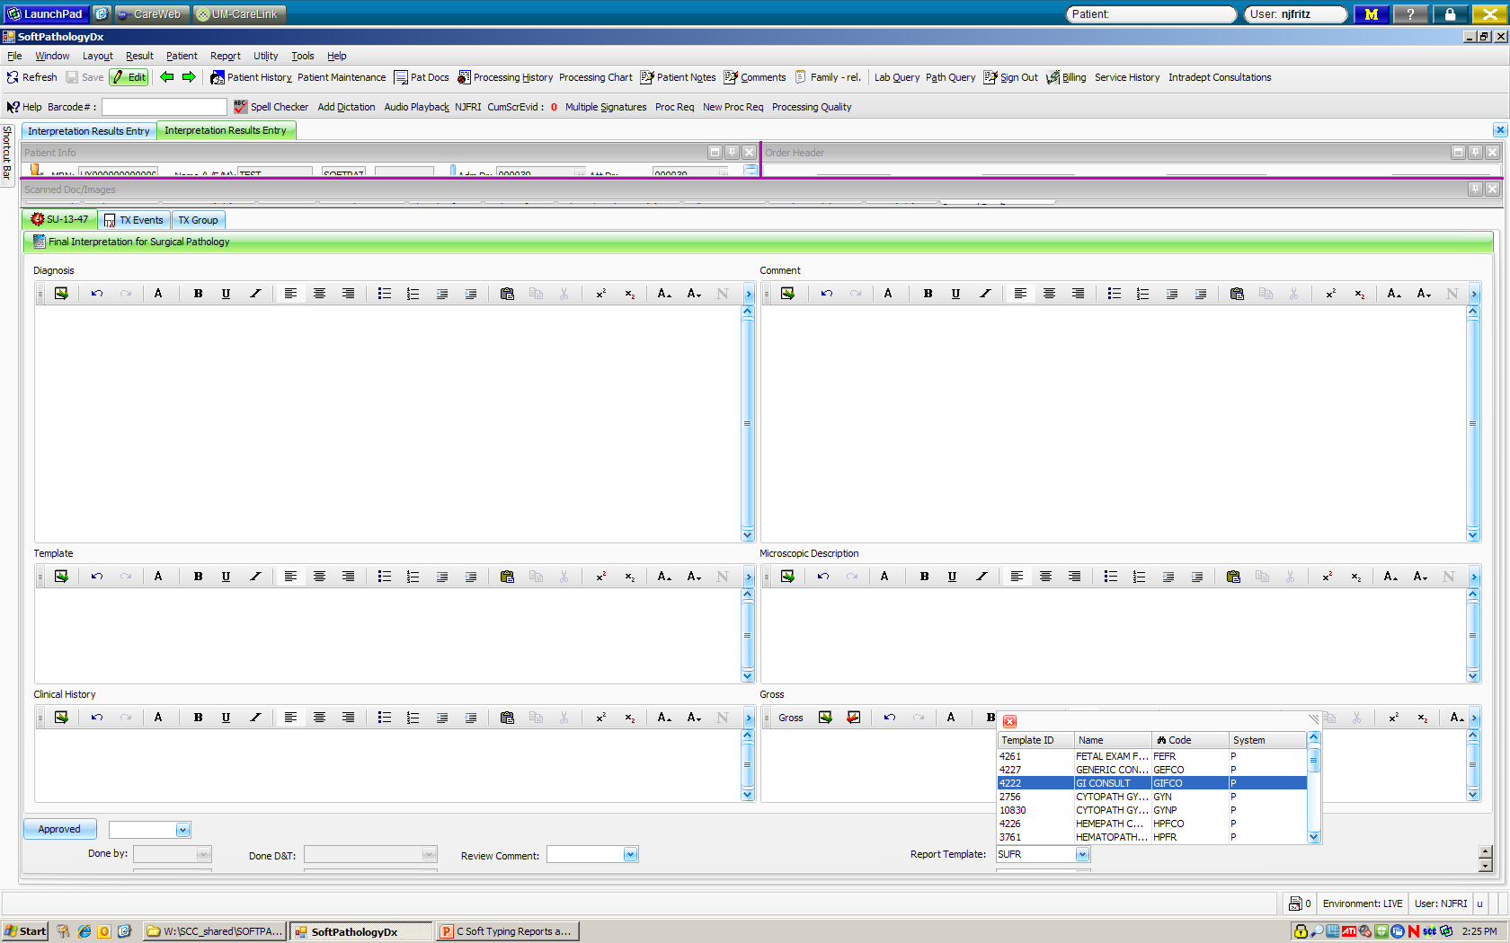
Changing templates (to re-assign a case)

Slide 38
CONSULT Template list
GIFCO – GI SERVICE
GEFCO - GENERIC
HPFCO - HEME
IDFCO – DERM

Slide 39
SURGICAL TEMPLATES
TRCON – TRANSFER CASE (TD, TS, TC, TE, etc.)
SUFR – IN-HOUSE SURGICAL CASES
HPTCO – HEMEPATH TRANSFER CASE (TH)

Slide 40
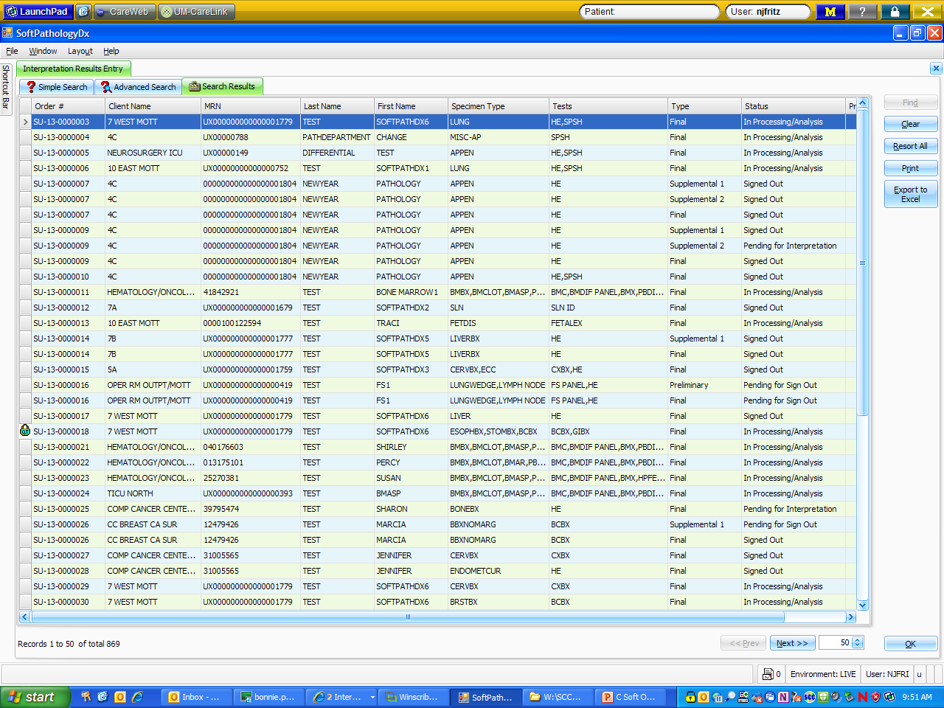
Searching for patients
Result tab: Shows status of case
  Interpretation Result Entry: Can search by Order #, MRN, Last Name, Barcode

Slide 41
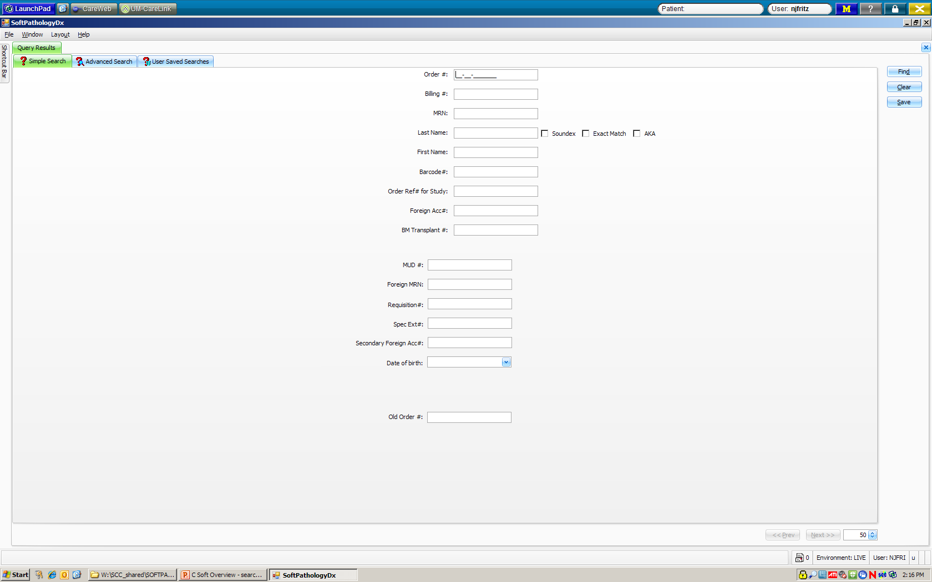
Searching for patients: Query tab

Slide 42
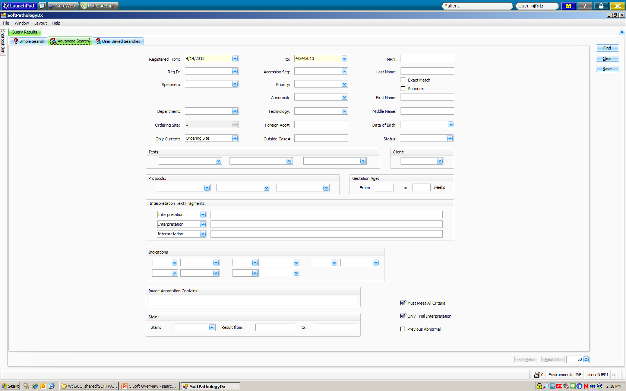
Searching for patients: Query advanced:

Slide 43
Cool new tools!
In a case:
  Patient history: All of the patient’s previous records from PathNet can be viewed
  Processing history: A list of all procedures that have been performed on this order
  Processing chart: Icon drawing showing processes completed on this order
  Patient Notes and Family-rel: Places to store more information

Slide 44
PathNet to Soft
PDI = Reports – Result Reports
CNI = Simple search screen: shows status of case and lists all cases for a patient
ATR = Results – Interpretation Result Entry
OID = All information is on the opening screen of every case
API to see if cases are typed = Reports – Result Reports
Stalled Case List = My Orders
Look up status of stain order = in case, click Proc Req

