Slide 1
Soft – Typing reports/consults
The New Laboratory System
By Soft Computer Consultants

Slide 2
How to Log In
On your desktop, in the bottom tray, lower right corner:
Double click the icon, select QA
Click SoftPathDx
Click Start
When login screen appears, use your UNIQUE NAME AND LEVEL 2 PASSWORD
Verify your workstation (bottom right corner)

Slide 3
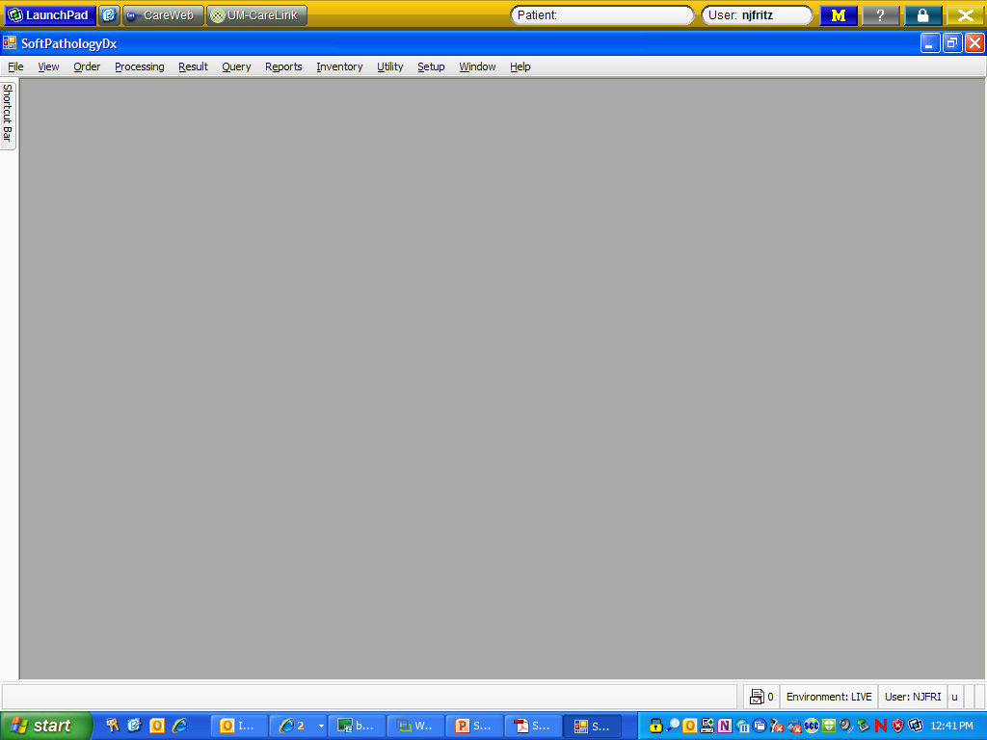
This is what the opening screen looks like……..
Skip to:
Searching for Patients

Slide 4
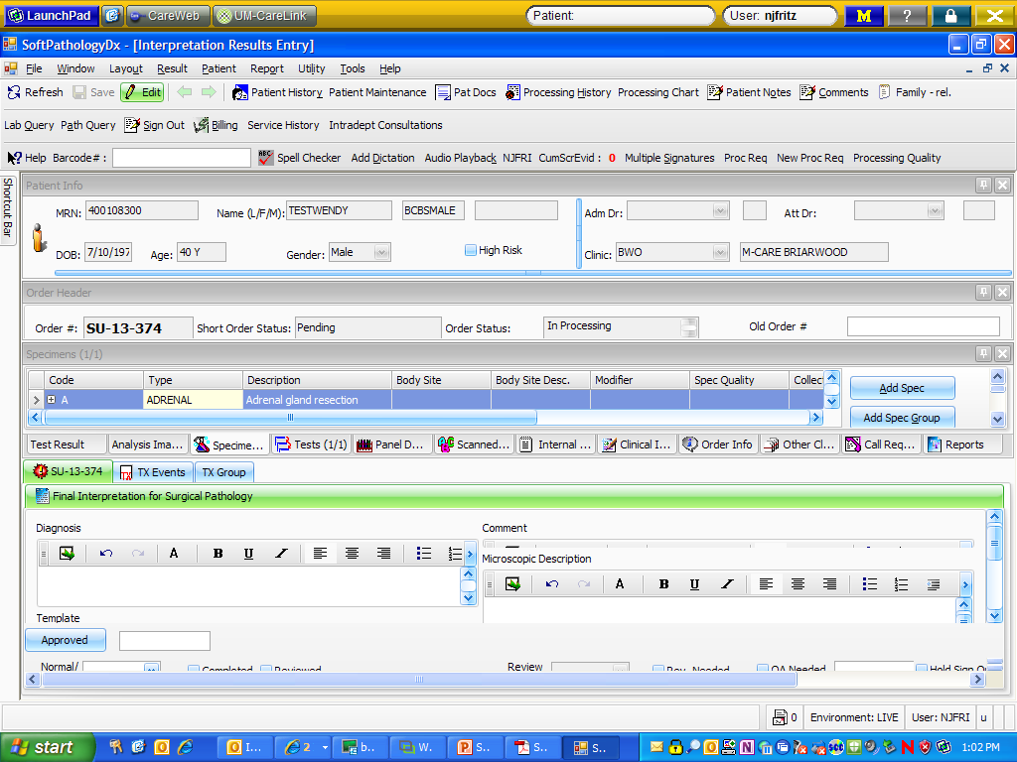
Typing Reports
Interpretation Result Entry: Scan or type your Order #

Slide 5
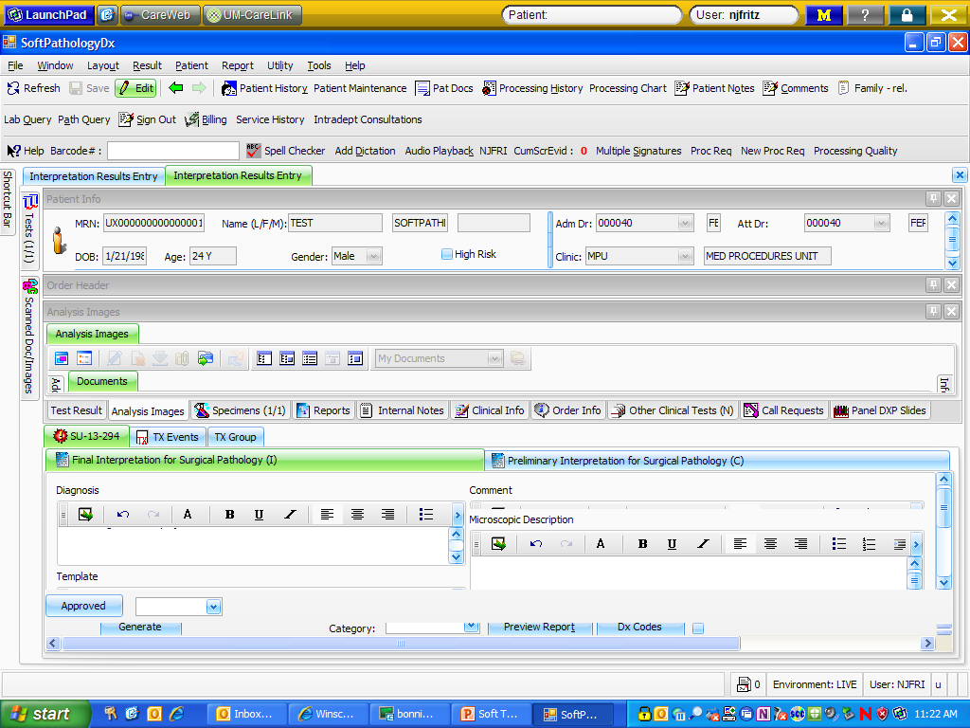
Scanned documents

Slide 6
Double click on the picture of the paper to open the typing boxes

Slide 7
What goes where?
Diagnosis = interpretation field and comment (if pathologist dictates for comment to be part of diagnosis)
Comment = letter portion

Slide 8
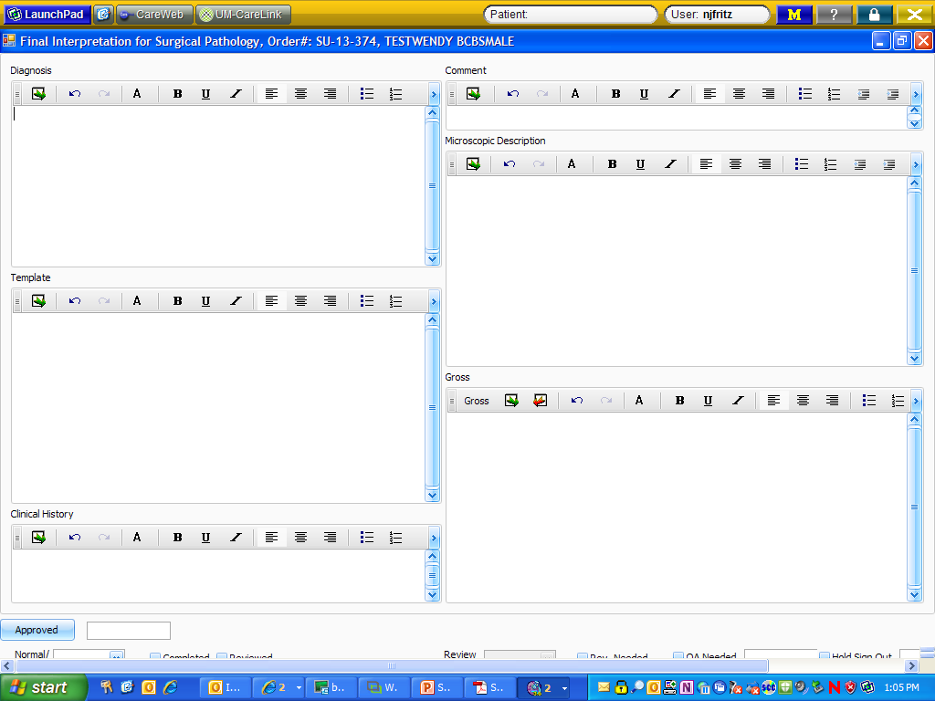

Slide 9
When typing is completed:
Close the “typing boxes” window
  Check the completed box – VERY IMPORTANT
Click the dropdown next to “Approved” and look through the menu to select the resident/fellow who dictated the case

Slide 10
Typing macros/tools:
Canned messages: phrases and paragraphs created to shorten the typing
Tools: Auto Text Settings – macro expander (like in PathNet f9 or MSWord)
UDx: Cancer templates where we just fill in click boxes as dictated

Slide 11
Supplemental/revised reports
\\Pathsans2\groups\SCC_shared\SOFTPATHDX\End User Training\C Soft Supplemental and Revised Reports Module.pptx

Slide 12
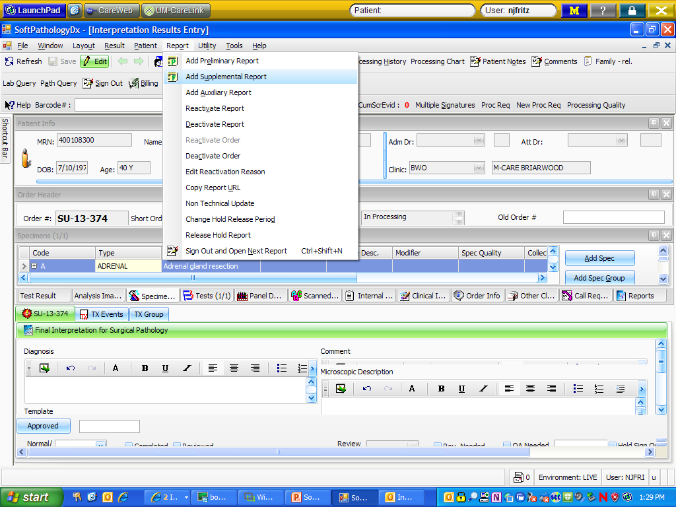

Supplemental Reports
Like a PathNet addendum
Reactivate Order, Add Supplemental Report

Slide 13
Lab portal Equivalent Functions
Ordering stains:
  Proc Req
Checking on status of requested stains:
  Proc Req; Edit
Stalled case list:
  I don’t know – My Orders?

Slide 14
billing
In the event that a pathologist dictates billing codes, the typist can go to the billing for this case and check/change the billing.
While in the case, choose the Billing button
    Global – check to see if the billing code that was entered at accessioning (surg path cases) is correct. You can add/change/delete billing here.

Slide 15
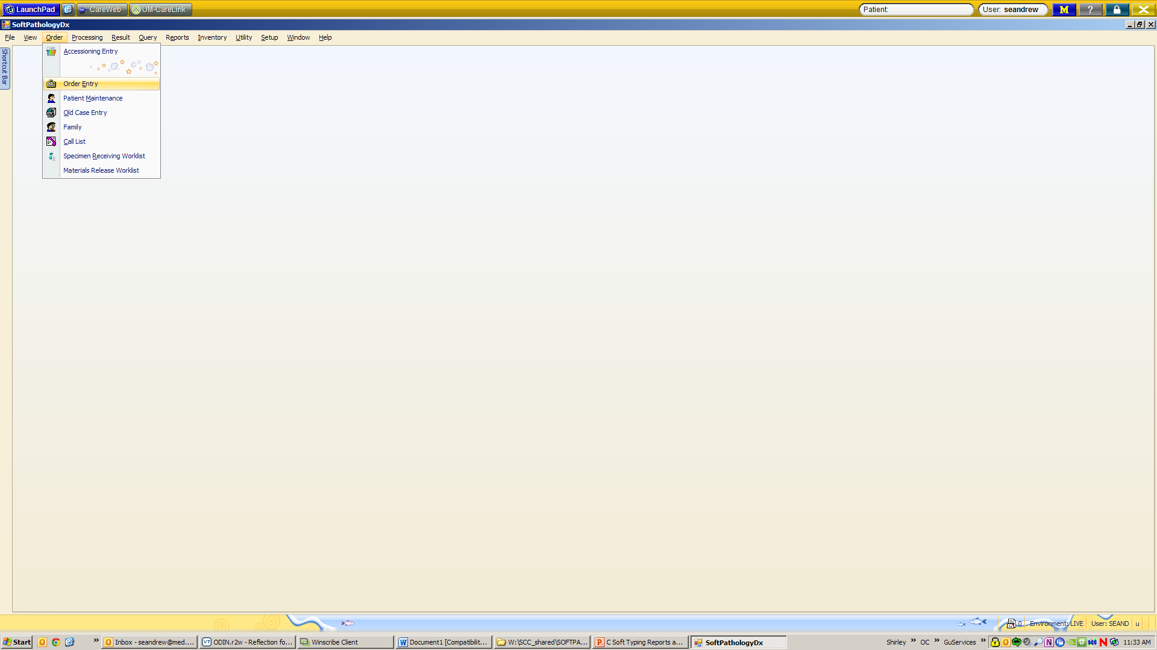

Order Entry (to re-assign a case)

Slide 16
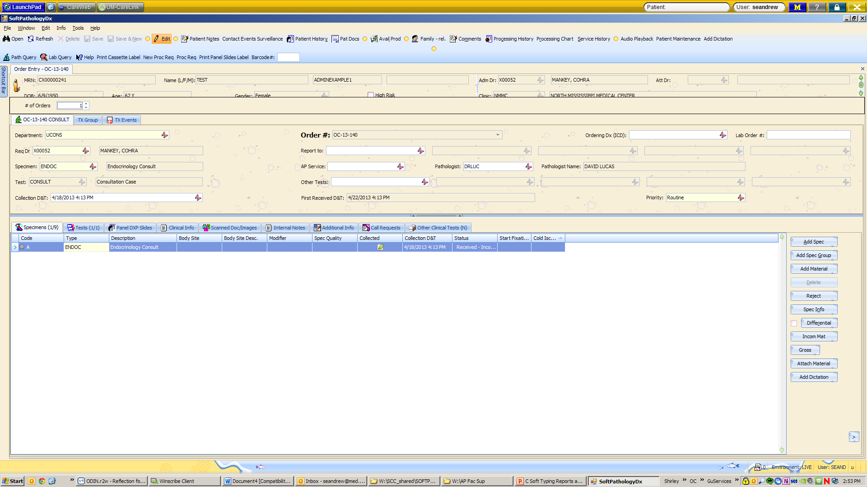

Order Entry (to re-assign a case)

Slide 17
Re-assigning cases
After re-assigning the case through Order Entry, double check to see that the correct template is in place for the pathologist receiving the case

Slide 18
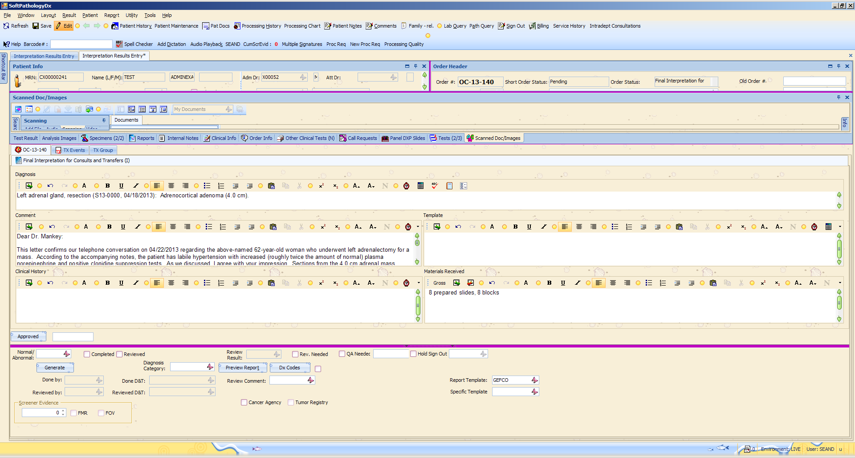

Changing templates
Interpretation Result Entry: Scan or type your Order #

Slide 19
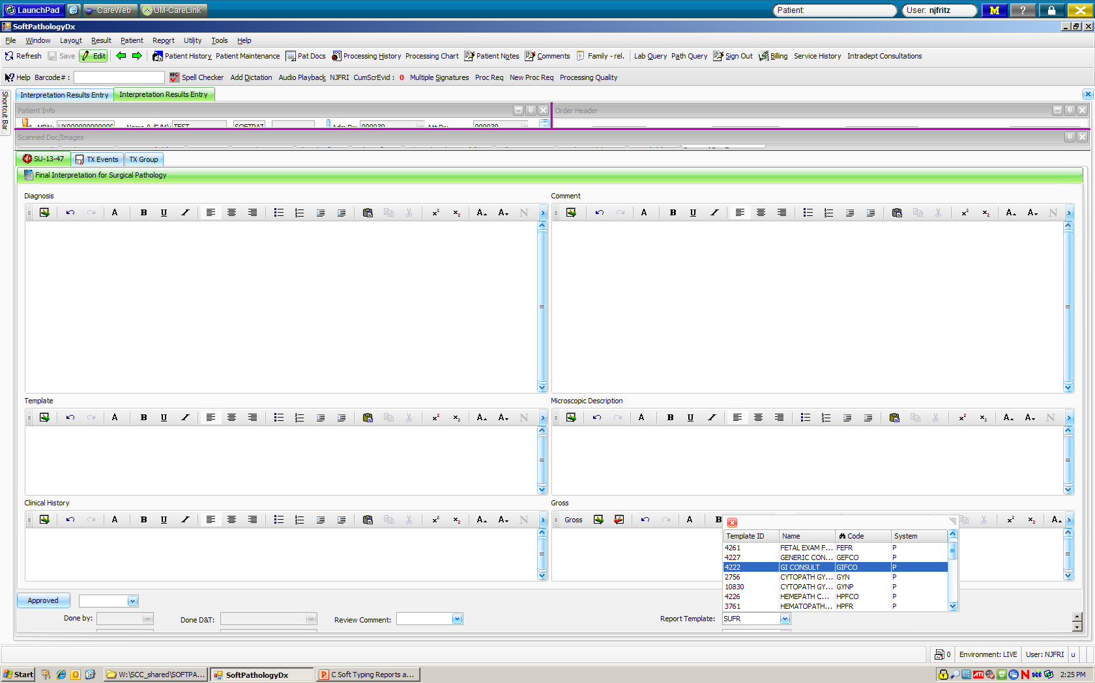
Changing templates (to re-assign a case)

Slide 20
CONSULT Template list
GIFCO – GI SERVICE
GEFCO - GENERIC
HPFCO - HEME
IDFCO – DERM

Slide 21
SURGICAL TEMPLATES
TRCON – TRANSFER CASE (TD, TS, TC, TE, etc.)
HPTCO – HEMEPATH TRANSFER CASE (TH)
SUFR – IN-HOUSE SURGICAL CASES

Slide 22
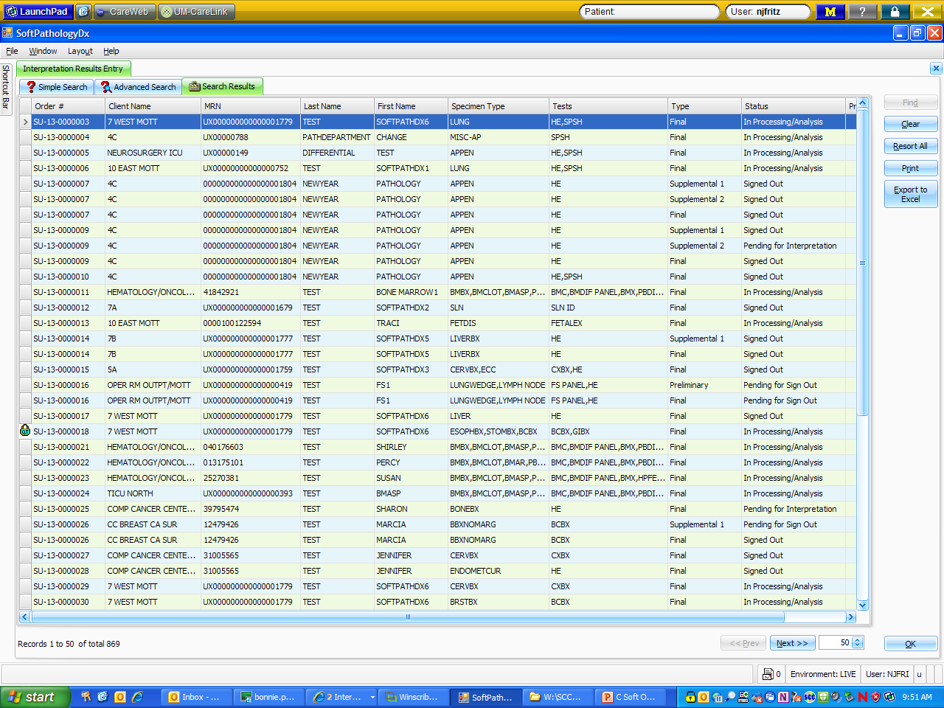
Searching for patients
Result tab: Shows status of case
  Interpretation Result Entry: Can search by Order #, MRN, Last Name, Barcode

Slide 23
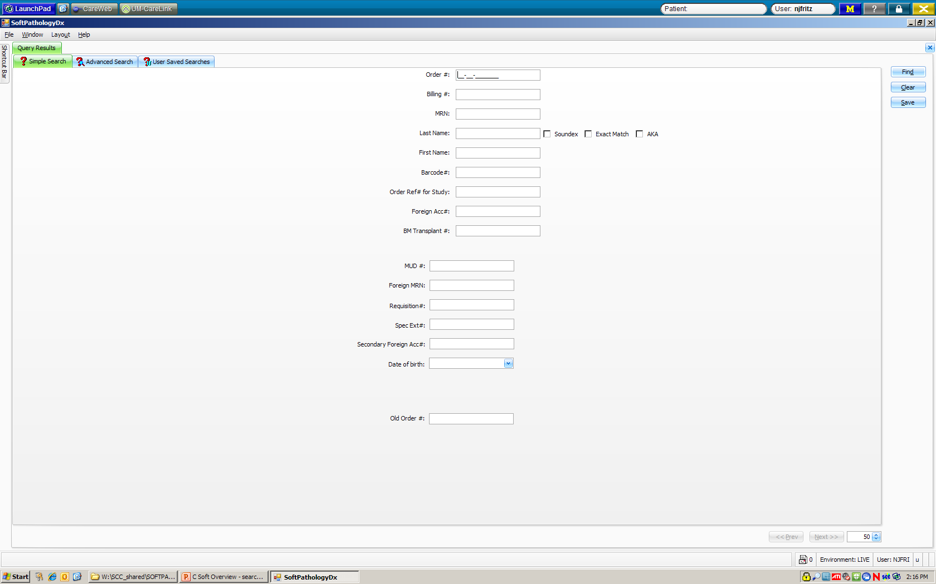
Searching for patients: Query tab

Slide 24
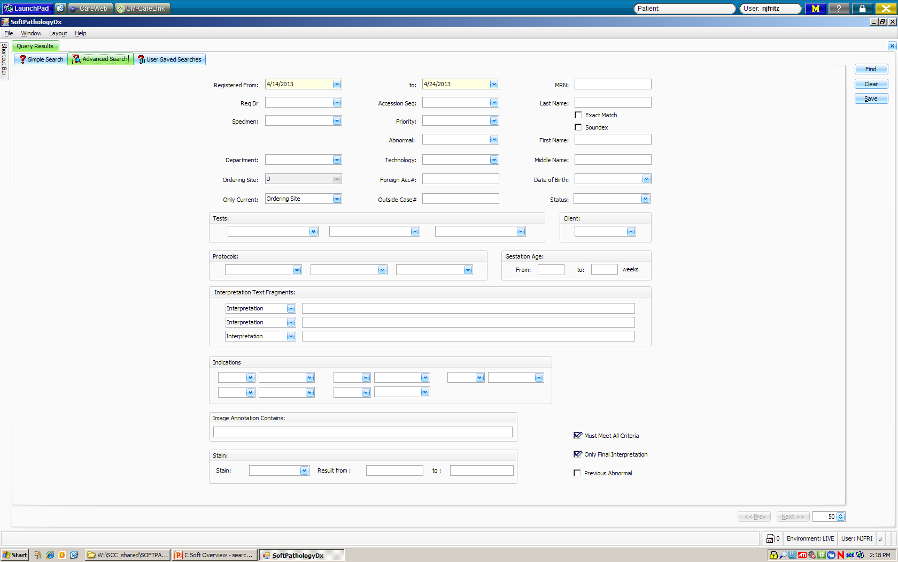
Searching for patients: Query advanced:

Slide 25
Searching for patients
Reports
  Result Reports
  Print out for tumor board (PDI)
  Only displays verified/signed out cases
Skip to:
Typing Reports

Slide 26
Cool new tools!
In a case:
  Patient history: All of the patient’s previous records from PathNet can be viewed
  Processing history: A list of all procedures that have been performed on this order
  Processing chart: Icon drawing showing processes completed on this order

Slide 27
PathNet to Soft
PDI = Reports – Result Reports
CNI = Simple search screen: shows status of case and lists all cases for a patient
ATR = Results – Interpretation Result Entry
OID = All information is on the opening screen of every case
API to see if cases are typed = Reports – Result Reports
Stalled Case List = My Orders
Look up status of stain order = in case, click Proc Req

