Slide 1
Grossing Skin Specimens
May Chan, MD

Slide 2
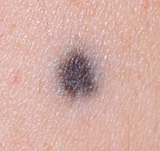
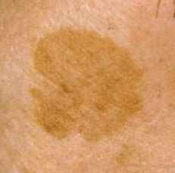
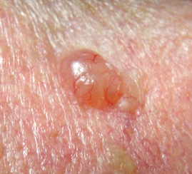
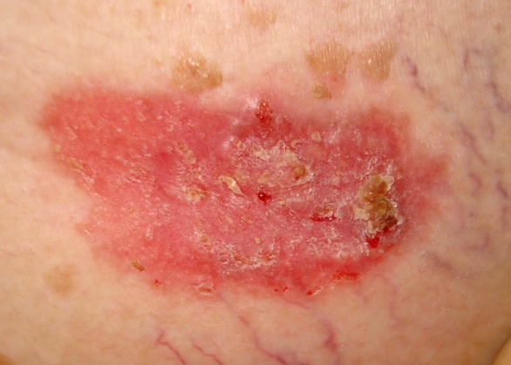
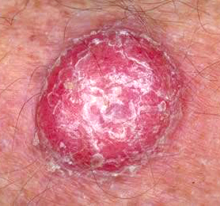
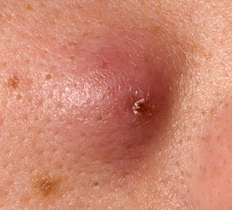
Describing the Lesion
Flat
  Macule (< 1 cm)
  Patch (> 1 cm)
Raised
  Papule (< 1 cm)
  Plaque (flat topped, > 1 cm)
  Nodule (dome shaped, > 1 cm)
Ulcer
Scar
Macule
Patch
Papule
Plaque
Nodule
Nodule

Slide 3
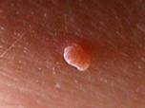
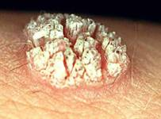
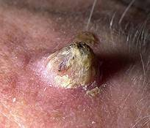
Describing the Lesion
Size
  “L x W cm excised to a depth of D cm”
  Punches: “0.5 cm punch biopsy excised to a depth of 0.5 cm”
  Multiple similar skin tags in a jar:
  “Six polypoid portions of skin ranging from 0.2 x 0.2 x 0.1 cm to 0.6 x 0.3 x 0.2 cm”
Distance from margins
Configuration
  Polypoid / pedunculated
  Warty / verrucous
  Keratotic (horn)

Slide 4
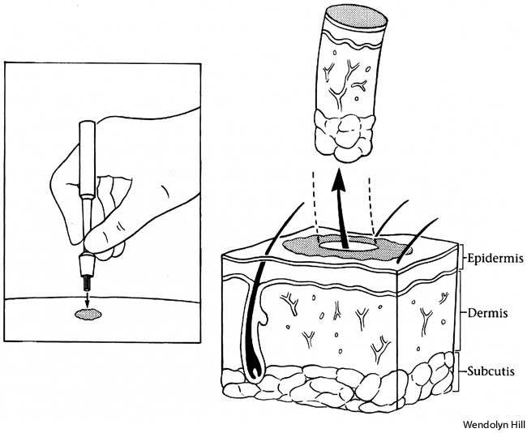
Punch Biopsies
Usual indications:
Inflammatory conditions
Dermal neoplasms

Slide 5
Punch Biopsies
Measure and ink
≤ 0.3 cm: Submit whole
0.4 cm: Bisect
≥ 0.5 cm: Serially section (2 mm apart)
Lay specimen on its side and cut from the edge
4 mm punch

Slide 6
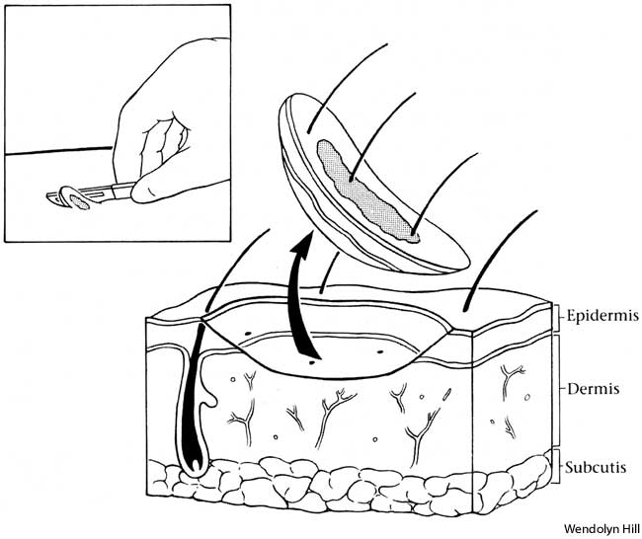
Shave Biopsies
Usual indications:
Epidermal lesions
Melanocytic lesions

Slide 7
Shave Biopsies
Deep surface usually smooth and/or shiny
Note depth of shave
Note height of papule (“raised 0.3 cm above the skin surface”)
Cut small tips away from lesion if possible
≤ 0.3 cm: Submit whole
0.4 cm: Bisect
≥ 0.5 cm: Serially section (2 mm apart)
0.7 × 0.5 × 0.1 cm shave

Slide 8
Biopsy of tiny Lesions
If lesion is small (< 2 mm), section eccentrically to avoid exhaustion of lesion
0.4 cm punch
0.4 cm shave

Slide 9
Small Excisions
Usually elliptical, sometimes oval/round
Small, relatively non-aggressive lesions:
  Non-melanoma skin cancers (SCC, BCC)
  Dysplastic nevus
  Melanoma in situ or thin melanoma (< 1mm in depth)
Tips should be SMALL and AWAY from lesion!!!
Sections should be about 3 mm thick
Submit entire specimen

Slide 10

Small Excisions
Unoriented:
  Ink in 1 color
  Both tips in cassette #1,
  body in sequential order
Oriented:
  Ink in 2 colors
  1st tip in cassette #1,
  body in sequential order,
  2nd tip in the last cassette
Blue
Green

Slide 11
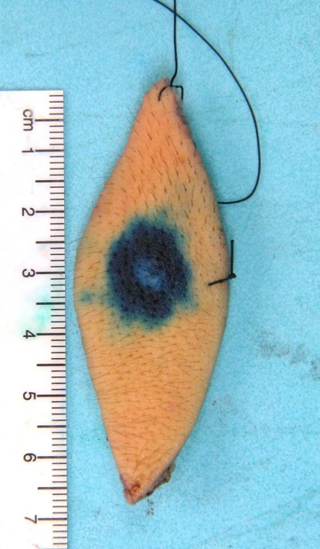
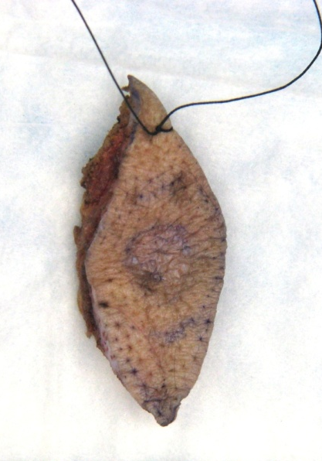
Orientation
Superior
Stick with surgeon’s terminology whenever possible
  E.g., “Long stitch = superior,
  short stitch = lateral”
If only 1 stitch → make stitch 12 o’clock
Medial
Lateral
Inferior
12:00
9:00
3:00
6:00

Slide 12
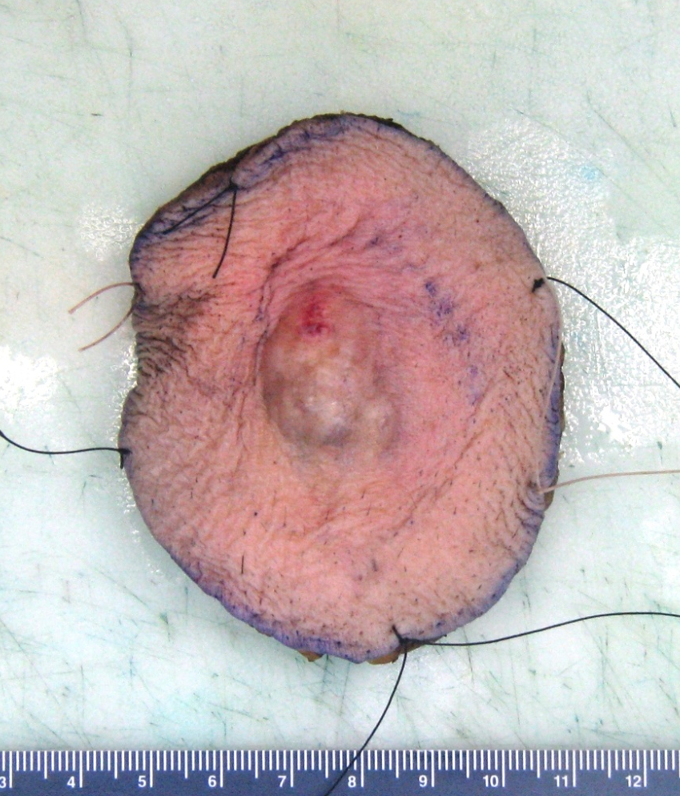
Small Oval/Round Excisions
Same inking and sectioning as ellipses
“Tips” = en face margins
  Any tumor cells present in tips will require multiple rounds of deepers to get to the true margin

Slide 13
Round Excisions
Keep “tips” as thin and small as possible to avoid cutting into subclinical lesion
x

Slide 14
Large Ellipses
Cannot fit a complete section in one cassette
Deep and aggressive tumors
  Thick melanoma (> 1 mm Breslow depth)
  Merkel cell carcinoma (MCC)
  Dermatofibrosarcoma protuberans (DFSP)
Look up biopsy report to find out margin status
Large amount of normal skin and fat
→ strategically represent!
Same 2-color inking protocol

Slide 15
Large Ellipses
↑
1.5 cm
↓
←1cm→
←1cm→

Slide 16
Large Ellipses
Measure and ink (2 colors)
Block out central lesion/scar:
  1 cm of normal skin on both sides
  Shave off excessive fat (1.5 cm from skin surface)
  Bisect/trisect sections that are too wide to fit in cassette
Submit tips and central block sequentially
If prior margins were negative, OK to submit every other section in the central block
Serially section and inspect the remainder of specimen; submit any additional lesions identified (e.g. satellite nodules)

Slide 17
If a section is too wide to fit in a cassette…
Bisect eccentrically if possible
  To preserve center of tumor where tumor thickness is measured
  Put bisected sections in same cassette if fit, or
  Place in two consecutive cassettes and dictate as such
Trisect if necessary
  Avoid cutting through center of tumor

Slide 18

If a section is too wide to fit in a cassette…
11
7
13
17
1
3
5
9
15
19
1
2
3
4
5
6
7
8
9
10
2
6
8
14
16
20
4
10
12
18
11
12
13
14
15
16
17
18
20
19
Do not bisect prior to serial sectioning!

Slide 19
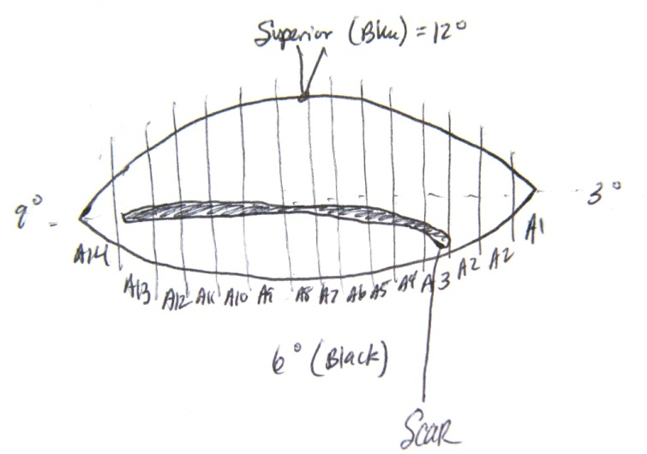
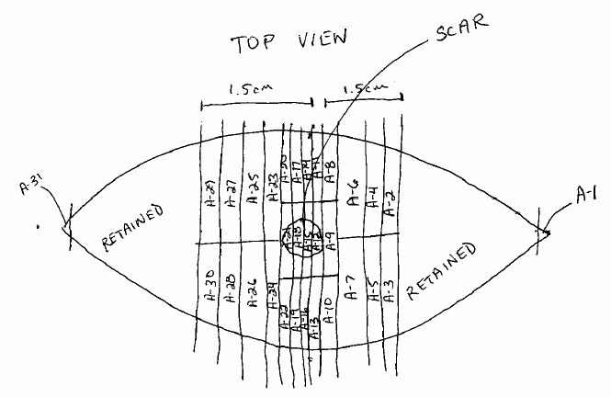
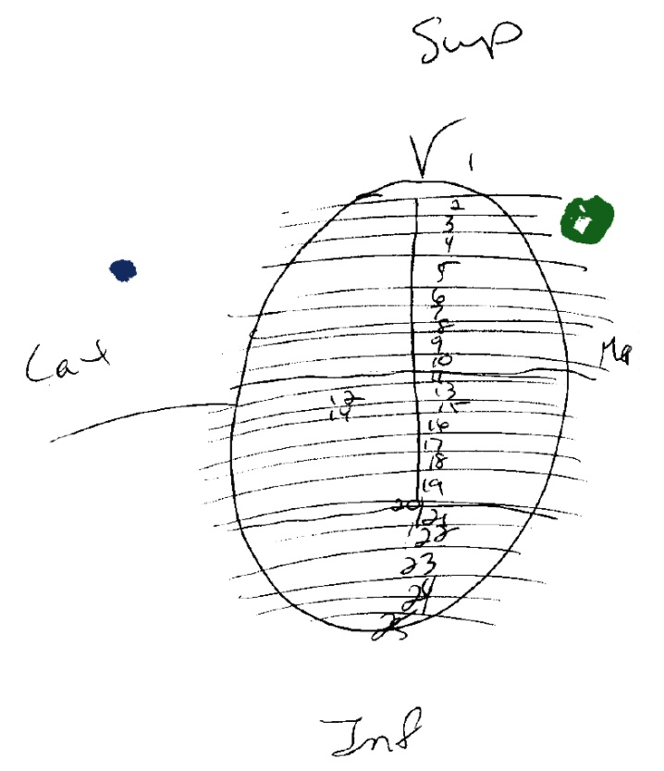
Grossing Maps
Extremely helpful and strongly encouraged for large excisions
Courtesy of Matt Gabbeart
Courtesy of Marc Stafford
Courtesy of Donna Chuey

Slide 20
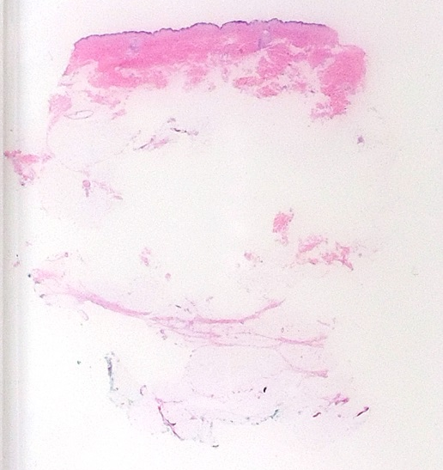
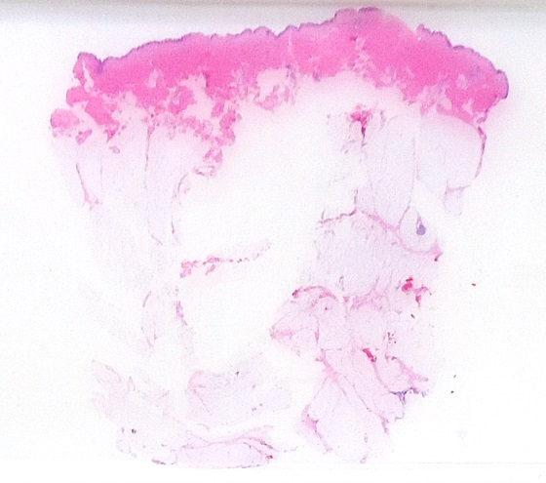
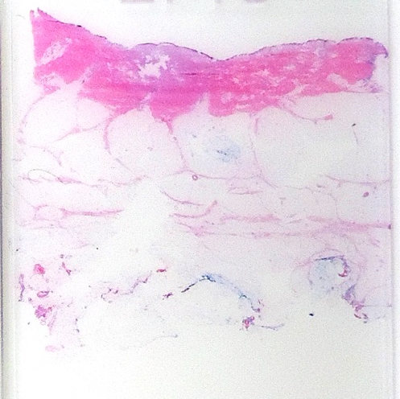
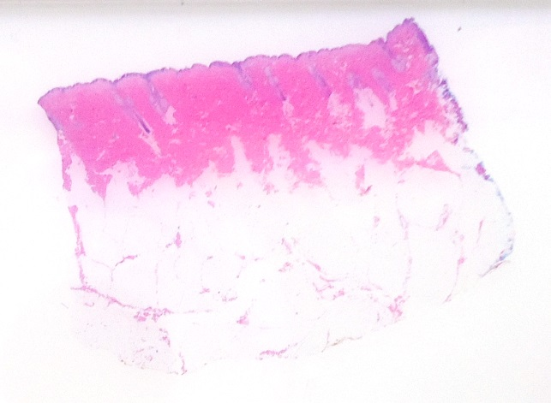
When too much fat is put through…
When extra fat is cut off at 1.5 cm…
: )

Slide 21
Large Round Excision for Single Lesion
Central lesion, grossly far from margins
Serially section tumor, include closest margins if possible
Radially sample rest of margins that are far from lesion
Do not shave peripheral margins!

Slide 22
Large Excision for DFSP
Submit entire tumor if fit in < 30 blocks
Otherwise, consult fellow or attending
  Serially section entire tumor
  Look for and submit any necrotic/grossly different areas (dedifferentiation = fibrosarcoma)
  Adequate sampling of the closest margins

Slide 23
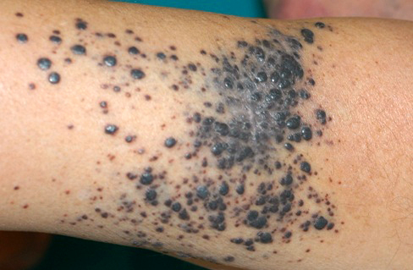
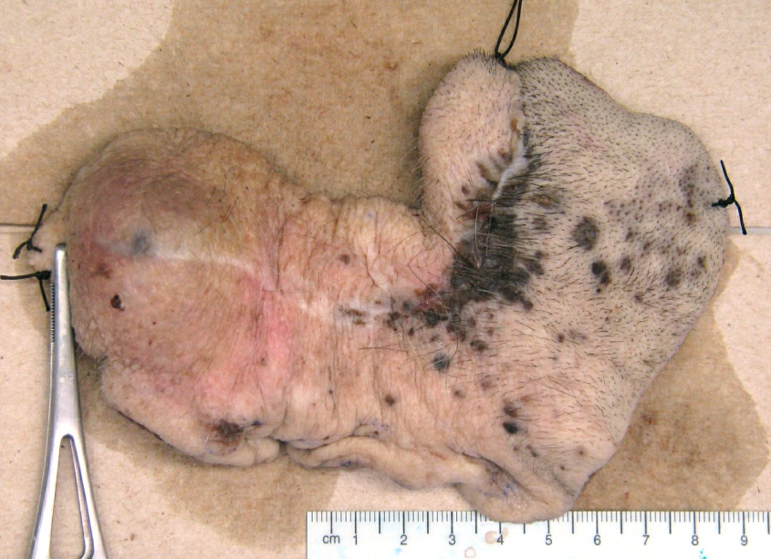
Large Excision for Satellitosis/Metastasis
Satellite: Separate nodule < 2 cm from primary tumor
In-transit met: > 2 cm from primary tumor
en route to sentinel LN
Both considered N1
Goal is to obtain clear margins to minimize risk of recurrence

Slide 24
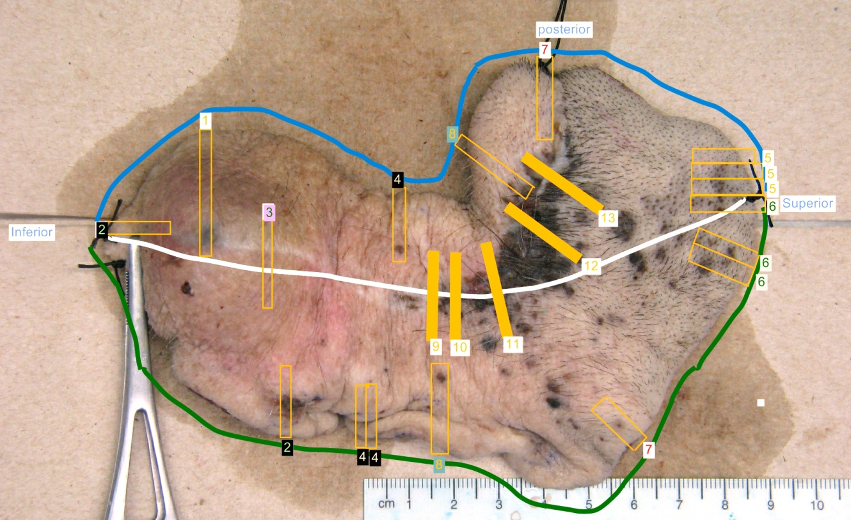
Large Excision for Satellitosis/Metastasis
Sample lesions with closest margins
Specify where each section is taken from
Map is always helpful!
Courtesy of Kristina Davis

Slide 25
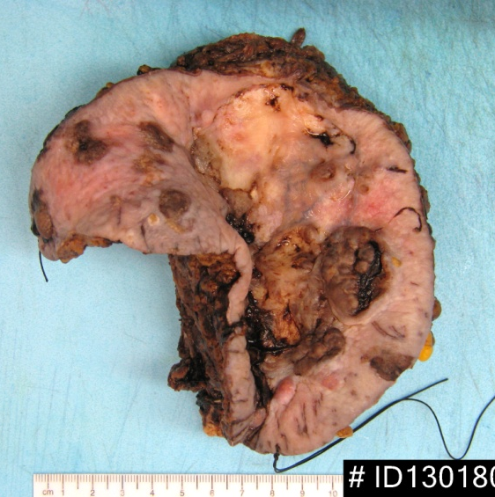
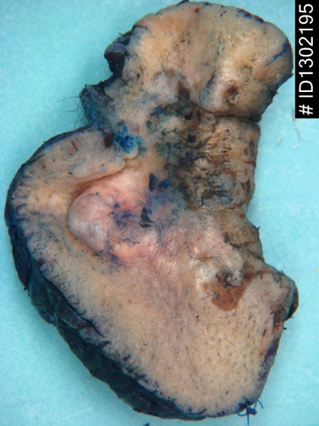
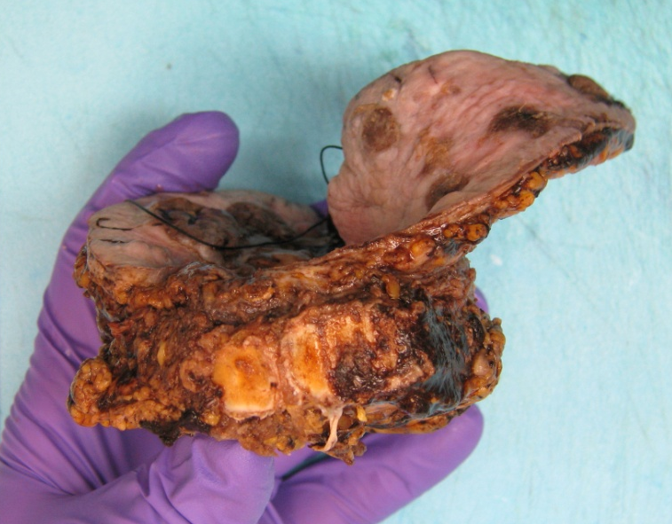
Other Irregular/Complex Excisions
Head and neck resections (parts of eyelid, ear cartilage, lip), vulvectomy, etc.
Grossing varies on a case-by-case basis
Consult dermpath fellow or attending
if questions

Slide 26
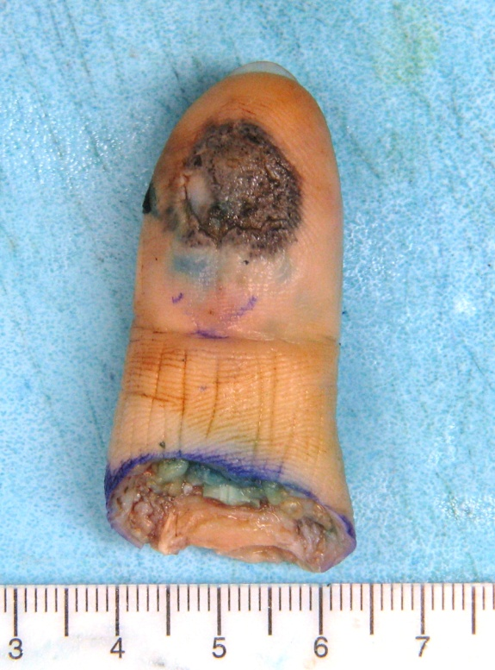
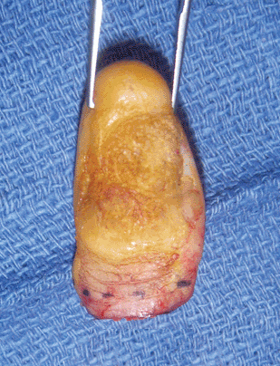
Amputations
Ink resection margin in 2 colors
  Medial vs. lateral, or
  Dorsal vs. ventral
If lesion far (> 2 cm) from margin:
  Shave skin and soft tissue margin
  Shave bone margin if concern for bone invasion (look up prior report)
  Perpendicular/radial sections of the entire lesion + adjacent normal skin
  Include 1-2 sections of tumor with underlying bone if concern for bone invasion
If close (< 2 cm) to margin:
  Perpendicular sections to include resection margin

Slide 27
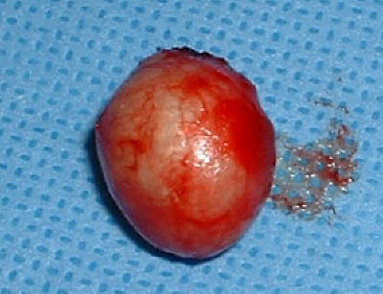
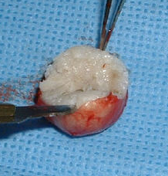
Cyst Excisions
Note any epidermis
Measure and ink
Look for cyst cavity/contents
Cyst present:
  Describe cyst contents,
  e.g. “white pasty material”
  Represent in ≤ 3 blocks
  Do not put through excessive amount of cyst contents
No cyst:
  Describe - Solid nodule? Distance from inked margin?
  Submit entire specimen
Notes:
<3 blocks?

Slide 28
Square Excisions
To clear peripheral margins of lentigo maligna
Staged excisions to conserve tissue on face
En face margins to enable complete evaluation of the margins (lower recurrence rate)
Extremely important to gross correctly
  One shot at getting the orientation right
  Direct impact on next stage of treatment

Slide 29
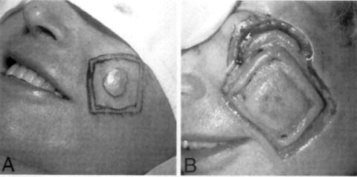
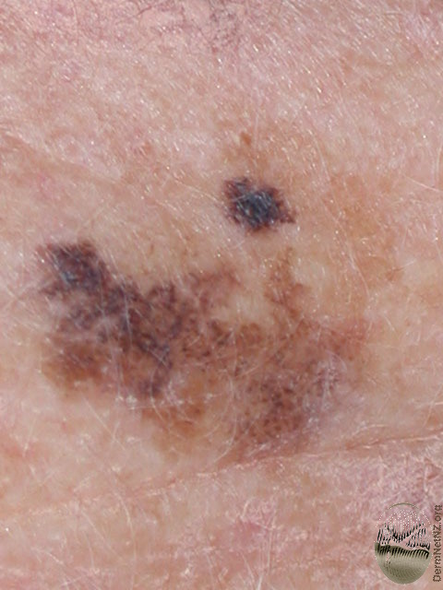
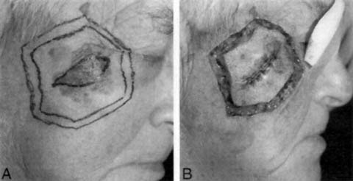
Square Excisions
Clinical photos

Slide 30
Square Excisions
At least 0.5 cm around visible lesion
Subclinical MIS/ AJMH may extend to or beyond square
Visible
Subclinical

Slide 31
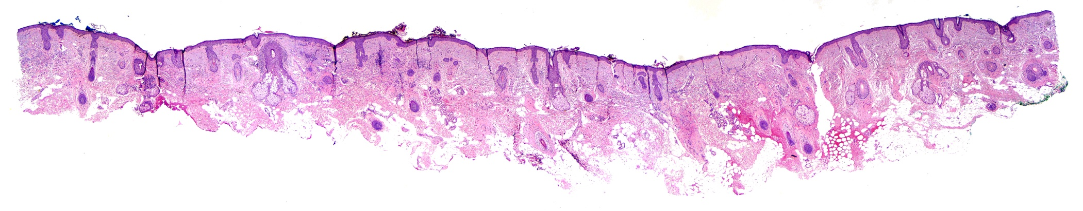
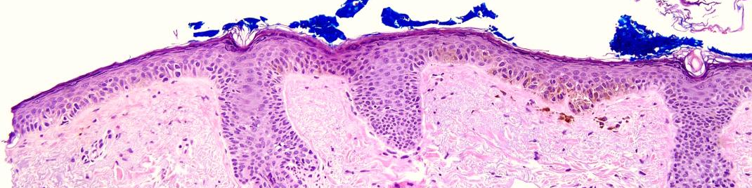
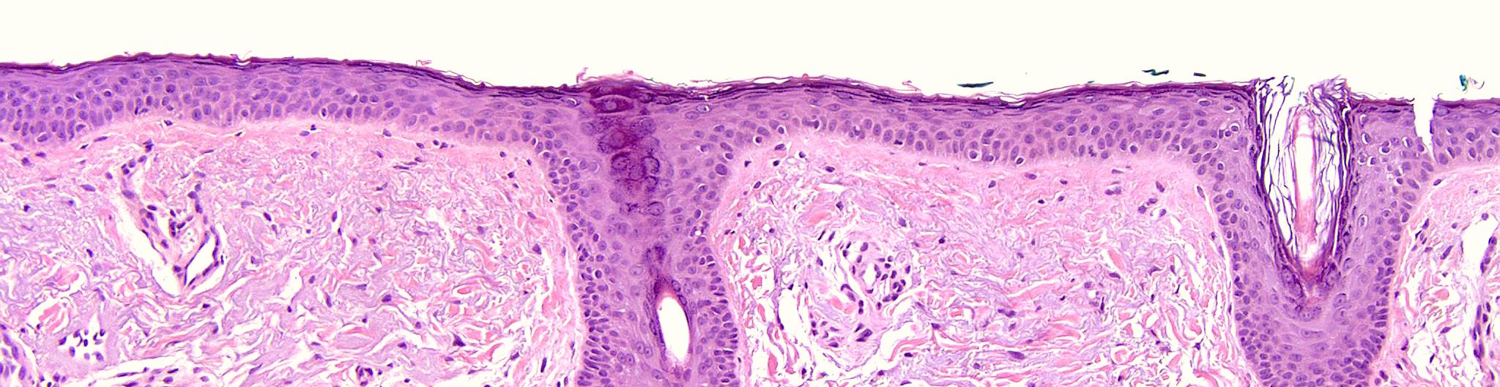
+
-
Blue (A-B)
Green (B-C)

Slide 32
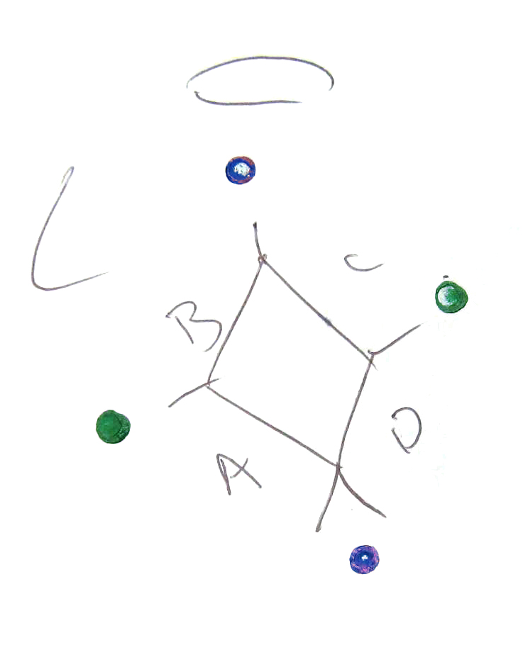
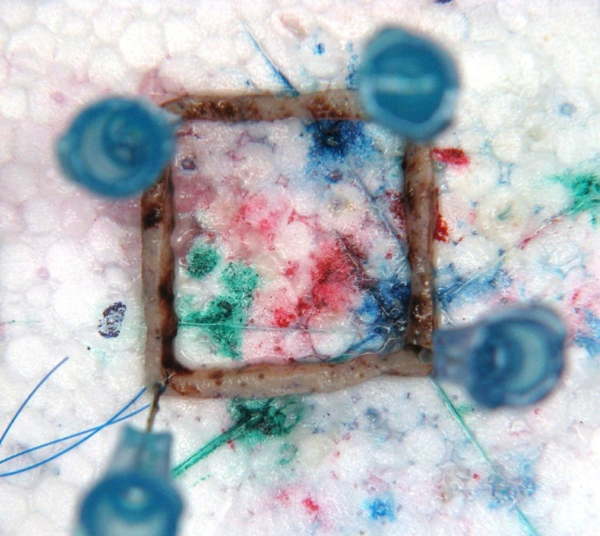
Two-Bladed Square Excision
B
A
C
D

Slide 33
Two-Bladed Square Excision
Ink outer corners different colors
Mark outer edge (true margin) with a red dot
Cut at junctions
Outer margin (red dot) faces DOWN in cassette
One segment per cassette (keep in order):
  A1 = segment A
  A2 = segment B
  A3 = segment C
  A4 = segment D
B
A
C
D
Notes:
Rush?

Slide 34
Full Square Excision
Ink corners different colors
Mark outer margins with red dot
Shave thin (2 mm) strips off of each side (i.e., create segments A through D)
Ink remaining central island in 2 colors (diagonal)
Section central island diagonally and place in TWO cassettes sequentially (e.g., from A-B junction to C-D junction)
A
Blue
D
B
Green
C
A-D half inked blue,
B-C half inked green.

Slide 35
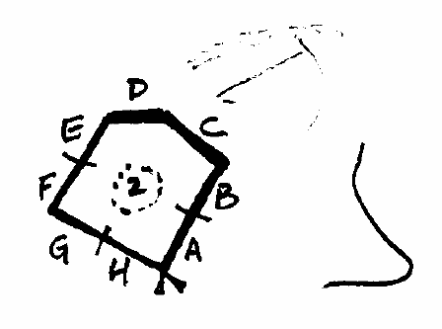
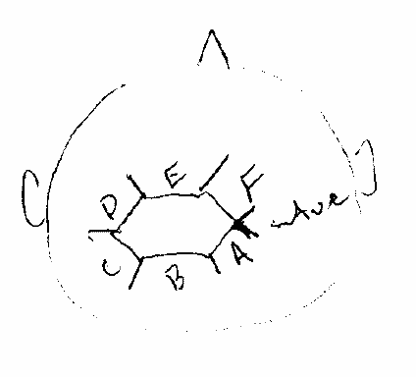
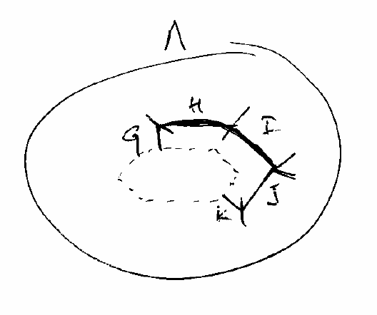
Other “Squares”
Shape of lesion or anatomic site
Stage II and beyond

Slide 36

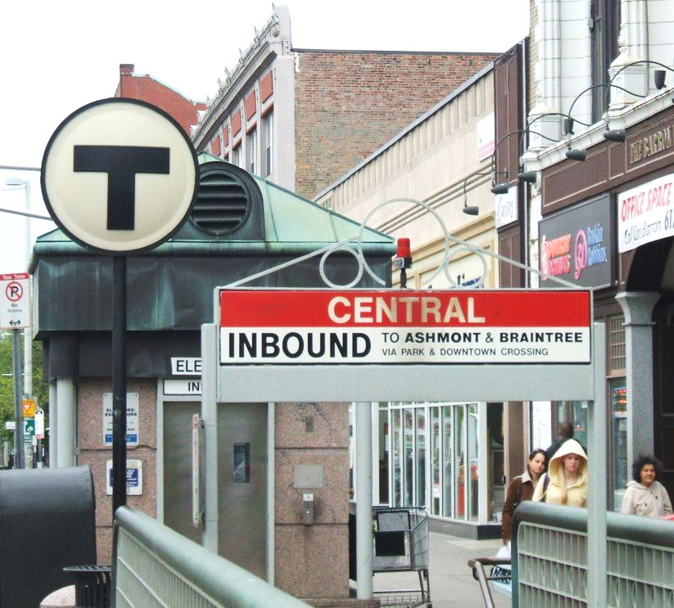
Central Island, Kenya
Central Square, Boston

Slide 37
Excision of Central Island/Square
S/p clearance of peripheral margins by two-bladed square excision
Usually unoriented
Ink one color
Section diagonally

Slide 38
Alopecia Biopsies
Ideally two punch biopsies for vertical and horizontal sectioning
Consult attending if only one punch is submitted
Look out for:
  Scalp punch biopsy
  “AA” (androgenetric alopecia or alopecia areata)
  DLE (discoid lupus erythematosus)
  LPP (lichen planopilaris)
  FFA (frontal fibrosing alopecia)
  CCSA/CCCA (central centrifugal scarring alopecia)
  Telogen effluvium
  Folliculitis decalvans
  Trichotillomania

Slide 39
Alopecia Biopsies (4 mm punch)
Vertical:
Horizontal:
Red
Ink margins
Bisect
Cut surfaces face down
Levels x3
Cut slightly (~1 mm) above dermosubcutaneous junction
Ink cut surfaces red
Cut surfaces face down
Levels x3

Slide 40
Alopecia: Horizontal Sectioning
Red

Slide 41
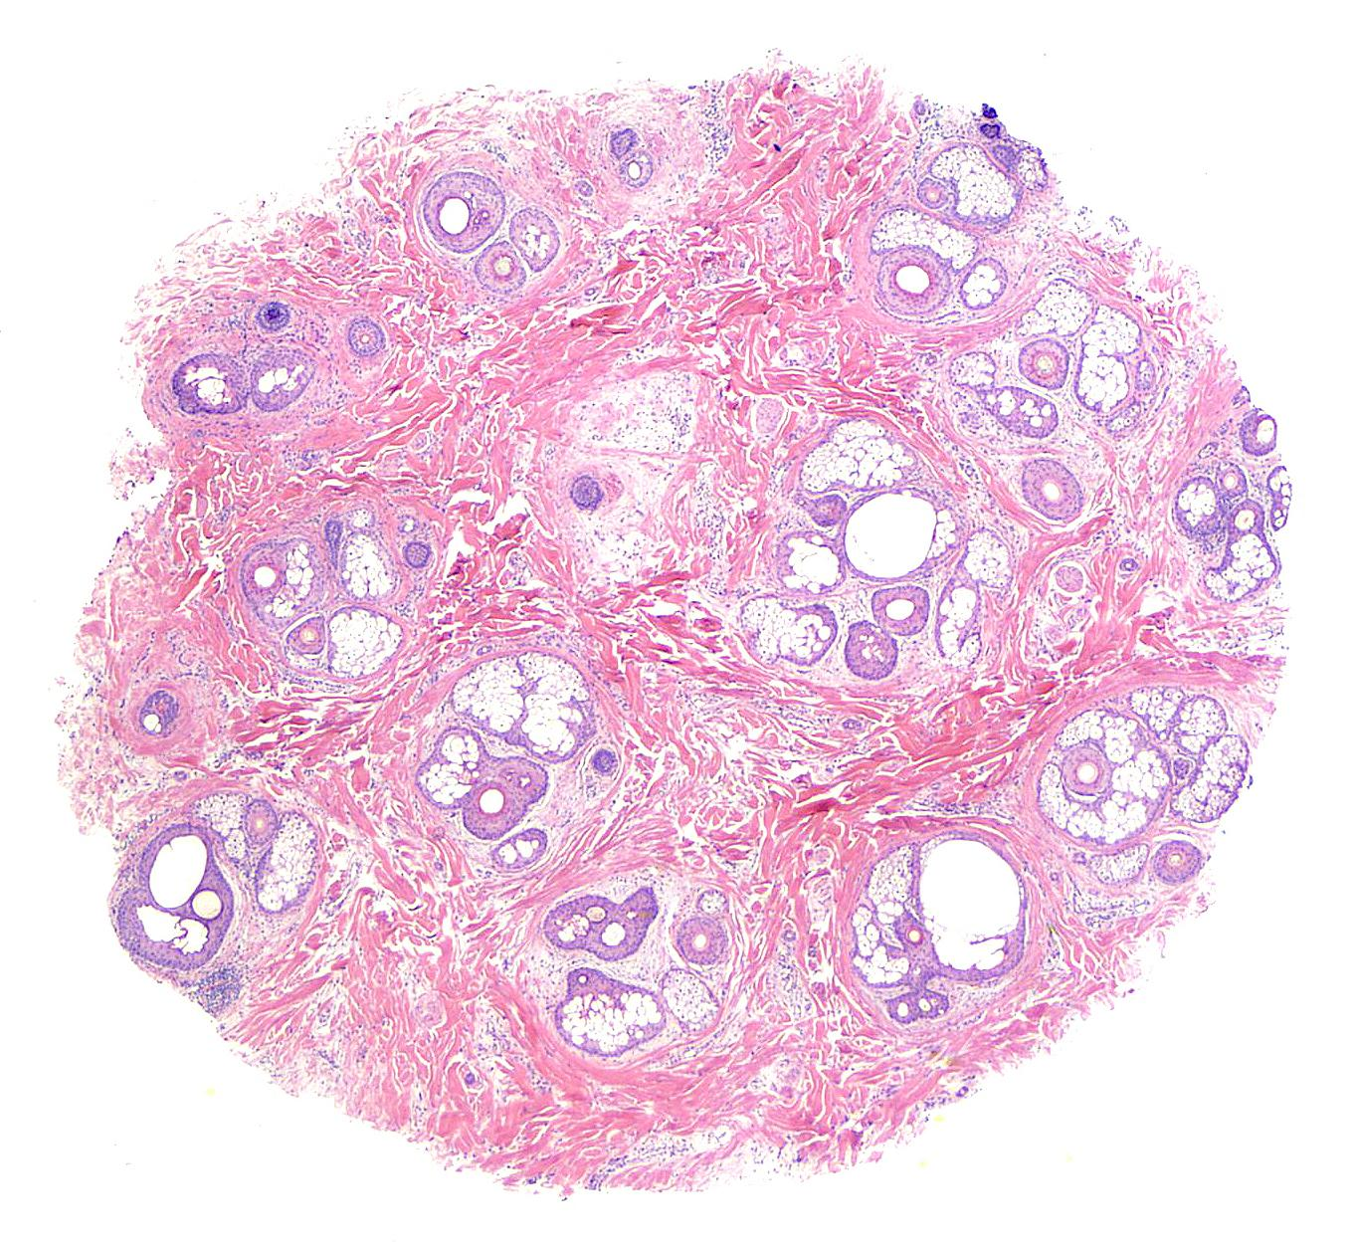
Alopecia: Horizontal Sectioning
Visualize all hairs at once
Best for hair counts
  Terminal vs. vellus/miniaturized
  Anagen vs. catagen/telogen
Terminal
Vellus

Slide 42
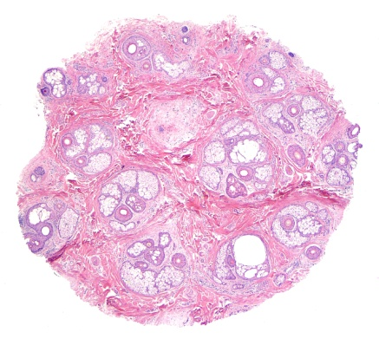

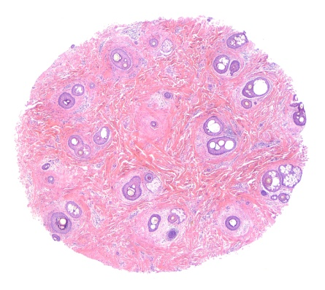
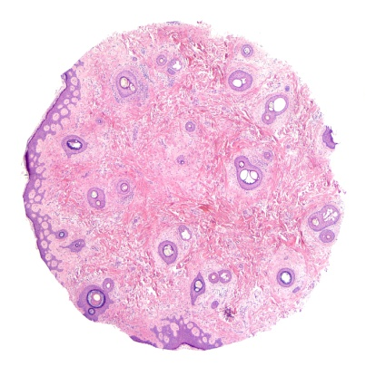
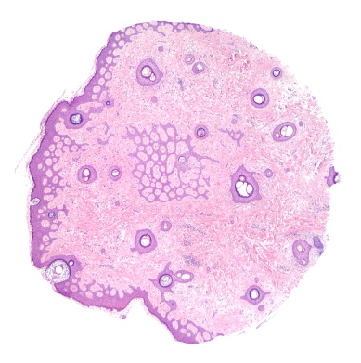
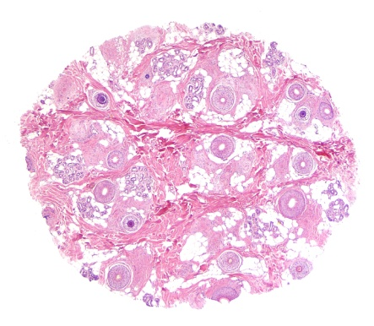
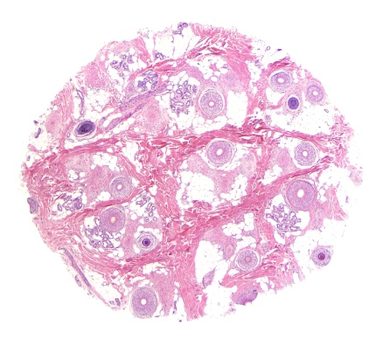



Alopecia:
Horizontal
Sectioning
L1
L2
L3
L4
L5
Top
Bottom

Slide 43

Alopecia: Vertical Sectioning
Visualize entire length of a hair follicle
Best for determining the level at which the pathologic process occurs
  Epidermis
  Hair bulge
  Hair bulb

Slide 44



Hair Shaft Specimens
Multiple hair shafts submitted in dry specimen jar
Give specimen to Lisa, Maegan, or Danielle to be mounted on glass slide and cover-slipped
Light microscopic examination for hair shaft abnormalities
  Fracture, irregularity, coiling/twisting, extraneous matter, etc.
Trichorrhexis nodosa
Trichoptilosis
Trichothiodystrophy
McKee’s Pathology of the Skin, 4th Ed.
Notes:
Give to supervisors?

Slide 45

Nail Clippings
Nail plate only
Most cases to r/o onychomycosis
Entirely submit (in biopsy bag if small pieces)
Soften briefly in KOH
Order GMS upfront
Notes:
Decal? Biopsy bag?

Slide 46



Nail Bed/Matrix Biopsies
Punch
Shave
Without nail plate
With nail plate

Slide 47


Nail Bed/Matrix Biopsies
Melanonychia
  Melanin in nail plate
  Melanocytic lesion in matrix
Subungual tumors
  Inclusion cyst, glomus tumor, verruca, keratoacanthoma, SCC, onychomatricoma, etc.
Decal briefly if nail plate present
Gross as punch or shave biopsies

Slide 48

Nail Bed Excisions
For biopsy-proven neoplasms
Oriented for margin evaluation → ink in 2 colors
Decal briefly if nail plate present
Gross as small excision (serially section and entirely submit)
Consult PA, fellow, or attending if questions

Slide 49
Sentinel Lymph Nodes
Carefully dissect off fat and isolate lymph nodes
Put through as few blocks as possible!
  Section along longitudinal axis (through hilum)
  Ink multiple nodes in the same cassette in different colors
Order IHC at time of grossing but pay attention to the type of cancer!
  Melanoma: S100, Melan-A
  Merkel cell carcinoma: CKCTL, CK20
  SCC/adnexal carcinoma: CKCTL
Non-sentinel lymph nodes: No IHC needed
Notes:
SLN protocol?

Slide 50
Sentinel Lymph Nodes
Longitudinal axis:
Short axis:

Slide 51


Direct Immunofluorescence Specimens
Blistering disorders, vasculitides, lupus
“DIF” or “DFL” on requisition
Submitted in Michel’s or Zeus medium
No grossing needed → Give to IPOX lab
Notes:
Measurements?

Slide 52
10 Ways to Shine
Keep tips small and away from lesion
Cut thin (2-3 mm) sections
Avoid excessive fat in sections
Look up prior pathology report for large excisions
Draw grossing maps
Gross square excisions correctly
Gross alopecia biopsies correctly
Minimize # blocks for SLNs
Order right IPOX for SLNs
Order GMS for nail clippings

Slide 53
Grossing Questions?
Contact dermpath fellows, or dermpath attending to whom case is assigned
Attending | Contact Numbers
May Chan (preferred after-hours coverage) | Pager 18088 Office 3-5471 Home 734-418-3311
Doru Andea | Cell 646-660-1919
Doug Fullen | Cell 734-358-0399
Paul Harms | Cell 205-821-7850
Alex Hristov | Cell 410-491-4826
Lori Lowe | Cell 734-637-0762 Home 734-665-4791
Raj Patel | Cell 216-394-4053
Dermpath Frontdesk | 4-4460

